Slide 1

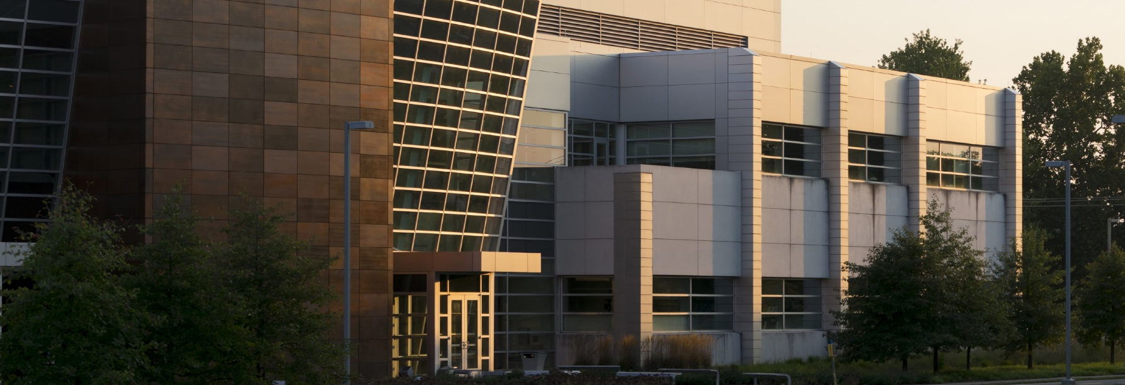
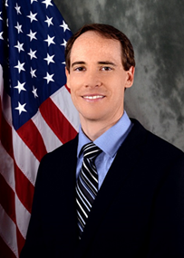

Building a Manufacturing Ecosystem for Flexible Hybrid Electronics: a Focus on Aerospace Opportunities
Thursday, November 30
2:00 – 3:00 pm
Burton D. Morgan Center 121
BIRCK NANOTECHNOLOGY CENTER
Dr. Benjamin J. Leever, Senior Materials Engineer. Dr. Leever is currently a Senior Materials Engineer in the Air Force Research
As advanced electronics proliferate in both the commercial and defense sectors, they continue to be largely limited to rigid form factors with bulky packaging dictated by traditional electronics manufacturing processes and fragile components. Yet for applications ranging from wireless, low-profile medical devices to smart food labels to aircraft with embedded stress sensors, there’s a need for high-performance electronics that conform to the shape of our bodies, vehicles, and consumer goods. Flexible Hybrid Electronics (FHE), which combine additive manufacturing processes with flexible silicon, will enable these capabilities. To move these concepts from the lab to the manufacturing floor in the United States, the Department of Defense established NextFlex, America’s Flexible Hybrid Electronics Manufacturing Institute in 2015. Based in San Jose, CA, NextFlex is a $170M public-private partnership that is building a domestic FHE manufacturing ecosystem by developing manufacturing processes and tools with its member companies and universities, standing up an FHE manufacturing pilot line in Silicon Valley, and establishing education and workforce development programs to train tomorrow’s workforce. This presentation will focus on the FHE opportunity, the NextFlex FHE manufacturing roadmaps, and NextFlex projects in areas such as device integration & packaging, modeling & design tools, and printed flexible components.
In addition, the presentation will highlight opportunities for FHE to impact the Air Force, including projects focused on conformal antennas for aircraft as well as wearable performance monitors for airmen. In-house research capabilities at AFRL will be discussed, including printing and characterization facilities. Finally, several AFRL projects related to FHE will be highlighted, such as work focused on flexible Li ion batteries, novel ink development, printed structures with embedded electronics, and printed multi-layer capacitors.
Laboratory (AFRL) Soft Matter Materials Branch. His primary roles are Advanced Development Lead and Government Chief Technology Officer of NextFlex, a $170M public-private partnership established to create a domestic manufacturing ecosystem in flexible hybrid electronics. In support of AFRL’s investments in Soft Matter Materials and Materials for Man-Machine Interface, Dr. Leever determines technical strategy, manages AFRL contracts, and establishes and leads industrial, academic, and governmental collaborations.

