Slide 1
ARMS 2130 Cabinets

Slide 2
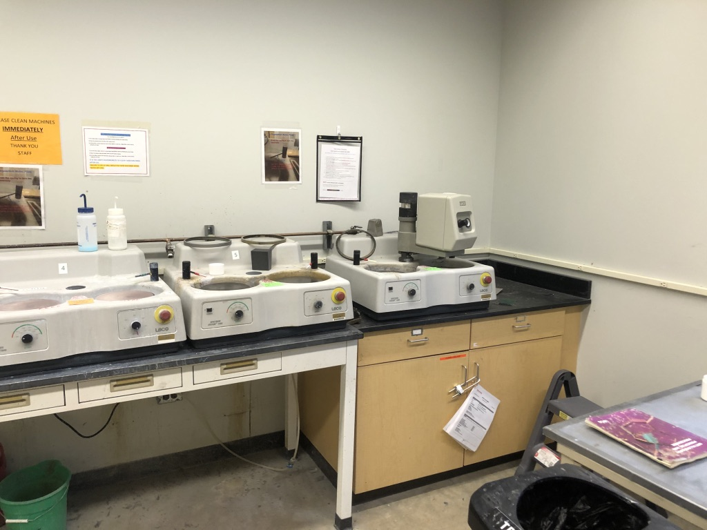
HF cabinet

Slide 3
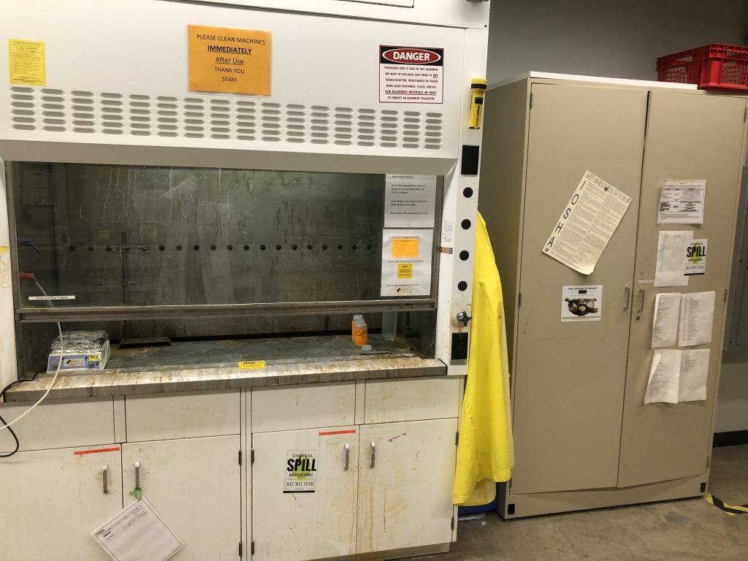
Flammables Cabinet
Oxidizing Acids
Organic & Mineral Acids

Slide 4
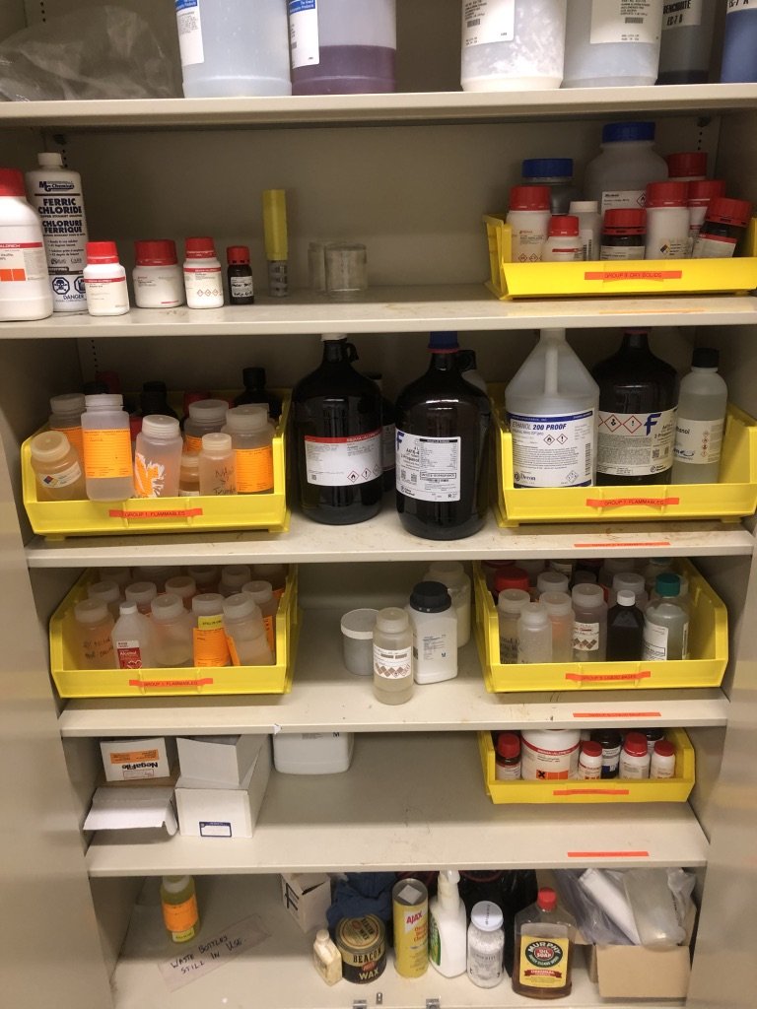
Flammables Cabinet
Dry Solids
Flammable Liquids
Flammable Liquids
Flammable Liquids
Liquid Bases
Reactive Metal Hydroxides

Slide 5
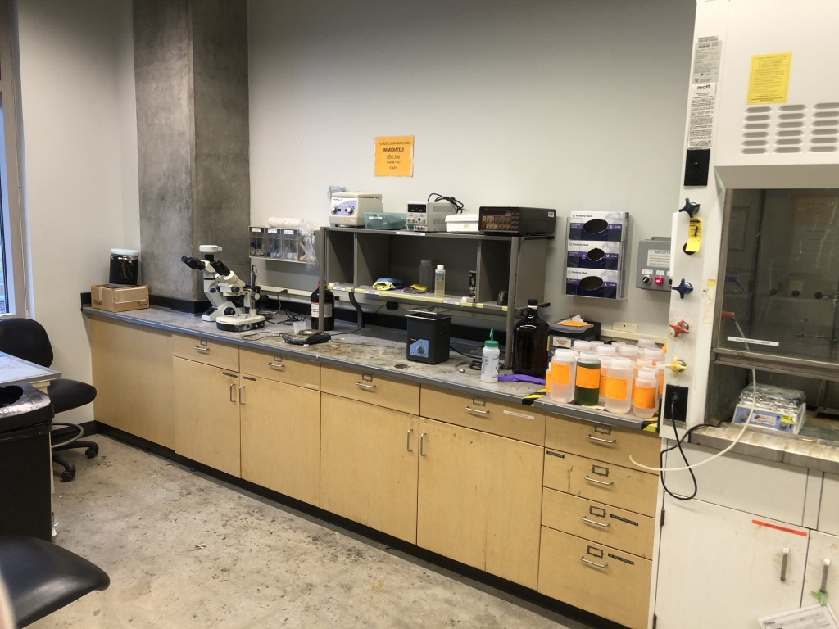
Non-Volatile Liquid Poisons
Oxidizing Liquids

