Slide 1
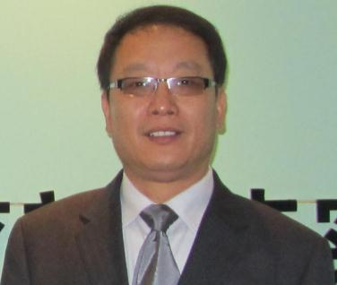
THE ENERGY CENTER
BIRCK NANOTECHNOLOGY CENTER AND
THE SCHOOL OF MATERIALS ENGINEERING
Porous Materials for Emerging Applications
George Zhao, Chair Professor, School of Chemical Engineering, University of Queensland
Thursday, February 7, 2013
10:30 A.M. in Birck, room 2001
A reception will proceed lecture at 10:00 am
Abstract
Porous materials have found many traditional applications, such as petroleum refining, ion exchange, gas separation and purification, and optoelectronics, benefiting from the highly ordered pore structure and huge specific surface area. Recent emerging applications, such as sustainable energy, water technology, and nanotechnology require advanced porous materials with well-defined structural, interfacial, compositional, and morphological properties. This new paradigm presents challenges and opportunities.
The well-known architect Robert Le Ricolais stated ‘‘The art of structure is where to put the holes”. For creating advanced porous materials for emerging applications, a suitable paraphrase would be ‘‘The art of making porous materials is how to control the size and connectivity of the pores’’. This presentation discusses our recently demonstrated approaches to making advanced porous materials for electrochemical energy storage, photocatalytic water disinfection and detoxification, catalysis, gas storage, and photonic technology.
Bio
George received his BSc degree in 1987 from Scholl Chemistry and Chemical Engineering, Shandong University, China. He then worked as a research fellow/senior research fellow at Dalian Institute of Chemical Physics, Chinese Academy of Sciences. In 1995, he moved to Brisbane as a Visiting Scholar to work at the School of Chemical Engineering, The University of Queensland. From 1996 to 1998, he was a PhD candidate of UQ working on mesoporous absorbents. After he earned his PhD in Engineering in 1999, he worked as a UQ Postdoctoral Research Fellow. In 2001, he joined the Dept of Chem and Biomolecular Eng, National Univ of Singapore, as an Asst Prof, and was promoted to Assoc Prof in 2006. In 2010, he was awarded an Australian Research Council Future Fellow. He took up the fellowship in 2011 to work at the School of Chem Eng, The Univ of Queensland, as a Chair Professor. He also holds a couple of joint/adjunct positions as a Si-Yuan Professor of Nanjing Univ, Chair Professor of Sichuan Univ, Shandong province Taishan Scholars Chair Professor of Qingdao Univ, Guest Professor of China Petroleum Univ and Adjunct Professor of Curtin University of Technology.

