Slide 1

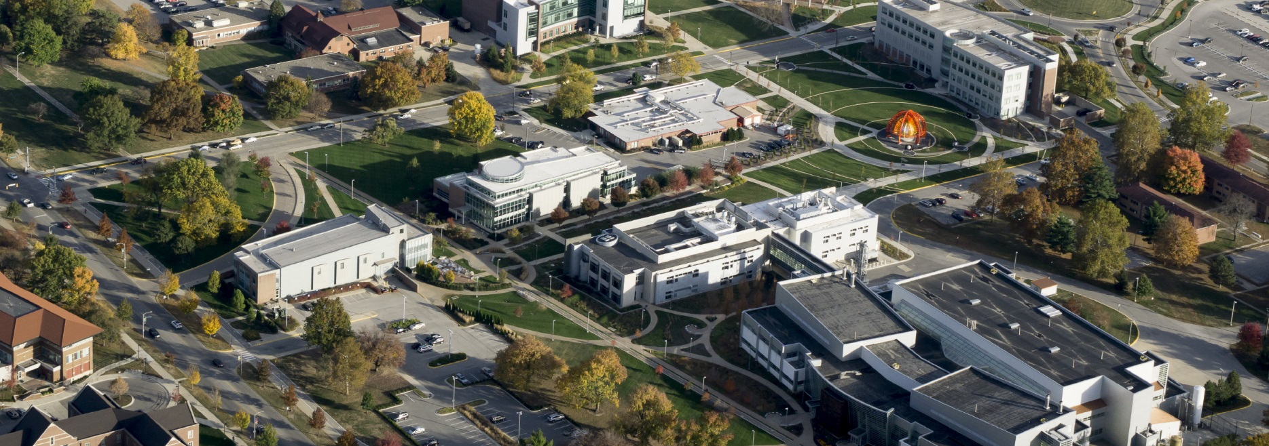
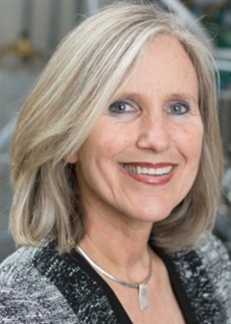

Taming amorphous oxides with ion beams to optimize optical interference coatings for demanding applications
BIRCK NANOTECHNOLOGY CENTER
Friday, November 10, 2017
Mug Shot
Image here
11:30 am
Burton D. Morgan Center, 129
Ion beam sputtering is a physical vapor deposition method that allows for the growth of thin films with superior control in thickness, uniformity and density. Reactive ion beam sputtering produces amorphous oxide films of the highest density. For this reason, it is the preferred deposition method to engineer interference coatings for demanding applications in coatings for high energy lasers operating in visible and near infrared and for the test masses of the Laser Gravitational Wave Interferometer (LIGO). In this talk, I will describe fundamentals of the ion beam sputtering of amorphous oxides, focusing on how the materials’ properties can be tailored for the specific laser applications. I will describe the characterization of thin films and optical multilayer structures in the context of the application. I will also present results on the use of broad area ion beams to pattern surfaces with periodic structures which are potentially enablers of three dimensional periodic multilayer structures.
Carmen S. Menoni is a University Distinguished Professor at Colorado State University in the Department of Electrical & Computer Engineering. Her group pioneered the use of bright beams of extreme ultraviolet (EUV) laser light for nanoscale imaging and mass spectra imaging, making it possible for a laser ablation method to reach nanoscale resolution for the first time. In parallel, Prof. Menoni’s team investigates the material science of ion beam sputtered thin films for applications in interference coatings for high peak power lasers and coatings for the test masses in the Laser Interferometer Gravitational Wave Observatory.

