Slide 1

Purdue Travel Center Overview
September 13, 2024
MSE 690 Seminar
Erin Barsteika, Travel Center Manager
Notes:
Erin Barsteika – I am the Travel Center Manager
Manage a team of 7 expense assistants
Vendor manager – vehicle rentals, hotels, airlines, parking, etc.

Slide 2
Contacts & Partner Areas
Travel Center:
AAA Corporate Travel:
  Email: purduetravel@purdue.edu
  Ph: 765-494-7354
    Available: 8am-12pm & 1pm-5pm, M-F
    We follow all University holidays for closures
  Expense Submission Form
  Website: Purdue Travel Center
  Reservations:
Ph: 877-379-0299
Email: purduetravel@aca.aaa.com
  Booking travel beyond 72 hours:
Purdue University Travel Reservation Form
  Online Support (issues with flights and hotels):
Ph: 877-463-0543
  Website: AAA Corporate Travel
Card Services:
Training:
  Email:
    Travel Cards: tcard@purdue.edu
    Purchasing Cards: pcard@purdue.edu
  Website: Procurement Card Services
  Email: pstraining@purdue.edu
  Website: Procurement and Travel Training
Notes:
Card Services provides Purchasing and Travel cards to Purdue Employees. You will need to first talk with your business office for approval and assistance in applying for an individual one.
Travel card eligibility is no longer determined by travel frequency, but a BO may determine it’s not practical for their area for every traveler to have their own.
If your BO deems you not eligible for a Tcard, you have options:
Airfare card is loaded in Concur and can be used for airfare only
Booking with AAA allows the use of the “ghost” card for airfare and/or hotels
You can use your personal funds and be reimbursed after travel is completed
Cash Advance through Concur
If approved, be sure to review the travel card manual to understand appropriate uses while planning and actively traveling

Slide 3
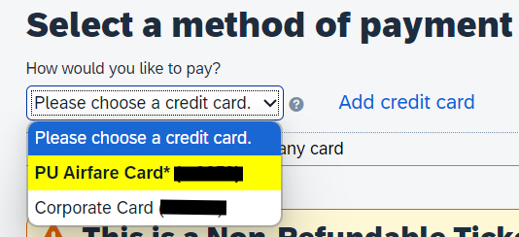
Alternative Payment Options
Airfare and Ghost cards:
  These are virtual cards linked to Concur
  Airfare card is loaded into your Concur account as a payment method for booking flights
  “Ghost” card is used by AAA for booking flights, hotels and cars.
  If a card must be presented at the counter:
      Personal funds with reimbursement after the conclusion of the trip
      Request a cash advance through Concur (speak with your business office first)
          If approved, the cash advance will be deposited into your bank account and you pay the money back within your expense report upon conclusion of your travel.

Slide 4

Why we were formed
The Purdue Travel Center was formed in 2019. We are committed to establishing discounted rates with preferred travel partners, providing training support and outstanding customer service, including 24-hour accessibility to AAA Corporate Travel agents.
Centralize travel compliance
Faster traveler reimbursement
Easier expense reporting
Easier travel booking
Better discounts for the University
Provide resources for Concur system
Notes:
Prior to it being centralized, travel was handled in individual business offices and travel centers across campus. There was a lack of consistency which opened the University up to state and federal audits, as well as misuse of funds, which would then affect grant funding. There was a need for consistency to protect the University and its traveler’s funding. We then were able to find other significant benefits such as better travel discounts, easier booking and expense options for travelers, and better reporting to senior management across the University.

Slide 5

What exactly do we do?
We do not book travel, but assist in every other way. Our goal is to make the process and outcome easy for travelers so they have more time to focus on their priorities.
BEST BENEFITS WE PROVIDE:
Create your expense reports so you don’t have to
AAA will book your travel so you don’t have to
Experts on regulations and want to help ensure you’re in compliance before you travel
Notes:
Common feedback from University travelers:
Concur is frustrating to use or not user-friendly
AAA can help you book with the same discounts as Concur
If you let us build your reports, you only need to login to Concur to submit
Reports are always sent back
If you let us build your reports, they will be audited while being built by us and will be completed correctly the first time – so no sent back reports!
It’s taking too long to get my reimbursement
We consistently complete expense reports on average within 2 business days of your request being sent.
We consistently complete an audit review of your report on average within 3 days after submission.
After created or approved by our office, your reports go to your fiscal approvers – we ensure this happens within 2-5 days of your initial contact with us

Slide 6

Booking Travel
Travel Booking Tool – Concur
  Travelers are encouraged to book business travel in Concur
  Expenses must be done in Concur
  Employees can utilize business and personal discounts within and without Concur
Travel Agency – AAA Corporate Travel
  Allows traveler to take advantage of newly established discounts
  Provides Duty of Care record in the event of an emergency
  Provides 24/7 access to AAA for rebooking/travel issues
Notes:
3 ways to book travel:
Using Concur – all discounts are loaded into Concur, so you will easily have access to all our agreed discounts with suppliers. We have resources giving you step by step instructions on how to do this.
Reach out to AAA – they are the University’s travel agent and also have access to the loaded discounts. They will be able to book everything and it will be completely linked to your Concur profile when you use any other University travel payment methods (not Purchasing Cards)
You can book directly with travel suppliers. You will not have access to airfare discounts, but hotel and vehicle rental discounts are available when using direct booking links or discount codes on our employee discount page.
We encourage the use Concur or AAA as they are easier for our office or AAA to assist if something were to go wrong. When booked outside of Purdue’s resources, especially if using a third-party discount company like Expedia, Travelocity, etc., are hands are typically tied in being able to assist in find resolutions.

Slide 7


Common Traveler Frustrations & Solutions
Frustrations
  Cost Comparisons and Personal Expenses
  Vehicle Rental Insurance
  Documentation Requirements
  Meal Expense vs “Fixed Meal Expense”
  Concur Bookings Being Cancelled
  Ramifications of Delayed Expense Report Submission
  General Misunderstanding/Unawareness of Travel Regulations
Solutions!
  We or AAA can run a Cost Comparison or review future travel for personal additions
  Always review Travel Regulations as you are planning/booking your travel
  Register for Travel Training
  Use Preferred Vendors and book through Concur or AAA, when possible
  Use our Travel Expense Submission Form
Notes:
Separating business and personal costs.
Cost comparisons are required if anything personal is ever added to travel. We can do that cost comparison for you but it must be done at the time or close to the time of booking. Reimbursement is capped if a cost comparison is not pulled prior to your travel.
If booking with AAA, you will need to indicate that you have personal time included in your travel dates and would like them to run a cost comparison for only your business dates.
Insurance on rental vehicles should never be added unless you are renting internationally. Use preferred vendors or Concur/AAA to avoid insurance additions, but if asked when traveling domestically, always decline. Those expenses will result in personal charges for you.
All receipts must show confirmation of payment – this means a payment method and matching amount.
Confirmations, quotes, estimates, etc are not confirmation of payment. Review documentation requirements in regulations
Purdue uses federal and state Per Diem rates for meals. Any meal or food purchased with a travel card will be marked personal within Concur and your “Fixed Meal Expense” will provide you reimbursement through the per diem rate.
The biggest issue we face in our center is delayed submission of expense reports. We want to help travelers and are the stewards for the outstanding travel expenses on tcards. All expenses should be submitted within 60 days from the last day of travel. If 180 days pass without submission, travelers are no longer eligible for reimbursement and they could be responsible for travel card expenses with no receipt. By allowing us to complete your expense reports once your travel is completed, you will not risk being personally responsible for any travel expenses.
Best solution is reviewing the regulations when preparing for your trips and registering for travel training. These topics are discussed in that live training and questions can be answered in real time during the training. If your questions aren’t answered after these steps, then we would love to help provide the answers!

Slide 8
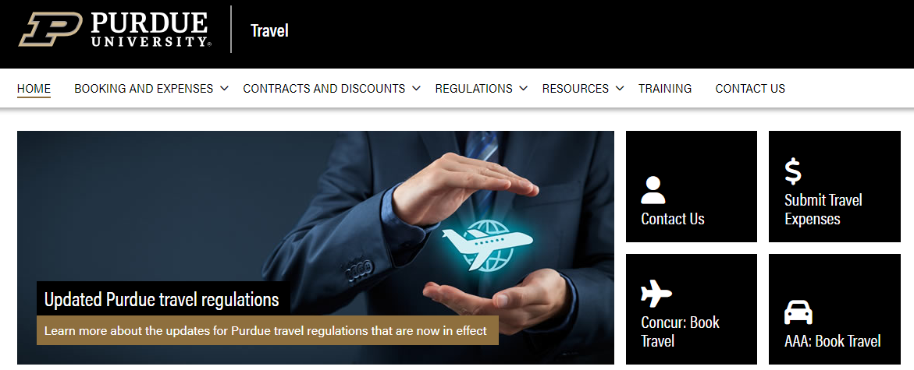

Travel Website and Concur
Purdue Travel Homepage
Concur Travel System
Notes:
Provide brief overview of the Travel website
Show how to locate Concur, how to login and brief overview of Concur

Slide 9
Key Takeaways
Review the regulations for compliance while you are planning/booking
Know how to reach us – we are here to help with any and all booking, policy, and expense questions. If we don’t have the answer, we will find it!
Utilize the resources we provide – website, trainings, regulations, travel agency, supplier discounts, etc.
We will do your expense reports so you don’t have to. It makes it easier for you and for us!
In general, business travel can be complicated and we don’t expect you to know the regulations or processes like we do. The best course of action is to ask for help or guidance, especially if you are new to traveling for Purdue.
Notes:
I could take your entire class time and only touch on the details in one area of travel. We understand how time-consuming looking through the regulations or creating your expense reports can be, so that is why our office came into existence. We take the burden of knowing the intricacies, so you don’t have to.

Slide 10
Resource Quicklinks
Resources Overview
Travel FAQs
Training and QRGs
Travel Discounts
  The Employee Discount Code Webpage requires Purdue login credentials
Travel Regulations
AAA Corporate Travel
Travel Cards
Requesting a Cash Advance through Concur
Note: The information and resources provided are regarding employees traveling on official University Business. If traveling in your capacity as a student and not as an employee, you will need to work with your business office regarding booking and expensing travel.
Notes:
I could take your entire class time and only touch on the details in one area of travel. We understand how time-consuming it is to look through the regulations and/or create your expense report, so that is why our office was brought into existence. We take on the burden of knowing the intricacies, so you don’t have to.

Slide 11
Questions?
Thank you!
For any past, current or future experience with the Purdue Travel Center, please tell us how we are doing!
Purdue Travel Customer Service Survey

