Slide 1

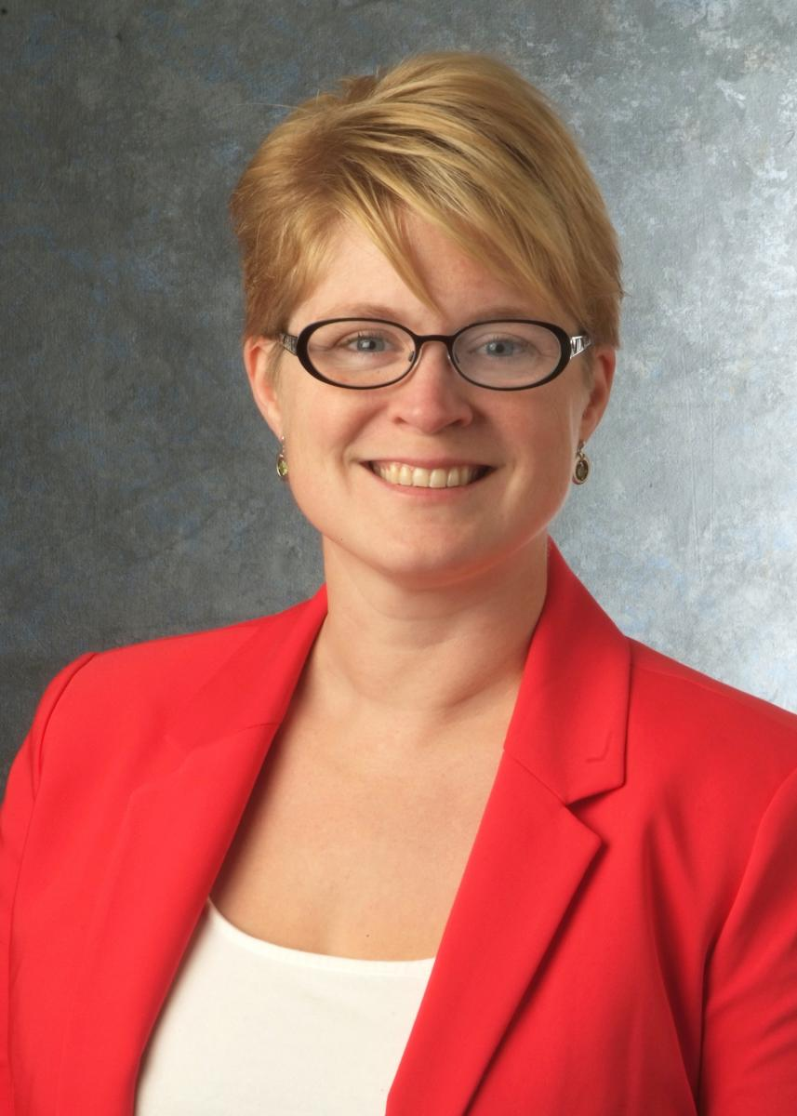
Data Science Enabled Design of Interface Rich Materials
Jennifer Carter
Assistant Professor in Materials Engineering at Case Western Reserve University
The seminar highlights the progress the group has made in utilizing data science to integrate experimental and computational approaches to explore the physics of microstructure evolution in interface-rich materials. In particular, the talk will focus on network modeling the relationship between compositional variables in martensitic 9-12wt%Cr steels and their resulting creep performance. A heuristic data science approach is used to couple exploratory data analysis with model development and a physics understanding of the phase stability of the material. The goal of the work is to make recommendations on the next composition to explore to optimize creep lifetimes at higher operating temperatures and stressed needed to operate the next-generation super-critical coal power plants.
Materials Engineering
Fall 2014
Seminar Series
Monday, Oct. 22
3:30 pm Coffee
3:45 pm Seminar
ARMS 1010
Professor Carter is an Assistant Professor at Case Western Reserve University since January 2013. She received both her B.S. (2006) in Mechanical Engineering and Materials Science and Engineering and her M.S. (2008) in Materials Science and Engineering from the University of California at Davis, and her Ph.D. (2012) in Materials Science and Engineering at from Ohio.
Her research focuses on utilizing data science to integrate novel experimental approaches to explore the physics of microstructure evolution in interface-rich materials. The objective is to understand deformation mechanisms and validate physics-based computational models of microstructure and performance relationships. These models will enable the improved design of processing routes and application performance of metallic materials, for elevated-temperature environments such as power plants and jet engines. She was awarded an NSF-CAREER grant in 2016 for her work in this interdisciplinary field.
In addition to her technical achievements, Jennifer devotes her time to STEM education and the inclusion of diverse viewpoints within her field. She is an academic advisor for students majoring in Materials Science, an affiliated faculty with the Applied Data Science Minor, and the faculty affiliate for the CWRU softball team. She is a volunteer for The Metals Minerals and Materials Society, currently serving as the chairperson for the Mechanical Behavior Subcommittee and the past chairperson of the Diversity Committee.

