Slide 1

Libraries and School of
Information Studies
August 2025

Slide 2
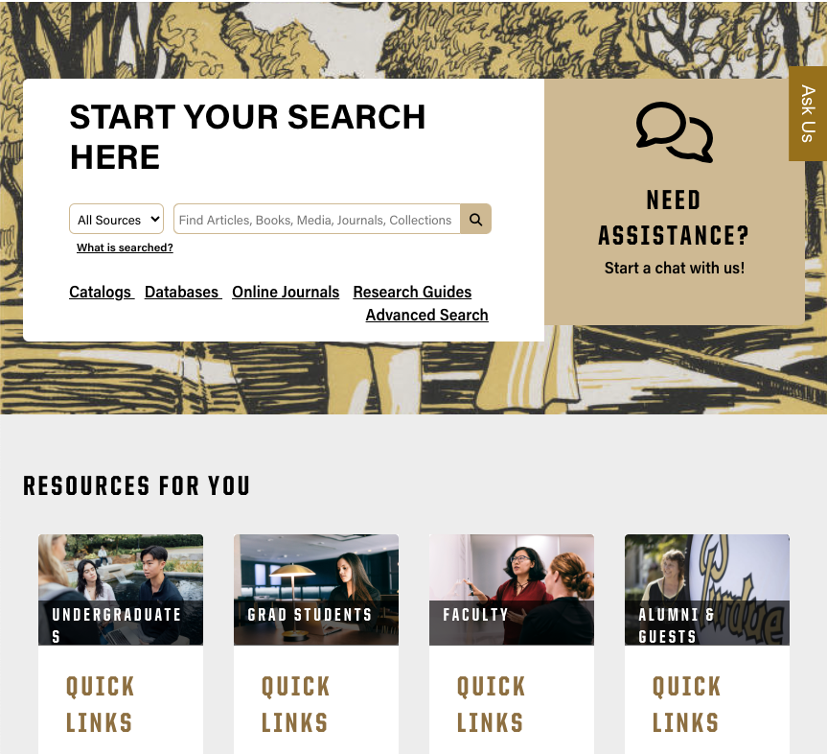
Accessing Libraries Materials
Looking for more?
Suggest a Purchase
apps.lib.purdue.edu/suggest-a-purchase
Ease your Access
LibKey Nomad++
Browser Extension
lib.purdue.edu/libkey-nomad-browser-extension
Simplifies access to library subscription content by enabling users to download paywalled articles for free when available.

Slide 3
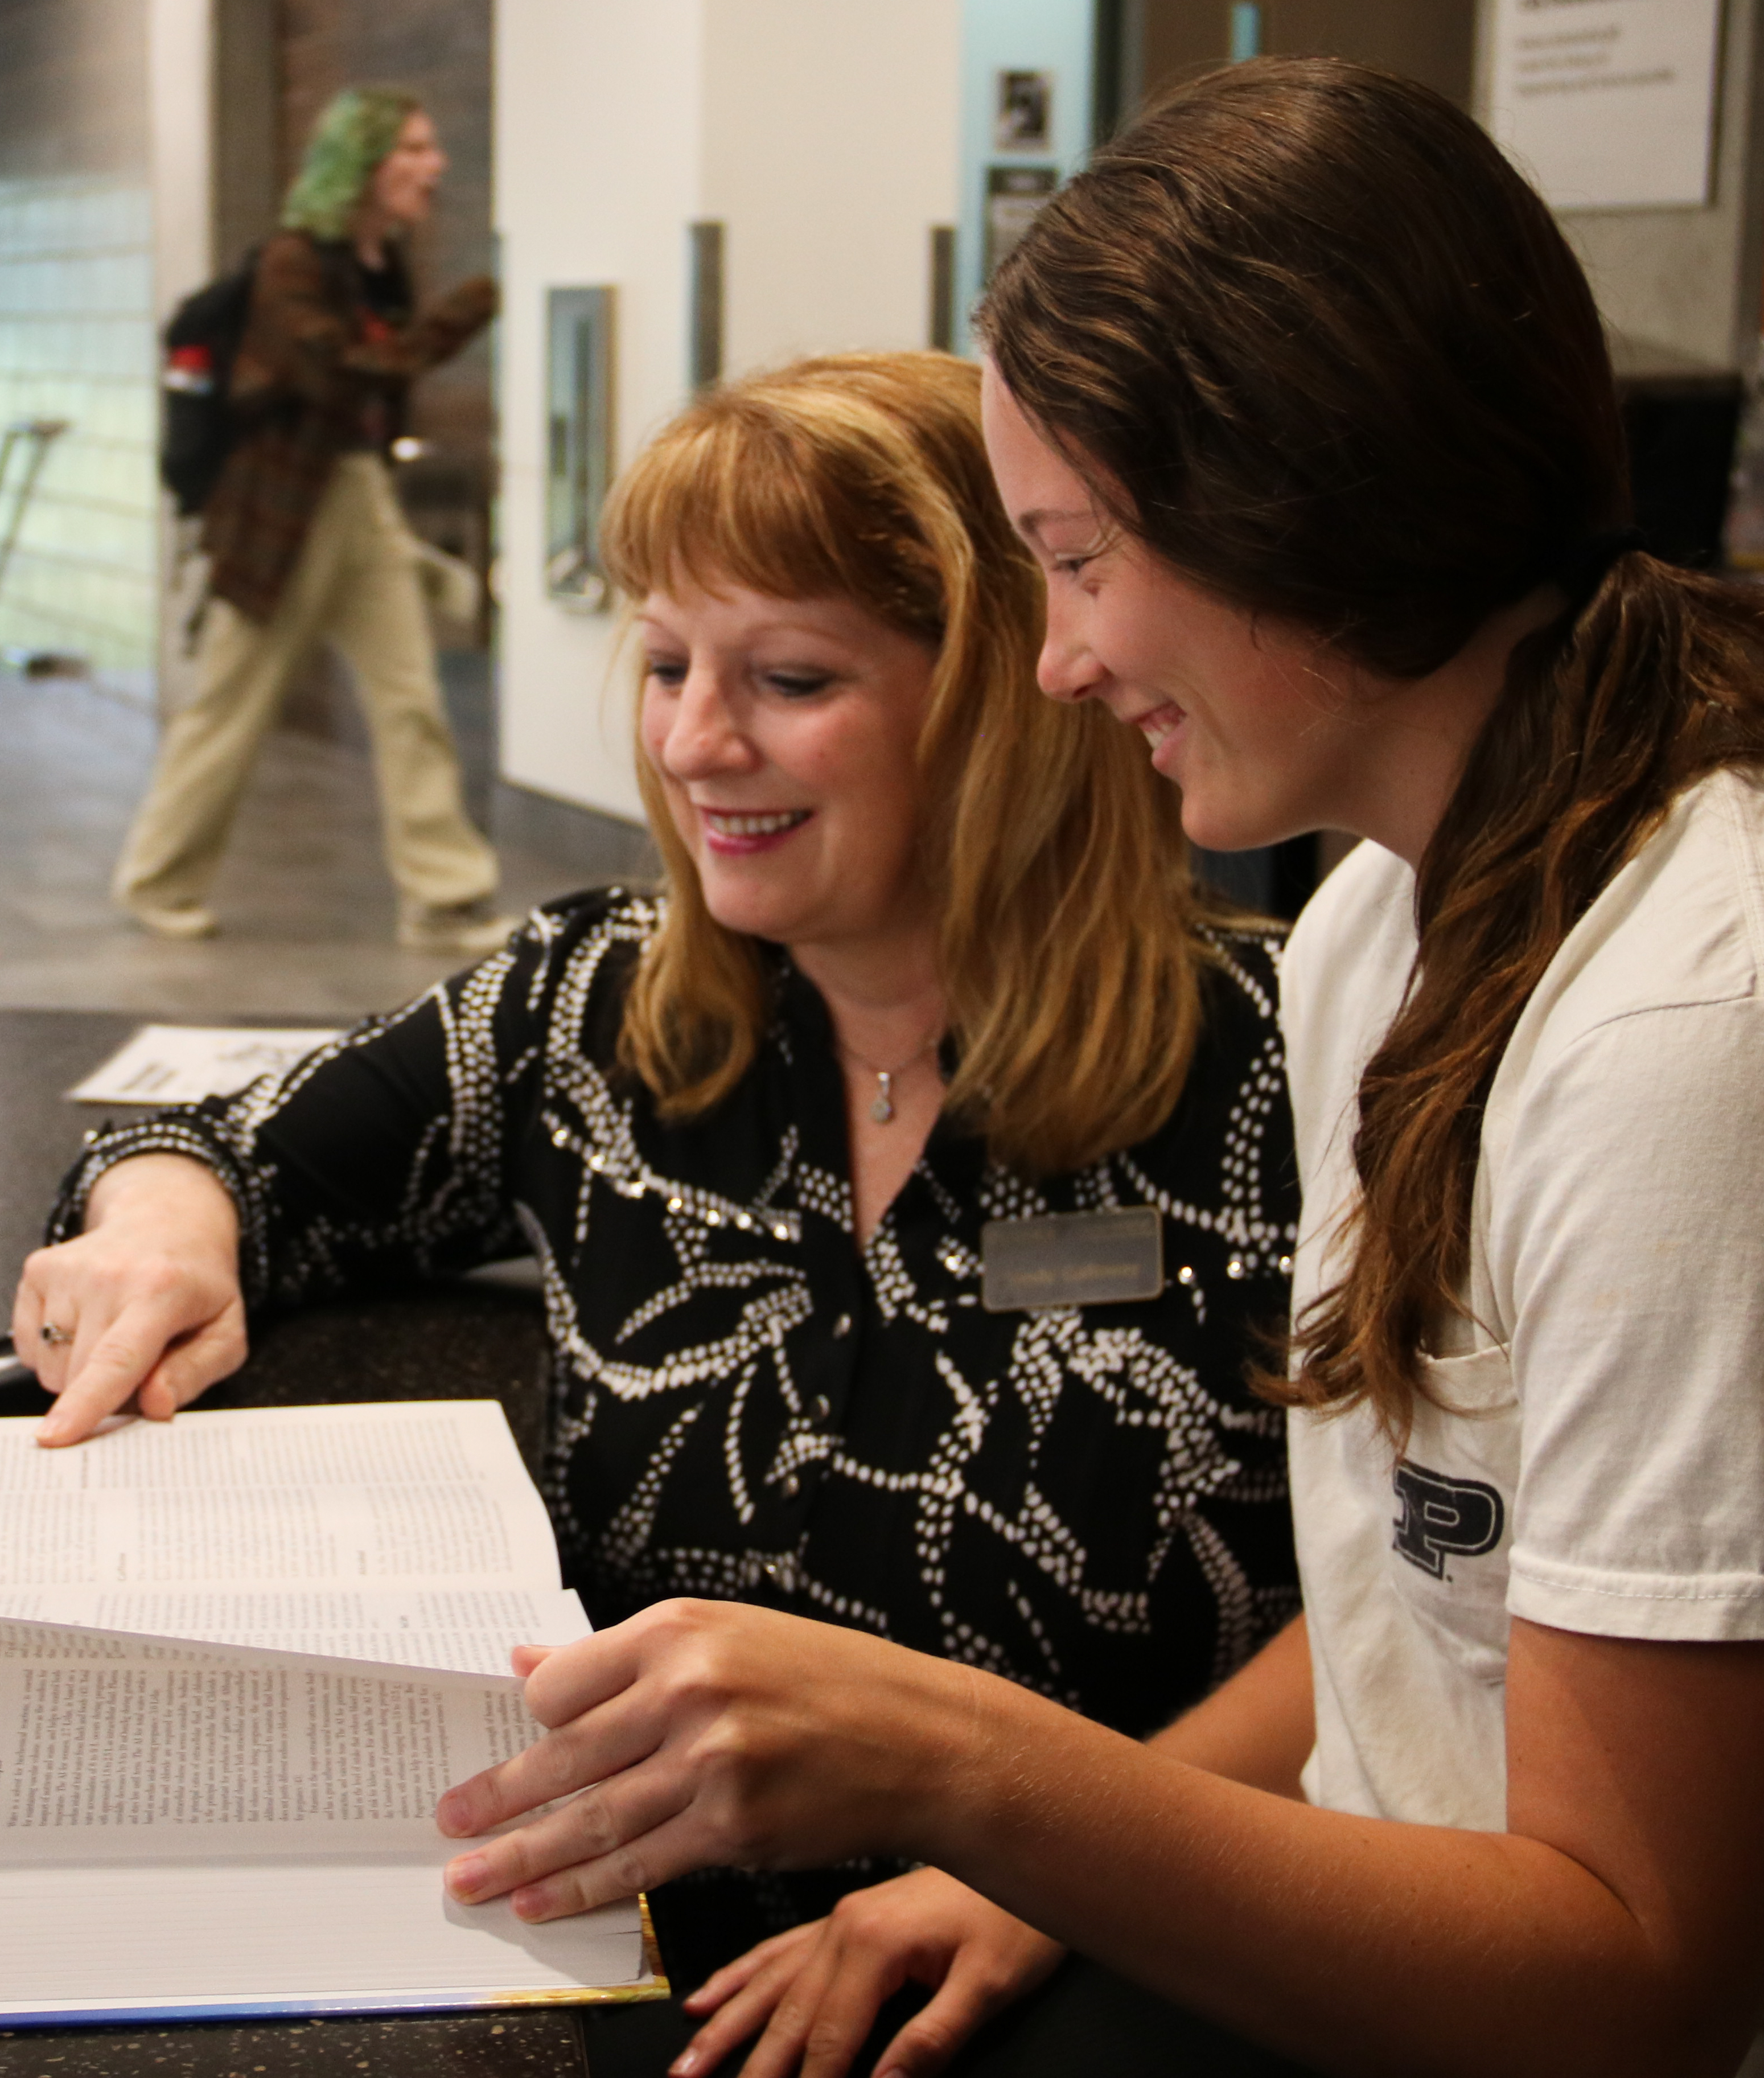
Connecting with Libraries
Ask a Librarian
lib.purdue.edu/help/askalib
Not sure where else to look? Chat, email, or text Purdue Libraries 24/7. Most questions are answered within one business day.
Subject Specialists
lib.purdue.edu/help/askalib/librarians
Have a subject-specific question? Reach out to a Faculty Librarian subject specialist.

Slide 4

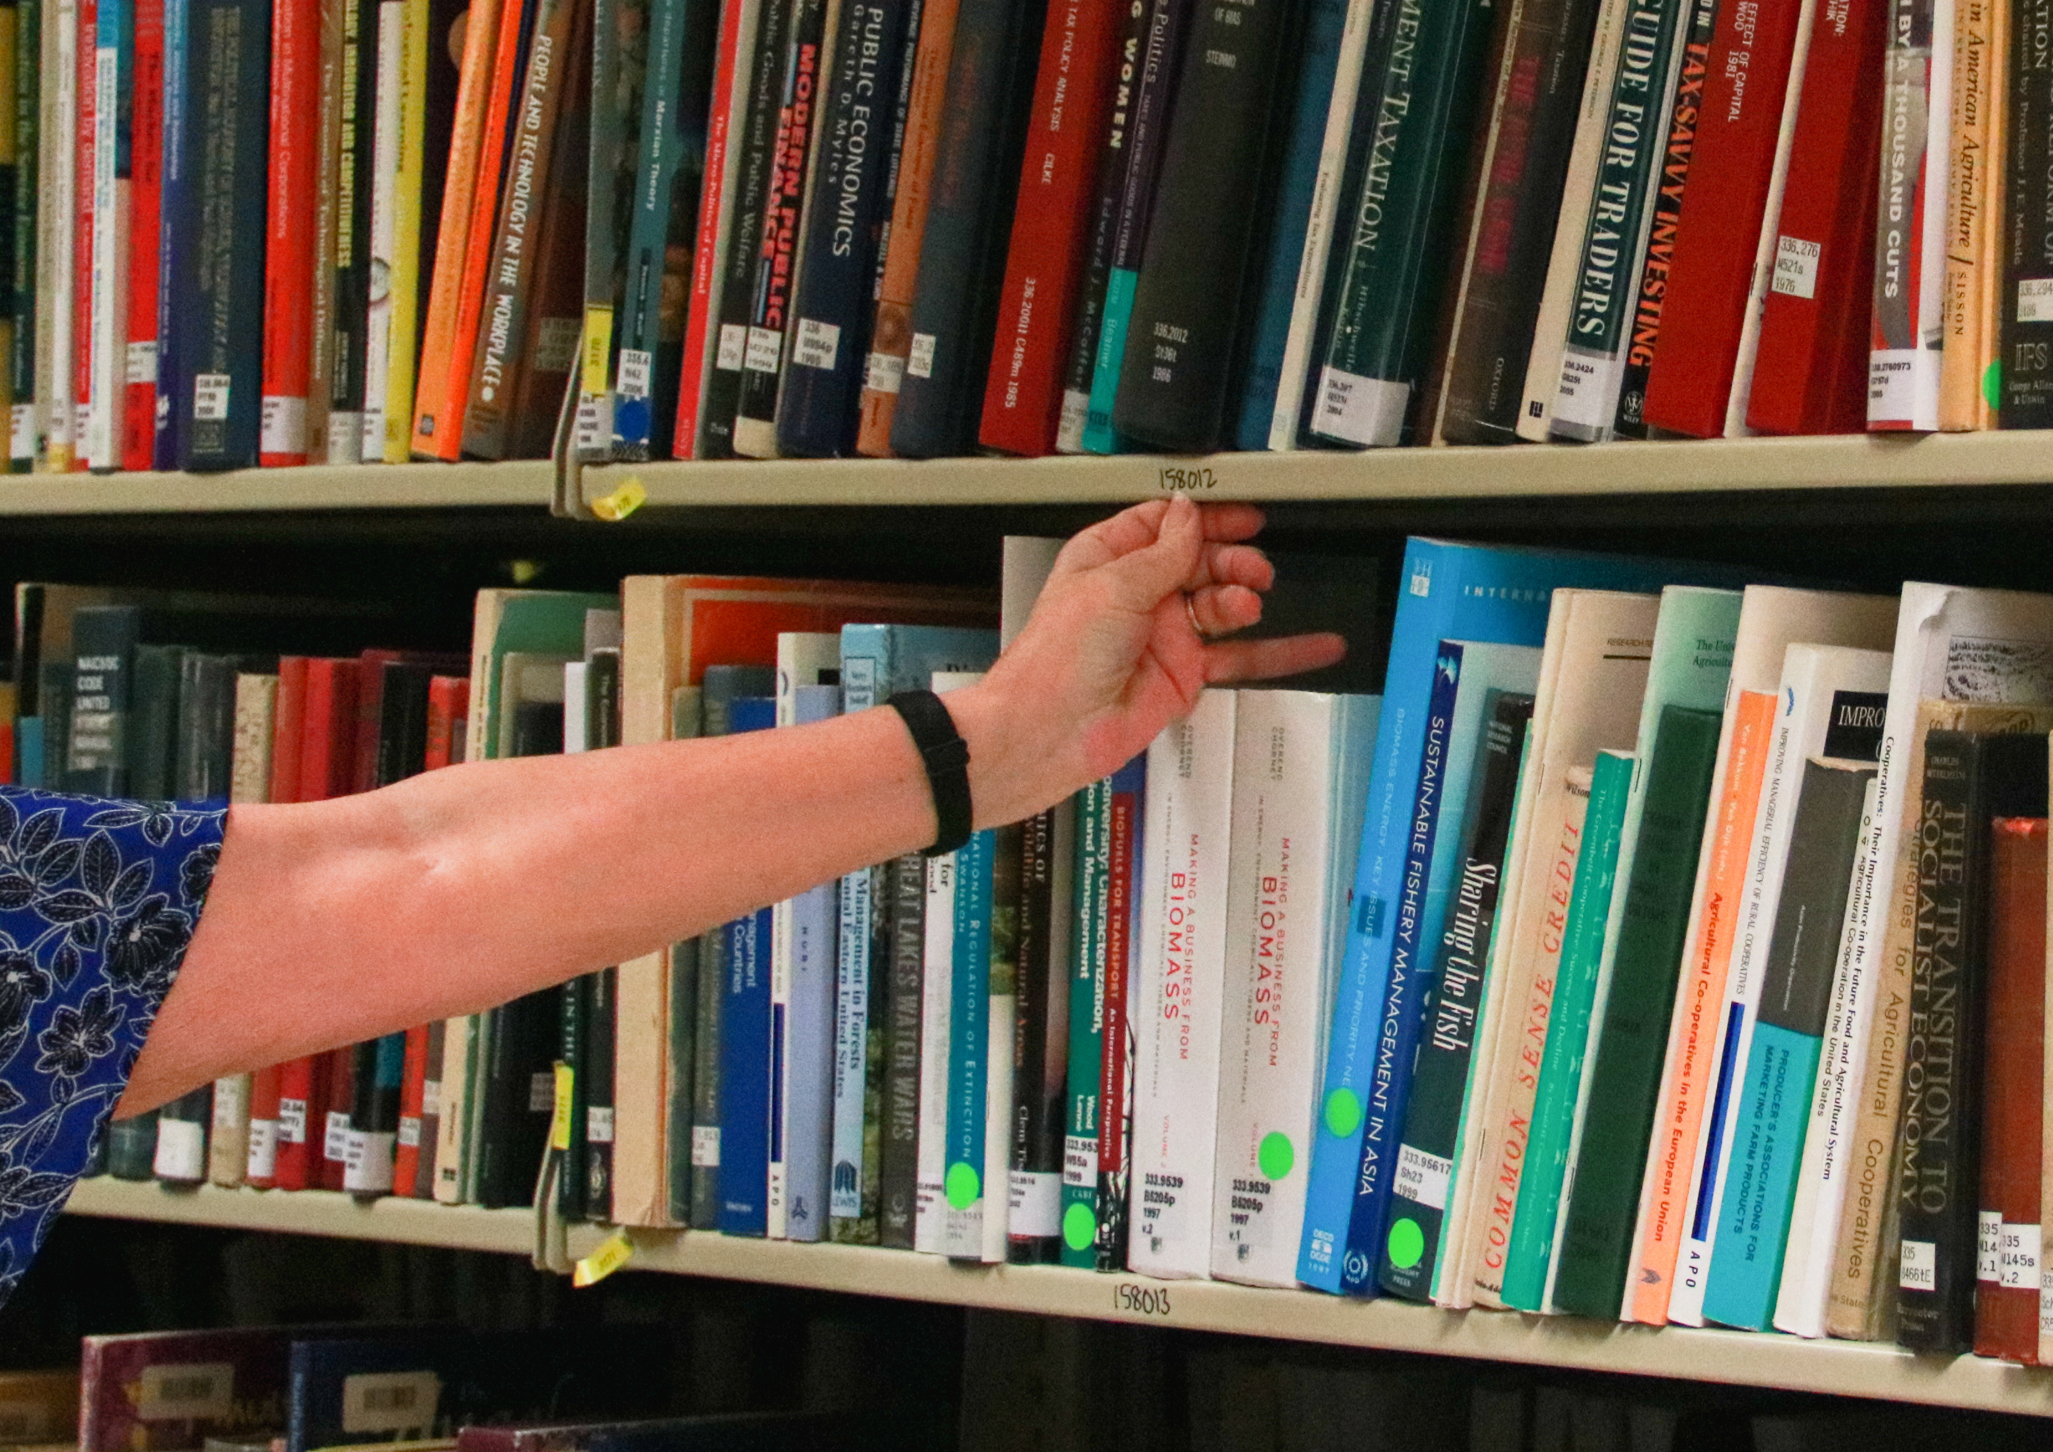
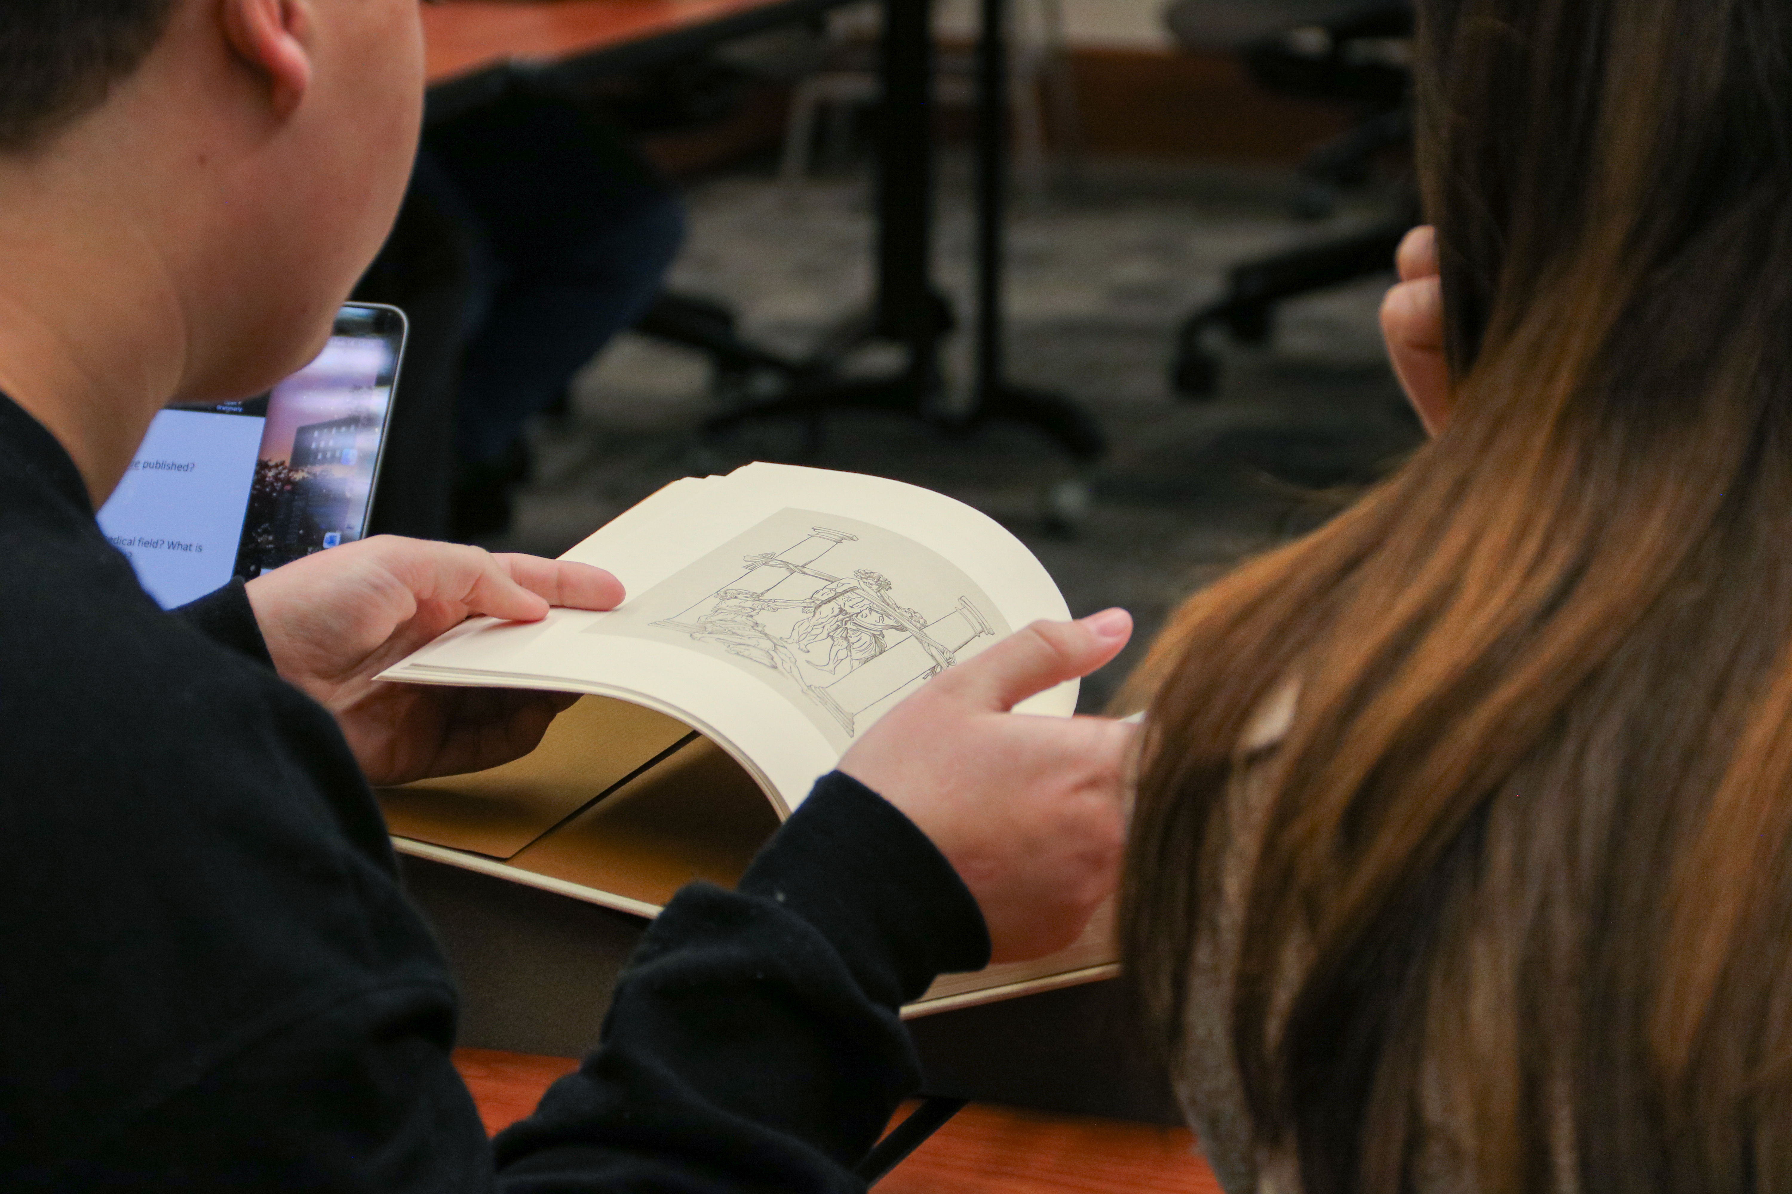
Enhanced Interlibrary Lending Services
Article Express
Purdue Borrow
(Fulfillment Network)
BTAA Resource Sharing
Delivers requested journal articles via email, often within minutes.
Allows users to request book and physical items across Purdue campuses.
Enables fast, long-term loans through Big Ten Academic Alliance libraries.

Slide 5
HELPFUL LINKS:
Here are several important links:
Links to Purdue University Libraries Resources:
Purdue Libraries website: www.lib.purdue.edu
Ask-a-Librarian service: https://lib.purdue.edu/help/askalib/
Library locations and hours: https://lib.purdue.edu/hourslist/
Interlibrary Loan: https://lib.purdue.edu/services/interlibrary-loan/
Course Reserves: https://lib.purdue.edu/course_reserves/
Links to IU resources:
Mechanical & Energy Engineering and Technology & Motorsports Engineering Library Guide (LibGuide) by Randall Halverson: https://iu.libguides.com/mechanical_eng
IUI University Library hours: https://iu.libcal.com/hours/

Slide 6
Affordable Course Materials
Purdue Libraries can partner with you to lower course material costs for your students.
Course Reserves
When a course material can be purchased in print or
licensed electronically for the campus, Libraries will
acquire it if possible.
Reading Lists (Leganto)
Our online course reserves system allows instructors to
create a structured electronic reading list (subject to copyright).
Open Education Resources
Open educational resources are freely accessible, openly licensed materials that are useful for teaching, learning, and assessing.
$677,757
Estimated Cost Savings for Spring 2024
$930,000
Estimated Cost Savings for Fall 2024

Slide 7



Purdue University Research Repository (PURR)
purr.purdue.edu
Publish and Preserve
Manage and Collaborate
Data Management Planning
Publish your data, get a DOI, and visualize use statistics. Published data receive long-term, robust preservation.
Project storage space for file management and features designed for collaborative work.
Meet funders’ data management and sharing requirements with resources and individualized support.

Slide 8
Open Scholarship
Open Access Publishing Agreements
Deposit Post-Prints to Purdue e-Pubs
Negotiate Author
Rights
Open Access Publishing Partnerships enable Purdue-affiliated authors to publish openly without incurring fees.
Most journal publishers support green open access, or self archiving, on an institutional repository. Purdue e-Pubs is a free, green open access service.
Most journal publishers support green open access, or self archiving, on an institutional repository. Purdue e-Pubs is a free, green open access service.
lib.purdue.edu/openaccess/publishing
docs.lib.purdue.edu
lib.purdue.edu/openaccess

Slide 9
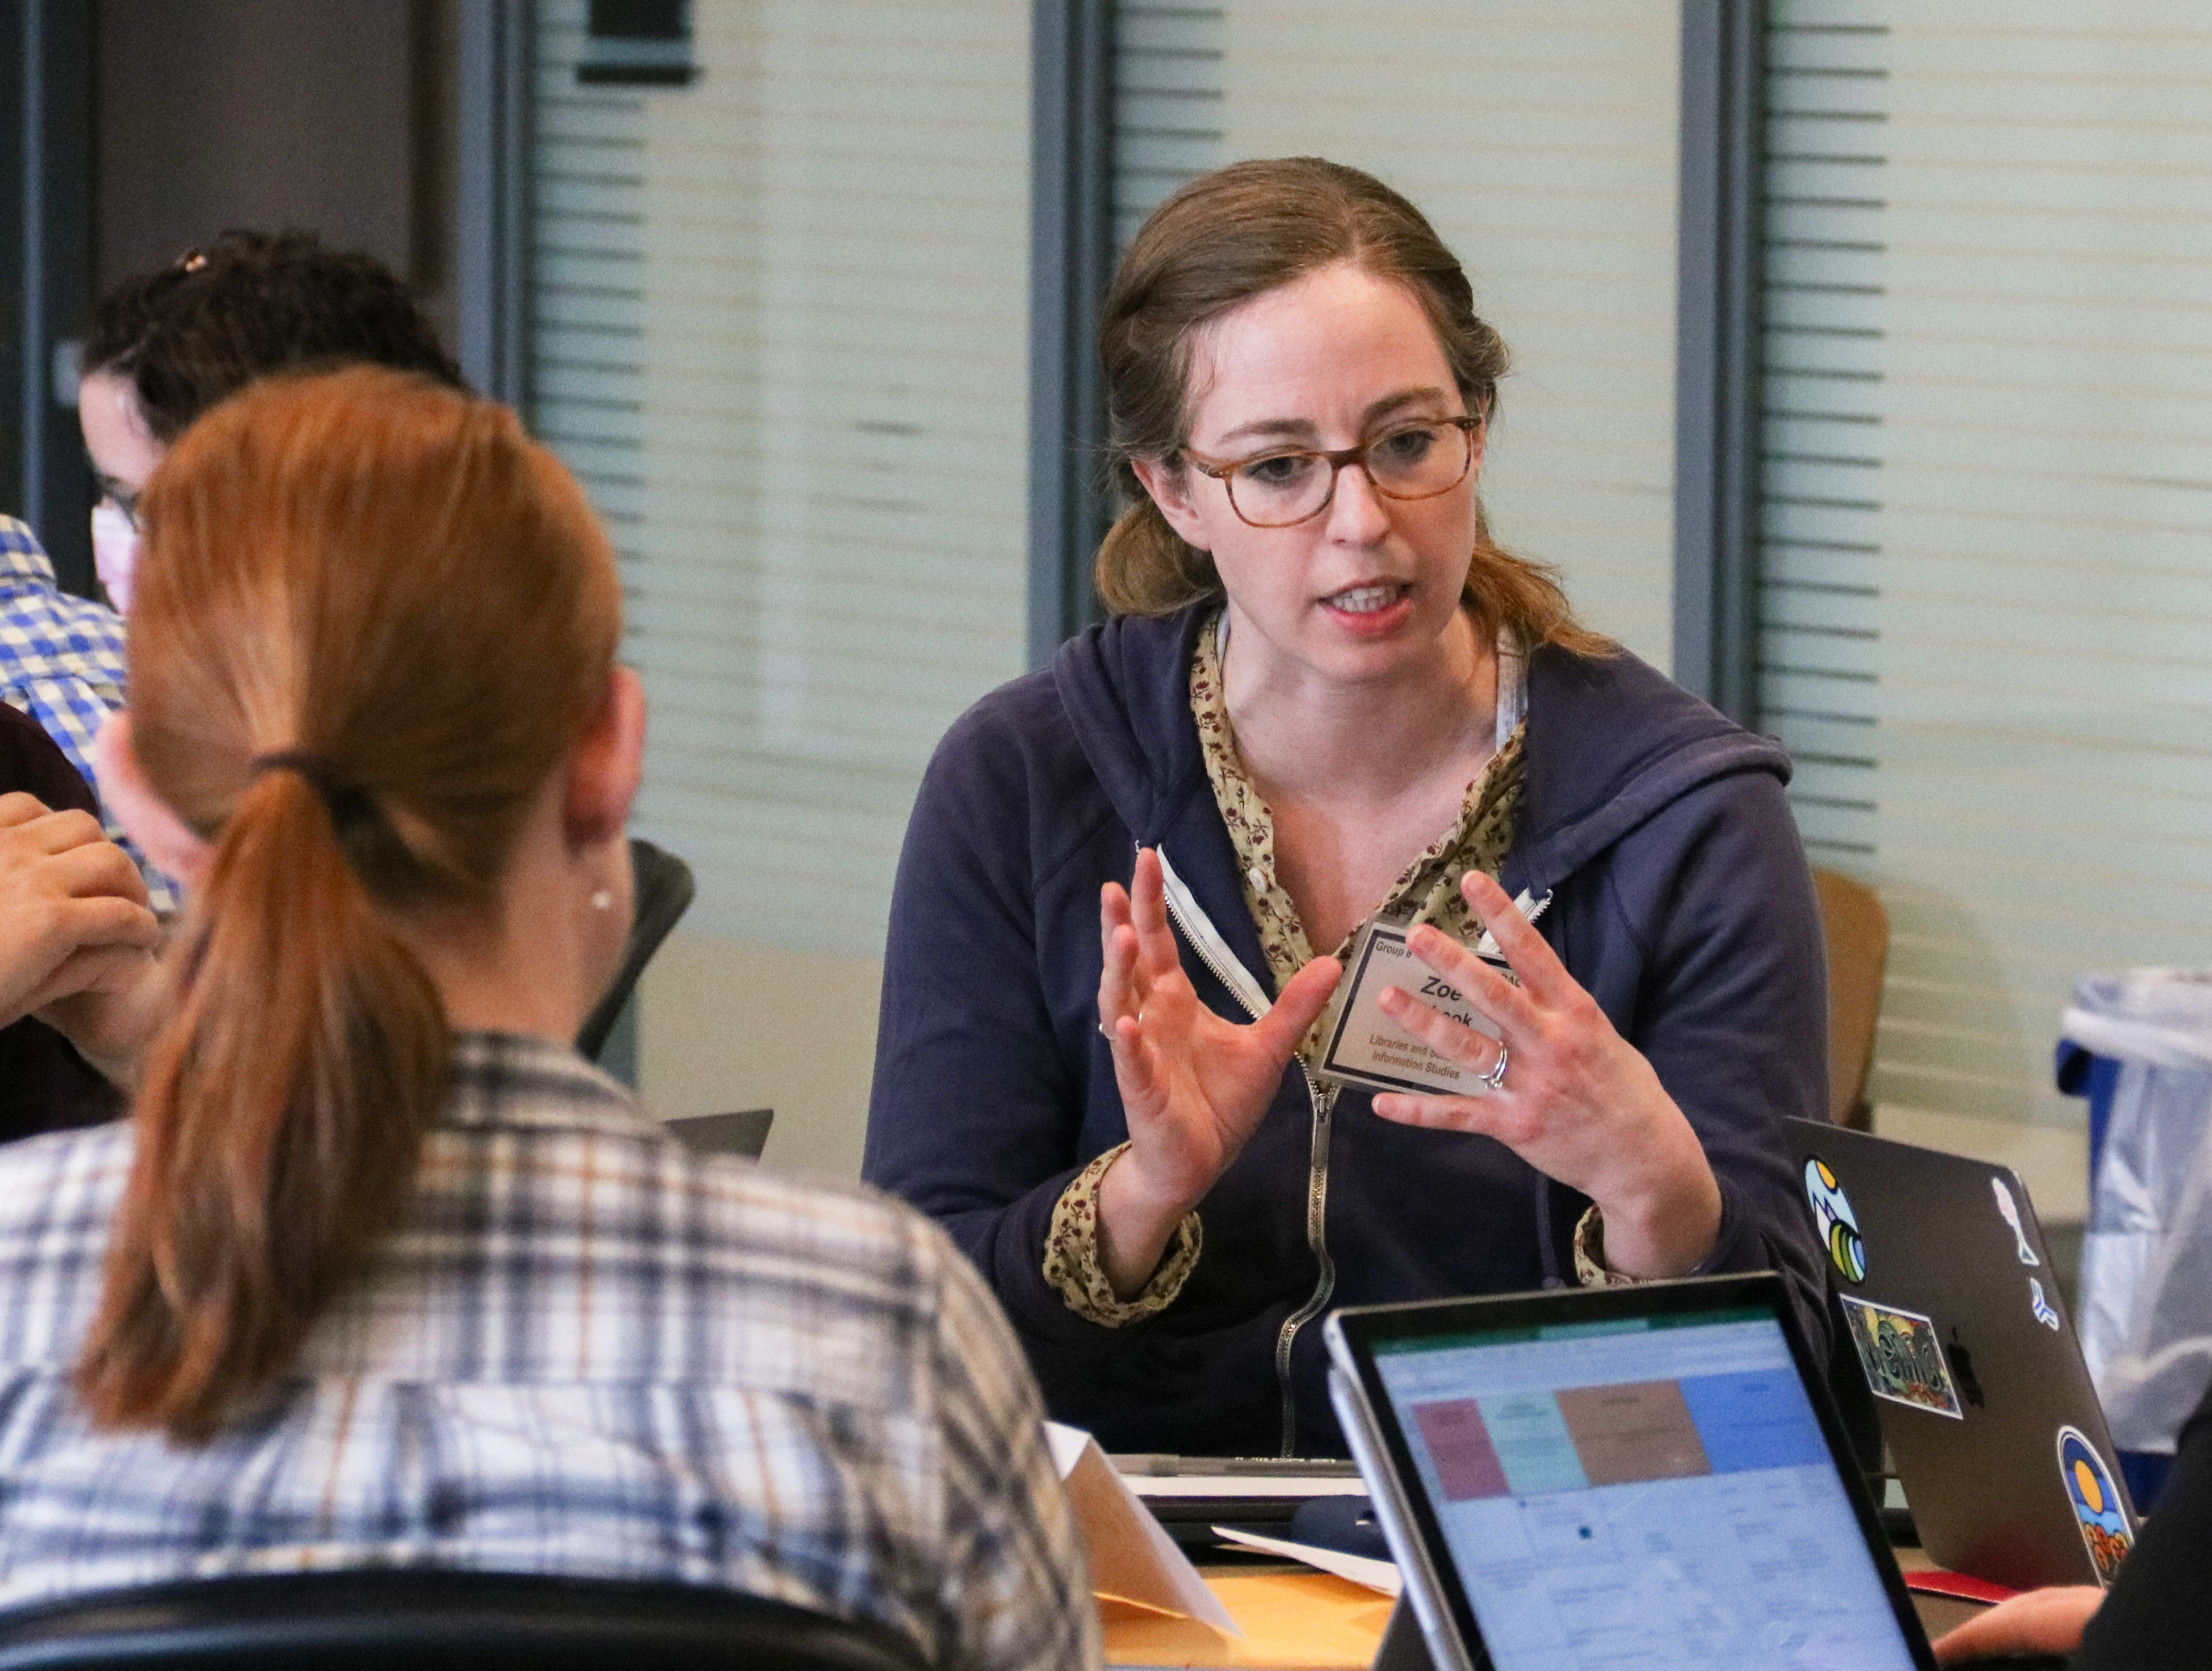
Advancing Research
Partner with Libraries Faculty
ORCiD at Purdue
Open Researcher and Contributor ID (ORCiD) provides a unique, persistent identifier that distinguishes you from other researchers.
ORCiD allows you to contribute your scholarship to Purdue’s global rankings.
guides.lib.purdue.edu/ORCiD/about

Slide 10
School of Information Studies
Undergraduate
Graduate
Information Studies Minor
Digital Humanities
Geospatial Information Science
15 Credits
12 Credits
12 Credits
Students will learn to make evidence-based decisions in professional and academic contexts.
Co-sponsored by the College of Liberal Arts, students will utilize computational methods for advanced research in the humanities or social sciences.
In collaboration with seven colleges at Purdue, students will analyze, interpret, and integrate spatial information in sciences, technology, humanities, or social sciences

Slide 11
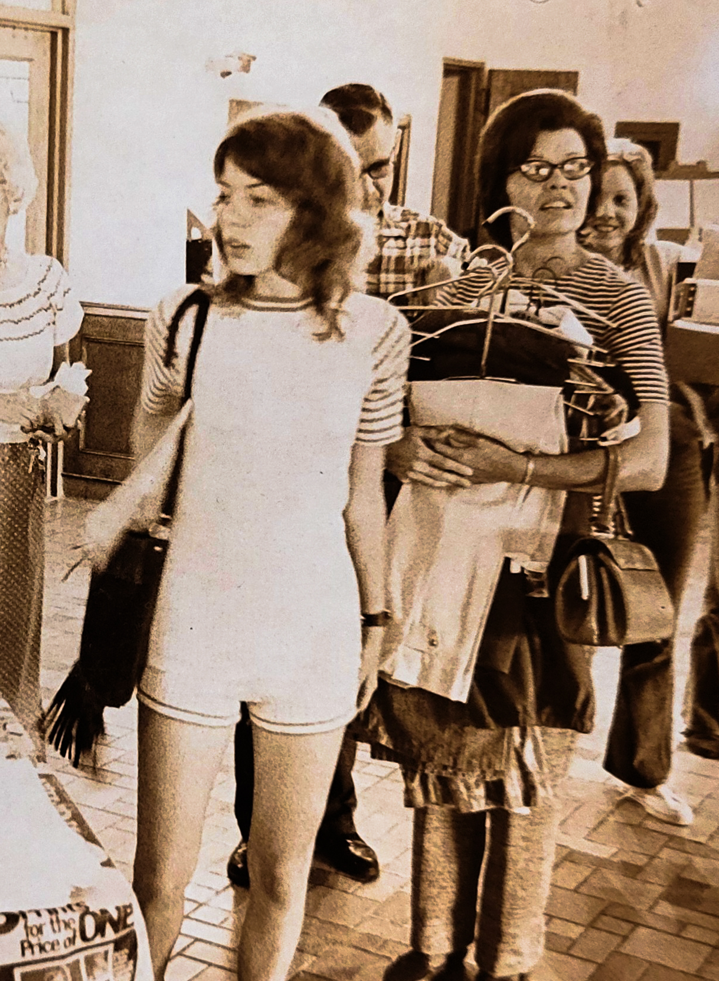
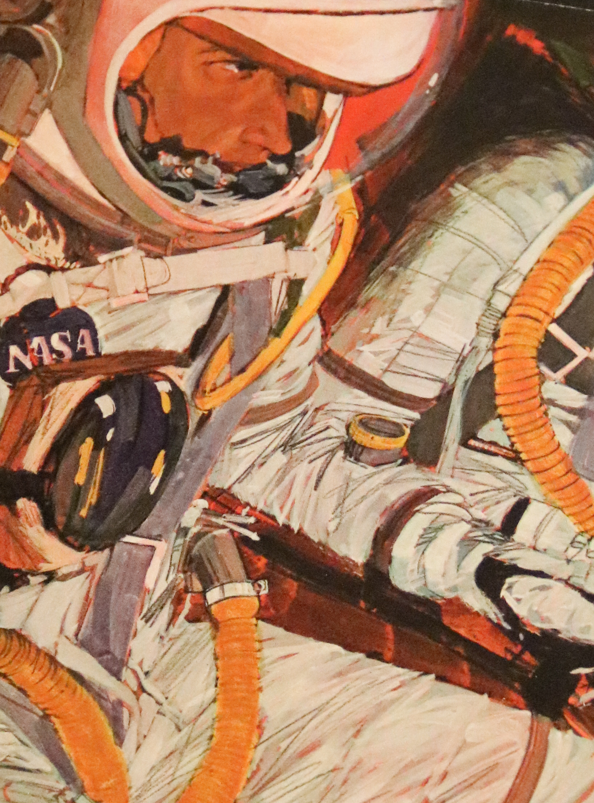
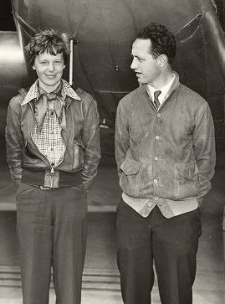

Archives and Special Collections
University
Archives
The Barron Hilton Flight and Space Exploration Archives
Susan Bulkeley Butler
Women’s Archives
Betsy Gordon Psychoactive
Substances Research Collection
Records Purdue’s official history through documents from administration, departments, and student organizations.
Chronicles Purdue’s contributions to aerospace through alumni, faculty, and research.
Showcases rare materials highlighting the overlooked stories of women at Purdue and in Indiana.
Explores the history of psychedelic research, patient experiences, and cultural/policy impacts.

Slide 12
Contact Us:
IUI Library
Purdue Library
Purdue Student Center Library
Randall Halverson
Engineering & Technology Librarian at IU Indianapolis University Library
rahalver@iu.edu
Thomas Gerrish
Assistant Professor – Mechanical Engineering at Purdue University West Lafayette Library
tgerrish@purdue.edu
Ann O’Donnell
Assistant Operations Manager – Student Center Library
atodonne@purdue.edu

Slide 13
Thank You!

