Slide 1
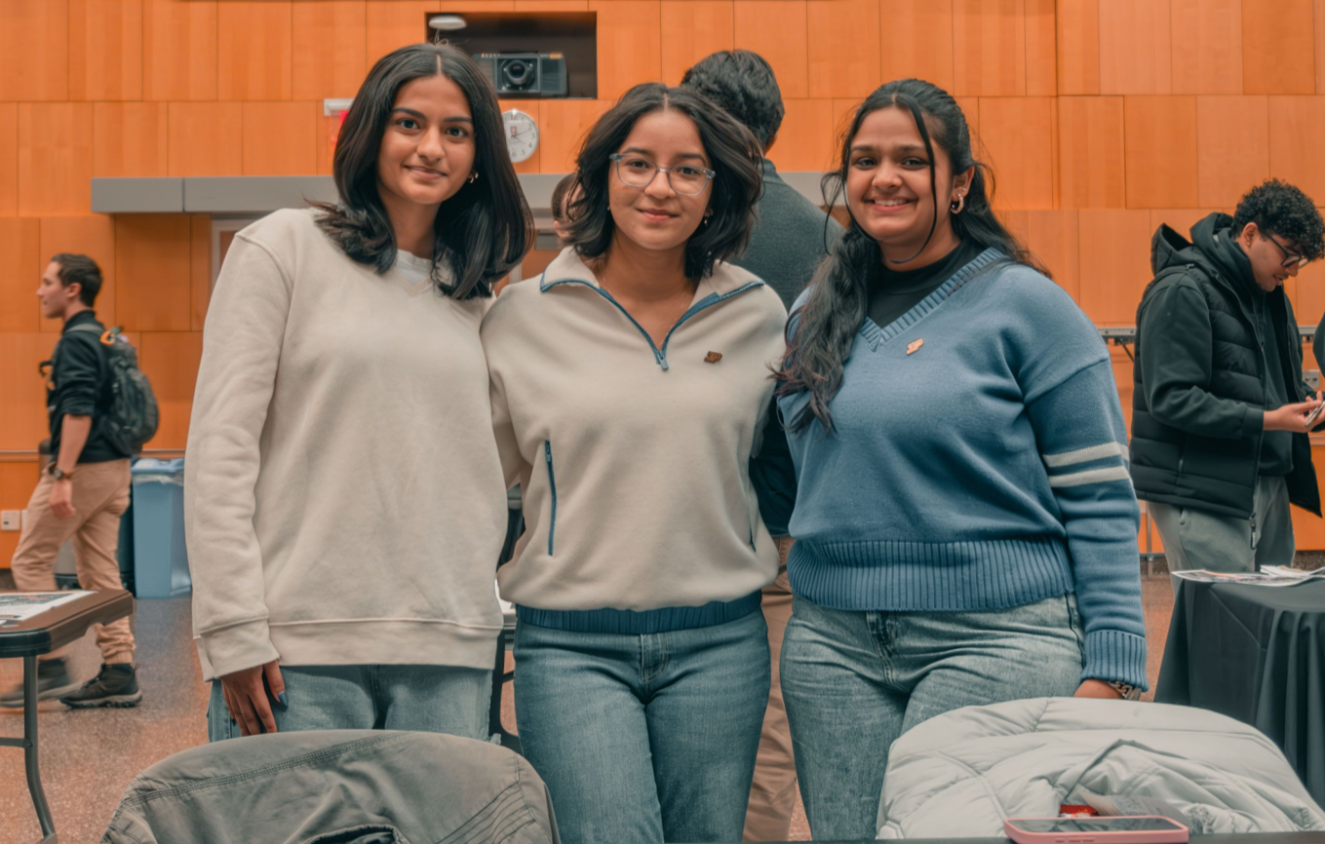
B-Involved Fair
August 27
3:00 – 6:00 PM
Boiler Park
Find Student Organizations and learn how to get involved!

Slide 2
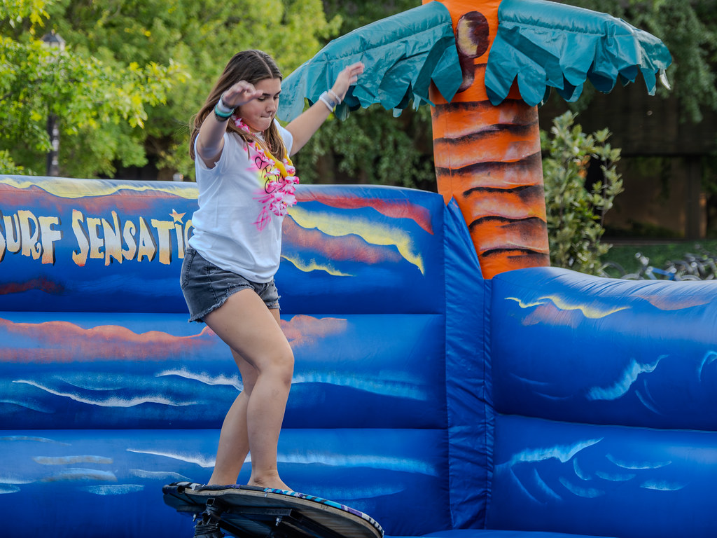
Beach Bash
August 30th
6:00 PM – 9:00 PM
Boiler Park
Celebrate the start of the school year with the Purdue Student Union Board (PSUB) Beach Bash! Join for food, snow cones, inflatable obstacle courses, photo opportunities and free giveaways.

Slide 3
Boilermaker Blitz:
An Indianapolis Scavenger Hunt
Saturday, Aug. 30 – Sunday, Aug. 31
Deadline to register: Friday, Aug. 29 by 12 p.m.
Submit Scavenger Hunt Selfies by Sunday, Aug. 31 at 10 p.m. to win a prize.
Explore the city of Indianapolis through the Boilermaker Blitz Scavenger Hunt. Create a group or be placed in a group to make new connections. Choose your route, use the interactive guide to learn more about each destination, snap a group selfie and upload it to win a prize!

Slide 4


Slide 5


Slide 6
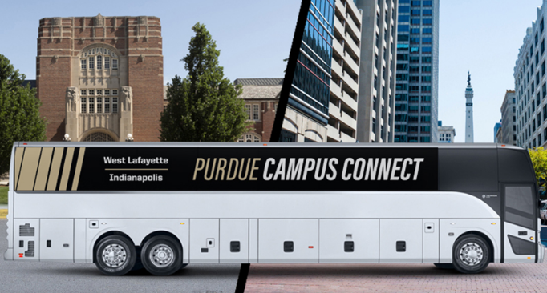

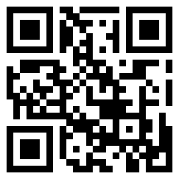

PURDUE CAMPUS CONNECT SHUTTLE
This fall the Campus Connect Shuttle will again run between Indianapolis and West Lafayette.
8 round-trips Monday–Friday
4 round-trips Saturday–Sunday
Reserve your seat through the R2U Connect app and get real-time route alerts and updates.
Follow @purdueoperations on Instagram for more information like this
Scan for more information including the full schedule

Slide 7
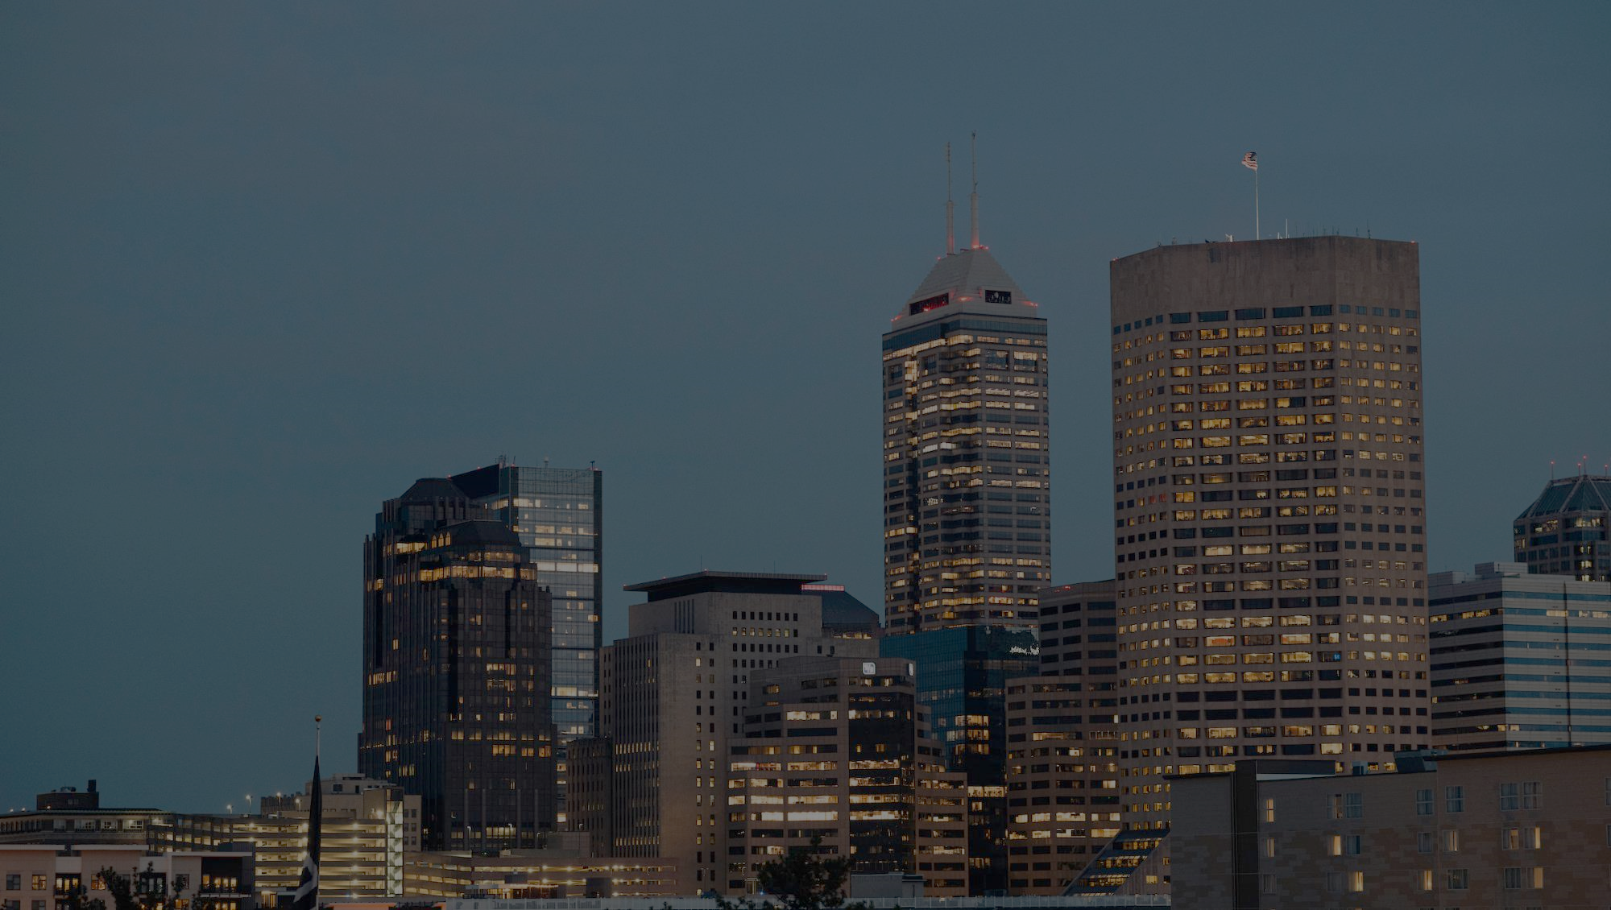


SAFE WALK PROGRAM
317-274-SAFE
Call this number 24/7/365 for assistance to and from campus buildings.
When you request a safe walk, an officer will arrive shortly to walk you to your desired location anywhere on campus free of charge.

Slide 8
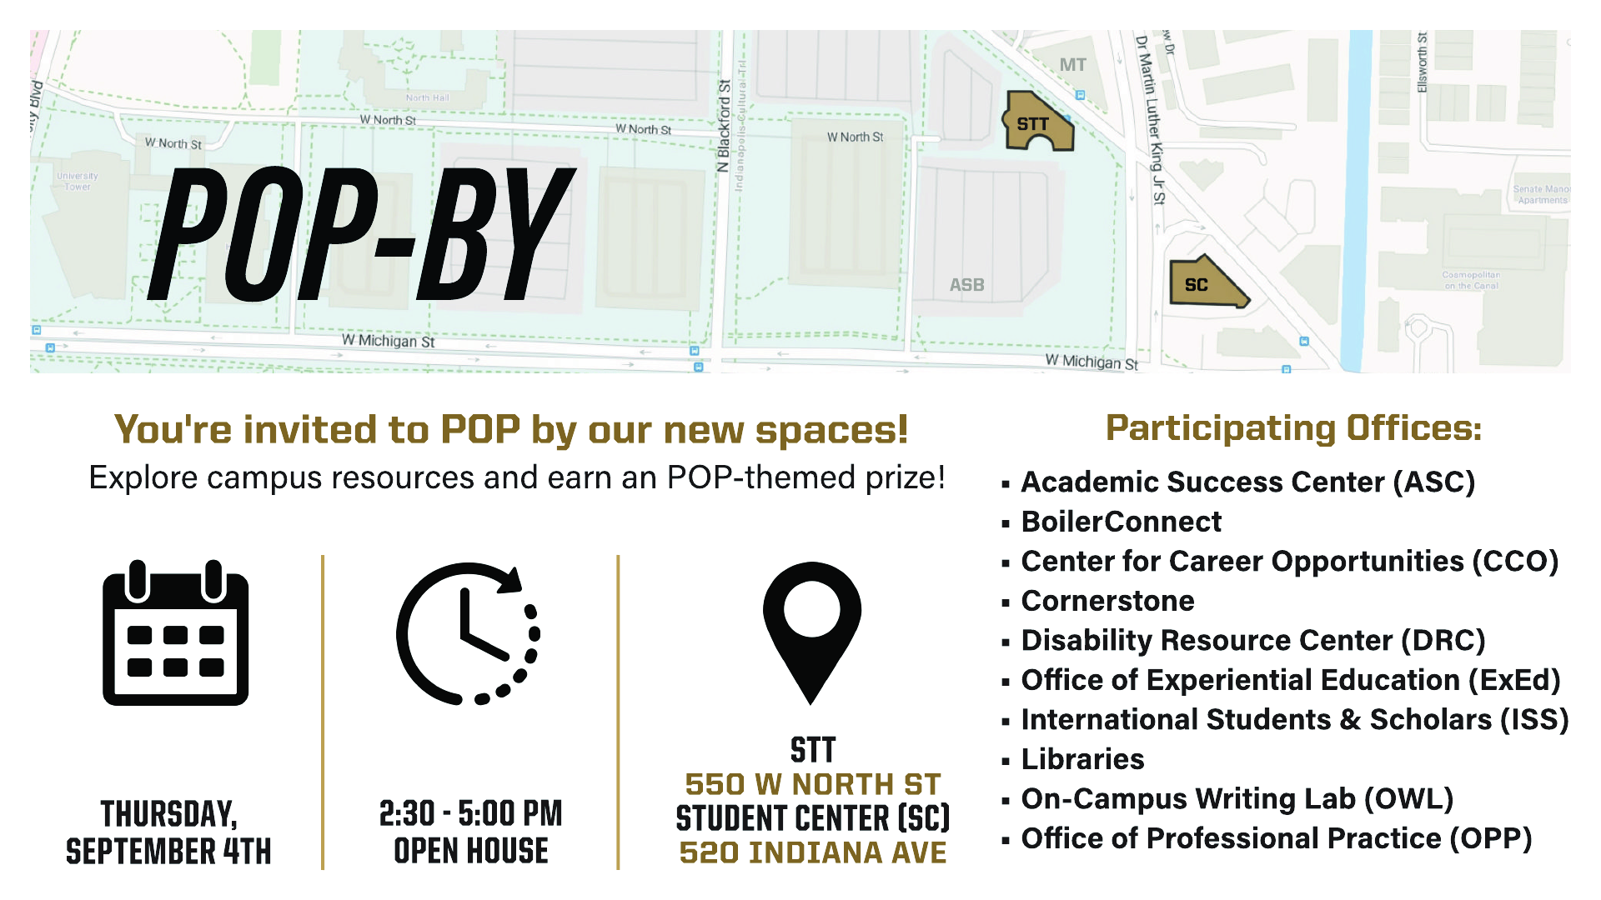

Slide 9
Events August 25-August 31
8/25/25 ECESS Welcome Back Café 9:00AM-12:00PM ET Hallway
8/25/25 Weldon Indianapolis Biomedical Engineering Teaching Asst. Orientation 5:30PM-6:30PM SL220A
8/26/25 ECESS Welcome Back Trivia Night 6:00PM-8:00PM – location TBD
8/26/25 College of Science Learning Community Night at Gainbridge – Fever! 7:00PM-10:30PM
8/27/25 B-Involved Fair 3:00PM-6:00PM Boiler Park (Lot 71)
8/27/25 ECESS Welcome Back Carnival 6:00PM-8:00PM North Hall Yard
8/29/25 ECESS Welcome Back Faculty Meet & Greet 12:00PM-2:00PM SL165
8/29/25 Welcome Back Mechanical Engineering (Indianapolis) 1:00PM-4:00PM ET Atrium
8/30/25 Boilermaker Blitz: An Indianapolis Scavenger Hunt! 8:00AM-8:00PM City of Indianapolis
8/30/25 SAAC Faculty and Staff Mingle at the Indianapolis Zoo 9:00AM-5:00PM Indianapolis Zoo
8/30/25 PSUB Beach Bash 6:00PM-9:00PM Boiler Park (Lot 71)
8/31/25 Boilermaker Blitz: An Indianapolis Scavenger Hunt! 8:00AM-8:00PM City of Indianapolis

Slide 10
WelcoME Back!
Fr, Aug 29, 1:00 – 4:00 PM, ET Atrium

