Slide 1


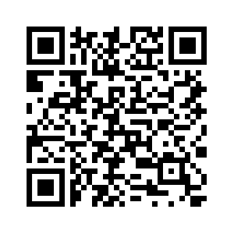

Graduate TAs needed for EPICS/VIP/FYE
Interested in a Teaching Assistantship?
Follow the QR code to apply for a Fall 2025 graduate TA position!

