Slide 1
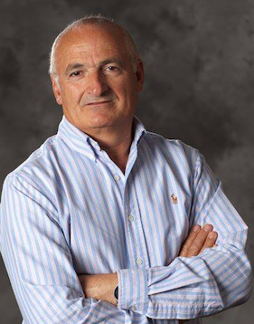

Purdue Engineering in Indianapolis Distinguished Lecture Series
All are invited
Lecture: Control of Vehicles and Traffic for Safety and Mobility
Time: 2:00 pm – 3:00 pm
Date: Monday, October 20, 2025
Location: University Library, Lilly Auditorium, 0130
Dr. Petros Ioannou
University Professor at the University of Southern California and holds the A.V ‘Bal’ Balakrishnan Endowed Chair in the Department of Electrical and Computer Engineering.
Bio /abstract info

