Slide 1
Additive Manufacturing curriculum
Michael Sealy & Ajay Malshe
Contact information: msealy@purdue.edu

Slide 2
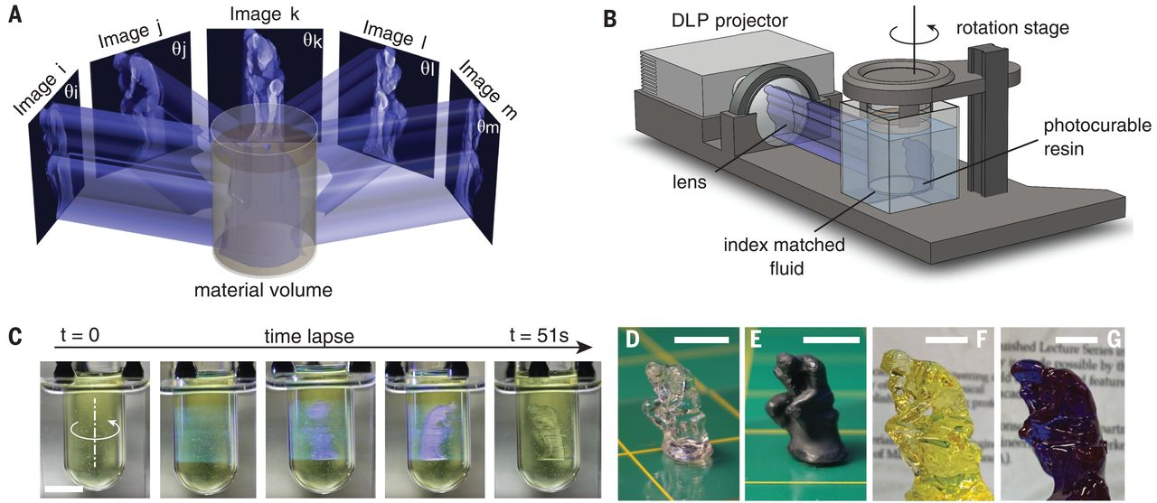
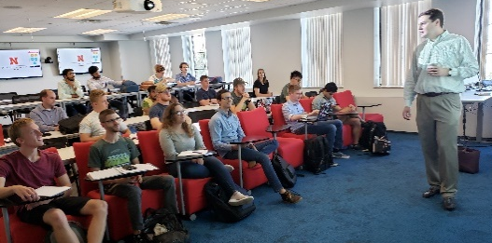
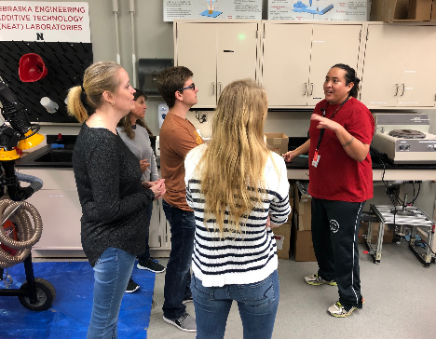
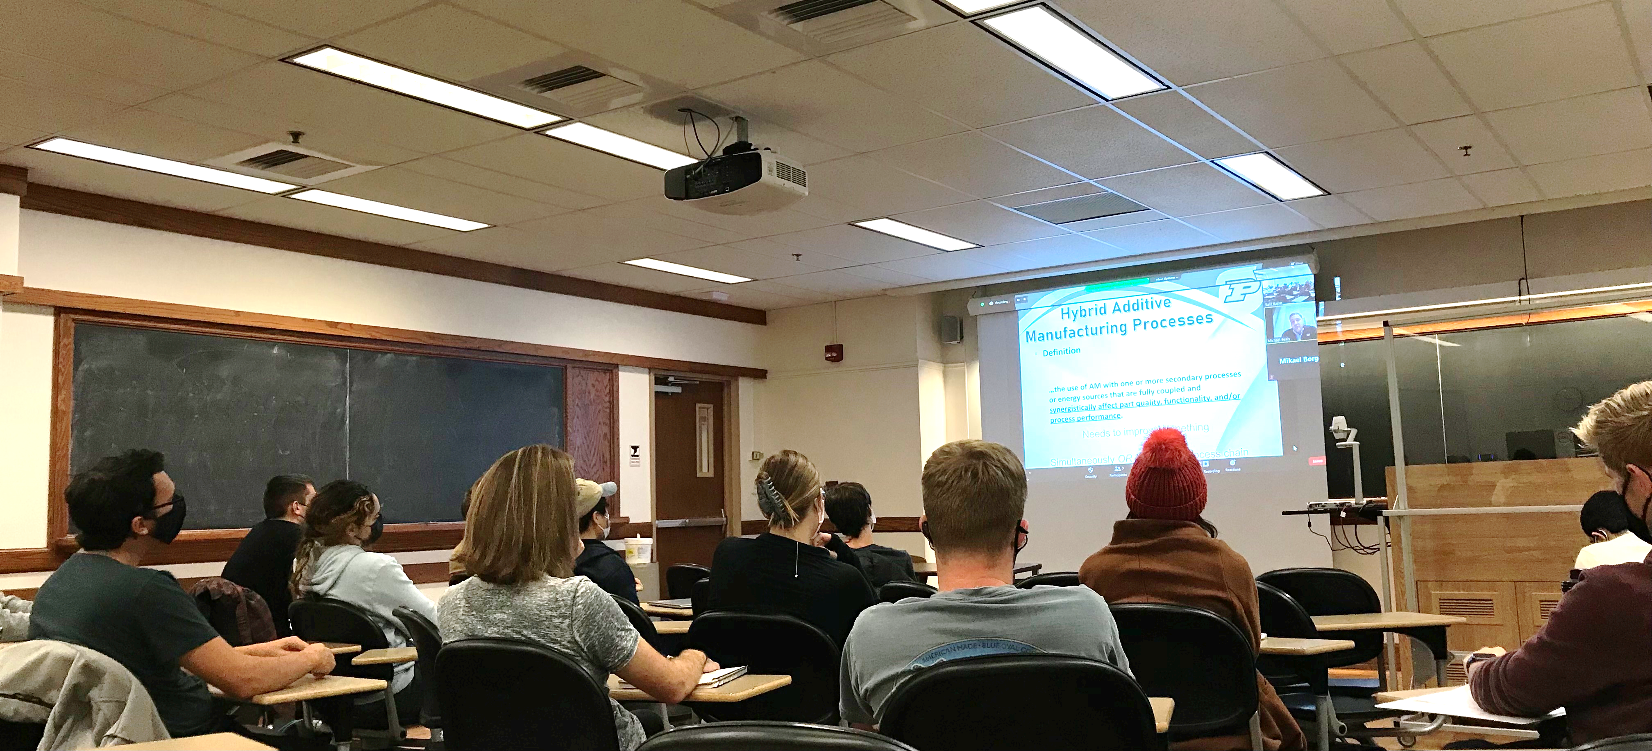
Building an Additive Manufacturing Curriculum
Motivation
Academic Apprenticeships - Need more experiential learning opportunities
  Aligns with national priorities of building an additive manufacturing workforce
  Number of job adds requiring AM skills increased more than 1800% since 2010; 9 out of 10 manufactures struggle to find skilled workers
Increase positive awareness of advanced manufacturing
  Avoid dumb, dirty, and dangerous bias toward manufacturing
Create near-peer mentoring opportunities

Slide 3













EXTERNAL Survey of Additive Manufacturing Curriculums
Universities Surveyed

Slide 4
EXTERNAL Survey of Additive Manufacturing Curriculums
Penn State
Graduate Program: Additive Manufacturing and Design
Courses
  Additive Manufacturing and Design Seminar Series (1 credit)
  Additive Manufacturing of Metallic Materials (4 credits)
  Additive Manufacturing Processes (4 credits)
  Advanced Metallic Material Feedstocks for Additive Manufacturing (4 credits)
  Bioprinting (3 credits)
  Culminating Experience Part I & II – Literature Review/Proposal (3 credits)
  Cybersecurity for Additive Manufacturing (2 credits)
  Design for Additive Manufacturing (4 credits)
  Engineering and Scientific Principles of Additive Manufacturing (4 credits)
  Engineering Design and Analysis with CAD (3 credits)
  Legal Issues in Additive Manufacturing (2 credits)
  Metal Additive Manufacturing Laboratory (3 credits)
  Non-destructive Evaluation for Additive Manufacturing (3 credits)
  Polymer and Composite Materials for Additive Manufacturing (3 credits)
  Statistical Methods for Additive Manufacturing (3 credits)

Slide 5
Purdue Additive Manufacturing Curriculum
Proposed Additive Manufacturing Curriculum Map
Fall 2022
Spring2023
Fall 2023
Spring2024
Fall 2025
ME 496
Fundamentals of Additive Manufacturing
(3 hrs)
Lecture/Lab
ME 496
Experiential
Additive Manufacturing
(3 hrs)
Lab
ME 496
Fundamentals of Additive Manufacturing
(3 hrs)
Lecture/Lab
ME 596
Design for
Additive Manufacturing
(3 hrs)
Lecture/Lab
ME 496
Fundamentals of Additive Manufacturing
(3 hrs)
Lecture/Lab
ME 496
Contemporary
Additive Manufacturing
(3 hrs)
Lecture
ME 596
NDE
Additive Manufacturing
(3 hrs)
Lecture/Lab
ME 596
Adv. Practice in Metal
Additive Manufacturing
(1-3 hrs)
Lab
ME 496
Bioprinting
(1-3 hrs)
Lecture/Lab
ME 496
Contemporary
Additive Manufacturing
(3 hrs)
Lecture
ME 444
Toy Making (CAD/Design)
(3 hrs)
Lecture/Lab
ME 444
Toy Making (CAD/Design)
(3 hrs)
Lecture/Lab
ME 596
Legal, Policy, & Societal Issues in AM
(1-2 hrs)
Lecture
ME 596
Cellular Agriculture
(1-3 hrs)
Lecture/Lab
Other topics of interest:
Multi-material AM
Statistical Methods for AM;
Energy-Material Interactions for AM;
Evaluation Methods for Additive Manufacturing
MSE 597
Additive Manufacturing of Materials
(3 hrs)
Lecture
MSE 597
Additive Manufacturing of Materials
(3 hrs)
Lecture
ME 444
Toy Making (CAD/Design)
(3 hrs)
Lecture/Lab
CE 299
3D Printing of
Concrete
(3 hrs)
Lecture
CE 299
3D Printing of
Concrete
(3 hrs)
Lecture

Slide 6
INTERNAL Survey of Additive Manufacturing Curriculum
Multifunctional Printed Sensors | T. Tallman
Additive Manufacturing of Propellant | S. Son
Additive Manufacturing of Propellant II | S. Son
Additive Manufacturing of Materials | K. Trumble
Additive Manufacturing of Materials | K. Trumble
3D Printing of Concrete | J. Olek
Purdue College of Engineering
31 courses in ME across 16 faculty
Only one ME course with enrollment greater than one student in last 2 years
Other schools taught 6 AM related courses
Two courses outside ME had enrollment greater than one student
Largest: MSE 597 AM of Materials by K. Trumble (50+ students)
Largest in ME: ME 496 AM Fundamentals by A. Malshe (30+ students)
Anomaly Detection in Additive Manufacturing (3D Prints) | M. McClain
Additive Manufacturing of Polymers / Plastics | Y. Shin
3D Printer Modification | M. Jun
Composite 3D Printing | M. Jun
Additive Manufacturing: Fundamentals, Equipment, & Apps. | A. Malshe
Additive Manufacturing of Soft Materials | Y. Shin
Nanoscale 3D Printing | X. Xu
Multimaterial 3D Printer | A. Chortos
Additive Manufacturing of Energetics | M. McClain
Properties of Metal Additive Manufacturing | Y. Shin
High Explosive 3D Printing | M. McClain
3D Printing with Vision | S. Zhang
3D Printing in Water Treatment | D. Warsinger
Modeling of Metal AM Parts | Y. Shin
In-Situ Diagnostics of AM | S. Zhang
Research on 3D Printing | M. Jun
Image Digitization Printing | B. Han
Transport in 3D Printing | X. Ruan
Developing Nano 3D Printing | L. Pan
3D Printing of Food | A. Malshe
3D Printing Fire Project | A. Malshe
Additive Manufacturing | M. Jun
Vibration Assisted 3D Printing | J. Rhoads
Additive Manufacturing | Y. Shin
CAD for Microfluidic Printing | B. Han
Res(?) in Additive Manufacturing | J. Rhoads
Epoxy Development 3D Printing | T. Li
Nanoscale 3D Printing Research | X. Xu
3D Printing of Pharma Products | M. Gonzalez
3D Food Printing Ink Characterization | A. Malshe
Additive Manufacturing of Energetics | S. Son
ME

Slide 7
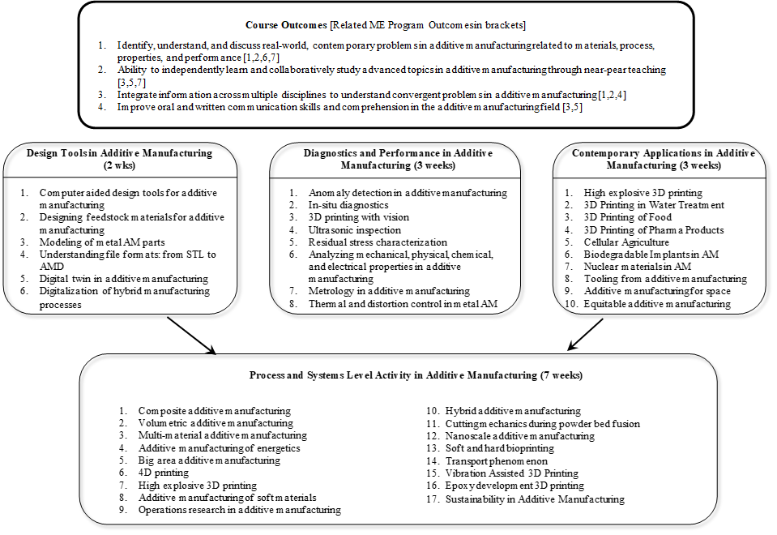
Purdue Additive Manufacturing Curriculum
Contemporary Additive Manufacturing Course Profile

Slide 8
Purdue Additive Manufacturing Curriculum
Contemporary Additive Manufacturing Course Profile
Objective & Format
  Given the diversity of research activity in additive manufacturing across multiple disciplines, the objective of this course is to introduce advanced research topics in the field to promote convergent learning experiences
  Expose students to an international community of experts in additive manufacturing and related fields through a distributed learning model and near-peer teaching
  Long-term goal is education repository for contemporary topics in AM
  Suggested 3 credit hours; Meets twice per week
Course Outcomes [Related ME Program Outcomes in brackets]
  Identify, understand, and discuss real-world, contemporary problems in additive manufacturing related to materials, process, properties, and performance [1,2,6,7]
  Ability to independently learn and collaboratively study advanced topics in additive manufacturing through near-pear teaching [3,5,7]
  Integrate information across multiple disciplines to understand convergent problems in additive manufacturing [1,2,4]
  Improve oral and written communication skills and comprehension in the additive manufacturing field [3,5]

Slide 9
Purdue Additive Manufacturing Curriculum
Contemporary Additive Manufacturing Course Profile
Design Tools in Additive Manufacturing
(2 wks)
Computer aided design tools for additive manufacturing
Designing feedstock materials for additive manufacturing
Modeling of metal AM parts
Understanding file formats: from STL to AMD
Digital twin in additive manufacturing
Digitalization of hybrid manufacturing processes
Diagnostics and Performance in Additive Manufacturing (3 weeks)
Anomaly detection in additive manufacturing
In-situ diagnostics
3D printing with vision
Ultrasonic inspection
Residual stress characterization
Analyzing mechanical, physical, chemical, and electrical properties in AM
Metrology in additive manufacturing
Thermal and distortion control in metal AM
Contemporary Applications in Additive Manufacturing (3 weeks)
High explosive 3D printing
3D Printing in Water Treatment
3D Printing of Food
3D Printing of Pharma Products
Cellular Agriculture
Biodegradable Implants in AM
Nuclear materials in AM
Tooling from additive manufacturing
Additive manufacturing for space
Equitable additive manufacturing
Process and Systems Level Activity in Additive Manufacturing (7 weeks)
Composite additive manufacturing
Volumetric additive manufacturing
Multi-material additive manufacturing
Additive manufacturing of energetics
Big area additive manufacturing
4D printing
High explosive 3D printing
Additive manufacturing of soft materials
Operations research in additive manufacturing
Hybrid additive manufacturing
Cutting mechanics during powder bed fusion
Nanoscale additive manufacturing
Soft and hard bioprinting
Transport phenomenon
Vibration Assisted 3D Printing
Epoxy development 3D printing
Sustainability in Additive Manufacturing

Slide 10
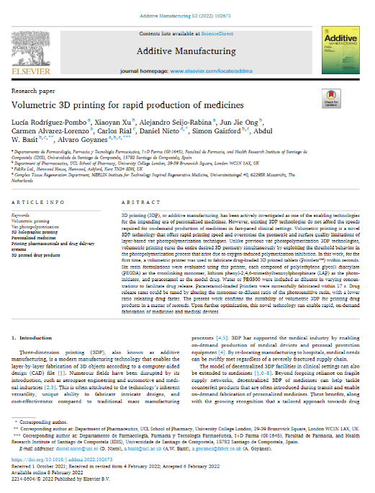
Purdue Additive Manufacturing Curriculum
Contemporary Additive Manufacturing Course Profile
Evaluation
  Weekly comprehension reports
  Semester report / presentation on a literature review topic
Quad Chart Comprehension Analysis
Purpose
What are they trying to do?
How is problem solved today?
What are the limitations of the present approach?
Procedure
What is their approach?
What is new about the approach?
Why do you think it will (will not) succeed?
What are their milestones?
Results and Analysis
Summary of key results
What are the conclusions?
Impact
What is the impact? What difference will it make?
How much will it cost? Is technology translatable?

Slide 11
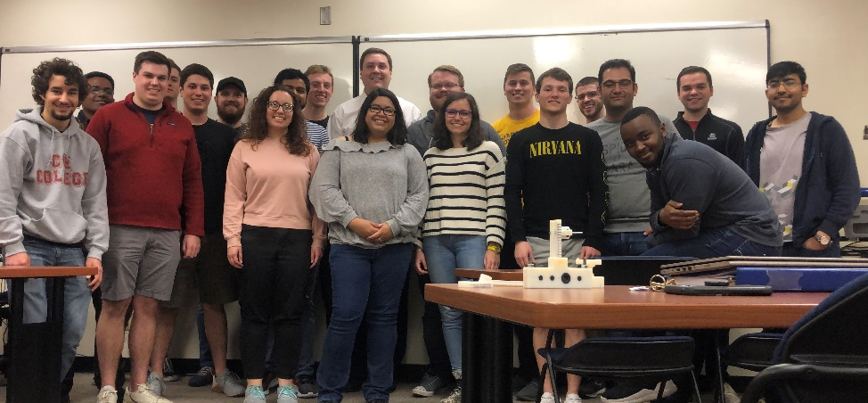







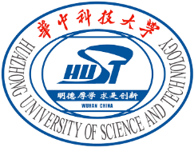






















Thank You
Corresponding author: Michael Sealy, Ph.D.
School of Mechanical Engineering
Purdue University
msealy@purdue.edu
256.702.5031
NEAT LAB
Nebraska Engineering Additive Technologies Lab

