Slide 1
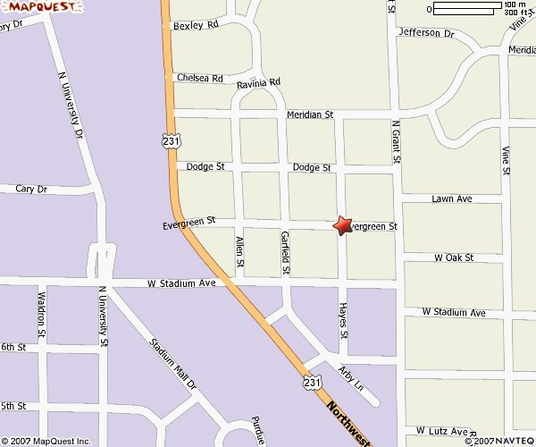
Graduation Celebration ( rain or shine)
Where: 703 Hayes Street West Lafayette (765-714-9794).
When: Saturday August 3rd from 6 till ??????
Food and beverages will be provided. Chips and side items appreciated. Bring a chair !
Live Music (at 7 pm): Mixed Tapes plus mystery band
(If you get a chance bring a can of food for the shelter)

