Slide 1
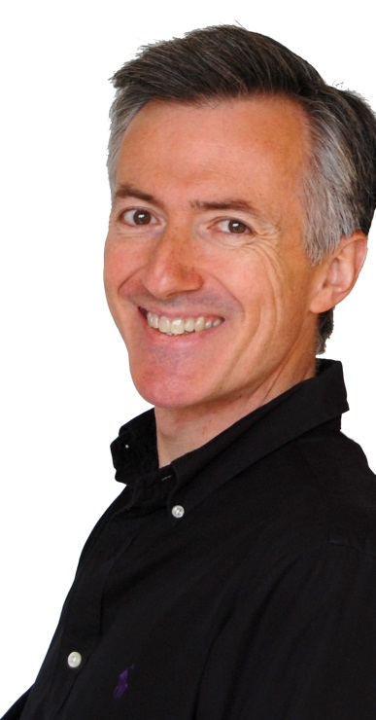
Conveying Messages with Graphs
Although widely used in research to analyze data and to communicate about them, graphical displays are still poorly mastered by researchers, who often use the wrong graphs or use them in the wrong way (and popular software does not exactly help). Based on Dr. Doumont's book Trees, Maps, and Theorems addressing “effective communication for rational minds,” the lecture discusses how to select the right graph for a given data set and a given research question, how to optimize the graph's construction to reveal the data, and finally how to phrase a useful caption.
Speaker Bio
An engineer from the Louvain School of Engineering and PhD in applied physics from Stanford University, Jean-luc Doumont now devotes his time and energy to training engineers, scientists, business people, and other rational minds in effective communication, pedagogy, statistical thinking, and related themes.
For additional information on Dr. Doumont’s communication programs, visit www.principiae.be.
Conveying Messages with Graphs
Tuesday September 29th 6:30-8:30 pm
Forney Hall G140
Register at: http://bit.ly/GSworkshops
Purdue Graduate School
Purdue College of Science
Purdue College of Engineering

