Slide 1

2017 LORRE Integrated Safety Plan (ISP)
LORRE Safety committee

Slide 2

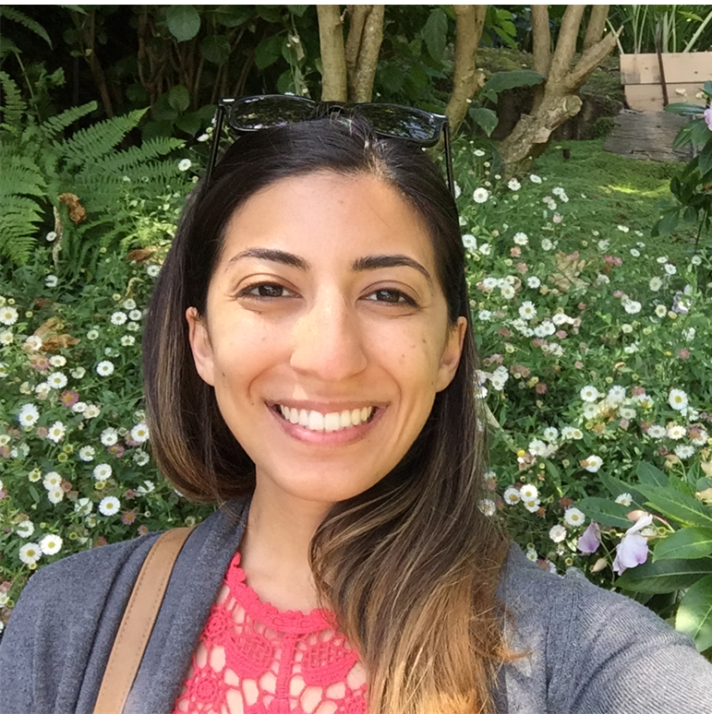
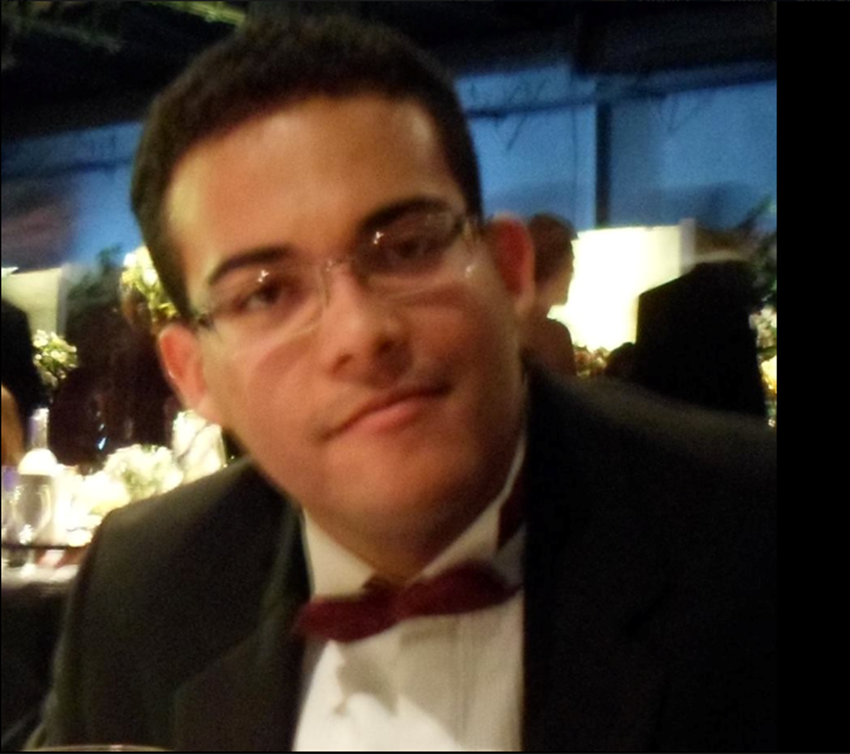
New Safety Committee Members
Samira Fatemi and Antonio Carlos Feritas dos Santos are new members of the LORRE Safety Committee. Their effort, dedication, and action towards lab safety is appreciated by everyone. Their participation will help LORRE function safely and efficiently.

Slide 3

Purpose and significance
Purdue University’s Integrated Safety Plan (ISP) is an important strategic goal and policy. Recertification occurs once a year . This requires everyone’s help to enhance security awareness and promote a culture of safety by integrating environmental health and safety into all operations .
REM via the LORRE safety committee: Help and monitor regulatory compliance
LORRE: Complete audit checklist for all areas, identifying and correcting deficiencies in a timely manner
REM will audit LORRE and offer safety recommendations
LORRE will improve the level and consistency of regulatory compliance
Purdue Vice President for Research will sign and renew the lab certification
Procedure

Slide 4

Division of labor and schedule
Complete the Integrated Safety Plan Self Audit Checklists by 6/22
Audit | Rm#
Wang, Xu | 231
Molina de Vasconcellos, Vanessa | 233/252
Modereger ,Brent | 235
Hsu,Cherie | 236
Ji, Guanya | 237/254/256
Hooker, Casey | 333
Dr. Kim, Daehwan | 335
Vozka, Petr | 359
Muskat, James Matthew | 336
Red Corn, Raymond | B38/138
Carie, Carla | LORRE office
Dr. Zhang, Ximing | LORRE storage

Slide 5

Division of labor and schedule Cont.
Mayors will lead each lab to correct the identified deficiencies before 6/30
Safety committee will prepare all requisite documents, and the PI will sign before 6/30
RM# | Mayor
B38/138 | Dr. Beheshti, Iman
231 | Kreger, Amanda
233/252 | dos Santos, Antonio Carlos
235 | Dr. Kim, Daehwan
236/336 (Office) | Fatemi, Samira
237 | Red Corn, Raymond
254/256 | Orrego Lopez, David
333 | Emma; Burchell
335( Specialized Labs)
359 | Zhang, Leyu
336 | Burchell, Julia

Slide 6

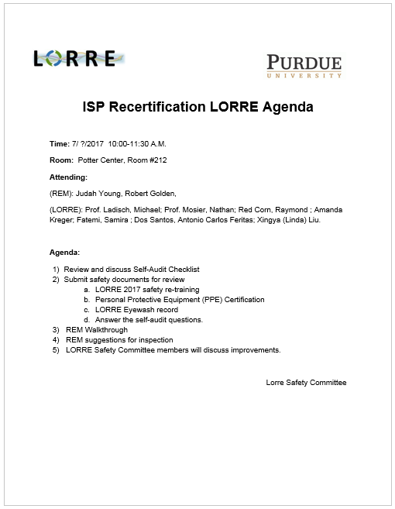
ISP Recertification Agenda
We will contact REM to schedule the annual safety rectification audit for early July. We will use their suggestions to improve our level of safety.
Also, we will have a Lab safety day (half day), where all LORRE people attend to organize and clean the labs.

Slide 7

Thanks for your help

Slide 8
Studie Explanation How to use the ISP self-Audit checklist.
REM Audit checklist: (Click the hyperlink below)
https://www.purdue.edu/ehps/rem/home/forms/ispcheck.pdf

