Slide 1
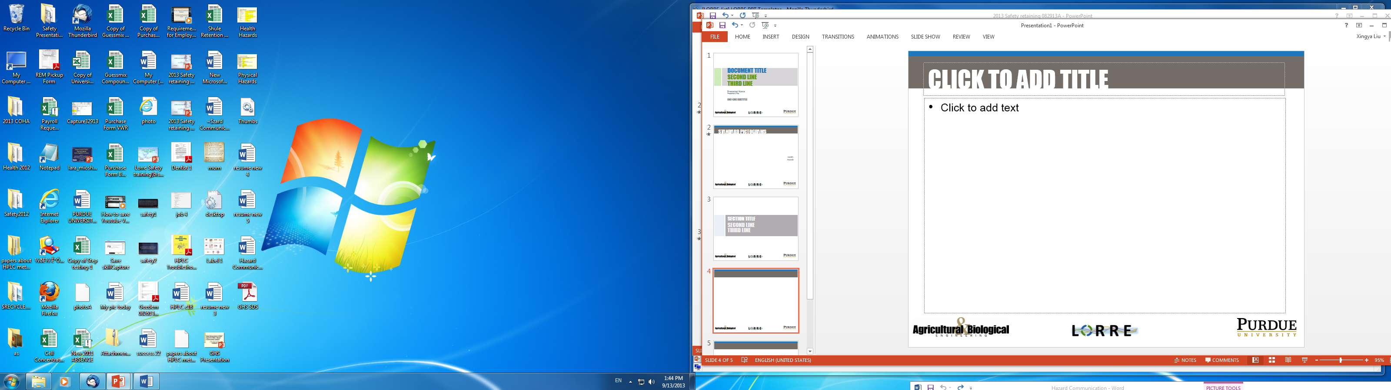
LORRE 2013 Safety Retraining
Sept. 19, 2013
LORRE Safety Committee

Slide 2
Topic Overview
Understand Globally Harmonized System (GHS) and Hazard Communication Standard (HCS)
  Specific changes in the revision:
    Labeling of chemicals
    Safety Data Sheets (SDS)
    Hazard classifications
    Effective timeline
Review lab safety protocol
    A Day in the Lab
    Mr. Safy & Mr. Risky
Perform Integrated Safety Plan (ISP) Safety Certification

Slide 3

NEW Hazard Communication Standard
The GHS of Classification and Labeling of Chemicals is commonly referred to as the “purple book”
HCS was established by The US Occupational Health and Safety Administration (OSHA) in 1983
The HCS was revised in 2012. Aligns US with GHS
Reduces confusion using standardization, has benefits in terms of protection and trade
Purdue will transition over next 3 years
Globally Harmonized System (GHS) Awareness Training
http://www.purdue.edu/rem/

Slide 4
OSHA Effective Timeline
Date | Action
12/1/2013 | All employees must be trained on new label elements and Safety Data Sheet format
6/1/2015 | Compliance with all modified provisions of the final rule except for shipping container labeling
12/1/2015 | Provide revised labels for all products shipped
6/1/2016 | Update all labels, implement Hazcom program, and provide training for newly identified hazards

Slide 5
Change to Safety Data Sheets
Rename Material Safety Data Sheets (MSDS)
to Safety Data Sheets (SDS)
now have a specified 16-section format
Section 1-11 will be of the most concern
Sections 12-15 must also contain , Although the headings for Sections 12-15 are mandatory, But OSHA will not enforce the content of these four sections because these sections are within other agencies' jurisdictions.

Slide 6
Safety Data Sheets (SDS)
New 16-section standardized SDS format required (ANSI Z400.1)
Section 1 – Identification
Section 2 – Hazard(s) identification
Section 3 – Composition / Information on Ingredients
Section 4 – First-aid Measures
Section 5 – Fire-fighting Measures
Section 6 – Accidental Release Measures
Section 7 – Handling and Storage
Section 8 – Exposure Controls / Personal Protection
Section 9 – Physical and Chemical Properties
Section 10 – Stability and Reactivity
Section 11 – Toxicological Information
Section 12 – Ecological Information
Section 13 – Disposal Consideration
Section 14 – Transport Information
Section 15 – Regulatory Information
Section 16 – Other information including date of preparation of last revision

Slide 7
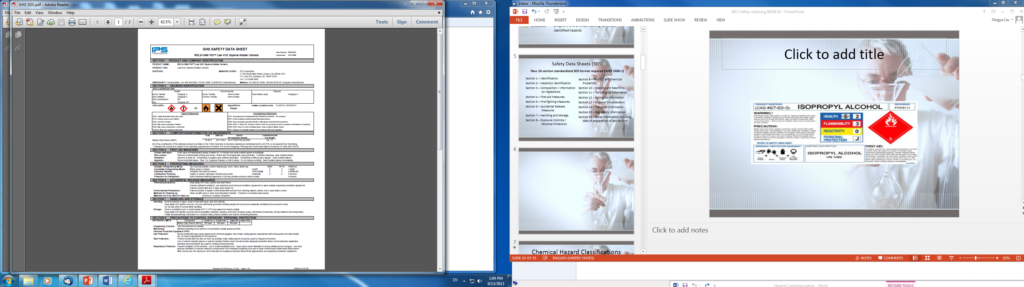
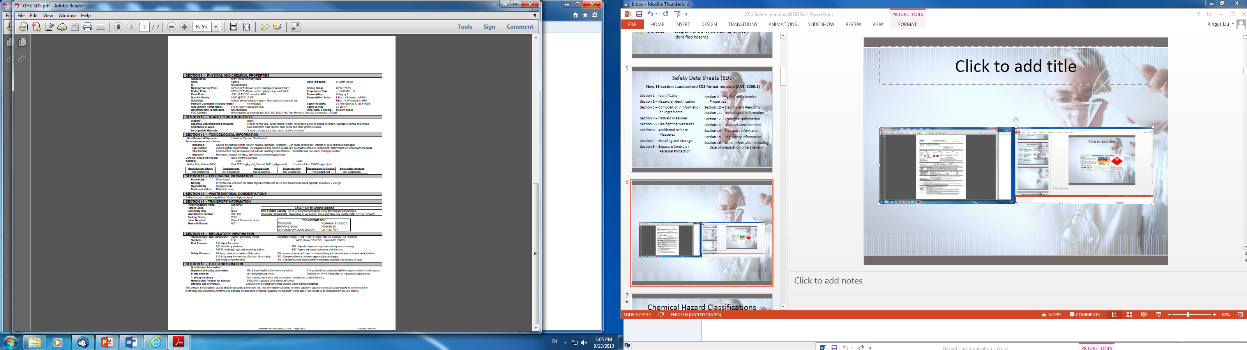
New SDS Sample

Slide 8
Chemical Hazard Classifications
Health Hazard Categories
Ex: Acute Toxicity
Environmental Hazard Categories
Ex: Aquatic Toxicity
Physical Hazard Categories
Ex: Flammable Aerosols
*New: in addition to physical and health hazards specifically concerning combustible dust, asphyxiates, and pyrophoric gas hazards

Slide 9
The GHS hazard ranking scale
Category 1 = severe hazard
Category 2 = serious
Category 3 = moderate
Category 4 = slight
Category 5 = minimal
Note: Different (opposite)
(NFPA/HMIS system )
4 = severe
3 = serious
2 = moderate
1 = slight
0 = minimal

Slide 10
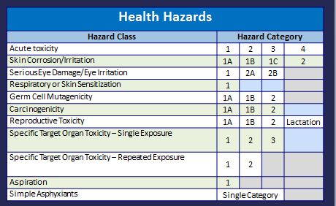
Health Hazard Categories
www.michigan.gov/miosha

Slide 11
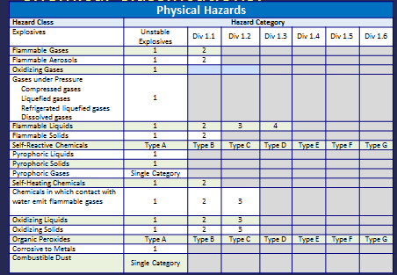
Physical Hazard Categories
www.michigan.gov/miosha

Slide 12
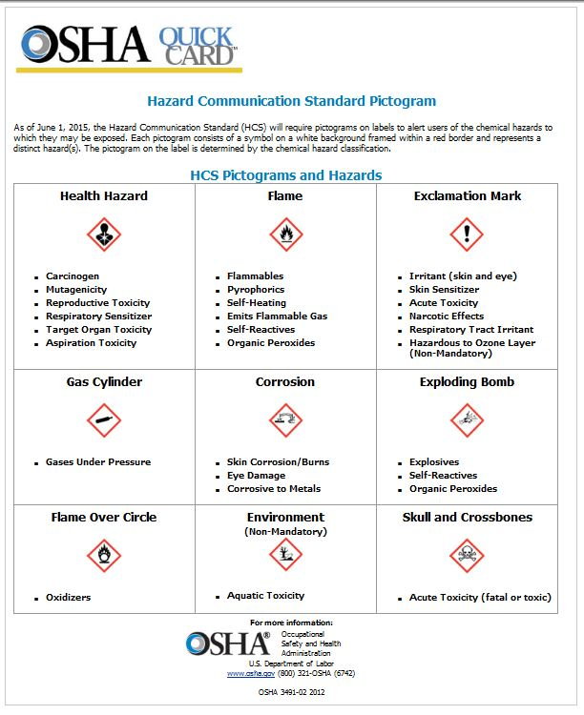
HCS Pictograms
9 Hazard Pictograms.
Each has:
  Red Border
  White background
  Black picture
Understand the pictograms and their corresponding chemical hazard
Radiological & Environmental Management (REM) will provide pictogram reference cards to post in work areas for future reference

Slide 13









Standard Hazard Pictograms and Corresponding Hazard Classes
Environmental Hazards
Physical Hazards
Health Hazards

Slide 14
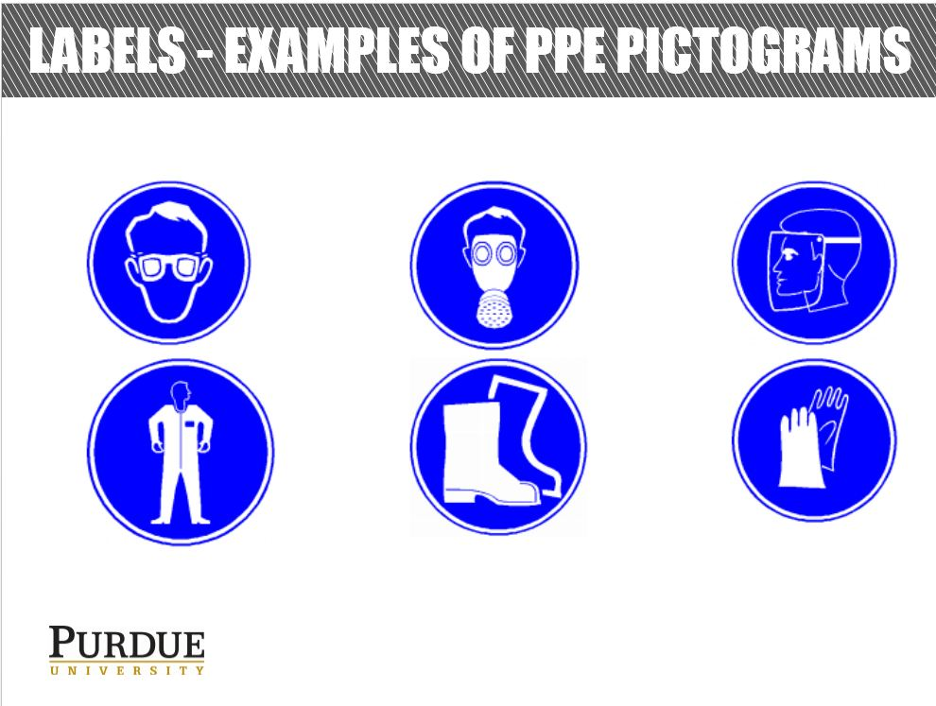

Slide 15
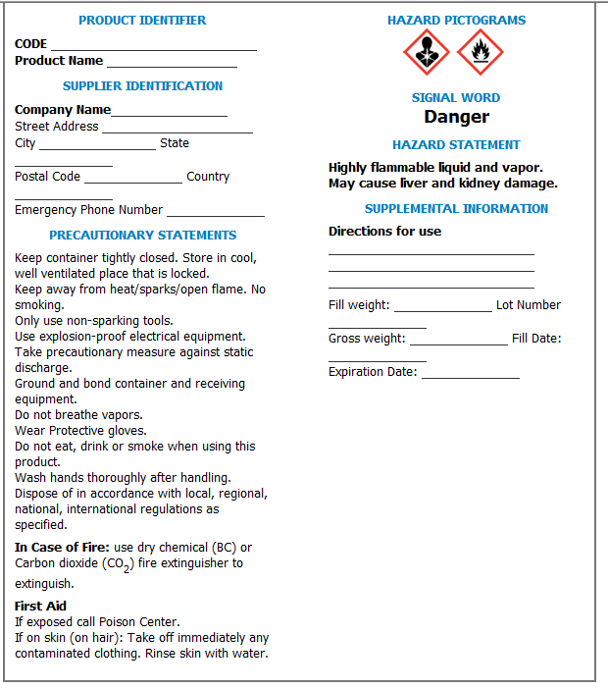
New Standard Label
Product Identifier
Supplier Identification
Precautionary Statements
Hazard Pictograms
Signal Word
Hazard Statement
Supplemental Information

Slide 16
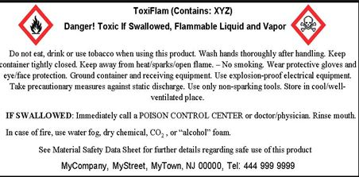
Safety Signal words
a signal word – either DANGER or WARNING where necessary
"Danger" is used for the more severe hazards, while "warning" is used for less severe hazards
If there is no significant hazard, a signal word won’t be used

Slide 17
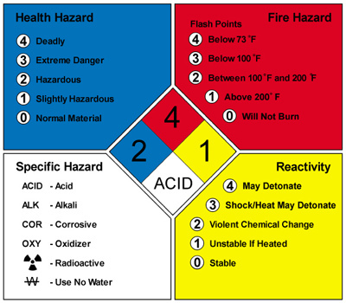
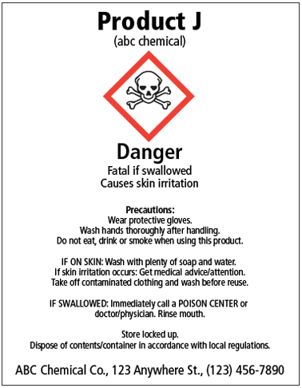
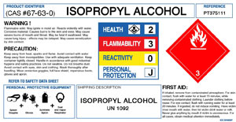
Example GHS Label

Slide 18
Review From 1st Video
Never underestimate the importance of Personal Protective Equipment
When used properly, chemical fume hoods are effective at protecting lab workers
Consult safety resources prior to beginning work
Proper training is critical to a well-run lab
Maintain good housekeeping practices
A safe and productive research lab starts at the top

Slide 19


Slide 20
Review From 2nd Video
This is a good demonstration (see Mr. Risky & Mr. Safy: Who is right? Who is wrong? )
How to collect information
  Check SDS
Working with cryogenics
Fume hood and protection against hazardous vapors
Store flammables in flame-proof cabinet.
Store : avoid chemical incompatibilities
Separate acids and bases.
Separate waste correctly to avoid hazardous reactions
Hazardous Situation Case Accidents

Slide 21
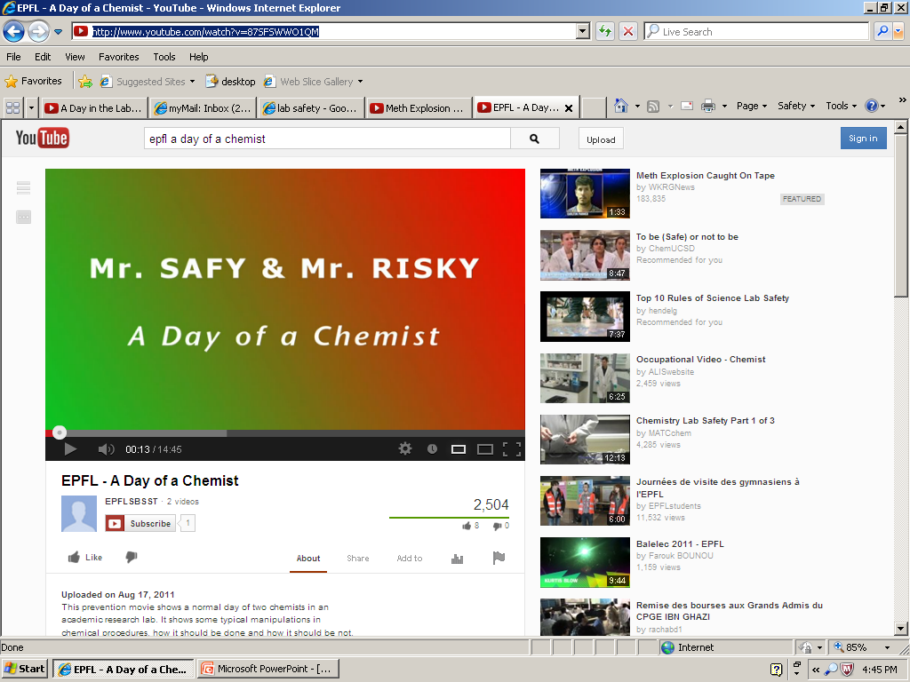

Slide 22
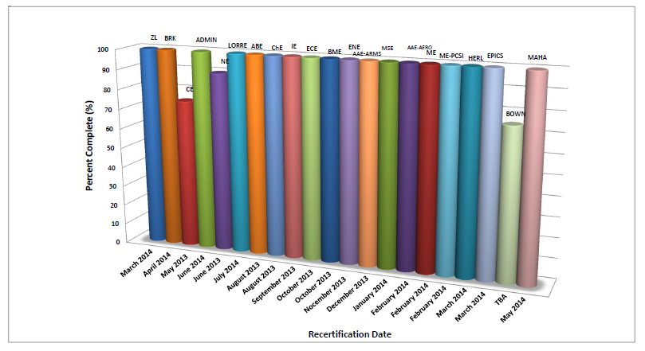
LORRE Recertification Tasks
Perform Safety Training
Regular safety committee meetings Complete self-audits for all areas
Means of communicating safety issues to the department in a timely manner
Upper administrative support for safety
Correct deficiencies
Improve LORRE’s daily safety practices
An annual safety program audit and walk-through by REM

Slide 23


New Safety Committee Members
Based on REM ISP inspection’s suggestion, added two graduate students in our committee.
Provide new perspective and strengthen effectiveness of LORRE Safety Committee
Barron Hewetson
Mahdieh Aghazadeh

Slide 24
LORRE Safety Committee Members
Name | Phone | Email
Michael Ladisch | 765-494-7022 | ladisch@purdue.edu
Nathan Mosier | 765-494-7025 | mosiem@purdue.ed
Rick Hendrickson | 765-494-7029 | hendr@purdue.edu
Tommy Kreke | 765-494-7031 | tkreke@purdue.edu
Barron Hewetson | 765-494-7031 | hewetson@purdue.edu
Mahdieh Aghazadeh | 765-494-0326 | maghazad@pudue.edu
Xingya (Linda) Liu | 765-494-7052 | Xingya@purdue.edu

Slide 25
Watch out for Lab safety
Great job in REM inspection!
We can have a building inspection at any time
Always wear PPE when working in the lab (Gloves, goggles, lab coat, closed-toe shoes)
All chemicals and liquids need to be labeled and covered
Must correctly dispose of old chemicals and lab waste materials
Used bacteria must be autoclaved immediately
Return all chemicals and clean the lab bench after finishing experiments

Slide 26
Thank You:
Eliott and Alisha for helping with the presentation
All of you for coming

