Slide 1
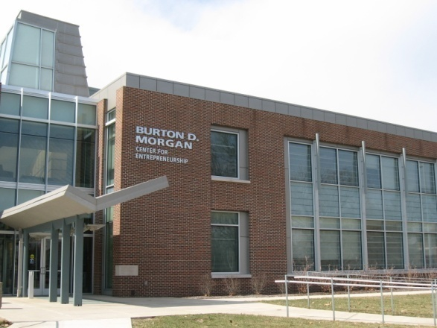
Technology Realization/
Commercialization/Entrepreneurship
ENTR 500 MGMT 590 TECH 581
Fall 2017
Mondays: 4:30 to 6:20 PM
Burton D. Morgan Center for Entrepreneurship
Course Description
Want to learn more about patents, licensing and building a
technology start-up company?
This seminar series is focused on pertinent issues related to technology, innovation and entrepreneurship. Students will be exposed to numerous topics through guest speakers, supplemented by readings and class discussion. While the term technology realization is used, technology is broadly interpreted to encompass a multidisciplinary perspective. During the first half of the course, speakers will focus on the commercialization process (intellectual property, licensing, corporate organizational structures, corporate product development, strategy, etc.). The second half of the course will address issues associated with raising capital (crowd funding, angel investors, venture capital, government funding) and building a technology start-up company.
Instructor
Tim Peoples, trpeoples@prf.org
Managing Director – Purdue Foundry

