Slide 1
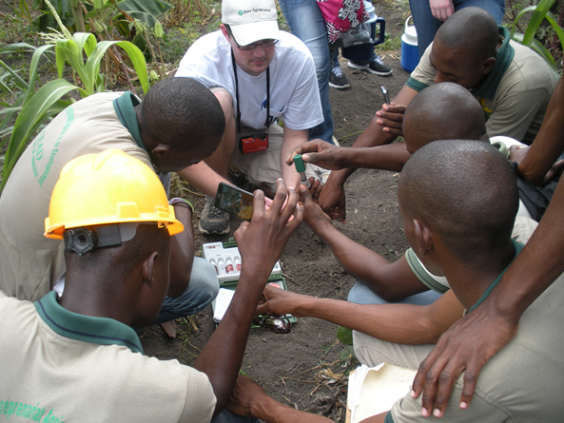
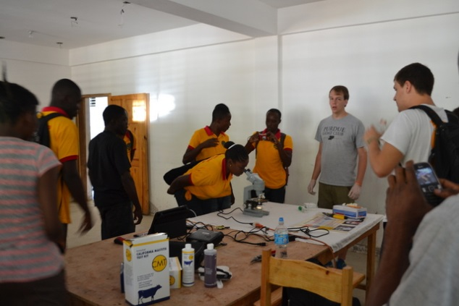
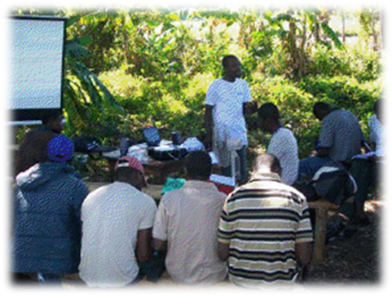
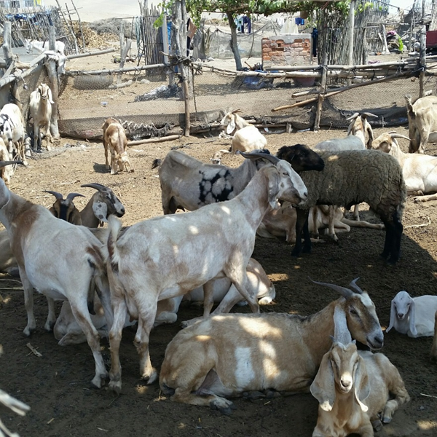
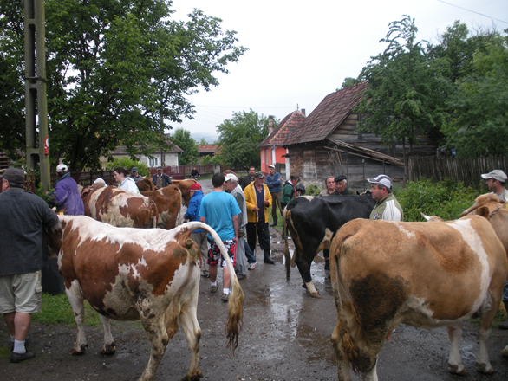
International Engagement and Development Strategies
18384 - AGR 59500 - 001; Spring, 2017; three credits
MON-WED-FRI, 1:30-2:20; REC 108
an overview of cross disciplinary, cultural, theoretical frameworks, communication tools, and assessment methods applied to international agricultural development and engagement.
This seminar/colloquium class focuses on applying technical disciplines of agriculture, food, and natural resources to global challenges in culturally appropriate strategies that lead to sustainable development.
An interdisciplinary team coordinated by Mark Russell, YDAE,
765-494-8423, mrussell@purdue.edu

