Slide 1



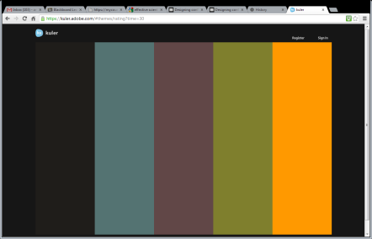



PROGRAM (GLOBAL DEVELOPMENT TEAMS/EPICS/SENIOR DESIGN/ETC.)
REGION/COUNTRY
PROJECT TITLE, 72 pt or larger
Students names, affiliations | Students names, affiliations | Students names, affiliations
Advisors names, affiliations
BACKGROUND, 48 pt or larger
Why is this project important? Who does it impact? How did this project come about? When did the project start? What is the motivation? Mention key statistics, such as the number of people or places this work could impact (or provide an info-graphic to illustrate them), and include references. Place your reference citations in the reference section below.
Keep body text brief and concise. 28 pt or larger font.
2009
A list of 4 to 8 notable accomplishments with short descriptions and dates (applies primarily to projects more than one year old), .
Make it your own!
This is a template. Move things around. Get creative with graphics. Consider the fields provided as a guide to what you should include, but don’t feel too constrained by it.
Include a title, or an explanation of what’s relevant about the figure. Reference any data sources.
2010
e.g., first visit to community, built a prototype, hosted a workshop. May include expected future events.
.
Graphics
Two to four high-resolution photos – Preferably of the “project in action”. Include photo reference information such as the photographer, date, and place taken. If you are not using original photographs, please provide a reference/link to the original work.
Three figures and/or info-graphics – e.g. renderings, schematics, graphs. If you are not using original figures or graphics, please provide a reference to the original work.
OBJECTIVES (or AIM)
Provide in list or bullet form
Provide in list or bullet form
Provide in list or bullet form
Colors
Why use the same old MS color palates? Find creative palates to match the spirit of your work here: https://kuler.adobe.com
Once you find one you like, in PowerPoint you can go to the Design tab, choose Colors, select Create New Theme Colors, and manually match the colors from your selected palate.
NOTE: Colored backgrounds do not print well and use a lot of ink. Accent with color, but don’t drown your poster in it.
2011
Etc. etc.
Include a title, or an explanation of what’s relevant about the figure. Reference any data sources.
Poster dimensions
This template is 30-in wide by 40-in tall.
You may use a portrait or landscape poster, but its dimensions must not exceed 48” by 36”.
To change the dimensions of this poster, go to Design, Customize, Slide Size, Custom Slide Size, and enter the dimensions you prefer.
Source: Who took the photo, when?
Source: Who took the photo, when?
METHODOLOGY
Describe how you are going about addressing the challenge. Avoid technical jargon. Describe your approach in a way a non-technical person could follow. Consider using bullets, numbers, or describing step by step.
CURRENT FOCUS / FUTURE WORK
Describe what the team is currently working on, why that’s important, and how it contributes to the objectives/aim.
Describe tasks you hope to undertake in the future, and where you hope to see the project in a few years.
Great resources for inspiration!
A blog about designing research posters: http://colinpurrington.com/tips/academic/posterdesign
Flickr group “Pimp My Poster”: http://www.flickr.com/groups/pimpmyposter/
PROJECT IMPACT
Describe the ultimate expected impact of the project. Include quantifiable amounts, e.g., numbers of people impacted, number of kW generated, gallons of water produced.
PARTNER
Partner(s) information
Name of organization
Description of the organization’s mission
Logo of the organization, as possible
REFERENCES
[1] Use any citation style
[2] Chicago, MLA, APA, etc.
[3] Just be consistent

