Slide 1
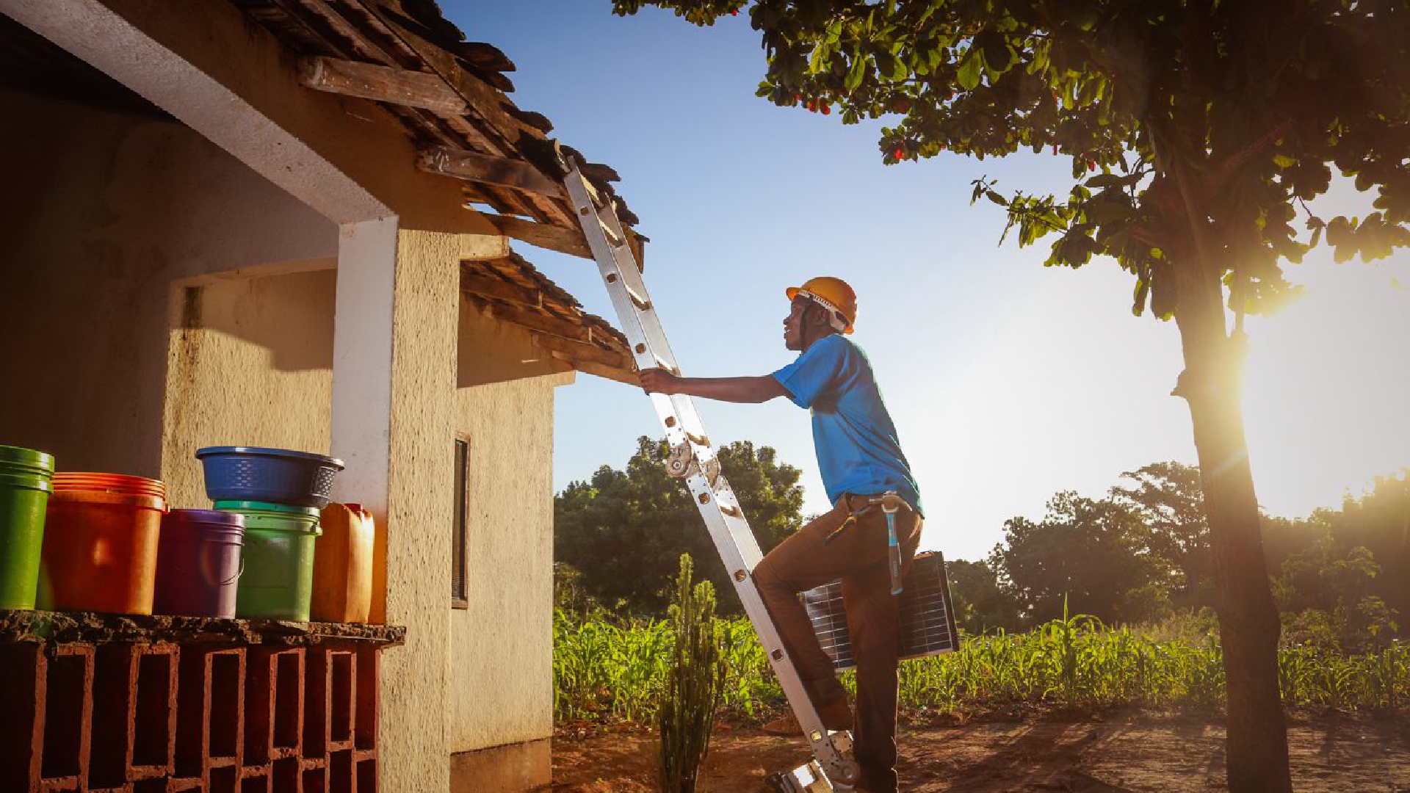


DEVELOPMENT INNOVATION VENTURES
February 2022
TURNING BRIGHT IDEAS INTO GLOBAL SOLUTIONS

Slide 2

Agenda
1
2
Introduction to DIV
Transformative Innovations
3
Application and Award Process

Slide 3
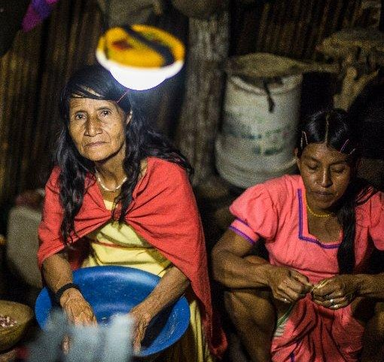
Development Innovation Ventures
USAID's evidence-tiered open innovation program that
invests in breakthrough solutions to some of the world's toughest development challenges

Slide 4
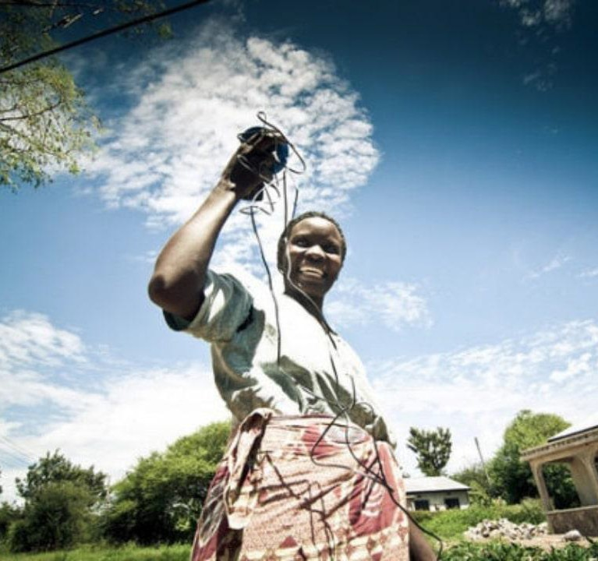
What We Do
DIV combines best practices from venture capital and academia, using rigorous evidence to inform investments that scale the most impactful, cost-effective solutions.

Slide 5
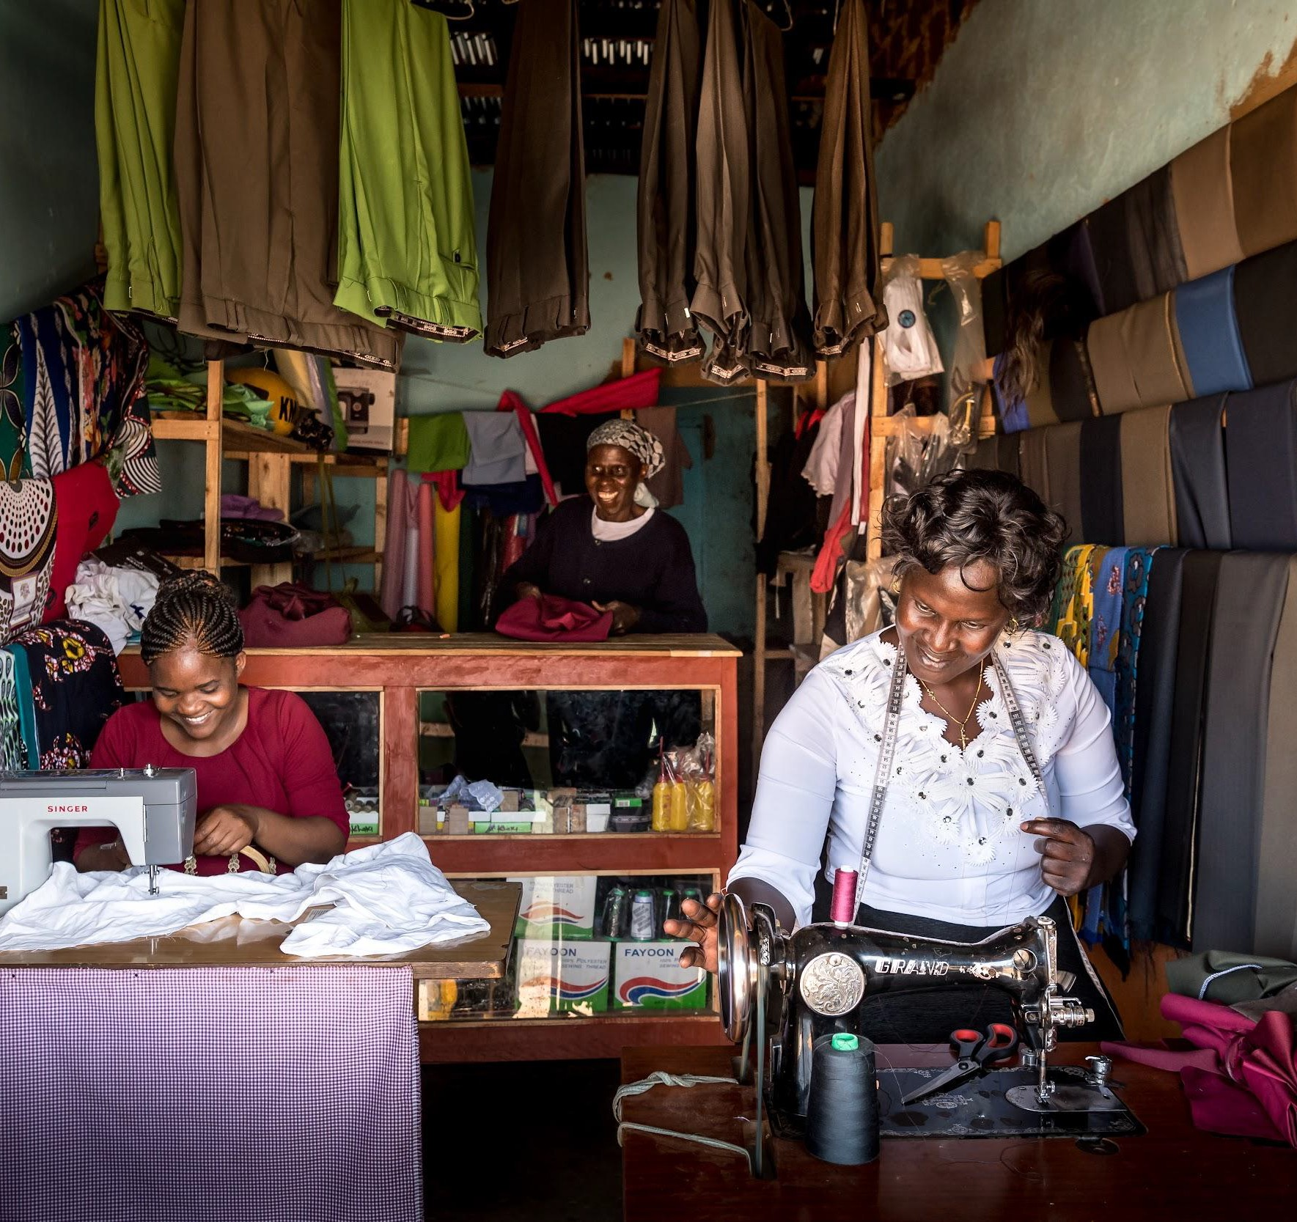
Innovation
A creative solution to any global development problem
New products, services and technologies
New business and delivery models
New applications, replications, and adaptations of proven models
Policy innovations
Behavioral science interventions

Slide 6
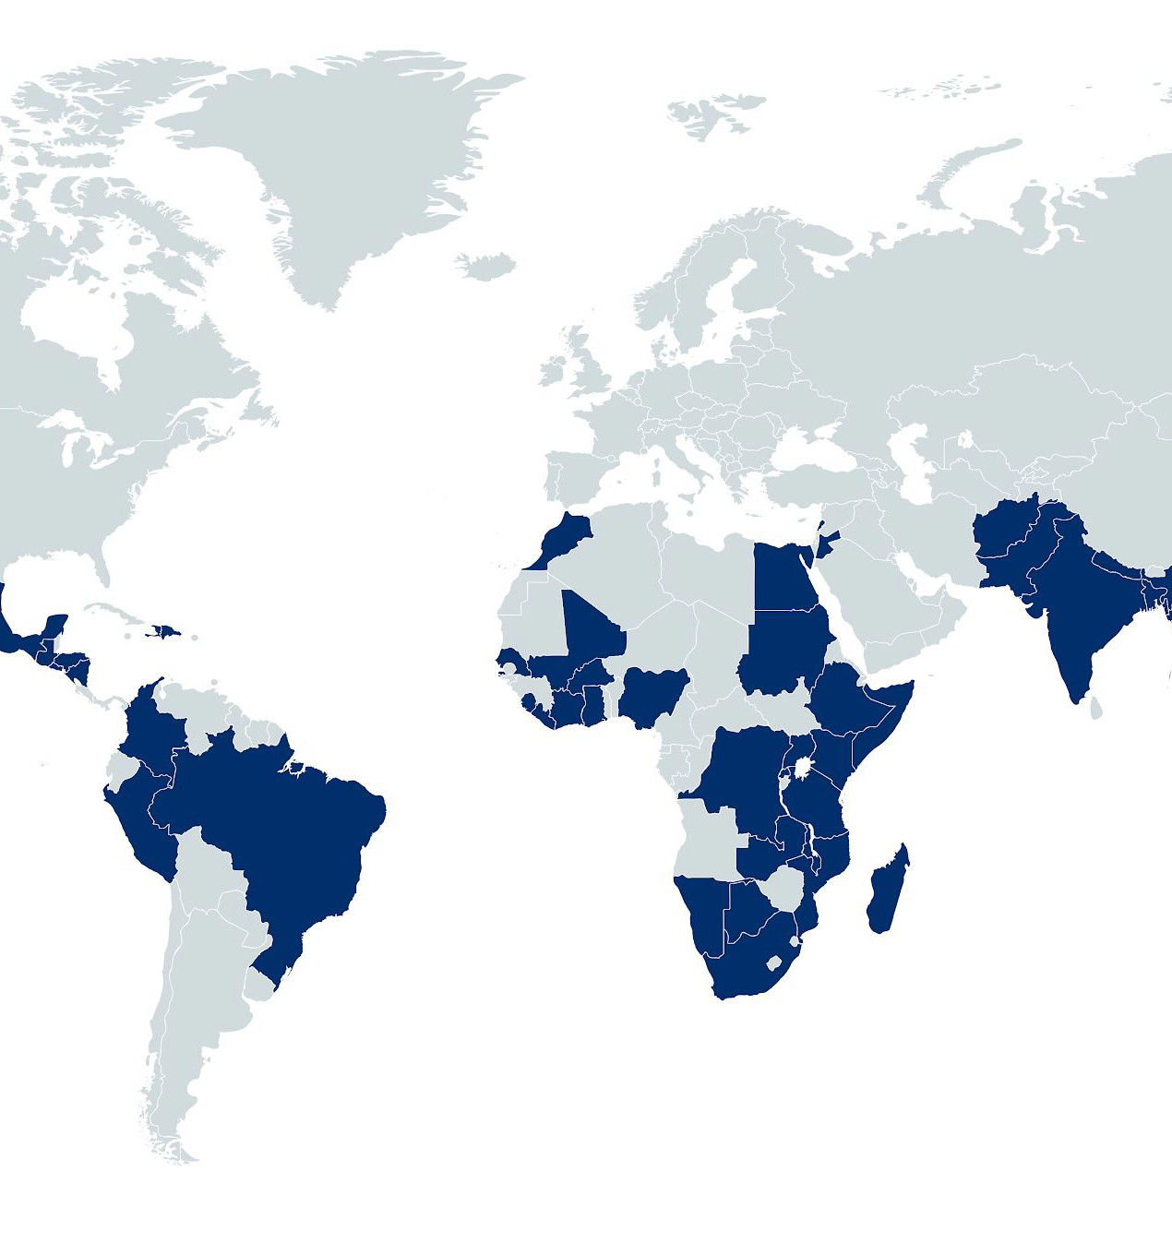
Funding ideas from anyone, anywhere
DIV accepts applications year-round for innovations in every sector and country where USAID operates, from social entrepreneurs, nonprofit organizations, researchers, and private sector companies

Slide 7


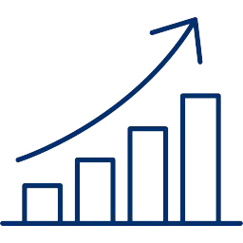

Tiered Funding
Stage 1
Pilot
Stage 2
Test and Position for Scale
Stage 3
Transition to Scale
Up to
$200,000
Up to
$1.5 million
Up to
$15 million
Evidence Grants (up to $1.5 million) support research to generate rigorous evidence of impact and cost-effectiveness

Slide 8



DIV Principles
Rigorous Evidence
We value rigorous evaluation of social impact to assess what is working - and
what is not
Cost-Effectiveness
We invest in solutions that deliver more impact per dollar than other interventions
Potential for Scale
We support solutions that can scale sustainability through the private and/or public sectors

Slide 9







DIV by the Numbers
252
Awards
47 Countries
50% of innovators are new USAID
partners
99 million direct beneficiaries*
$17 social benefit for every $1 spent*
12,000+
applications received
$172 million invested in innovative solutions
*Analysis of DIV’s early portfolio from: Kremer, Michael, Sasha Gallant, Olga Rostapshova and Milan Thomas, 2021. Is Development Economics a Good Investment? Evidence on scaling rate and social returns from USAID’s innovation fund.”

Slide 10
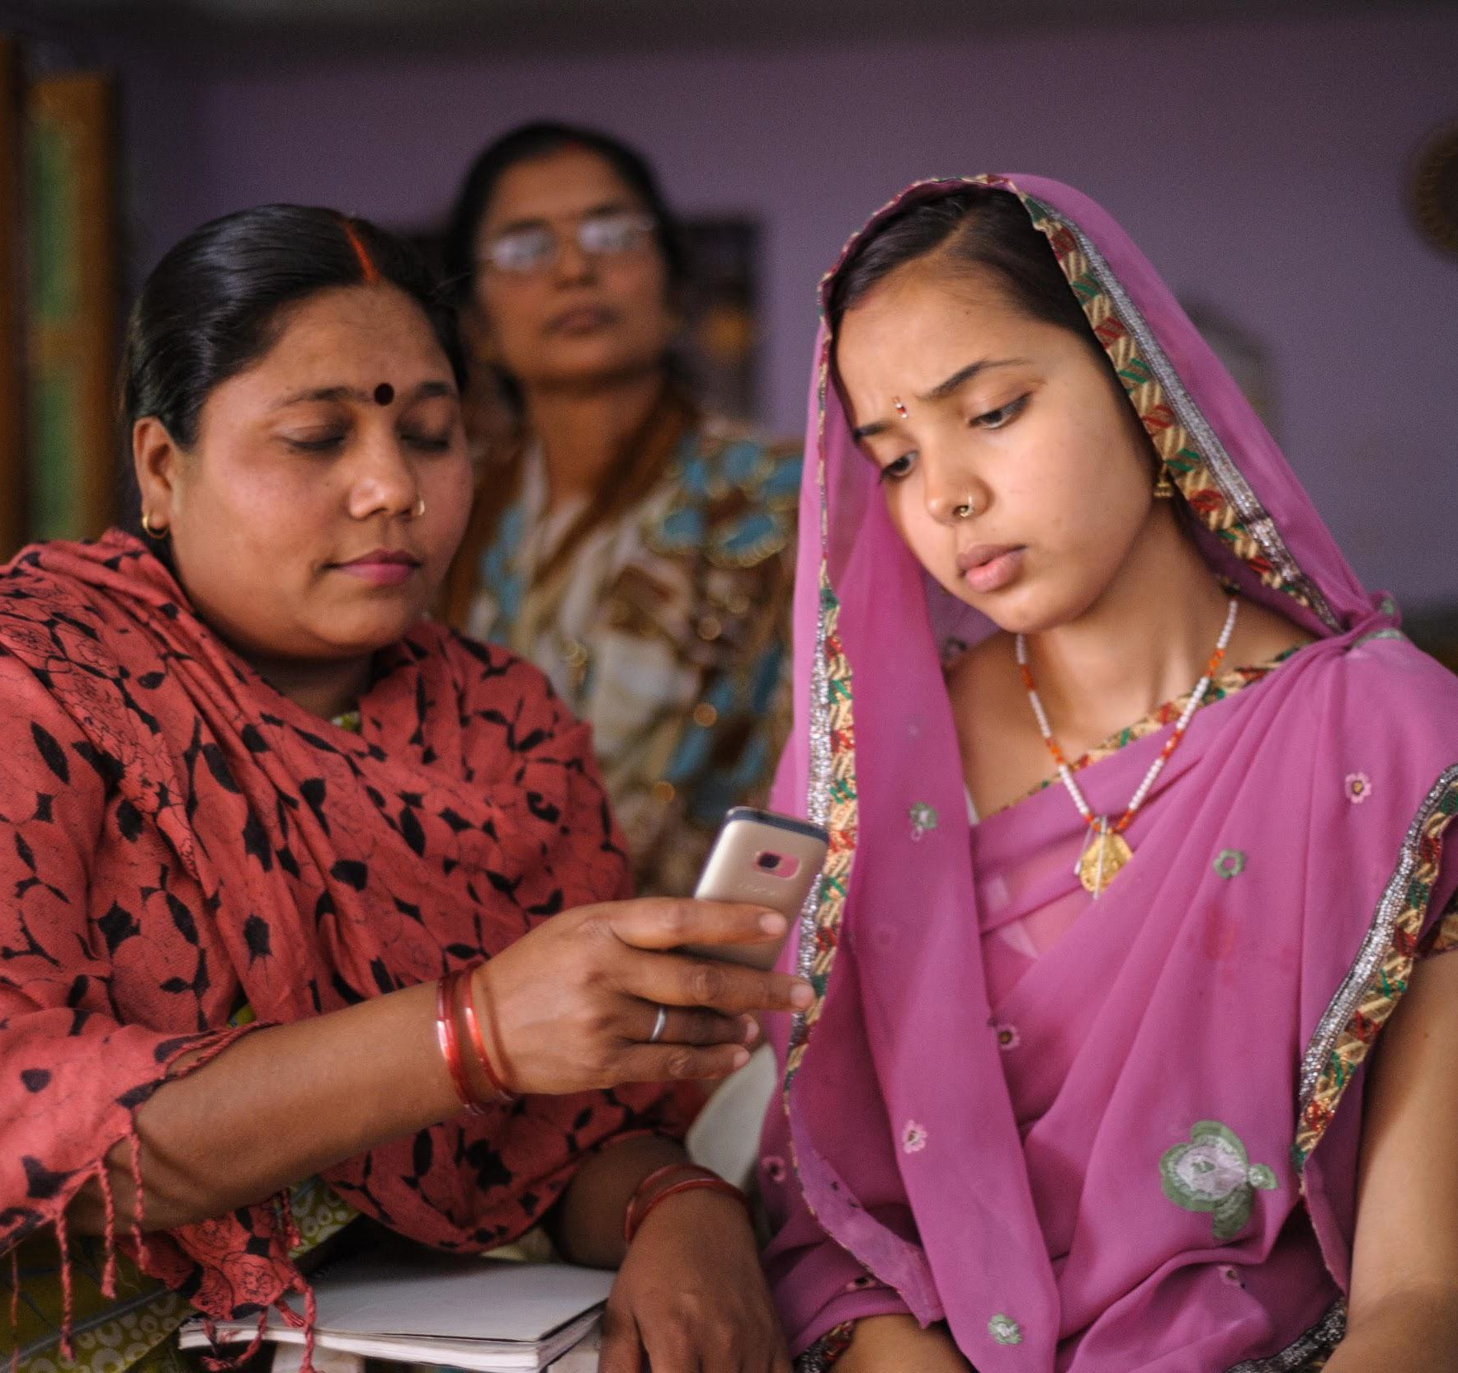
Dimagi CommCare
India: Stage 1 (2010); Stage 2 (2012, 2020)
Problem: Frontline worker care for 1,000+ people with just pen and paper records
Solution: Dimagi created CommCare, an open source mobile data collection and service delivery platform
Impact: Reached 100 million households in India and used by frontline workers in 130 countries across sectors. 60+ peer-reviewed studies demonstrate impact on improving people’s lives, from reducing maternal mortality to improving nutrition

Slide 11
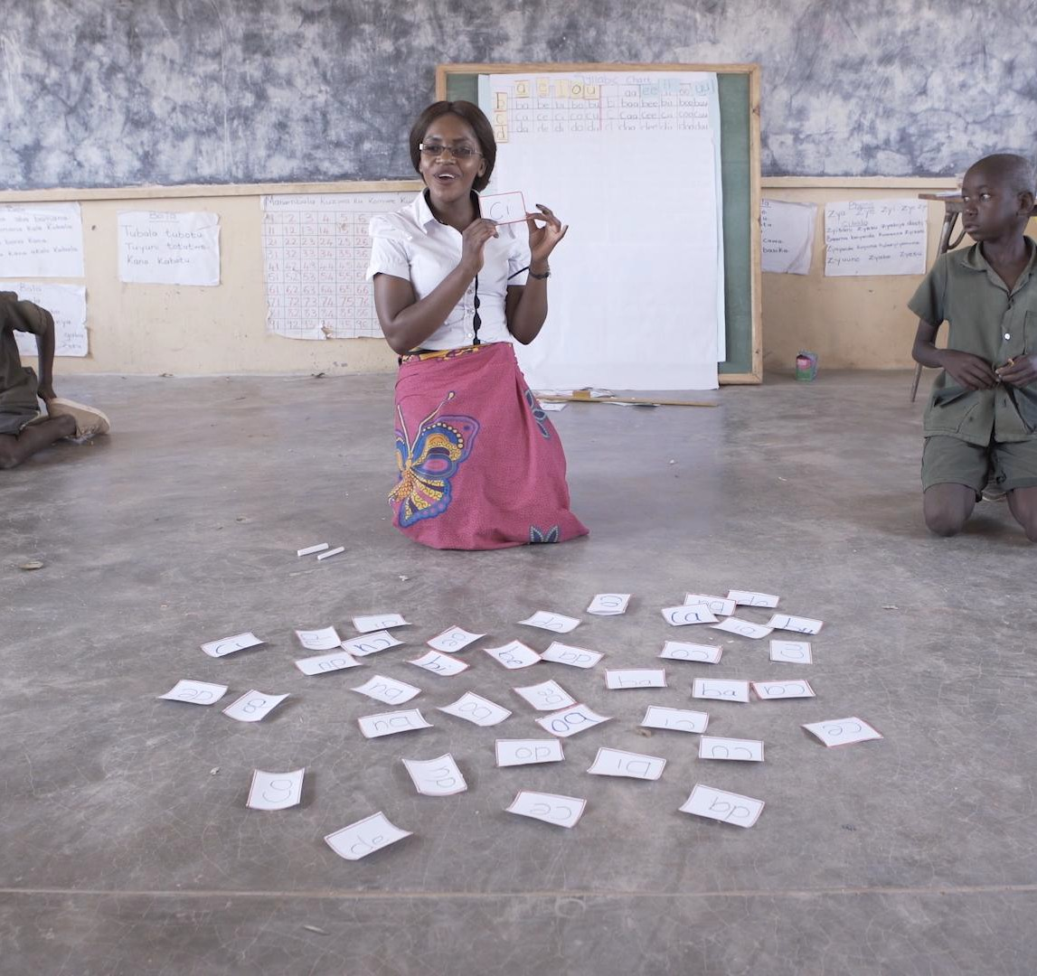
Teaching at the Right Level
India: Stage 1 (2013), Zambia: Stage 2 (2017),
Botswana: Stage 3 (2020)
Problem: Millions of primary school students do not read at grade level
Solution: Group students by skill level instead of age or grade, and tailor lessons and assessments to learning level to help students catch up
Impact: 50 million students and teachers reached, with rigorous evaluations in multiple countries should increased education levels and cost-effectiveness. DIV’s support helped catalyze $25M more from other funders to expand the TaRL model to 12 African countries.

Slide 12
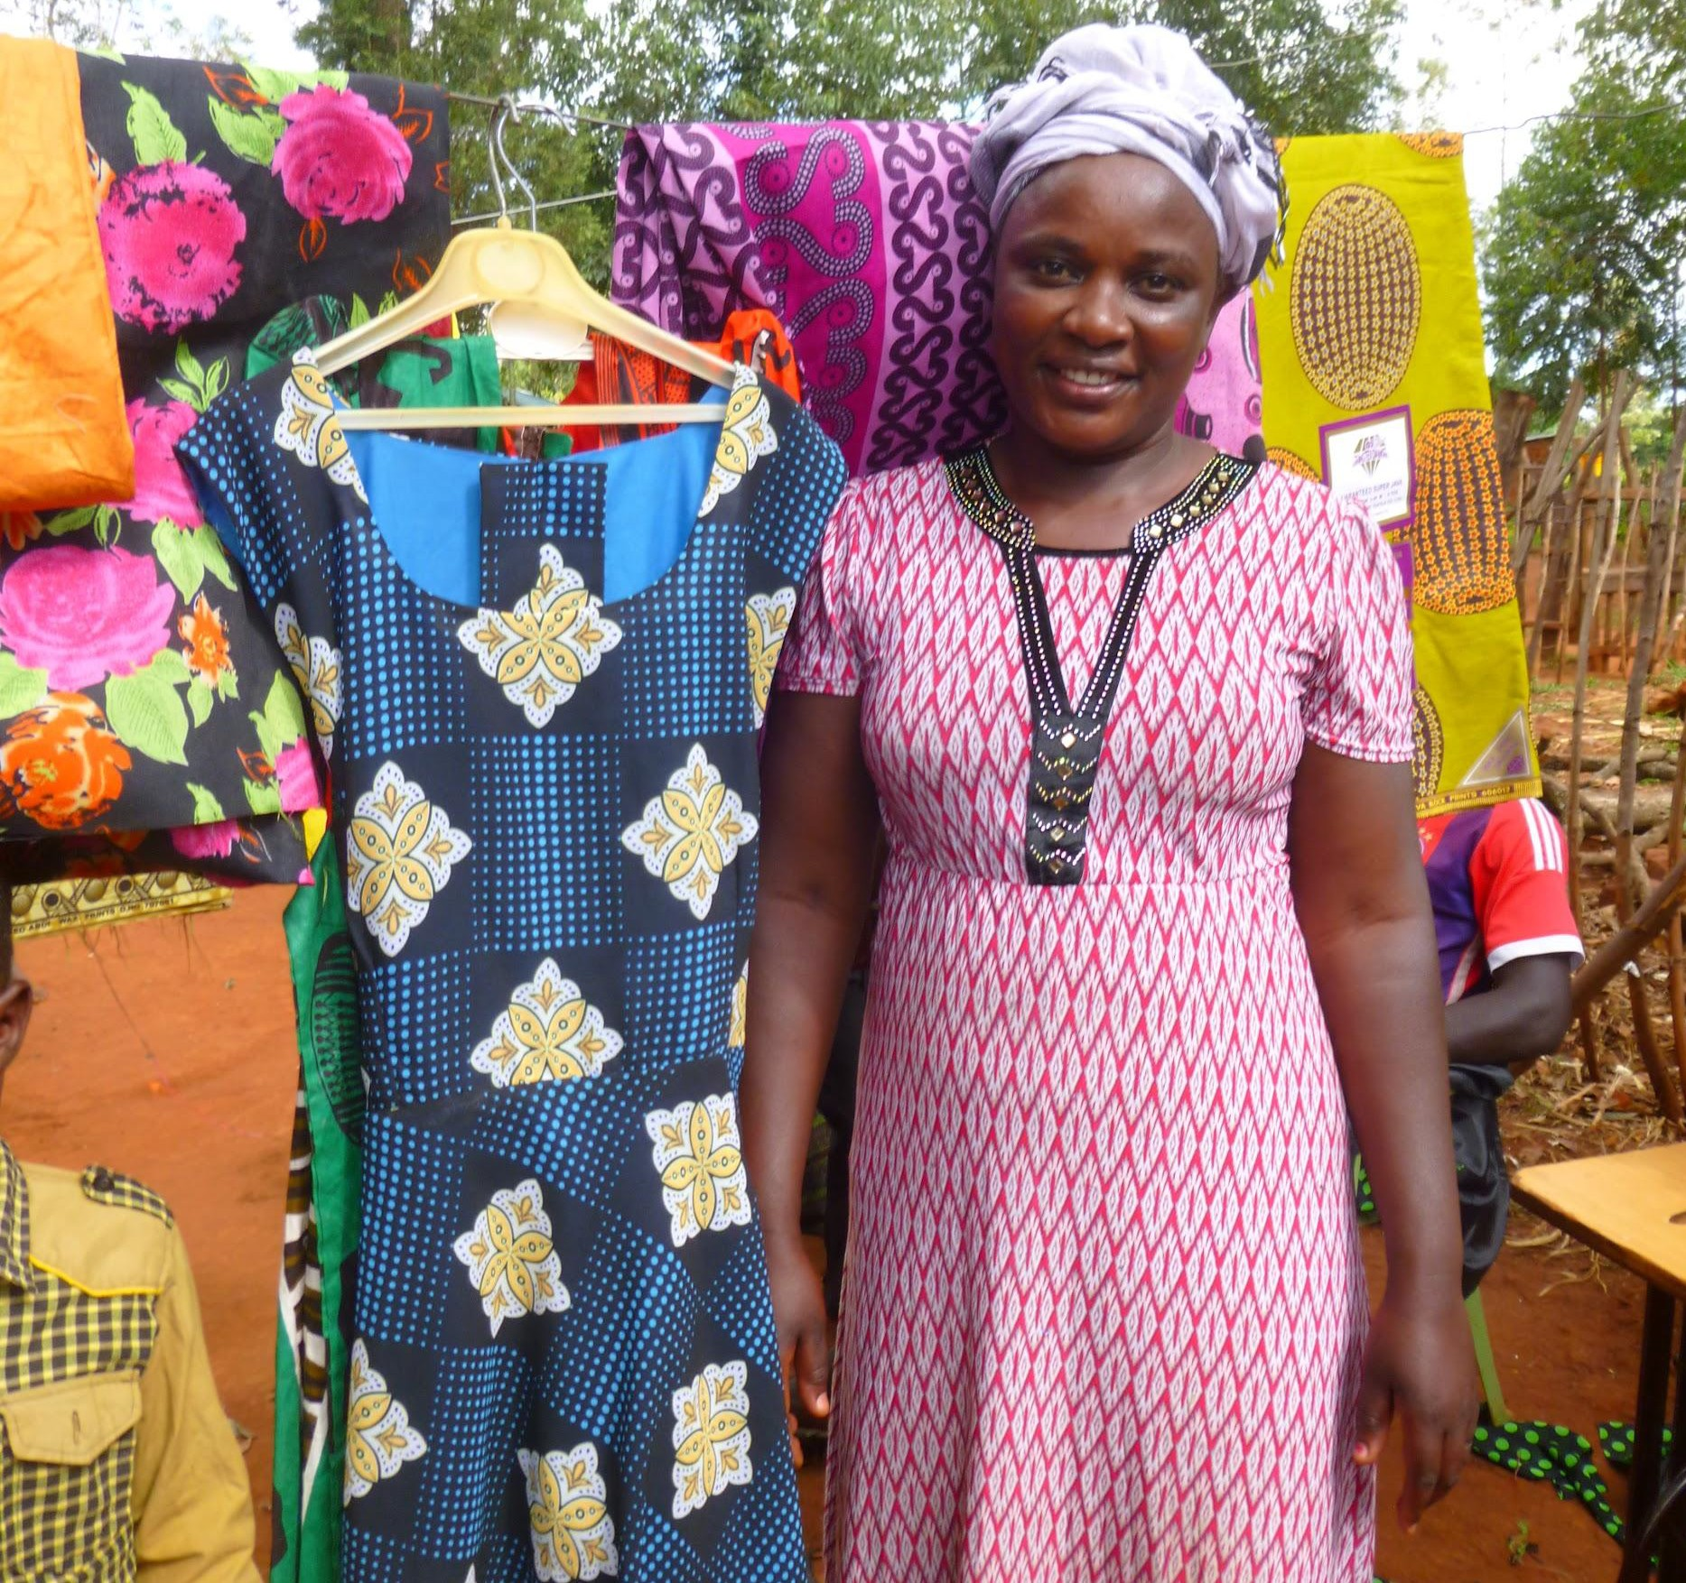
Testing Ground for Development Innovation
Rigorous Evaluation tests early-stage innovations to reduce risk and prepare for uptake at scale and develops critical evidence needed to support large investments. 40% of DIV awards include randomized controlled trials (RCTs)
Outcomes-based Funding:
Pioneers in the use of milestone-based awards
Outcomes funder on USAID’s first development impact bond
Launched USAID’s first cash benchmarking experiments
Testing other results-based mechanisms

Slide 13

Application Process
Read Annual Program Statement (APS) at www.usaid.gov/div
Complete self-screening questionnaire
Fill out draft of sample application offline in English
Visit the DIV Portal to submit application https://divportal.usaid.gov/s/
Respond to any requests for additional information

Slide 14

Application Timeline
Application Submission (rolling)
Due Diligence (2-5 months)
Eligibility Assessment (1-2 months)
Award Negotiation
(2-5 months)
Applicants will be informed as quickly as possible if their applications do not meet DIV’s quality standards at any phase of the review process.

Slide 15






What DIV Provides to Innovators
Flexible, patient grant funding
An open door to USAID
Connections to partners and funders
Venture assistance
USAID network
Dedicated grant manager
15

Slide 16
“Over the last decade, DIV’s sustained focus on innovation, rigorous evidence, and value for money has led to tangible results for millions of people around the world....
We look forward to seeing even greater impacts from DIV’s investments over the next 10 years.”
— 2019 Nobel Laureate and DIV Co-Founder and Scientific Director Dr. Michael Kremer

Slide 17
Thank You!
Learn More:
About DIV: www.usaid.gov/DIV
About grantees in DIV’s investment portfolio: divportal.usaid.gov
Follow DIV: #DIVUSAID

