Slide 1


Engineering Education Summer Research Experience in Kenya
Information Session
October 18, 2023

Slide 2

Overview
6-week international research experience in Eldoret, Kenya
June 3-July 19, 2024
Partnership between Purdue University and San Francisco State University
All expenses paid (travel, housing, food, activities) and includes a weekly stipend
Focused on community-engaged engineering and the design of localized engineering education curricula
Features professional development activities, hands-on projects, the opportunity to work in teams, and local mentorship

Slide 3


Slide 4
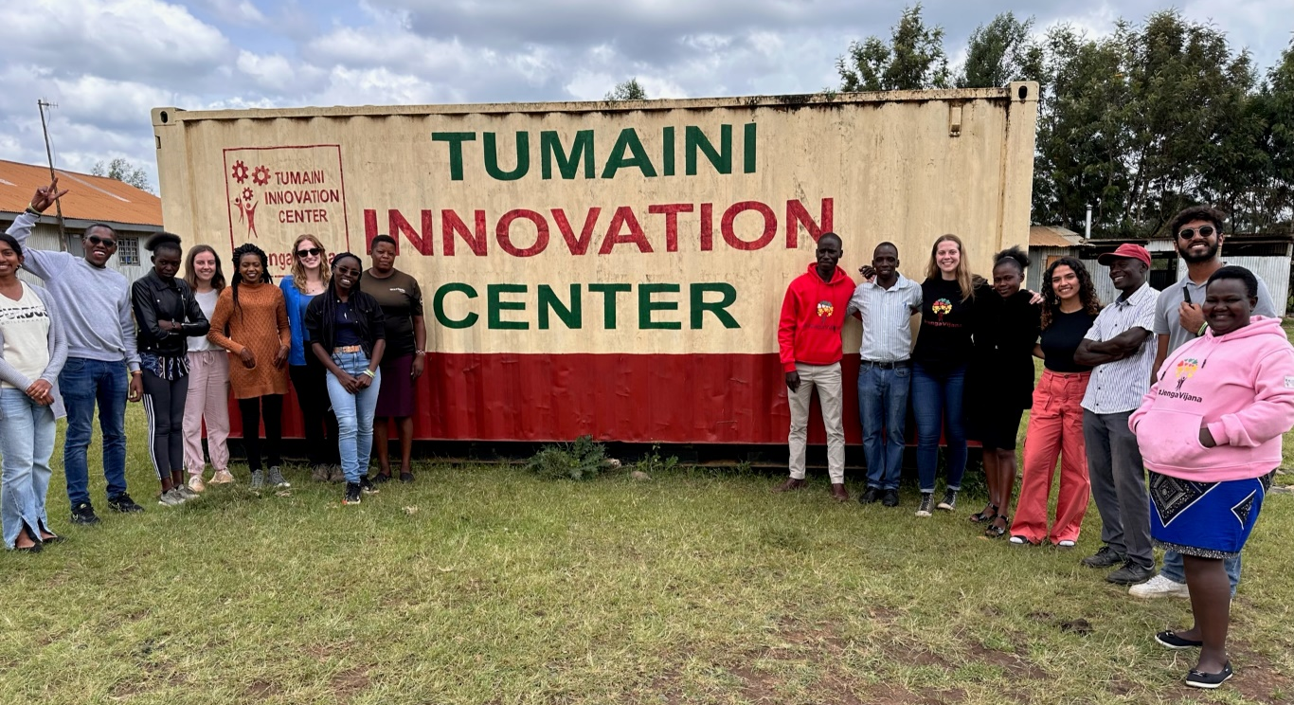
Our community partners
Tumaini Innovation Center
Moi University
AMPATH

Slide 5
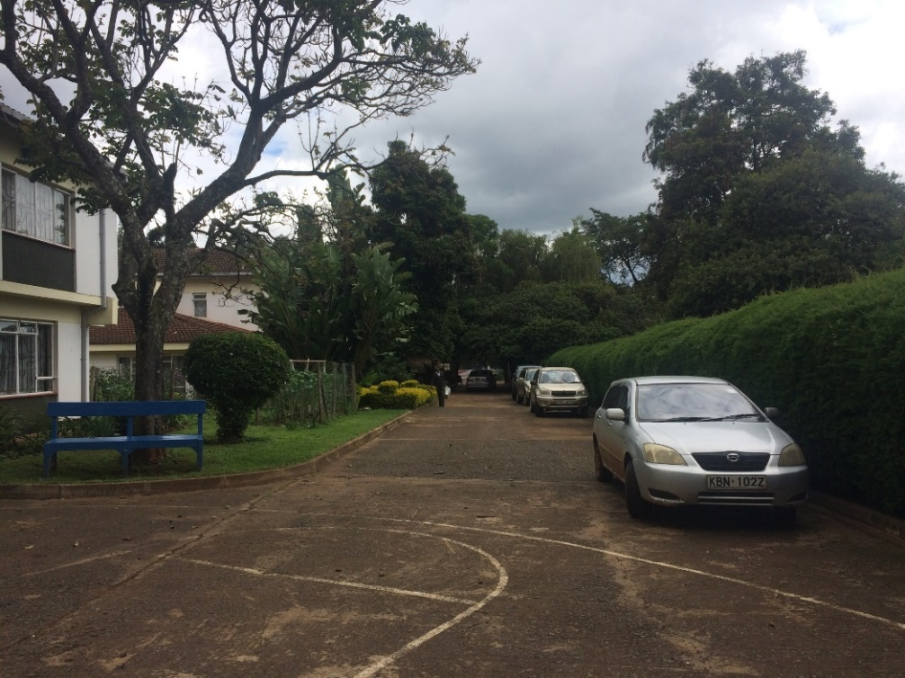
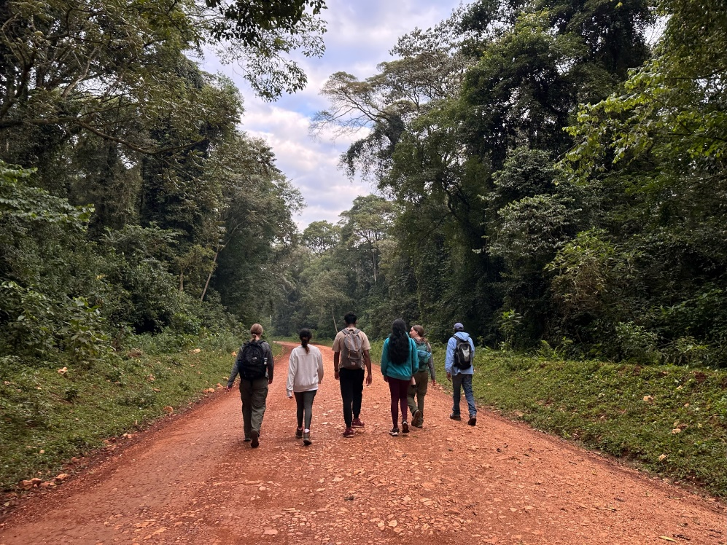
Logistics
Housing and meals provided at AMPATH’s IU House
Weekends available for day trips/travel

Slide 6
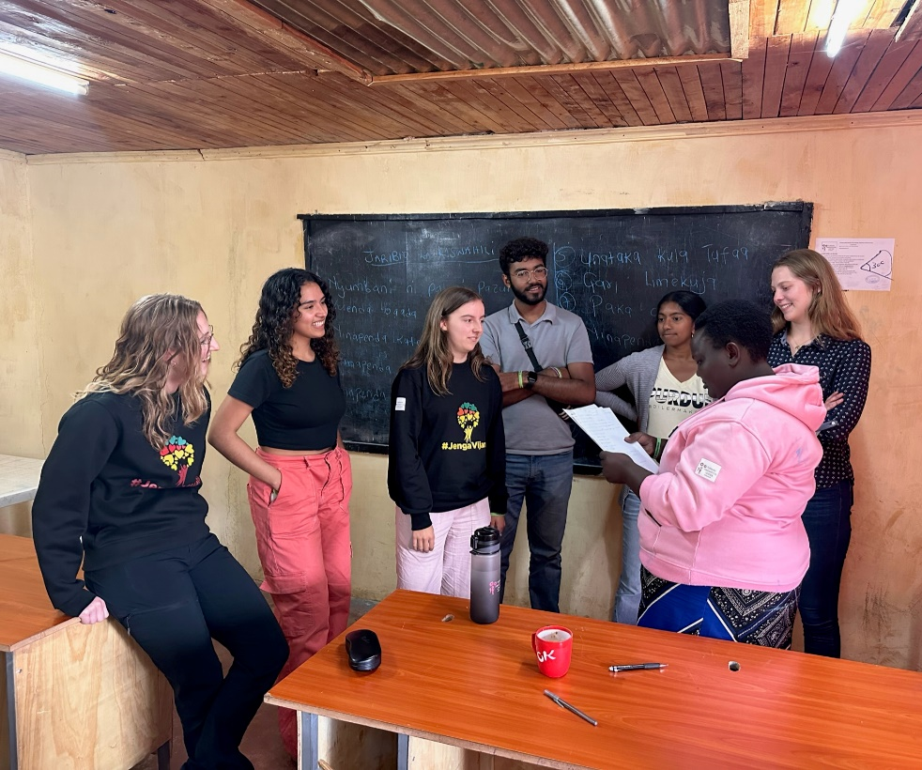
Requirements
Current undergraduate or graduate student at time of application (or accepted to a graduate program at time of application)
  Any discipline of study/major
U.S. citizen, U.S. national, or permanent resident of the United States
Have a valid passport or be able to acquire one by April 2024, valid through January 2025
Commit to weekly, virtual pre-trip training sessions and periodic logistics meetings January - May

Slide 7
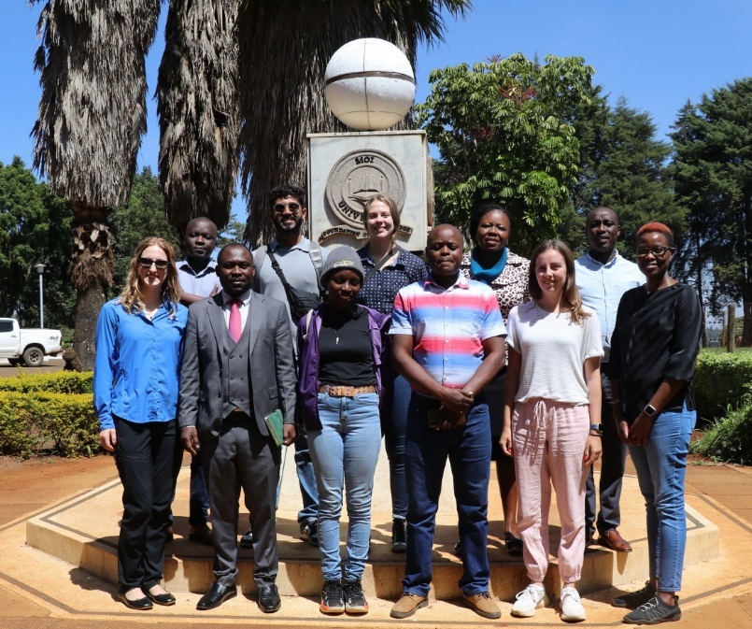

Strong applicants…
Demonstrate an interest in conducting rigorous research
  Examples: through prior experience or a detailed description in your application about why you are interested in research
Have cross-cultural competency
  Examples: through prior experience traveling or living outside of the United States, interactions with family members/friends from other cultures or countries, speaking/studying a second language, global-themed coursework, or international activities on campus
Are flexible, eager to learn from community partners, adaptable, motivated, and self-driven

Slide 8
Application: https://etap.nsf.gov/award/625/opportunity/5052
Create a profile at www.nsfetap.org
  Includes lots of information about you
Requires three short essay questions (300-500 words) and CV/resume
  Make sure you address the essay questions
  Should be well-written and with few grammar mistakes
Due November 3 November 10
No transcript or letters of recommendation required
Selection not based on GPA
No prerequisite courses

Slide 9
Before you apply!
Think about your interests and goals – does this program fit well for you?
  This can help you draft your application essays
Think about your other time commitments and responsibilities
  Will you be able to commit to the program dates?
Talk to your parents/guardians/people in your life
  Make sure that important people in your life are on board with your plan to apply to this program
  Don’t wait to have these conversations until after you go through the application process

Slide 10
Application Office Hours
Office Hours 1 – Thursday, October 26
7:30 PM ET / 4:30 PM PT
  https://purdue-edu.zoom.us/join
  Meeting ID: 765 496 0195
  Passcode: 492633
Office Hours 2 – Monday, October 30
8:00 PM ET / 5 PM PT
  https://sfsu.zoom.us/join
  Meeting ID: 779 225 1232
  Passcode: 066057

Slide 11
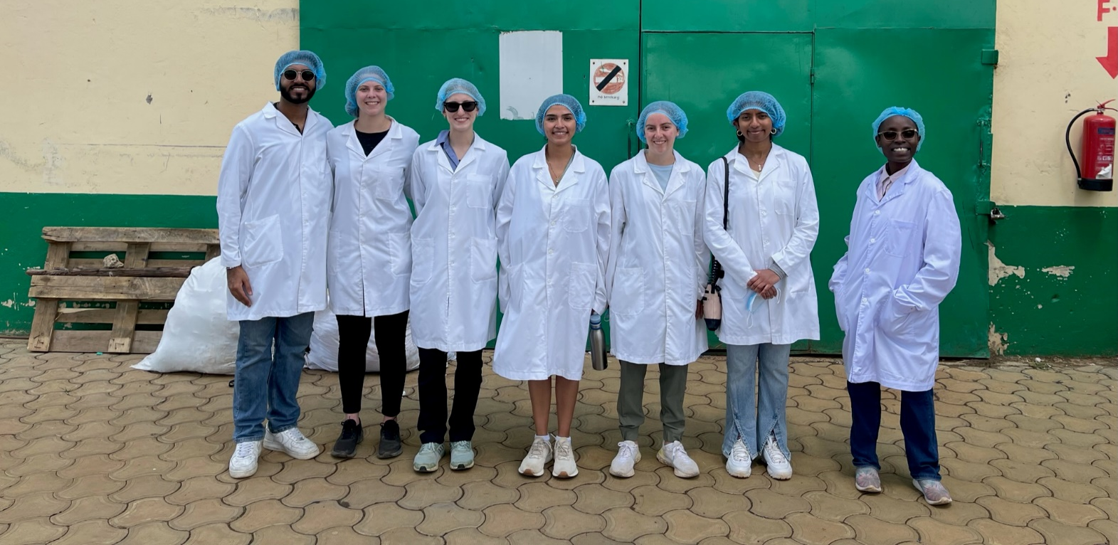
Questions?
Application:
https://etap.nsf.gov/award/625/opportunity/5052
Email: sclaussen@sfsu.edu / deboerj@purdue.edu

