Slide 1
Anaerobic Digestion
A primer
focused on failure
Raymond Red Corn
Masters Student in Agricultural and Biological Engineering
EWB-Purdue Design Team

Slide 2
Failure; even on U.S.A. Farms
Digester Type | % Inoperable
Complete Mix | 70
Plug Flow | 63
Covered Lagoon | 22
(Lusk, 1998)

Slide 3
Ground Rules
I welcome…
Interruptions
Additions
Tangents

Slide 4
OUTLINE
Terminology
Digestion Overview
Opportunities in Wastewater
Loading Rate
VFAs in Anaerobic Digestion
How to Increase the Concentration of VFAs
Temperature
Markets for VFAs
Operational Advantages
Operational Challenges
Biogas
Objectives
Layout and Analysis

Slide 5
Terminology

Slide 6
Important term
Volatile Solid;
A solid which can be burned off; estimate of digestible organic matter.

Slide 7
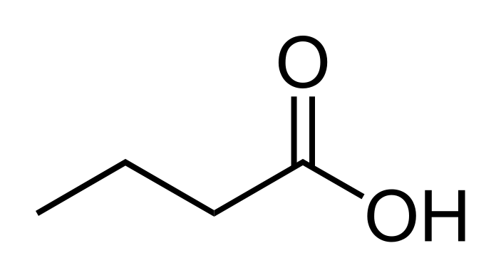
Volatile fatty acids
Organic Acids
Carboxylic Acid
Fatty Acid
(Aliphatic Tail)
Volatile Fatty Acids
VFAs, Volatile Acids (VA),
Short Chain Fatty Acids (SCFA)

Slide 8
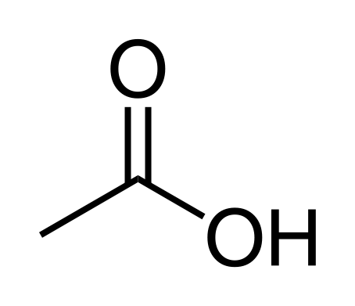
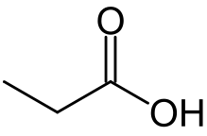
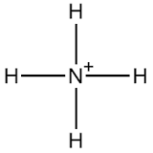
Different words ~ Same thing
Deprotination
Acetic Acid / Acetate
Propionic Acid/ Propionate
VFAs
Butyric Acid/ Butyrate
Ammonium/ Ammonia

Slide 9
Overview of digestion
The role of acids and ammonia

Slide 10
can it be digested?
Good
Not Good
Human excretion
  Separate urine if possible
  Toilet paper OK
Animal excretion
Cooking grease
Food waste
Woody material
Organic
(Volatile Solid)
Carbohydrate
Protein
Lipid

Slide 11
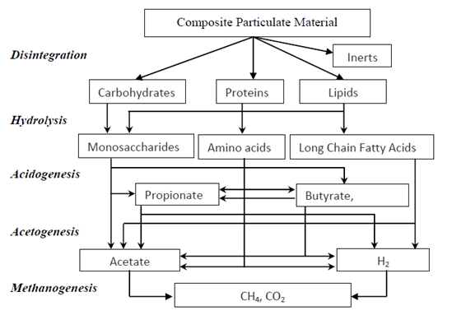
It is complicated
Overall digestion Model
Ammonia
(Chen et. al., 2008, Batstone et al, 2002 and Tugtas, 2011)

Slide 12
Digestion Rates vary
Different molecules; different rates
Carbohydrates
Proteins
Lipids
Quickest
S l o w e s t
Simple Sugars
Starches
Cellulose/Fiber
(Eastman and Ferguson, 1981)

Slide 13
LOADING RATE
The most important factor

Slide 14
Ideal loading
1.6 - 4.8 g VS/L/day
for single stage digestion
(Tchobanoglous et. al., 2003)

Slide 15
Inhibition Happens at low levels
(Eastman and Ferguson, 1981), Acid inhibition level (Wang et. al, 2009), Ammonia inhibition (Chen et. al. , 2008)

Slide 16
Stuck happens
Acids and ammonia smell bad
Stuck Digester
Ammonia
(Chen et. al., 2008, Bastone et al, 2002 and Tugtas, 2011)

Slide 17
Design and implementation
Train and equip locals
for pH monitoring
Seed with sludge
from a working digester
Have a “stuck digester” plan

Slide 18
TEMPERATURE
…IT MATTERS

Slide 19
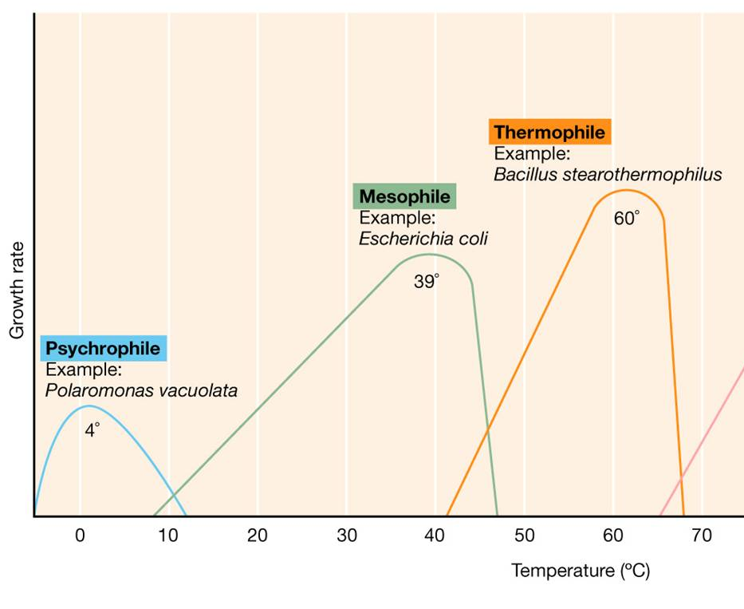
Temperature; many optimums
102˚F
140˚F
http://202.204.115.67/jpkch/jpkch/2008/wswx/chapter%206.htm

Slide 20
BIOGAS
Composition and treatment

Slide 21
BIOGAS; not just methane
(Tchobanglous et. al. ,2003)

Slide 22
gas is not always methane
Especially at startup
Acidogenesis
Glucose + 2H₂O → 2 Acetic + 2CO₂ + 4H₂
Glucose → Butyric + 2CO₂ + 2H₂
Glucose + 2H₂ → 2 Propionic + 2H₂O
Acetogenesis
Propionic + 2H₂O →Acetic + CO₂
Butyric + 2H₂O →2 Acetic + 2H₂
Methanogenesis
Acetic → CH4 + CO2
CO2 + H2 → CH4 + 2 H2O
(Mosey, 1983)

Slide 23
Startup can be confusing
Large amounts of gas will develop quickly. It may or may not be flammable but it is not necessarily methane.

Slide 24
BIOGAS
Other Gases; N₂, H₂, H₂O, H₂S
H₂S + 2O₂ → H₂SO₄
Control where this reaction occurs.
  Plan condensation points in piping
  Minor air sparging in digester
(Offgases)
(Soluble)

Slide 25
Important points
Failure is common
Avoid failure by
  Managing loading, esp. food
  Managing sulfur behavior.
Appoint failure experts

Slide 26

Laboratory of Renewable Resources Engineering

Slide 27
References
Batstone, D.J., Keller, J., Angelidaki, I., Kalyuzhnyi, S., Pavlostathis, S., Rozzi, A., Sanders, W., Siegrist, H., Vavilin, V. 2002. The IWA Anaerobic Digestion Model No 1(ADM 1). Water Science & Technology, 45(10), 65-73.
Chen, Y., Cheng, J.J., Creamer, K.S. 2008. Inhibition of anaerobic digestion process: A review. Bioresource Technology, 99(10), 4044-4064.
Eastman, J.A., Ferguson, J.F. 1981. SOLUBILIZATION OF PARTICULATE ORGANIC-CARBON DURING THE ACID PHASE OF ANAEROBIC-DIGESTION. Journal Water Pollution Control Federation, 53(3), 352-366.
Lusk, P., Wiselogel, A. 1998. Methane recovery from animal manures: the current opportunities casebook. National Renewable Energy Laboratory Golden, CO.
Mosey, F.E. 1983. MATHEMATICAL-MODELING OF THE ANAEROBIC-DIGESTION PROCESS - REGULATORY MECHANISMS FOR THE FORMATION OF SHORT-CHAIN VOLATILE ACIDS FROM GLUCOSE. Water Science and Technology, 15(8-9), 209-232.
Tchobanoglous, G., Burton, F., Stensel, H. 2003. Wastewater Engineering; Treatment and Reuse. Fourth ed. McGraw Hill.
Tugtas, A.E. 2011. Fermentative Organic Acid Production and Separation. Marmara University.
Wang, Y., Zhang, Y., Wang, J., Meng, L. 2009. Effects of volatile fatty acid concentrations on methane yield and methanogenic bacteria. Biomass & Bioenergy, 33(5), 848-853.

