Slide 1



Engineers Without Borders
General Meeting
9/17/2014 – Fall 2014

Slide 2
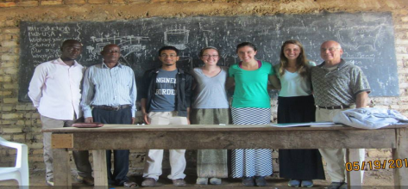
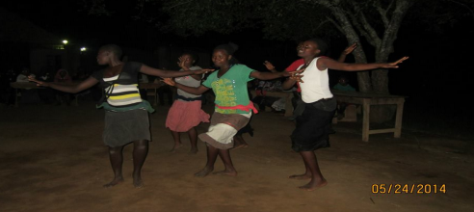
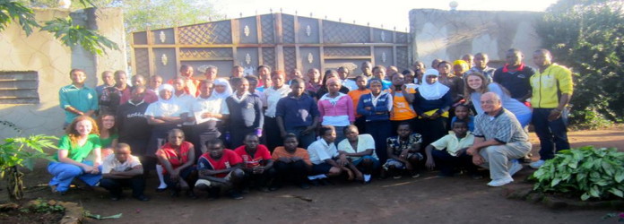

Our Project
What: Develop a sustainable biogas digester as an alternative energy source for the community.
Where: Nakyenyi, Uganda
Why: Deforestation due to wood being burned as fuel
How:
  Finished Assessment
  Trip Last May
  In design and
  implementation phase
  Planning on traveling
  for implementation in
  Summer 2015

Slide 3
Structure of the Club
EWB-EPICS Meetings:
  Lead: Project Manager: Katherine Schmotzer
  Members: Past board, project team, travel team, dedicated general members
    Must show at least 1 semester dedication in the general meetings to join the EPICs Team
  Responsibilities: Leading the design team and general members towards the successful design and implementation of our project.

Slide 4
Structure of the Club
General Meetings:
  Lead: Vice President: Emily Briggs
  Members: EWB-EPICS team members, previous members, and new members
    Anyone can join!
  Responsibilities: Supporting and assisting with the successful design and implementation of our project; running fundraisers and networking events, and performing assessments for future projects with the community.

Slide 5
Leadership Team:
President: Thalib Razi – arazi@purdue.edu
Vice President: Emily Briggs – briggs3@purdue.edu
Treasurer: Daniel Ellinwood – dellinwo@purdue.edu
Grant Writer: Kaushik Manchella –kmanchel@purdue.edu
Liaison: Lauren Reuland – lreuland@purdue.edu
Fundraising and Events: Rachel Lucas – lucas27@purdue.edu
Webmaster: Evan Kinney – kinneye@purdue.edu

Slide 6
Leadership Team (continued)
Project Manager: Katherine Schmotzer – kschmotz@purdue.edu
Design Leads:
  Biogas - Rajah – rtkanaga@purdue.edu
  Piping – Alex / Avi– amilat@purdue.edu/ aravirag@purdue.edu
  Education – Ana – avalenca@purdue.edu
  Grants – Kaushik /Dan – kmanchel@purdue.edu/ dellinwo@purdue.edu

Slide 7
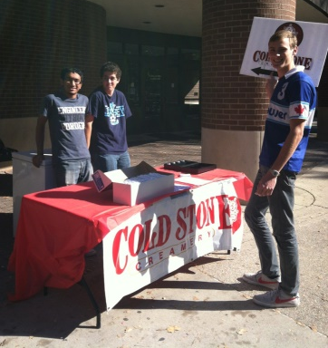
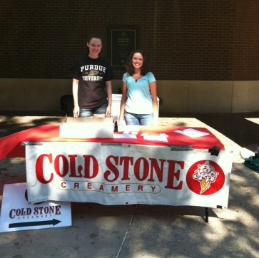
Upcoming Events
General Meeting
  When: Wednesday September 24th @ 7 PM
  Where: Hampton 3144
  Contact: Emily Briggs – briggs3@purdue.edu
Cold Stone Fundraiser
  When: September 18th from 11 AM to 4 PM
  Where: Outside Class of 1950
  Contact: Rachel Lucas – lucas27@purdue.edu

Slide 8
Stay Involved!
General Meetings:
  Wednesdays @ 7 PM Hampton 3144
Club Dues:
  EWB-USA membership:
    $30 for year
    $25 for semester
  Purdue Chapter membership: $20 for year
Join a design team!
Volunteer at upcoming events!
Sign-up for emailing list!

Slide 9
EWB-EPICS Updates
Completed:
  Reorganized semester leadership positions
  Finished Gantt charts
Next Steps
  Stakeholder profiles
  Project specifications
  Trip Archiving
  Biogas Research

Slide 10
Work on for Next Week:
Read:
  901/522 documents
  Biogas Reactors
  Uganda – culture/location/language/etc.

Slide 11

Design Leads
Biogas
Piping
Education
Breakout Sessions

Slide 12
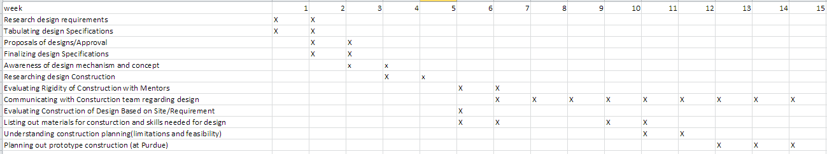
Biogas Design Team

Slide 13
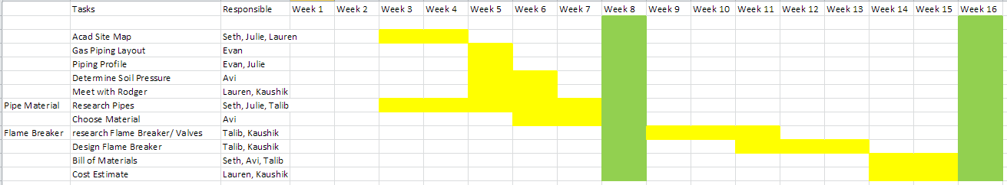
Piping Design Team

Slide 14
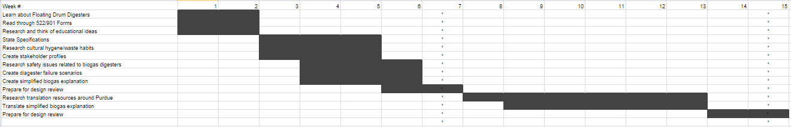
Education Design Team

Slide 15
Design Leads
Biogas
Piping
Education
Breakout Sessions

Slide 16
Trip Archiving
Data Collected
Pictures
Surveys
Survey Organization

Slide 17
Questions ?
President: Thalib Razi – arazi@purdue.edu
Vice President: Emily Briggs – briggs3@purdue.edu
Treasurer: Daniel Ellinwood – dellinwo@purdue.edu
Grant Writer: Kaushik Manchella –kmanchel@purdue.edu
Liaison: Lauren Reuland – lreuland@purdue.edu
Fundraising and Events: Rachel Lucas – lucas27@purdue.edu
Webmaster: Evan Kinney – kinneye@purdue.edu
Project Manager: Katherine Schmotzer – kschmotz@purdue.edu
Design Leads:
  Biogas - Rajah – rtkanaga@purdue.edu
  Piping – Alex / Avi– amilat@purdue.edu/ aravirag@purdue.edu
  Education – Ana – avalenca@purdue.edu
  Grants – Kaushik /Dan – kmanchel@purdue.edu/ dellinwo@purdue.edu

