Slide 1
Community Outreach / Water Conservation
Engineers Without Borders – USA: Purdue Chapter

Slide 2
Mission Statement
“The Community Outreach/Water Conservation team strives to promote public heath and environmental awareness, relevant to the larger project, to the community through sustainable educational methods.”

Slide 3
Questions
What are the public health objectives, direct or indirect, of our project?¹
Independent of the project, what areas of public health need improvement in the community?
¹EWB Community Health Assessment Guidelines

Slide 4
What is Public Health
"…the science and art of preventing disease, prolonging life, and promoting physical health and efficiency through organized community efforts for the sanitation of the environment, the control of community infections, the education of the individual in principles of personal hygiene, the organization of medical and nursing service for the early diagnosis and preventive treatment of disease, and the development of the social machinery which will ensure to every individual in the community a standard of living adequate for the maintenance of health.“²
²Preamble to the Constitution of the World Health Organization as cited in the EWB Public Health Guideline

Slide 5
Project Flow
Tentative Schedule
Team Recruiting
1 weeks
Project Definition
3 weeks
Cultural Understanding
Research
Communication
7 weeks
Educational Materials
7 weeks

Slide 6
Water Filtration: Point of Use
Boiling
Cloth filtration
Chlorination
Coagulation
Sand filtration
UV Sunlight
Solar Distillation
Source: EWB Webinar on Water Treatment

Slide 7
Water Filtration: Community
Chlorination
Slow Sand Filtration
UV
Reverse Osmosis
Source: EWB Webinar on Water Treatment

Slide 8
Common Water Contaminants
Arsenic
Fluoride
Source: EWB Webinar on Water Treatment

Slide 9
Water and Public Health
Hand washing
Other personal hygiene: bathing, face washing…
Identifying Safe water (www.cdc.gov/safewater)
Disease (malaria)

Slide 10
Water Conservation
Quantifying Use
  How much is necessary
Re-Purpose
  Graywater
Storage
  Catchments
  Rain Barrels

Slide 11
What is most important?....
Community!

Slide 12
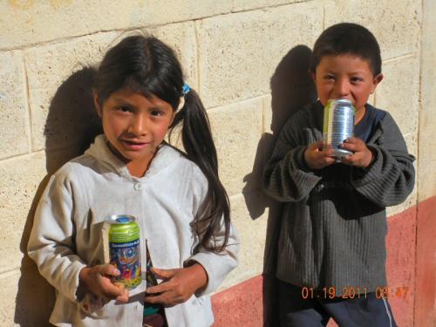
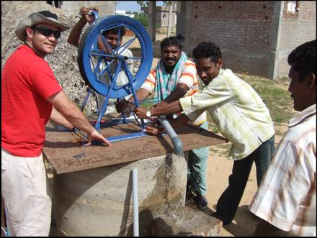
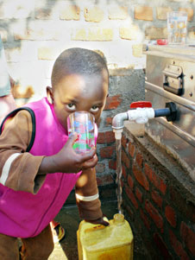
Brainstorming…
Photo Credits: http://www.ascehouston.org/en/art/52/, http://www.cannedwater4kids.com/images/uploads/EWB-Guatemala1.jpg, http://www.nasa.gov/offices/oce/appel/ask/issues/39/39s_engineers.html

Slide 13
Brainstorming…
What projects?
Educational programs?
Community communication?
Improving context sensivity?

Slide 14
Roles
Documentation
  Writing 524 and 525 content.
Communication Manager
  Maintain contact with EIA and other on-site groups.
Content Researchers/Writers
  Research and write content for project

Slide 15
Useful links
www.lifewater.org/hygiene-health
www.cdc.gov (so many links)
www.epa.gov/drink
www.biosandfilter.org
www.who.int

