Slide 1


Engineers Without Borders
Papachacra, Bolivia Project

Slide 2




Supported by

Slide 3
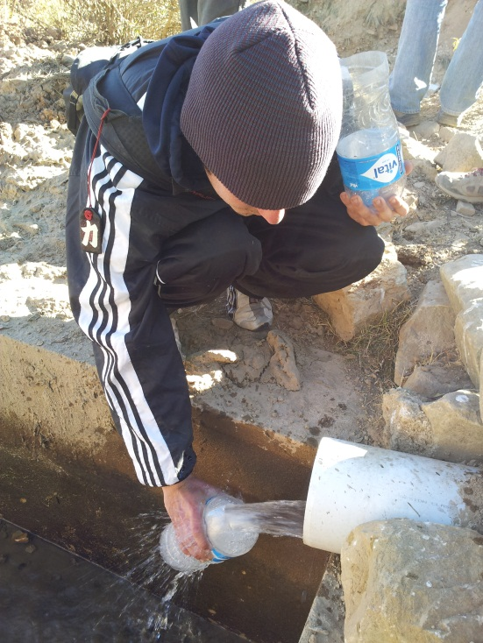
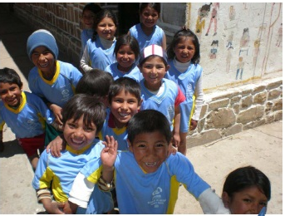
Current Project
Papachacra, Bolivia

Slide 4
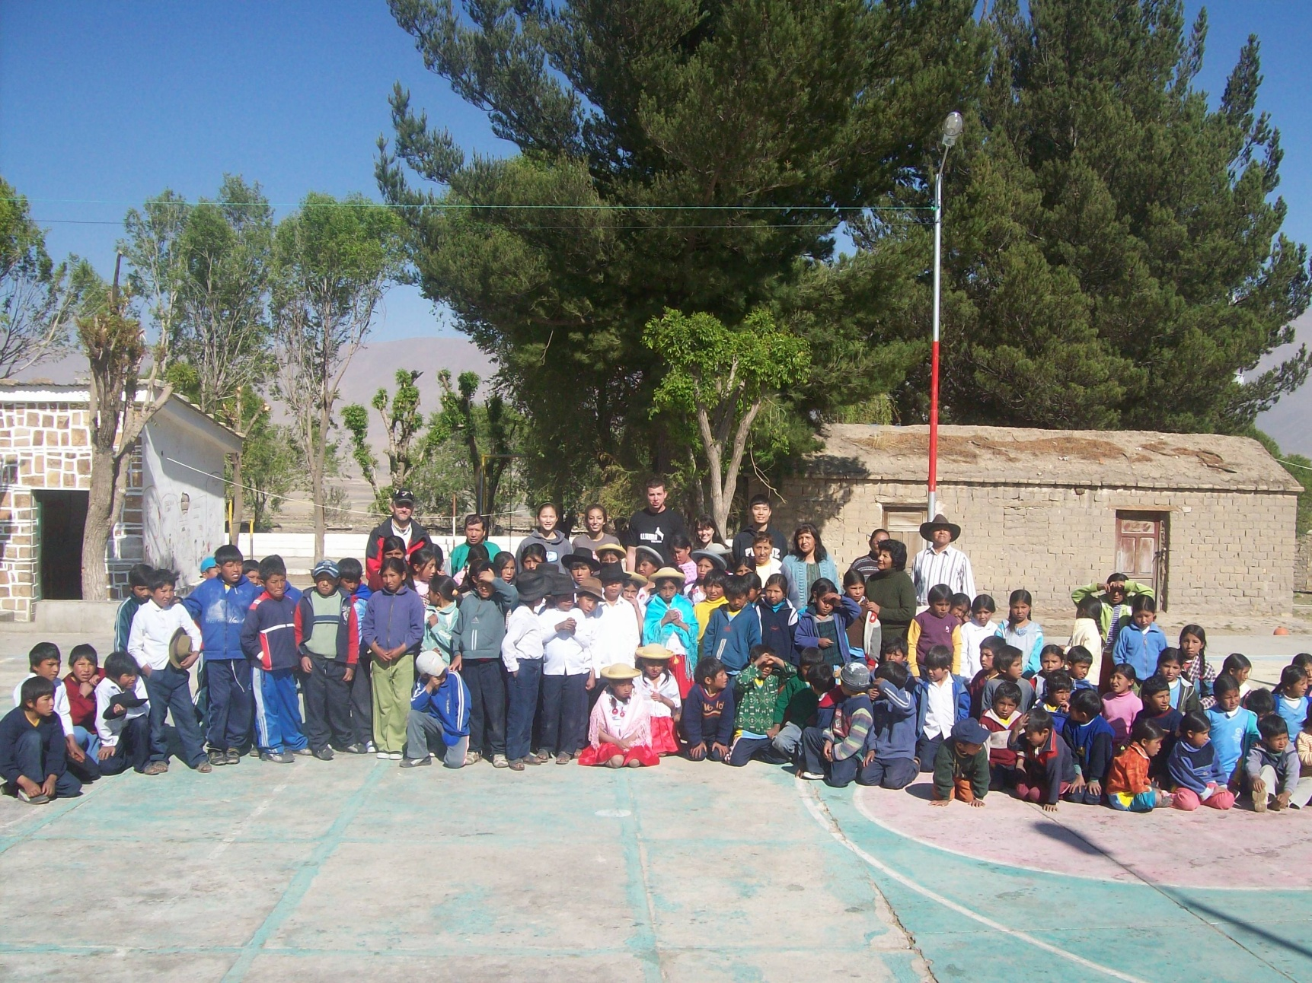
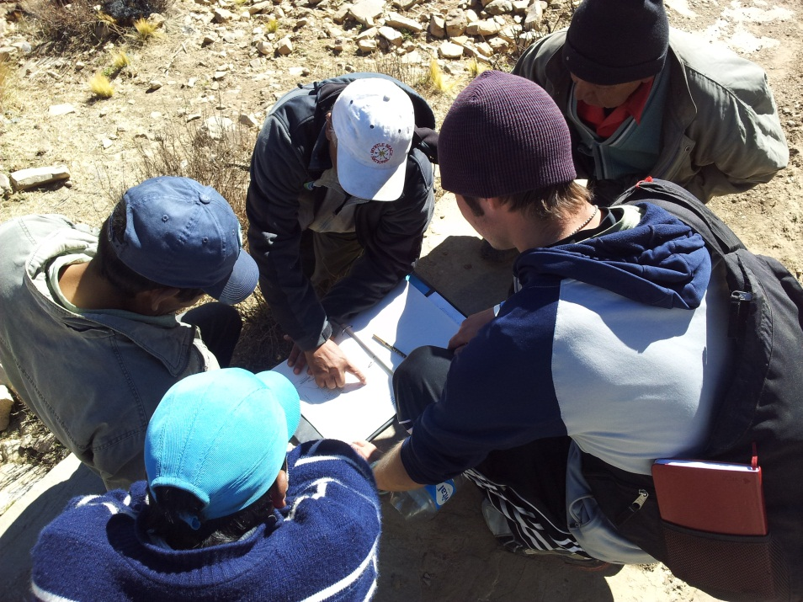
Purpose
Restructure potable drinking water system
Improve irrigation

Slide 5
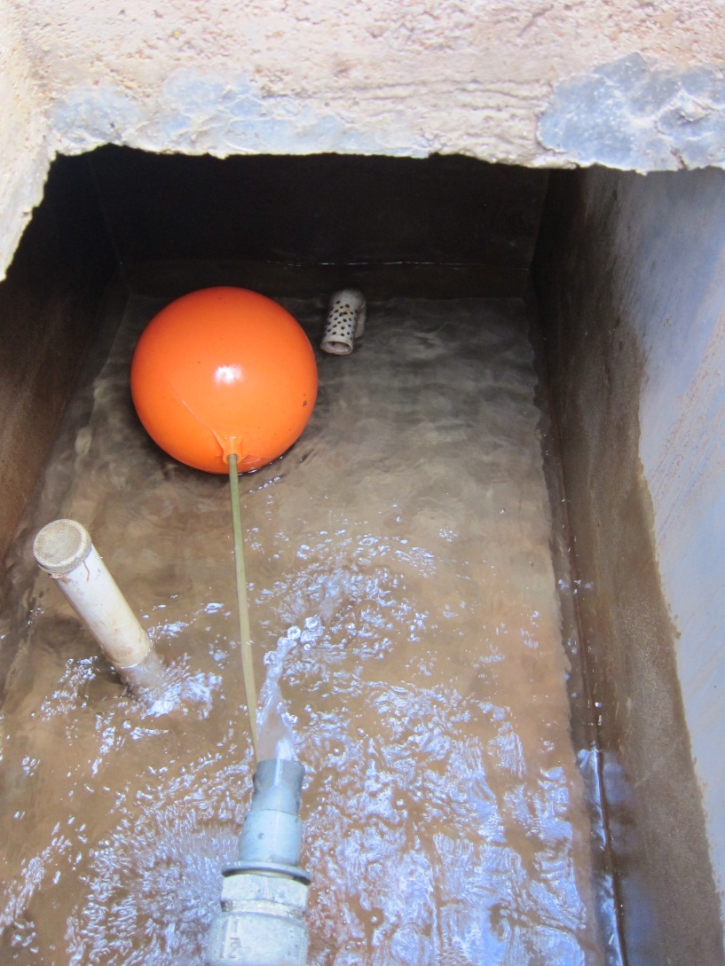
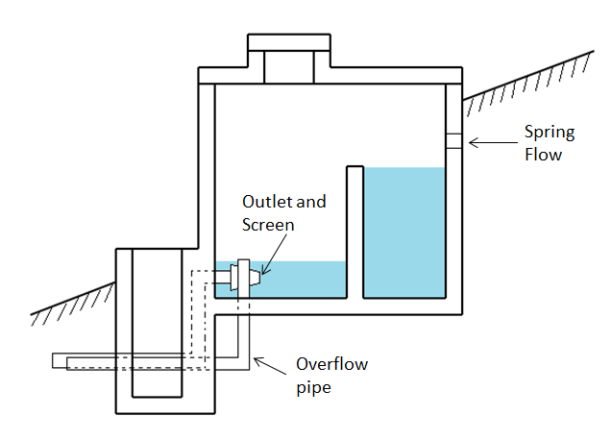
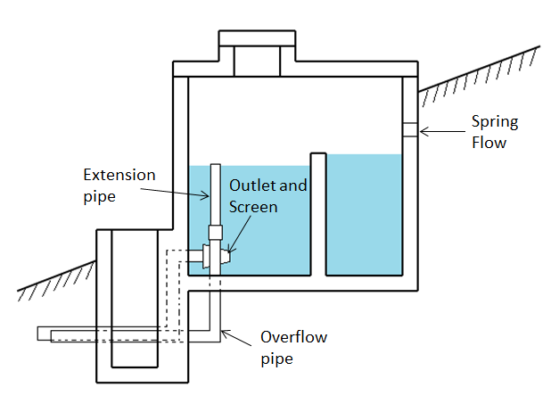
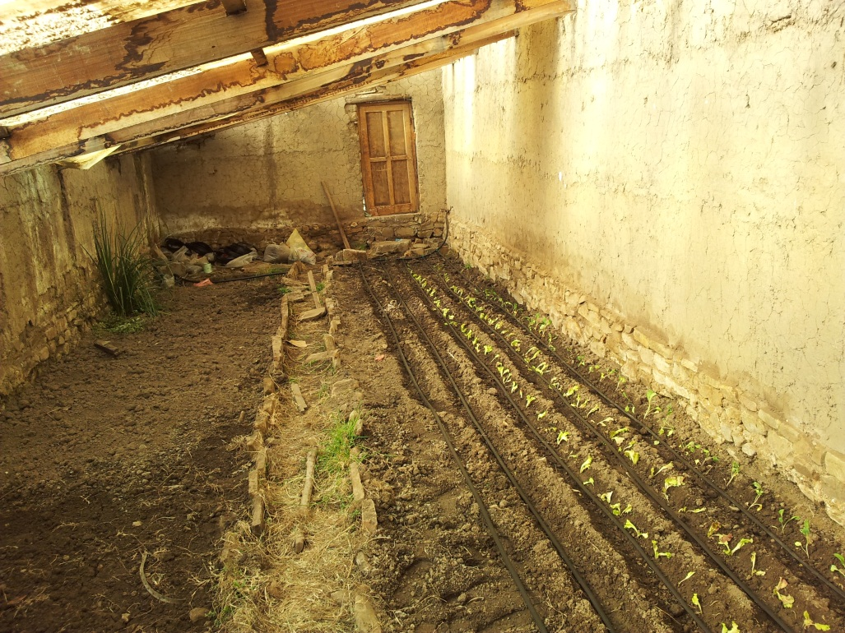
Work Completed

Slide 6
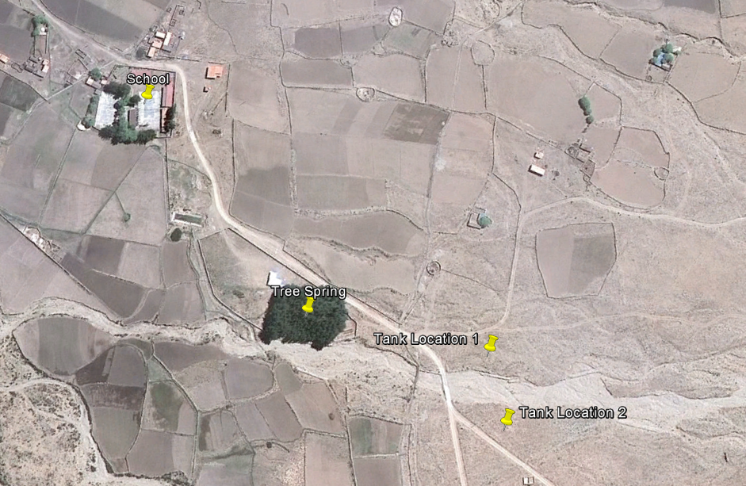
Site Map
Location | GPS Coordinates
School | 21°31'16.56"S , 64°57'25.09"W
Tree Spring | 21°31'22.83"S , 64°57'20.42"W
Tank Location 1 | 21°31'24.84"S , 64°57'15.75"W
Tank Location 2 | 21°31'26.46"S , 64°57'15.46"W

Slide 7
Current Projects
Collaborating with EWB National Chapter
Looking for Future Projects

Slide 8
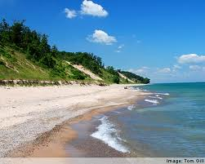
Future Projects
GEP
Indiana Dunes
Purdue – China Collaboration

Slide 9
Events
Volleyball, Frisbee, Soccer, anything you want!
Saturday Sept. 22nd at Pickett Park

Slide 10
GDT EXPO
Thursday Sept 27th
ARMS atrium
11:30am-4:30pm

