Slide 1
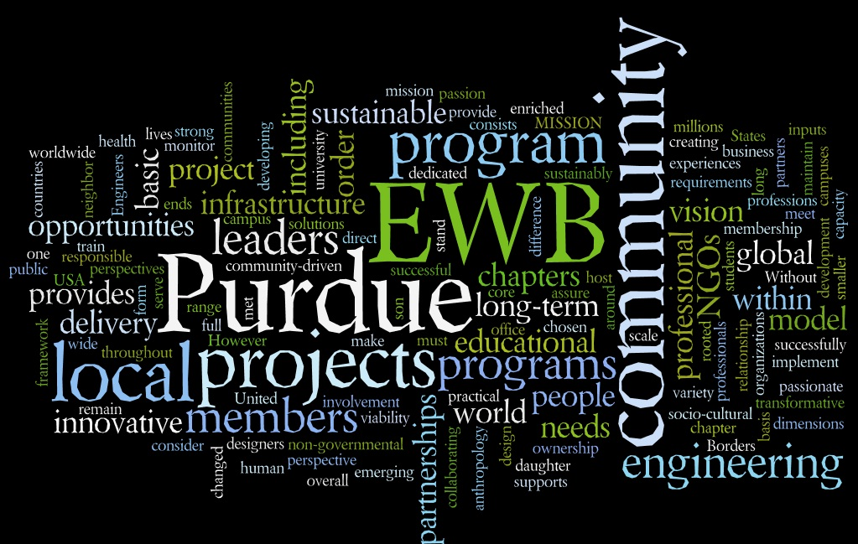

Slide 2

What is Engineers Without Borders?
Our mission: EWB-USA is a nonprofit organization created to support world-wide community driven partnerships to design and implement sustainable engineering projects.
Our Vision: “EWB-USA's vision is a world in which the communities we serve have the capacity to sustainably meet their basic human needs.”
Get Involved!
Purdue Chapter
Our Project
EWB National

Slide 3


National Chapter
EWB-USA:
Professional & student chapters
International & local projects
Get Involved!
Purdue Chapter
Our Project
EWB National

Slide 4
Purdue Chapter
Purdue Organization
Established over 7 years ago
ALL MAJORS WELCOME: NO BORDERS!
Current Project:
  Nakyenyi, Uganda
New this Year:
  EWB-EPICS Team
Get Involved!
Purdue Chapter
Our Project
EWB National

Slide 5
EPICS
“EPICS is a unique program in which teams of undergraduates are designing, building, and deploying real systems to solve engineering-based problems for local community service and education organizations”
Worked with Professor Oakes and EWB National to form the first ever EWB-EPICs Team!
Get Involved!
Purdue Chapter
Our Project
EWB National

Slide 6
Structure of the Club
EWB-EPICS Meetings:
  Lead: Project Manager: Katherine Schmotzer
  Members: Past board, project team, travel team, dedicated general members
    Must show at least 1 semester dedication in the general meetings to join the EPICs Team
  Responsibilities: Leading the design team and general members towards the successful design and implementation of our project.
Get Involved!
Purdue Chapter
Our Project
EWB National

Slide 7
Structure of the Club
General Meetings:
  Lead: Vice President: Emily Briggs
  Members: EWB-EPICS team members, previous members, and new members
    Anyone can join!
  Responsibilities: Supporting and assisting with the successful design and implementation of our project; running fundraisers and networking events, and performing assessments for future projects with the community.
Get Involved!
Purdue Chapter
Our Project
EWB National

Slide 8
Leadership Team (Fall 2014):
President: Thalib Razi – arazi@purdue.edu
Vice President: Emily Briggs – briggs3@purdue.edu
Treasurer: Daniel Ellinwood – dellinwo@purdue.edu
Grant Writer: Kaushik Manchella –kmanchel@purdue.edu
Liaison: Lauren Reuland – lreuland@purdue.edu
Fundraising and Events: Rachel Lucas – lucas27@purdue.edu
Webmaster: Evan Kinney – kinneye@purdue.edu
Get Involved!
Purdue Chapter
Our Project
EWB National

Slide 9
Leadership Team (Fall 2014)
Project Manager: Katherine Schmotzer – kschmotz@purdue.edu
Design Leads:
  Biogas - Rajah – rtkanaga@purdue.edu
  Piping – Julie/Evan– jwoodwo@purdue.edu / kinneye@purdue.edu
  Education – Ana – avalenca@purdue.edu
  Grants – Kaushik /Dan – kmanchel@purdue.edu/ dellinwo@purdue.edu
Get Involved!
Purdue Chapter
Our Project
EWB National

Slide 10
Our Project
What: Develop a sustainable biogas digester as an alternative energy source for the community.
Where: Nakyenyi, Uganda
Why: Deforestation due to wood being burned as fuel
How:
  Finished Assessment Trip Last May
  In design and implementation phase
  Planning on traveling for implementation in Summer 2015
Get Involved!
Purdue Chapter
Our Project
EWB National

Slide 11
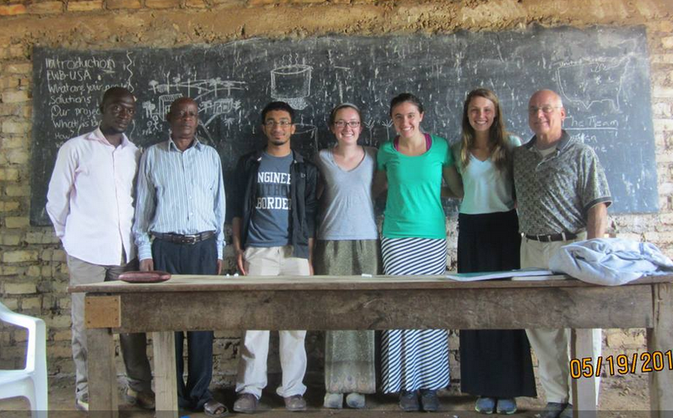
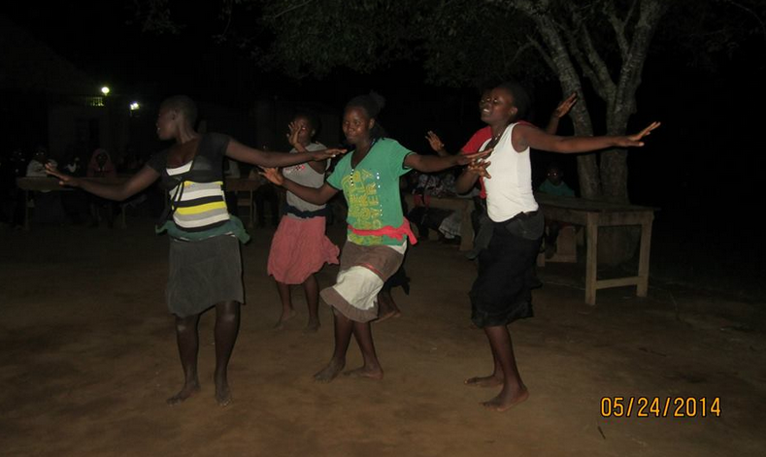
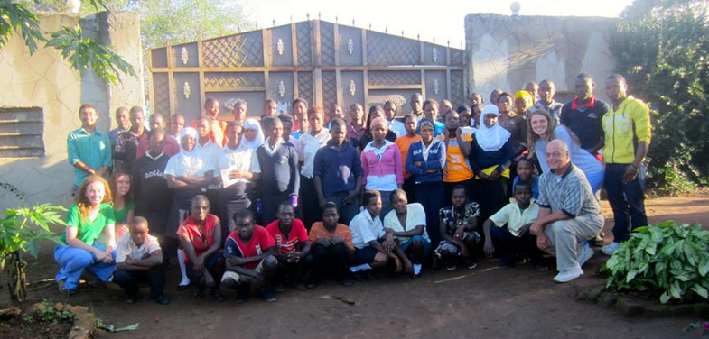
Past Assessment Trip
Presenter:
  Project Manager: Katherine Schmotzer
Get Involved!
Purdue Chapter
Our Project
EWB National

Slide 12
How to get involved
General Meetings:
  Wednesdays @ 7:30 PM PHYS 014
Club Dues:
  EWB-USA membership:
    $30 for year
    $25 for semester
  Purdue Chapter membership: $20 for year
Join a design team!
Volunteer at upcoming events!
Sign-up for emailing list!
Get Involved!
Purdue Chapter
Our Project
EWB National

Slide 13
Upcoming Events
First General Meeting
  When: Wednesday January 27th @ 7:30 PM
  Where: PHYS 014
  Contact: Emily Briggs – briggs3@purdue.edu
Get Involved!
Purdue Chapter
Our Project
EWB National

Slide 14
Questions ?
President: Thalib Razi – arazi@purdue.edu
Vice President: Emily Briggs – briggs3@purdue.edu
Treasurer: Daniel Ellinwood – dellinwo@purdue.edu
Grant Writer: Kaushik Manchella –kmanchel@purdue.edu
Liaison: Lauren Reuland – lreuland@purdue.edu
Fundraising and Events: Rachel Lucas – lucas27@purdue.edu
Webmaster: Evan Kinney – kinneye@purdue.edu
Project Manager: Katherine Schmotzer – kschmotz@purdue.edu
Design Leads:
  Biogas - Rajah – rtkanaga@purdue.edu
  Piping – Julie/Evan– jwoodwo@purdue.edu / kinneye@purdue.edu
  Education – Ana – avalenca@purdue.edu
  Grants – Kaushik /Dan – kmanchel@purdue.edu/ dellinwo@purdue.edu

