Slide 1

EPICS : INDIA

Slide 2
Team Introduction
Anwesha Sanyal Co-Project Manager
Prerena Prahlad Co-Project Manager
Karthick Shankar Leads Systems Integrator & Design Lead (Water)
Rahul Maheswaran Design Lead (Pump) & Webmaster
Meesam Zaheer
Hardi Sura Financial officer
Ryan Maclntyre
Jack Rau
Chelsea Tenbarge
Notes:
Caroline

Slide 3
Project Overview

Slide 4

Project Partner
Vellore Institute of Technology (VIT), India
VIT’s main campus is an approximately 360 acre span of land located in Vellore. There is also a 170 acre second campus located in Chennai.
They provide education to over 24,000 students coming from all over India and abroad.

Slide 5
We are working with a team of students from VIT to design a farming system for farmers in Vellore, that has the potential to have an impact the lives of the farmers.
Notes:
Here, after this, talk about the phases in which the presentation is going to be gone through

Slide 6
Stakeholders
Farmers in Vellore
Families of the Farmers
Surrounding community
Notes:
Sunny

Slide 7
Study Abroad Trip: ME and EPICS in India
March 10th-March 18th

Slide 8
24 Students (2 EPICS Members)
Mechanical, Materials, and First-Year Engineering Students
Meet and work with VIT Students
Visit to Javadi Hills (03/15)
Hackathon (03/16)

Slide 9
Water Team
EPICS : INDIA

Slide 10
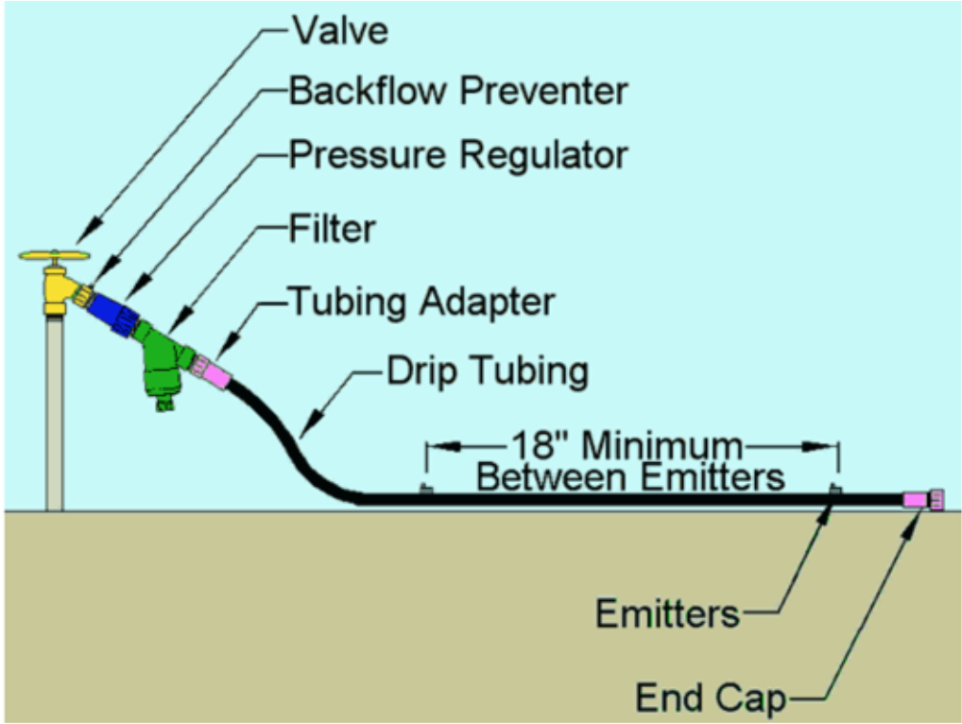
Last Semester’s Progress - Irrigation
We left off last semester with the concept of a drip irrigation system after lots of research. This here shows a typical drip irrigation system.

Slide 11
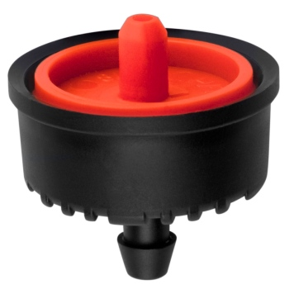
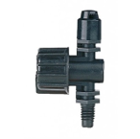
Last Semester’s Progress - Irrigation
We were also considering different kinds of emitters that we would be using for our system.
Emitter Type | Description (Pros/Cons)
 | These operate with higher pressure and use emitters to deliver water specifically to the roots. AREA OF COVERAGE IS SMALL BUT IS MORE EFFICIENT.
 | These operate with low water pressure and use small diameter pipes. However, they deliver water in a fan-like spray in the same manner as traditional sprinkler heads.​ IT COVERS MORE AREA THAN IN LINE EMITTERS, BUT IS SLIGHTLY LESS EFFICIENT.

Slide 12
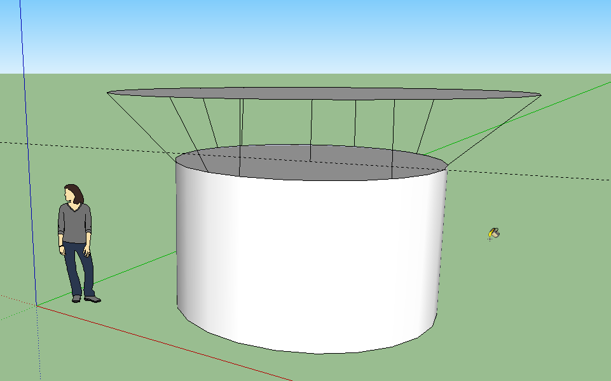
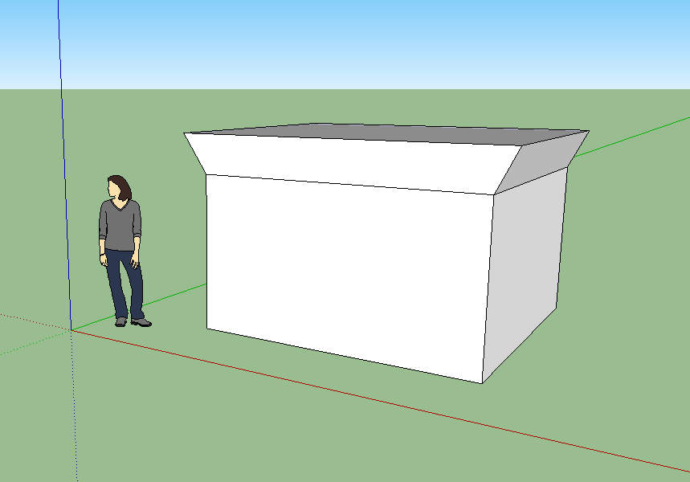
Last Semester’s Progress - Storage
We considered different types of tanks and weighed out their pros and cons.
  Elevated Tanks
  Overground Tanks
  Underground Tanks

Slide 13
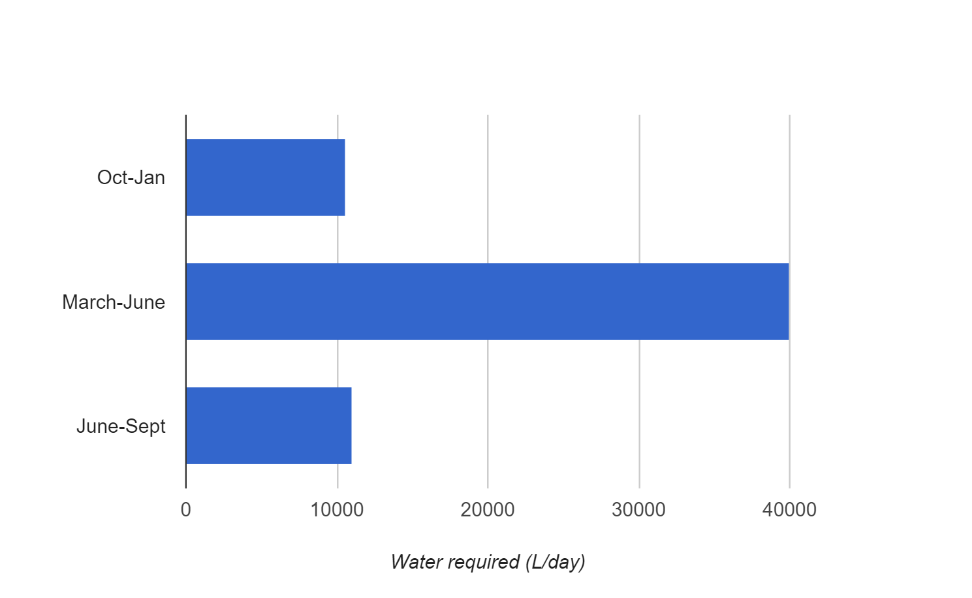
Verified Water Requirement Calculations

Slide 14
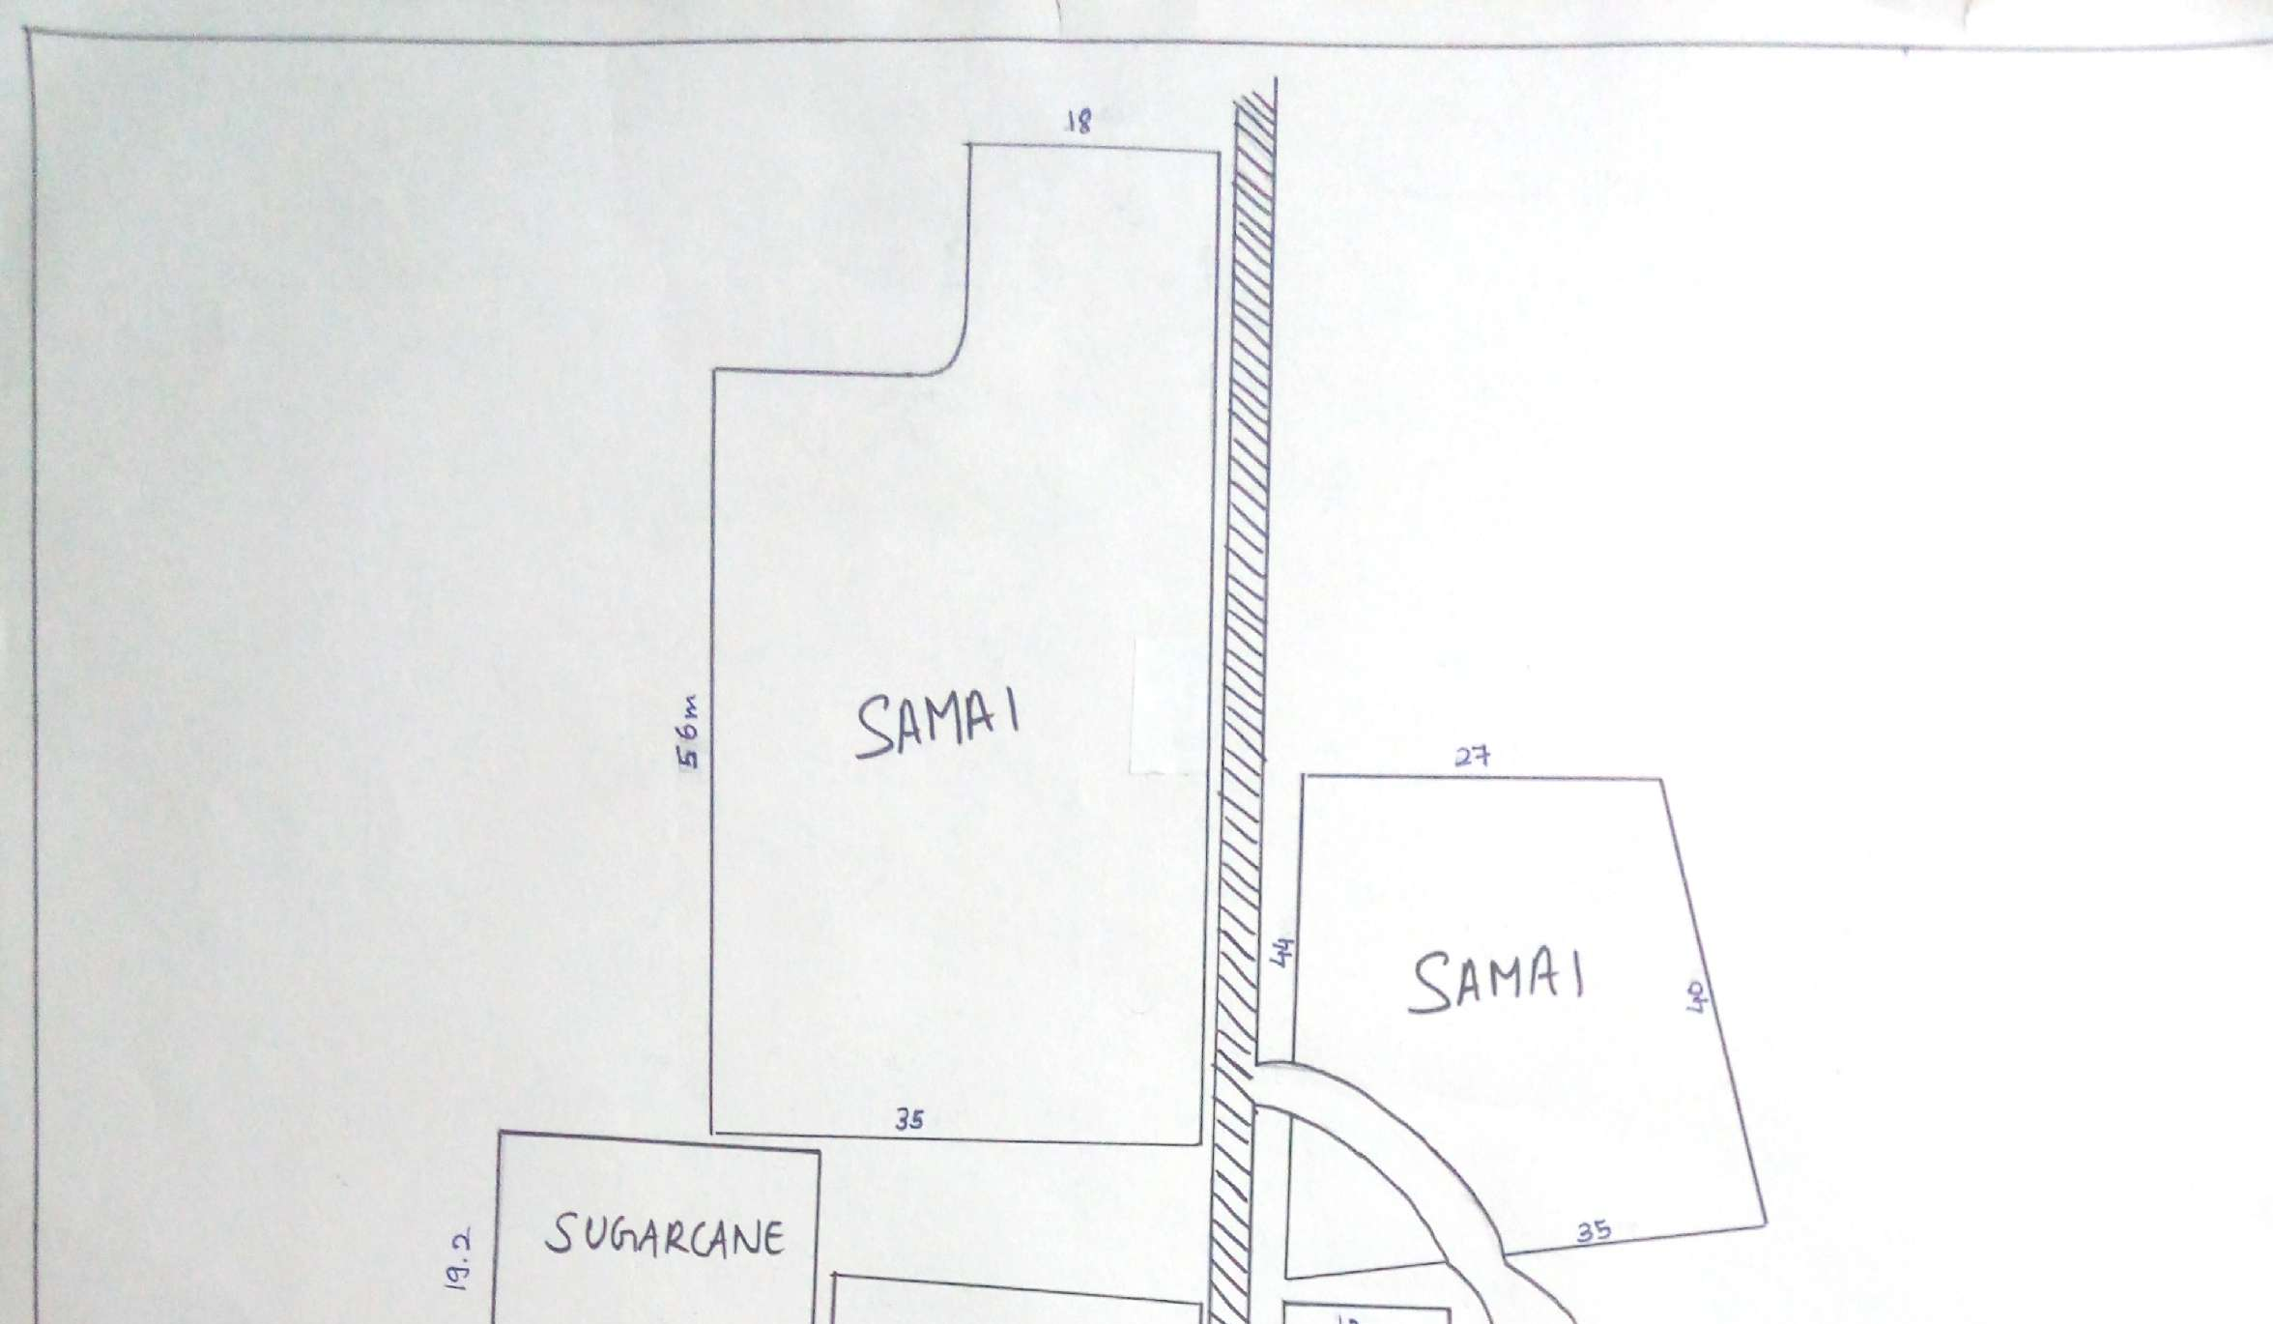
Situation at the Farms
Farmers flood the fields using water from wells
In the Samai area of the farm, they do not plant crops during non-monsoon seasons due to lack of water. Thus, the Samai plots are empty for many months.

Slide 15
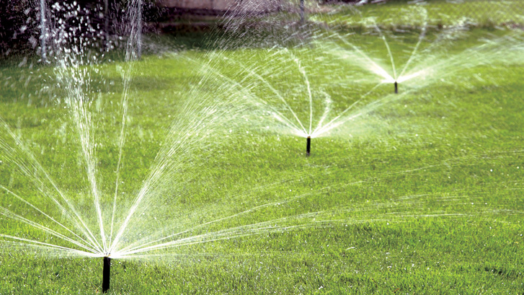
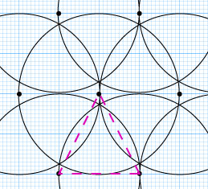
Sprinkler Irrigation System

Slide 16
Sprinkler Irrigation System
Our Project Partners, VIT, are prototyping this type of system because:
  Lesser piping on the field
  Easier to sow seeds
  Lower initial costs
  Easier to dispense water to crops that grow in close proximity

Slide 17
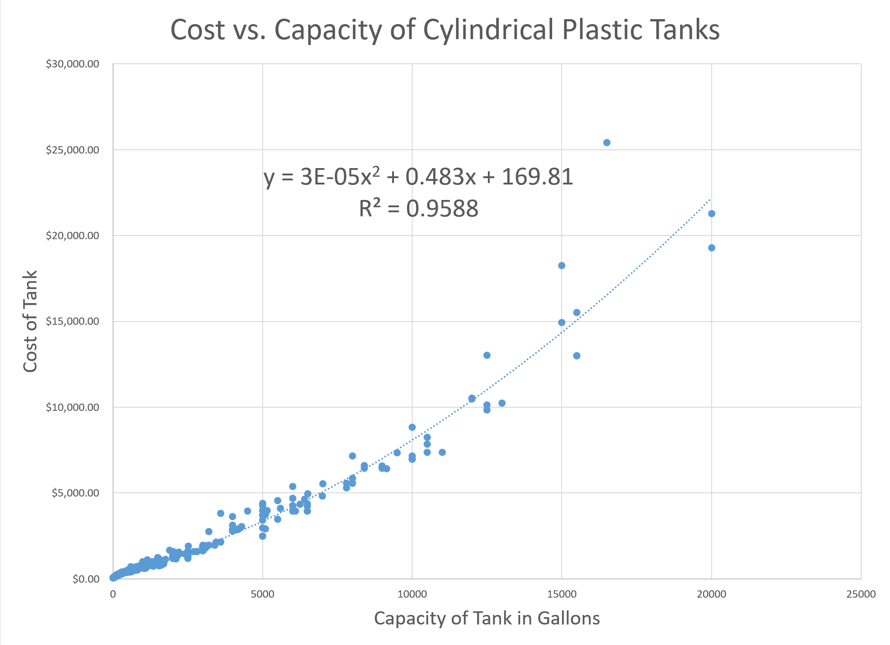
Cylindrical Tank Choice

Slide 18
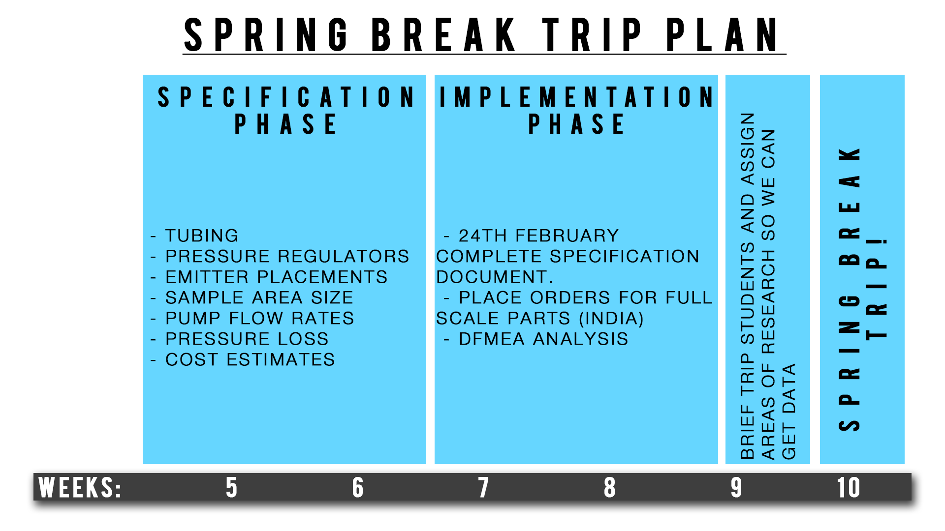
Spring Break Trip!

Slide 19
Emitter Choice
The micro-sprinkler emitter was chosen as our preferred emitter.
This is because:
  Acts over a larger area (typical wetted diameter is 2 to 7 feet).
  Generally, fewer application devices are needed per plant.
  Less plugging problems and less filtration required than point-source emitters.
  Easy maintenance.

Slide 20
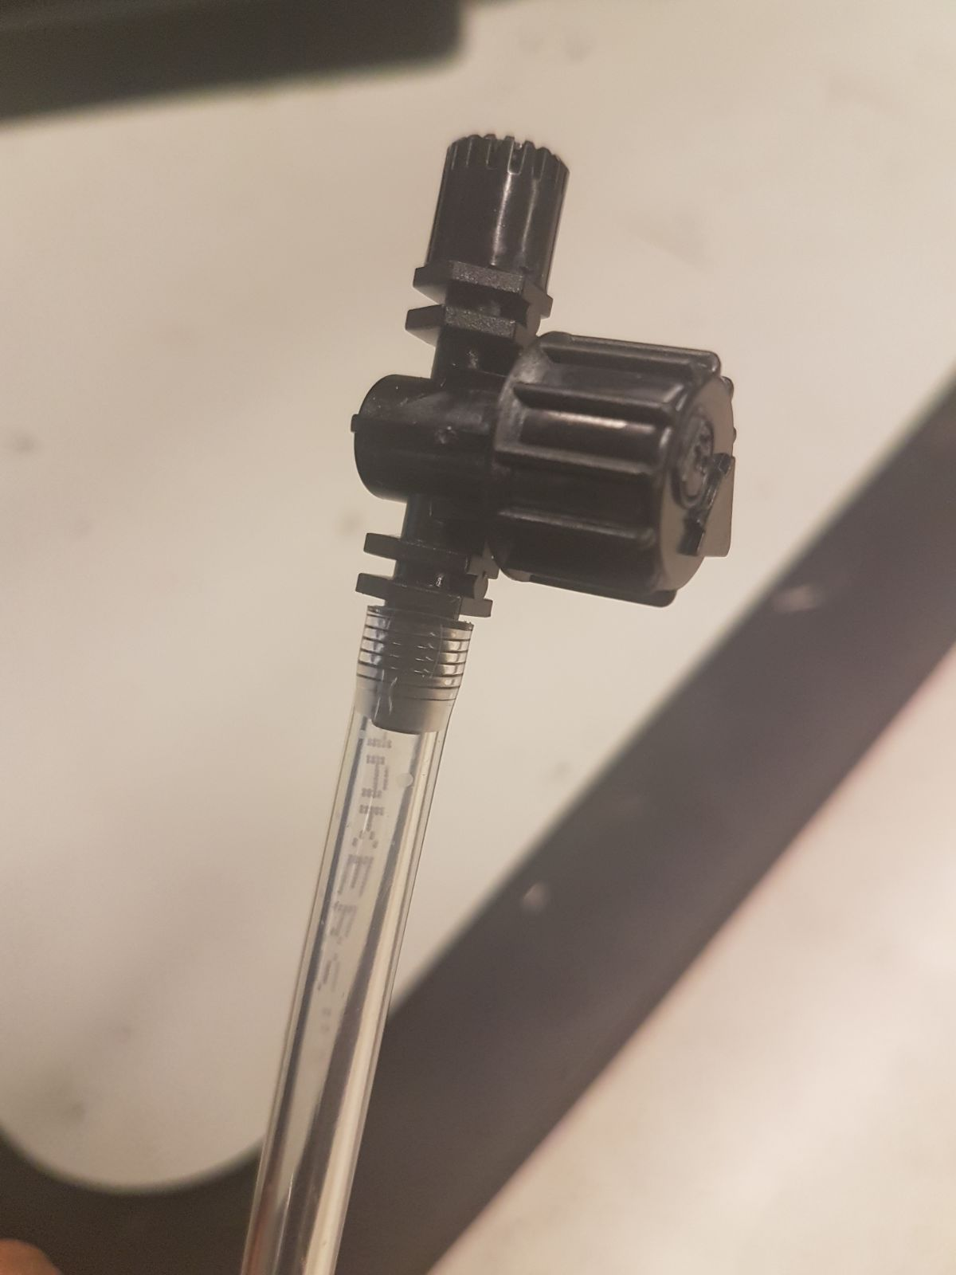
Prototype Parts

Slide 21
Drip Irrigation Specifications
Based on the average of numerous sorces of data, the following specifications table for the micro-sprinkler irrigation system can be made:
Criterion | Specification
Flow rate for each emitter | 60 L/hr
Working pressure range for each emitter | 1.5 bar or 150 kPa
Wetted Diameter of each emitter | 1.5 - 2 m
Nozzle size | 1.4 – 1.8 mm / 4mm dia
Elevation of emitter above ground | 20 cm
Lateral / main pipe size | 13 – 19 mm dia

Slide 22
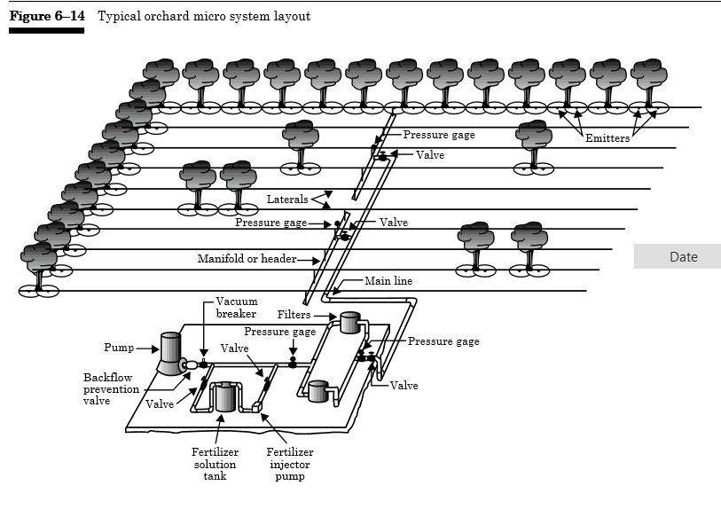
Sample Drip Irrigation Layout

Slide 23
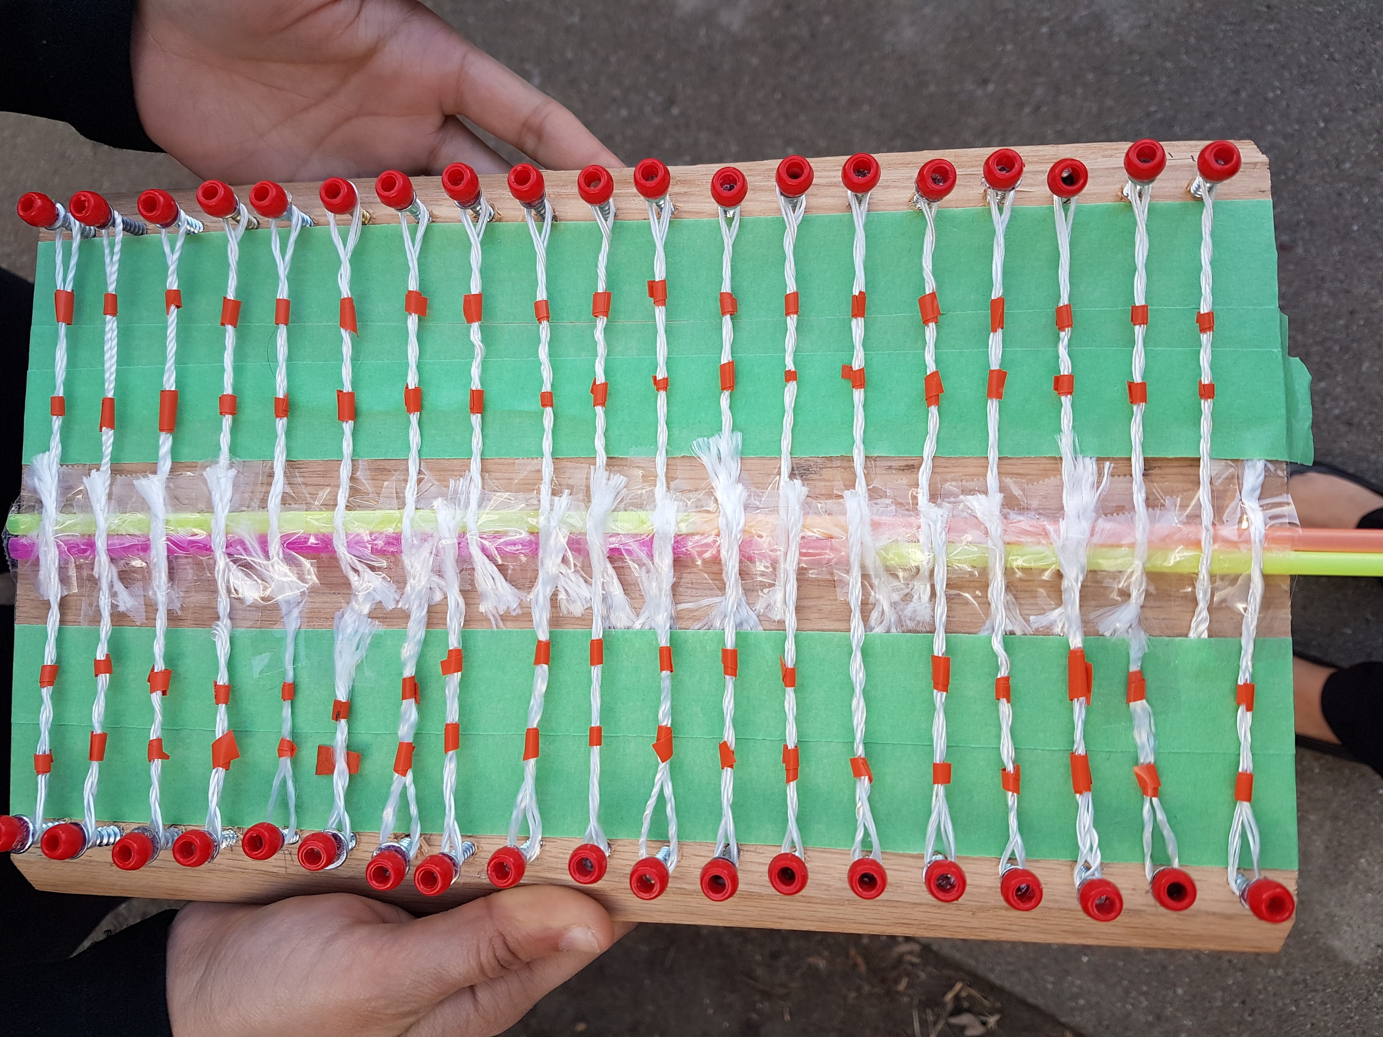
Model of System on a Farm

Slide 24
Future Plans
Hope to use this spring break trip to test solutions and come back with valuable feedback from the farmers.
  Utilize the help of the 22 ME students on the trip to come up with solutions at a hackathon in VIT
Confirming irrigation system will allow us to finalize a storage tank and data on the farm will give us ideas about the location of the tank.
Hope to implement a full scale prototype by this summer.

Slide 25
Questions/Feedback
Water Team
Notes:
All

Slide 26
Pump Team
EPICS : INDIA

Slide 27
Initial Handoff
Needed to reconsider options
Had to take economic factors into account
Had to take social factors into account

Slide 28
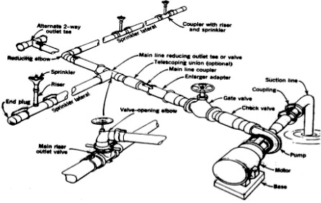
Initial Plan
Taking into account all of the variables without selecting our pump:
Pipe length
Storage elevation
Pipe angles/turns
Power source availability
Flow rate/Pressure

Slide 29
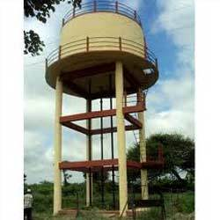
Take other factors into account
Prepare for every possibility
Elevated tank
Groundwater (Bore well)
Rainwater

Slide 30
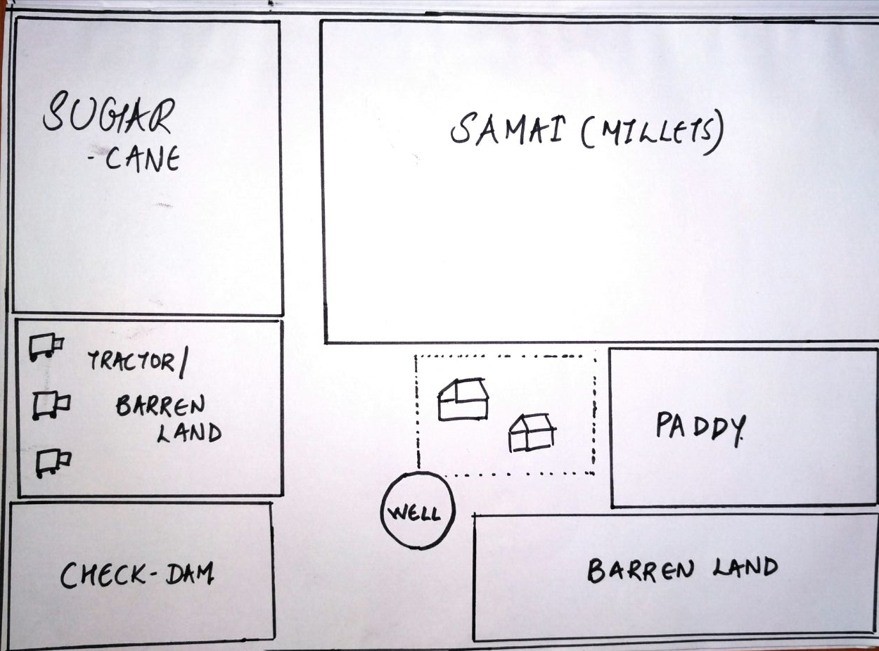
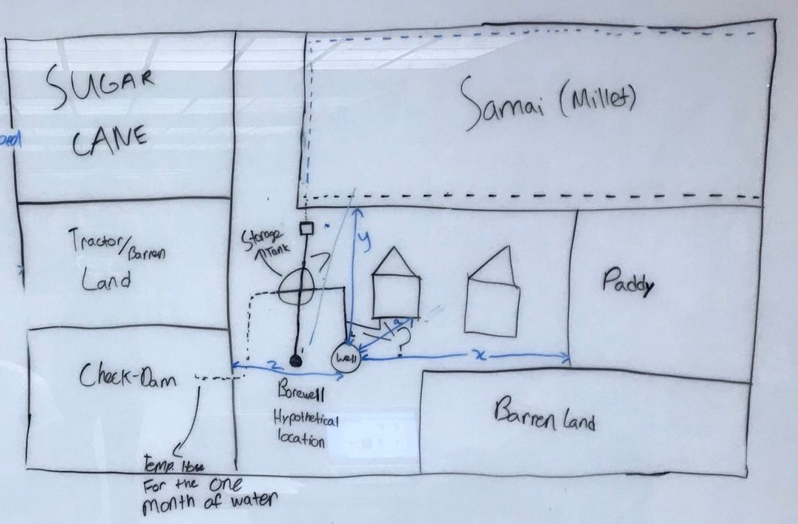
Given these factors, we used the map at the time to get a better understanding of what else needs to be taken into account.

Slide 31
There are essentially three types of electric pumps that we will be working with on this design
End-Suction Centrifugal Pumps
  Will be used to transport the water from a storage tank (if implemented) to the field itself.
  Portable and cheap however it doesn’t work as well up steep inclines
Submersible or Jet Pumps
  Transports water from the borewell to the storage tank or straight to the field. The borewell depth is uncertain, assume around 60-100 feet.
  Can be set to a depth of water so the well doesn’t dry up.
Booster Pumps
  Increases water pressure over the system. Will be used according to the design once again.

Slide 32
Design and Pump selection go hand in hand
Keep in mind that our system can vary from as simple as a two pump system to as complicated as a six pump.
The key is pressure over the system. Water pressure must match the sprinkler head pressure in order for the sprinkler to work.
When it comes to pumps, we follow this equation
Feet Head = Horse Power x 2178 / Gallons Per Minute
Three step process to selecting pumps:
  Estimate flow (GPM) and Feet Head requirements
  Select pumps and draft a design
  Optimize and finetune with respect to cost and efficiency

Slide 33
Future Plans & Updates
Finalize on the crop to be grown in the plot.
Depending on the crop, work with Water Team to calculate the water required to irrigate the crop.
Calculate the pressure required to pump water through the irrigation system (drip tubing and micro-emitters) depending on the values obtained.
Choose a suitable pump.

Slide 34
Questions/Feedback
Pump Team
Notes:
All

