Slide 1
EPICS : HFIC
Health for india’s children

Slide 2

HFIC
Team Introductions
Jacqueline Adams Co-Project Manager
Nia Hightower Co-Project Manager
Adam Cuculich Design Lead
Talia Fix McNamara
Anunai Ishan
Prerena Prahlad
Justin Figueroa Financial officer/Design Lead
Anwesha Sanyal Project Archivist
Rahul Mahewaram
Aditya Mishra
Zixin Ruan
Karthick Shankar
Henry Tingle
Abhijith Vamadev
Kaithlyn Waldman Design Lead
Meesam Zaheer
Xiantian Sun Webmaster
Notes:
Caroline

Slide 3
HFIC
Partner: VIT
The Vellore Institute of Technology was founded in 1984
Accredited with an ‘A’ grade from the The National Assessment and Accreditation Council (NAAC)
VIT’s main campus is an approximately 360 acre span of land located in Vellore. There is also a 170 acre second campus located in Chennai.
They provide education to over 24,000 students coming from all over India and abroad.
  Offering 19 undergraduate, 34 postgraduate, 2 integrated and 4 research programs.
Notes:
Caroline

Slide 4
HFIC
Communication with Partner
Weekly Skype meetings every Friday during lab to stay connected with VIT EPICS team.
Communication with VIT is a priority for this project and we as students have a group message with the students from VIT set up for quick communication.
The students go on site visits to the farms and then they communicate our questions and then return to us answers, data, and pictures.
  More direct line of communications with the user
Notes:
Caroline

Slide 5
HFIC
Purpose
Our team’s objective is to collaborate with VIT students and the farmers in Vellore to create solutions to inadequate water storage, irrigation, and harvesting. The goal is to improve and optimize the water storage, irrigation, and then eventually the harvesting to make the farms more productive and efficient, therefore benefiting the community as a whole.
Notes:
Levi

Slide 6
HFIC
Stakeholders
Farmers in Vellore
Families of the Farmers
Surrounding community
Notes:
Sunny

Slide 7
HFIC
Projects and Teams
Water Project
  Teams
    Storage
      Storing the rainwater so that the crops can be watered year-round
    Irrigation
      Developing a system to properly irrigate the crops
      Anwesha- Design Lead
    Pumps
      Developing a pump for the irrigation systems to properly irrigate the whole of the farm
      Adams and Justin-Co-Design Leads
Harvesting Project
  One Team
    Developing a tool for more efficiently harvesting the crops
    Kaitlyn- Design Lead
Notes:
Levi

Slide 8
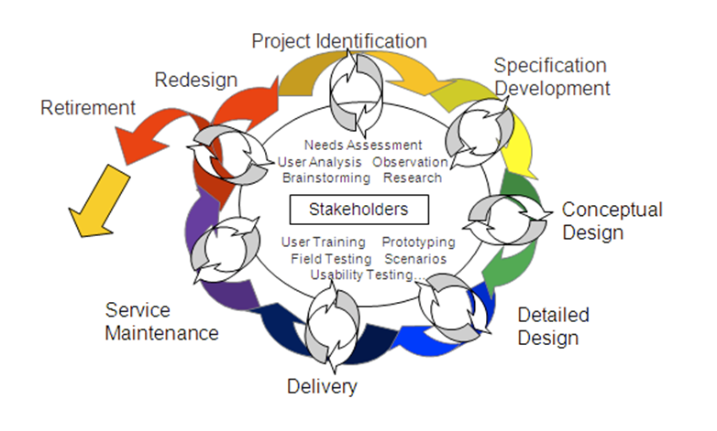
HFIC
Semester Goals
Development of conceptual design for storage, irrigation, pump and harvesting systems
Development of prototype of storage and irrigation systems with pump
Develop deliverables for the trip to VIT in the Spring
Notes:
Sunny

Slide 9
HFIC
Current Status-Water
Specification Phase
  Storage
  Irrigation
  Pumps
Both of the water teams are working to transition out of the specification phase and into the conceptual design phase.
Notes:
Levi

Slide 10
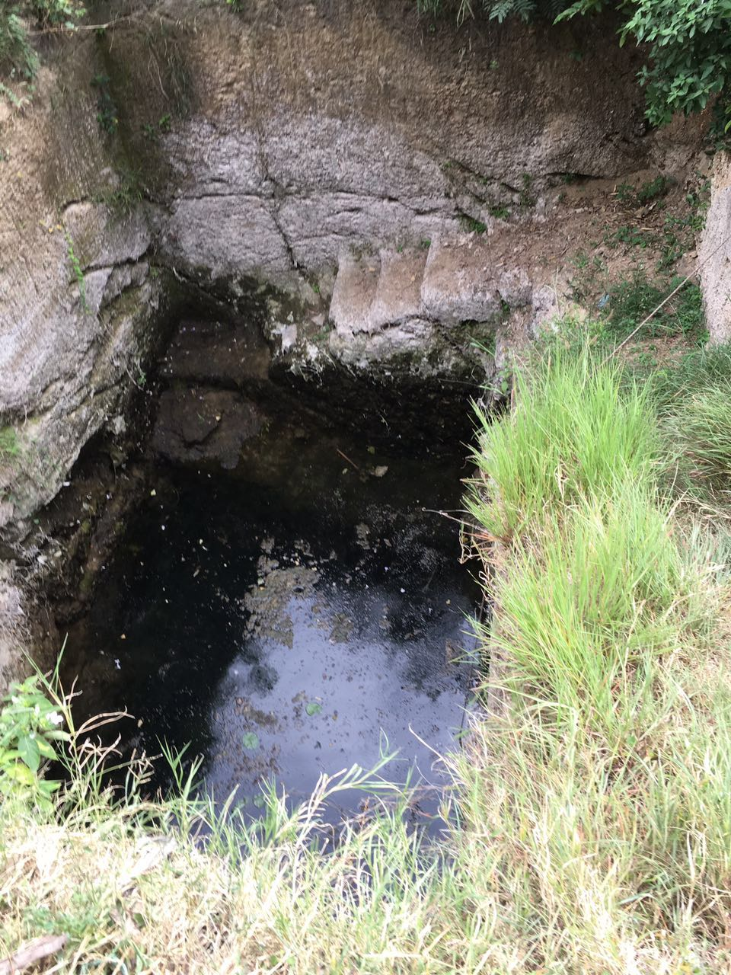
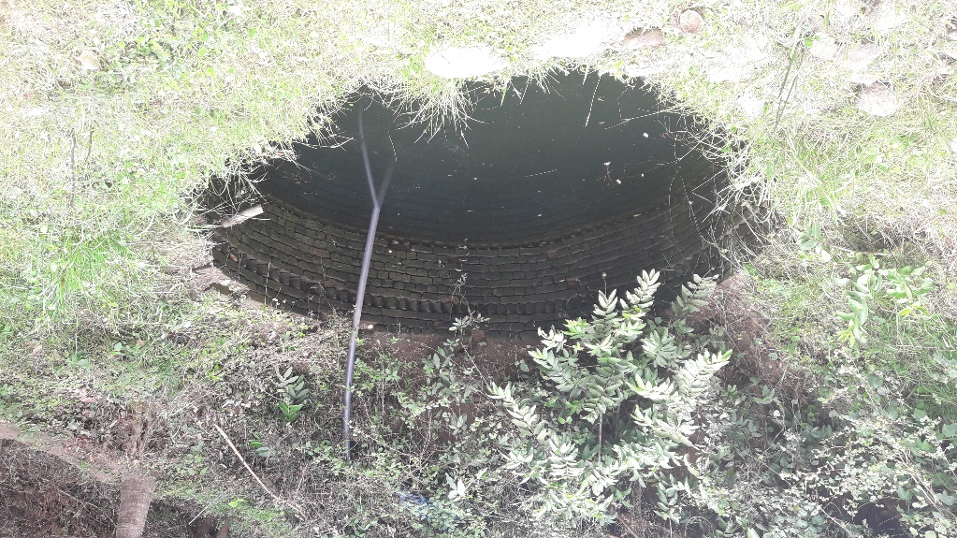
HFIC
Water Storage: Problem Statement and Current System
The farms in the Javadi Hills need a proper source of water and way to store it efficiently. Currently, their water source only lasts during the rainy (monsoon) seasons.
Currently the farmers are using ‘ponds’ in the ground to store the water
  The water collected is not lasting through the Dry Season
Notes:
Levi

Slide 11
HFIC
Water Storage: Current System
Information Gathered from two farms:
  Farm 1:
One well 20-25 ft deep filled w/ rainwater only during rainy season
Check dam 5 ft deep, 49.21ft long and 2ft wide usable only for one month during rainy season
  Farm 2:
Hand pumps fetch groundwater & channels are used to irrigate
7 wells, each about 30-40 ft deep
Canal distribution system or manually irrigate their fields from the well
Notes:
Levi

Slide 12
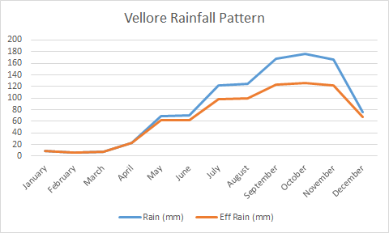
HFIC
Water Storage: Research
Water Availability
For farm one, at an average there is 196mm rainfall annually concentrated over a period of 3 months
The mean annual rainfall for Javadhi hills is 1100.85 mm with 480mm in south west monsoon (June - September) and 429 mm in North east monsoon (October - December)
Notes:
Levi

Slide 13
HFIC
Water Storage: Future Plans
From the next site visit that the VIT students take we hope to gain information on
  Dimensions of the houses on the farm
  Water flow rate from the existing pumps
  Groundwater levels and how they change throughout the seasons
  Daily amount of water needed to irrigate the crops
Meet with experts in water storage and irrigation.
Calculate exact water requirements and begin to build a conceptual design
Research case studies from farms in similar climates to start to design and develop solutions.
Develop a prototype that can be tested and shown to the VIT team in the spring.
Notes:
Levi

Slide 14
HFIC
Water- Irrigation
Currently working with storage team
  Irrigation system cannot be devised without the water storage specifications
Irrigation team has been working with the storage team to accumulate research
However once we move into the conceptual design phase the teams will split up again
  Then the irrigation team will separate and conceptually design and then prototype an effective irrigation system
Notes:
Levi

Slide 15
HFIC
Water- Irrigation
Current system and problems
  Farm 1
    Scarcity of water during summers which forces farmers to go and look for daily wage jobs
    Lack of adequate technologies to use the water table
    No proper irrigation techniques
  Farm 2
    Scarcity of water during non-monsoon months (summer season) –March – May
    Lack of modernized irrigation facilities
Notes:
Levi

Slide 16
HFIC
Water- Irrigation
Crop Analysis
  The three main crops grown in these farms are:
    Saamai (Foxtail Millet)
    Thinai (Little Millet)
    Raagi (Finger Millet)
  The other crop grown is Paddy (Rice)
  The millets are grown on 90% of the land area while rice take only 10%
Notes:
Levi

Slide 17
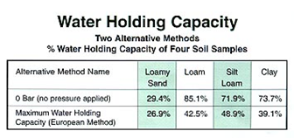
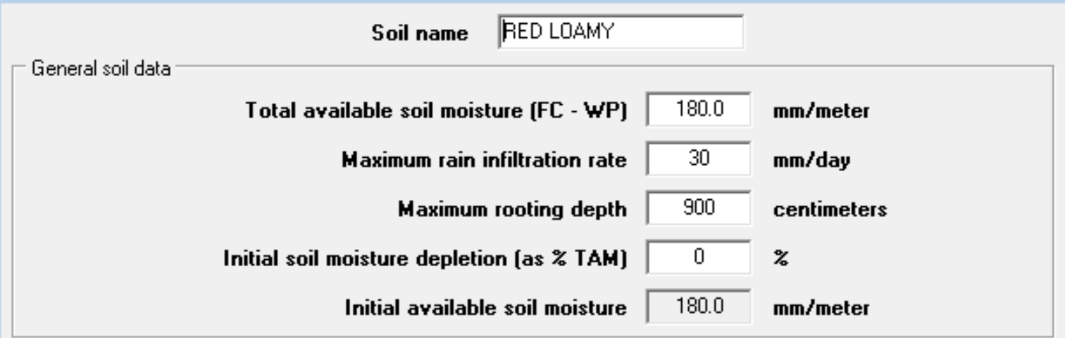
HFIC
Water- Irrigation
Both farms have red loamy soil.
50% of the land area is red loam, 13% clay soil, 12% sandy soil.
Soil Analysis
Notes:
Levi

Slide 18
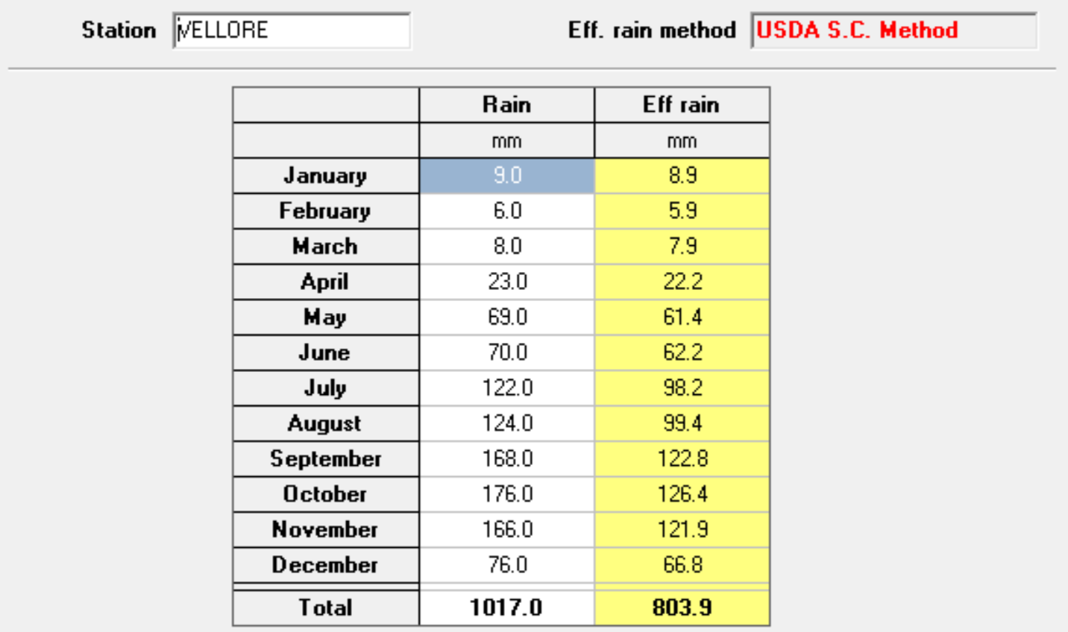
HFIC
Water- Irrigation
Rain Analysis
Notes:
Levi

Slide 19
HFIC
Water- Irrigation
Researched Information
ICU = ET_{c} - P - DS
where ICU = Irrigation Consumptive Water use needed to satisfy Crop Water Demand (mm)
ET_{c} = Potential Crop Evapotranspiration (mm)
P = Effective Precipitation (mm)
DS = Change in Soil Moisture (mm)
Notes:
Levi

Slide 20
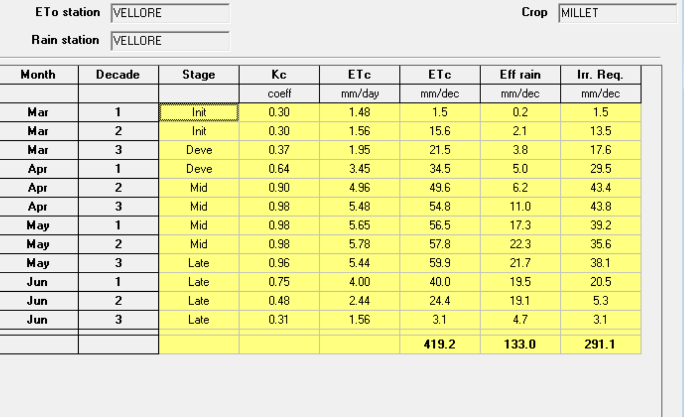
HFIC
Water- Irrigation
Average ICU (Irrigation Requirement) = 2.425 mm/day
1 Acre = 4046.9 m²
Volume of water per acre per day = (2.425x10⁻³)(4046.9) = 9.81 m³/acre/day
Volume of water required = 9810 L/acre/day = 2591.53 gallons/acre/day
Water Requirements- Summer Season
Notes:
Levi

Slide 21
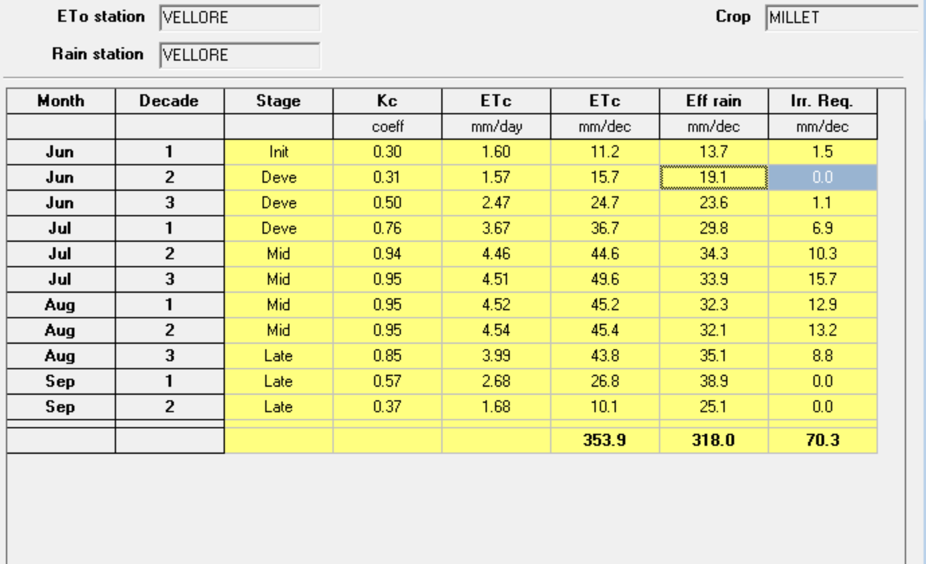
HFIC
Water- Irrigation
Water Requirements- South West Monsoon Season
Average ICU (Irrigation Requirement) = 0.64 mm/day
1 Acre = 4046.9 m²
Volume of water per acre per day = (0.64x10⁻³)(4046.9) = 2.59 m³/acre/day
Volume of water required = 2590 L/acre/day = 684.21 gallons/acre/day
Notes:
Levi

Slide 22

HFIC
Water- Irrigation
Water Requirements- North East Monsoon Season
Average ICU (Irrigation Requirement) = 0.61 mm/day
1 Acre = 4046.9 m²
Volume of water per acre per day = (0.61x10⁻³ )( 4046.9) = 2.47 m³/acre/day
Volume of water required = 2470 L/acre/day = 652.51 gallons/acre/day
Notes:
Levi

Slide 23
HFIC
Water- Irrigation
Future Plans
Collect rainfall data for 2016 and account for changes.
Research on effective irrigation systems prevalent around the world.
Conduct practical analysis with real soil samples.
Acquire data on how much water is currently being used by the farmers.
Notes:
Levi

Slide 24
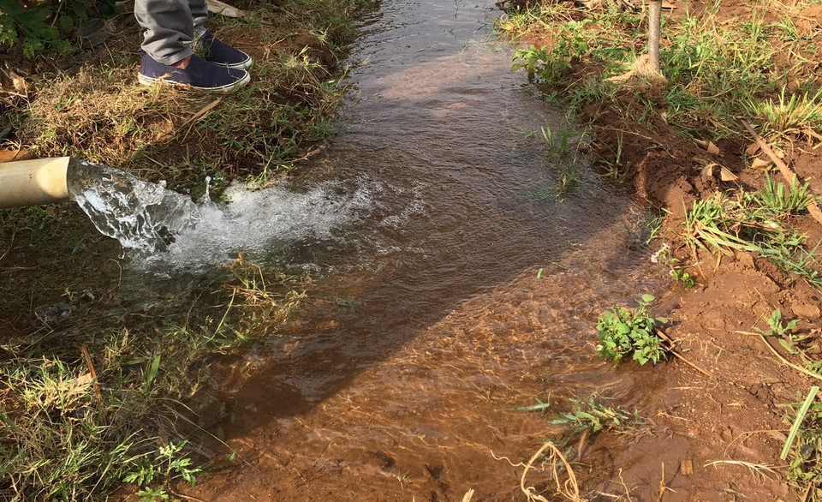
HFIC
Water-Pumps
Specification Phase
Pumps currently in use
  Farmers using a pump to draw water from stream into field
  Engine used was of 5HP
    Kirloskar diesel engine
  Motor was efficient at providing water to 1 acre of field in two hours of continuous use
Notes:
Levi

Slide 25
HFIC
Water: Pumps Specifications
Pump Classifications
  Centrifugal Pump
    Produce flow by increasing the velocity of fluid through the machine via a rotating vane impeller
    Flow is reduced when the viscosity of the liquid is increased.
  Positive Displacement Pump
    Operates via filling a cavity with liquid and then displacing that given volume of liquid
      Delivers a constant volume of liquid each cycle completely independent of discharge pressure
    Flow is Increased when viscosity is increased.
Notes:
Levi

Slide 26
HFIC
Water: Pumps Specifications
Energy Balance
After analyzing the control volume (the pump at hand), the kinetic energy and potential energy in the pump equation cancel out leaving:
W_{(dot)CV} is the required power
M_{(dot)} is the mass flow rate
h₁ and h₂ are the enthalpy values at the inlet and outlet, respectively
Notes:
Levi

Slide 27
HFIC
Current Status-Water: Pumps
Pump Pressure Head
Head a term used to describe the maximum height in meters or feet that a pump can deliver a fluid.
This term comes from pressure:
Pressure = 𝝆*g*h
𝝆 = density of fluid
g = acceleration due to gravity
h = height or *head*
Notes:
Levi

Slide 28
HFIC
Current Status-Water: Pumps
There are generally two different kinds of pumps used. Fossil fuel pumps, and electric pumps.
Pro Electric
Do not require anything but gas and oil.
Are usually very strong and can create large amounts of pressure and water flow
Do not require power set ups.
Con Electric
Very expensive.
Has lots of moving parts increasing failure rate, repair times and costs.
Use expensive fuels.
Are larger and heavier than electric pumps.
Pro Gas
They are smaller than gas or diesel pumps.
They are cheaper than gas systems.
They require less maintenance and are easier to repair.
They can be powered off many different electrical systems.
Are much quieter than their gas counterparts.
Con Gas
They require lots of electricity.
They have an expensive start up cost (power system included).
They can be difficult to run off grid reliably.
Notes:
Levi

Slide 29
HFIC
Water: Pumps
Future Plans
Create a full database of pumps, calculations, and applications useful to the other teams when they decide on a solution for water storage and use.
Research different types of pumps as well as their application with different solutions
Research power solutions such as solar / batteries / and subsidized electricity
Find similar solutions in other countries and learn from them in order to develop a better solution
Notes:
Levi

Slide 30
HFIC
Current Status-Harvesting
Specification Phase
Crops- Farm Specifications
Land size per farmer: 2-5 acres
Main crop: samai
Other crops: corn, tomato, beans , chili and some fruits.
Plough: tractors and oxen
Cultivation: Some farmers cultivate throughout the year. Some farmers cultivate from July to October.
600-700 kg of samai is cultivated per acre if sufficient rain is available, 350-450 kg otherwise
Fertilizer: Small farmers do not use much fertilizer for the crops. Some farmers use organic fertilizer only
Notes:
Levi

Slide 31
HFIC
Harvesting
User Needs
Problem:
Farms in India need further mechanization in order to optimize time spent harvesting.
Needs to meet this problem:
Mechanisms in order to minimize manual labor
Smaller Tractors because the farms are smaller
Multiple tractors so less sharing
Notes:
Levi

Slide 32
HFIC
Harvesting- Research
Methods from Other Countries:
Colorado grows over half the millet in the US
  Drill Seeding/Broadcast Seeding
  Swather
Low Cost Tractor/Trash Tractor:
Building a small tractor out of local and cheap material
  $750+
    As compared to anywhere from $2,000-$12,000 for buying a tractor
Threshing:
Building a multi-purpose threshing out of local and cheap material
  $750+
  Crops, samai
Notes:
Levi

Slide 33
HFIC
Harvesting- Future Plans
Completion of Specification Document
Conceptual Design
Collaboration with John Deere and other professionals
Develop prototype to take to India over spring break
Notes:
Levi

Slide 34
Questions/Feedback
Notes:
All

