Slide 1
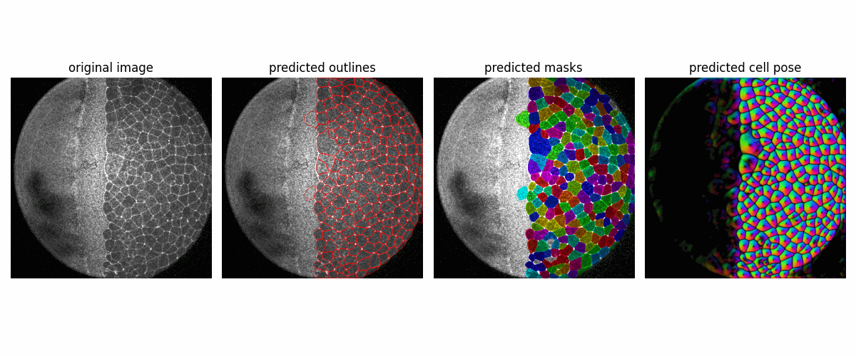
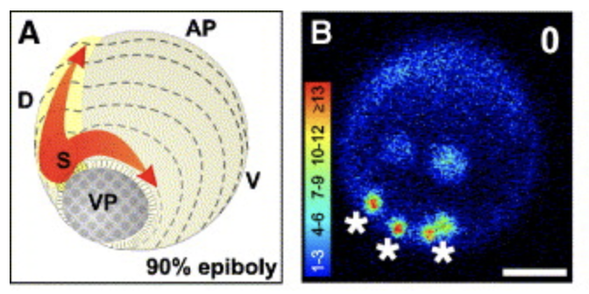
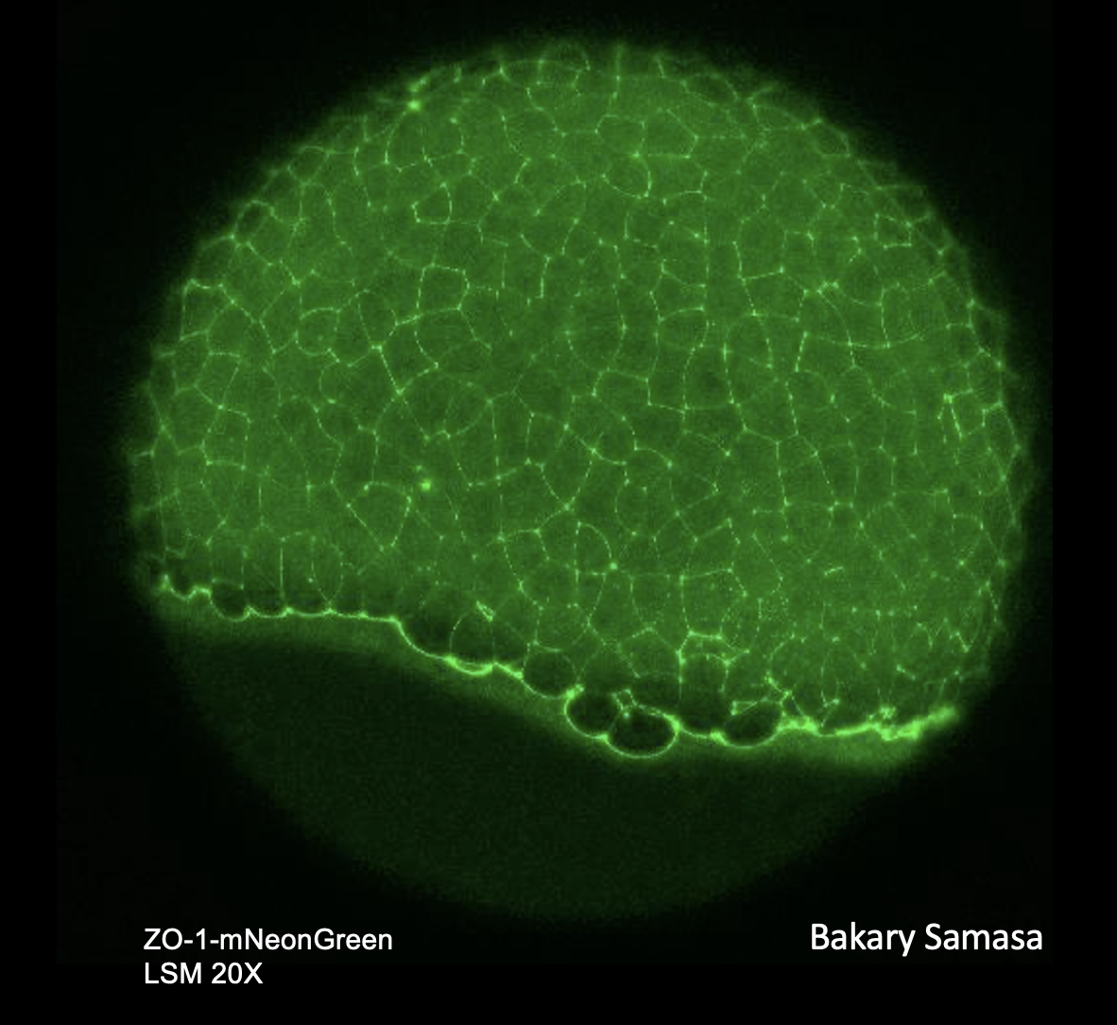
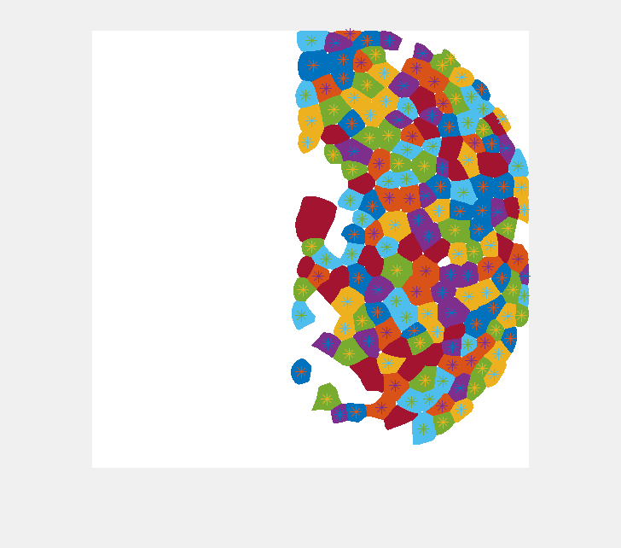
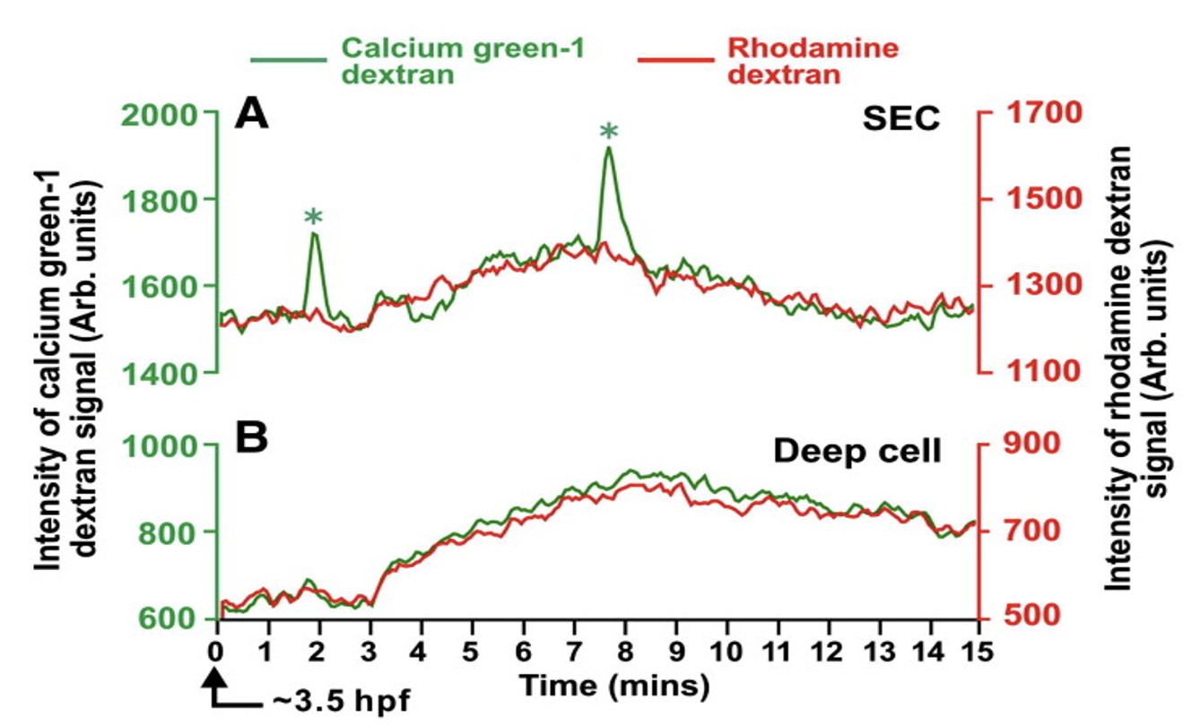
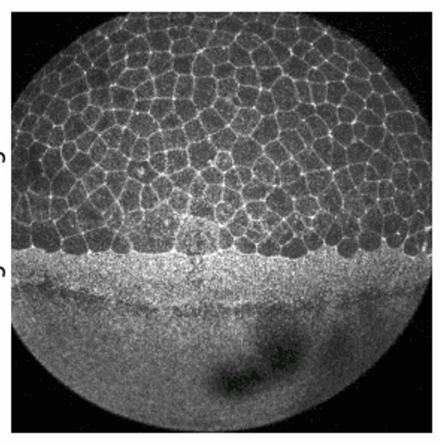
Segmenting EVL cell and tracking individual cell movement in Zebrafish Epiboly
Lionel Loo,Linlin Li, Bakary Samasa, David Umulis, Mary Mullins,
3D-2D maximum intensity projection
Cell segmentation with CellPose
Cell movement tracing
Reconstruct Cell traces in 3D
Analysis of cell shape changes and quantification of Ca2+ signaling
3D
data
Put 3D reconstruction results here
Webb (2006)
2D
images
Developmental Biology 327 (2009) 143–15
Webb, S. E., & Miller, A. L. (2006). Ca2+ signaling and early embryonic patterning during the blastula and gastrula periods of zebrafish and Xenopus development. Biochimica et Biophysica Acta (BBA)-Molecular Cell Research, 1763(11), 1192-1208.

