Slide 1

CONFIDENTIAL AND PROPRIETARY INFORMATION
Notes:
Welcome and thank you everyone for joining us today. Let’s get started.

Slide 2

Fast Facts
16,000+
5,000+
US $16.22B
US $2.2B
Employees
Worldwide
World-Class
R&D Engineers
Group Revenue
in 2024
Brand
Value
Over 160 offices and 1,300 support centers worldwide
CONFIDENTIAL AND PROPRIETARY INFORMATION
Notes:
在全世界華碩的員工已超過16,000位，其中包含了超過5,000位以上的專業工程師團隊,我們目前在全球不同的國家有超過160個辦公據點
品牌再近三個月的平均營收，已經超越2022年疫情的全盛時期

Slide 3

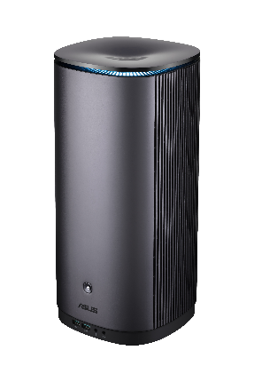
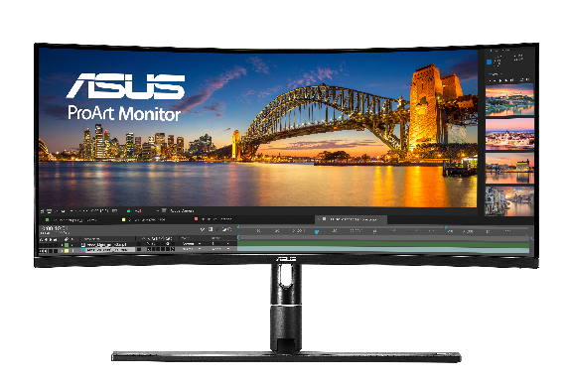
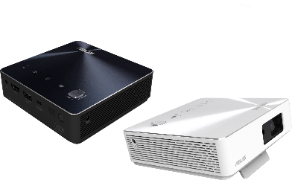
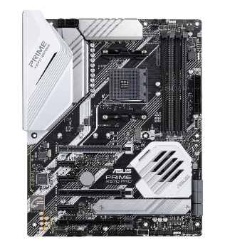
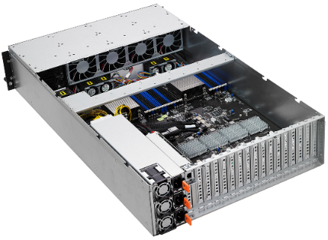
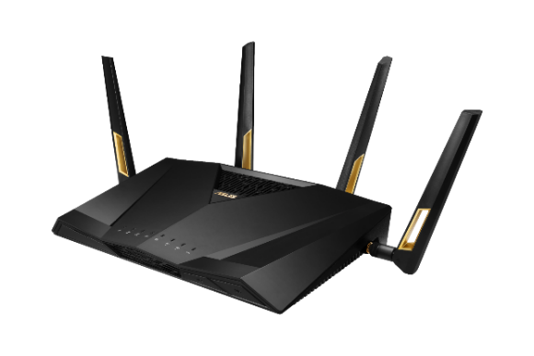
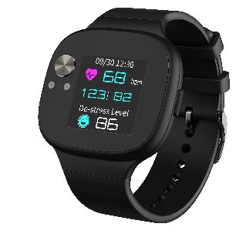

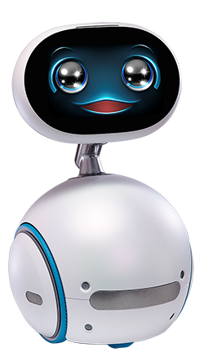
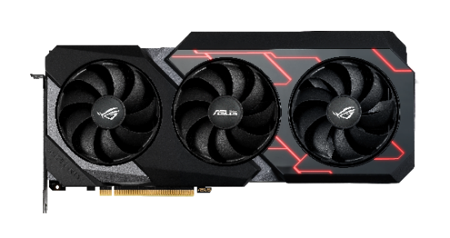
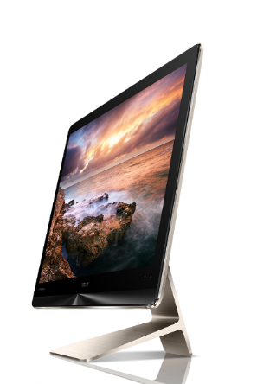
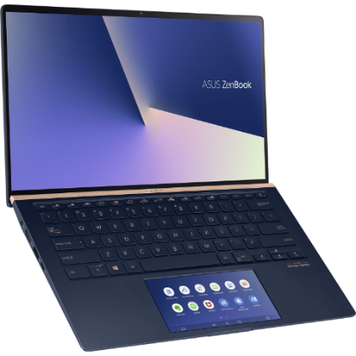
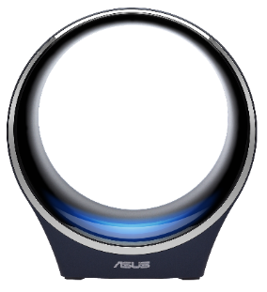
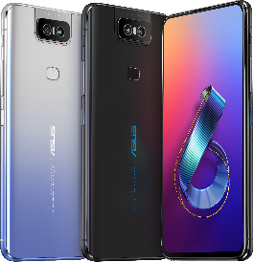

Product Portfolio​
Motherboard
Displays
Servers & Workstations
Projectors
Desktops
Multimedia
2 in 1 Convertibles
Networking
Healthcare
Robotics
Smartphone
Notebooks
IoT/Wearable
All In One
Notes:
或許許多同學都曾使用過我們的筆電或電腦，但你可能不知道，華碩其實是從主機板起家的。自成立以來，華碩已走過35年，始終秉持科技創新與貼近使用者需求的企業使命。華碩不斷開發和設計多元化的產品，例如智慧機器人Zenbo、智慧醫療和物聯網（IoT）產品等。
在ABC領域，也就是所謂的AI人工智慧、大數據和雲端技術方面，華碩也已耕耘多年，追求不斷進步，以滿足消費者的需求。

Slide 4
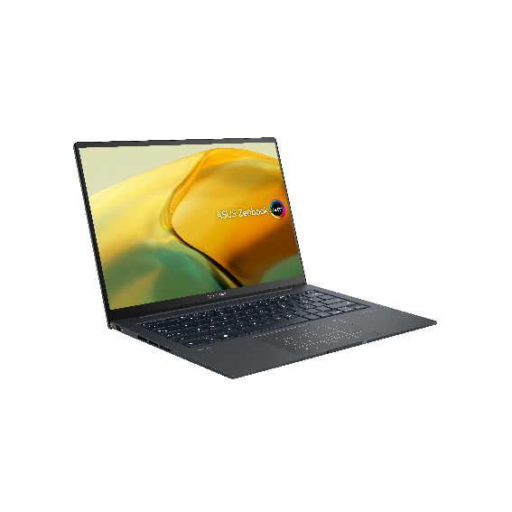
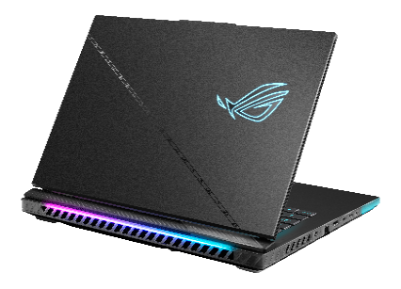
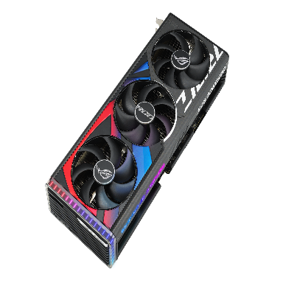

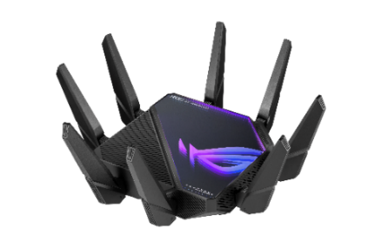
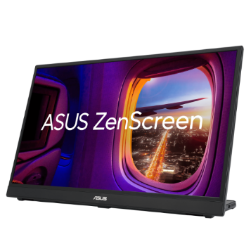
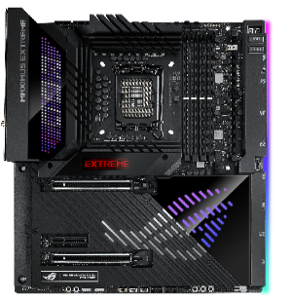
No.1
OLED & Creator
PC Brand¹
No.2 Gaming Laptop
Brand Worldwide ²
No.1 Global
Graphics Card Brand
PCMag’s Best Router
Brand for 11 years
No.1 Global
Portable Monitor Brand
No.1 Global
Motherboard Brand
[1] Based on GFK Y22 annual results
[2] Based on GFK & NPD data
CONFIDENTIAL AND PROPRIETARY INFORMATION
Notes:
華碩雖然是主機板起家，目前佔全球market share1/3，但其他產品例如電競筆電或Router都有不錯的市佔率

Slide 5








Worldwide Recognition
An ever-growing portfolio of products, solutions, and services that continue to garner global accolades
CLIMATE
LEADERS 2022
One of the World's Most Admired Companies (for 7 years)
Best Global Taiwan Brand
(for 9 years)
World’s Best
Employers 2022
Recognized by the Financial Times, Nikkei Asia, and Statista as one of the Climate Leaders in Asia-Pacific 2022
Good Design
Award 2022
Red Dot Design
Award 2022
iF Design
Award 2022
Golden Pin
Design Award
CONFIDENTIAL AND PROPRIETARY INFORMATION
Notes:
As you can see from our numerous awards, our unique approach to delivering incredible experiences to our users has been validated over and over again.
And, we are not just ambitious in the products we make. We are just as ambitious when it comes to climate action and corporate social responsibility
Note: presenter should pick the awards most relevant to them rather than reading out all of them.

Slide 6





Sustainability
Begins at Home
CONFIDENTIAL AND PROPRIETARY INFORMATION
Notes:
But, at ASUS, creating the incredible goes far beyond technology.
We strive to be a world-leading green high-tech company that is building a better, more sustainable world for everyone.
That’s why we integrate Corporate Social Responsibility into every business decision we make – and set measurable, meaningful goals in the pursuit of an incredible tomorrow.
For example, at our headquarters, our new Li-Gong building was designed with sustainability in mind and is LEED V4 Platinum certified — the highest level for energy efficiency and environmental sustainability.
This is just one of the many sustainable actions we have taken, there are many more to come.

Slide 7

User-Centricity
Drives Continuous
Transformation
CONFIDENTIAL AND PROPRIETARY INFORMATION
Notes:
A key part of this uniqueness is our focus on User Centricity.
In order to continuously innovate and deliver incredible experiences, ASUS places the user at the center of everything we do.
It is this User Centricity that drives our continuous transformation.
And, in order to ensure consistency over time, we have created clear processes and methodologies to guide us.

Slide 8

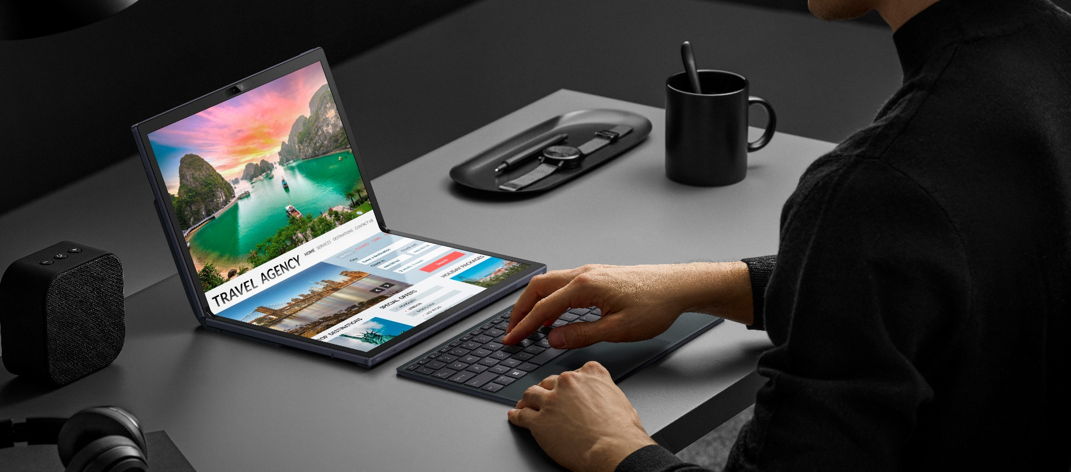
Design Thinking:
Start With User Needs
and Leverage User Insights
For product design, innovation, and engagement, we collaborate across different disciplines to solve user pain points.
CONFIDENTIAL AND PROPRIETARY INFORMATION
Notes:
Central to this is Design Thinking.
This starts with putting people first.
We continuously explore our users’ needs and leverage user insights to drive operations across the entire company.
Beyond product innovation, design, and R&D, we use Design Thinking for business development, process improvement, career growth, and more.
This approach delivers incredible experiences to users and is a key factor in our success.
This level of user-centricity enables cross-functional collaboration to efficiently solve user pain points.
Achievements developed from this line of thinking include:
The ASUS Dial, which helps content creators customize their workflows
The Zenbook 17 Fold OLED -- the world’s first 17” foldable OLED laptop, and winner of the 2022 Red Dot Product Design Award
And, incredible integrated solutions in smart manufacturing, smart retail, and smart medical.
But we don’t just rely on Design Thinking by itself. This powerful concept is integrated into our ASUS Golden Triangle Principle.

Slide 9

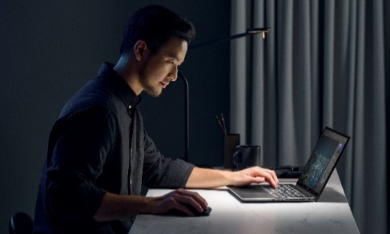
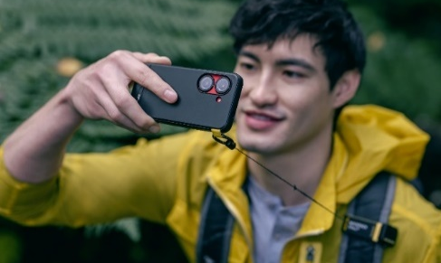


Cloud
Computing
Personal Computing
Mobile Computing
IoT Computing
AI Computing
CONFIDENTIAL AND PROPRIETARY INFORMATION
Notes:
Today’s ASUS is fully embedded into the current era of ubiquitous computing, where everything is interconnected.
Building upon our solid foundation in edge computing devices, we have expanded our focus to cloud computing.
Within this area, ASUS helps businesses design and develop their cloud infrastructure. This includes hardware and software, such as servers, storage, networking, virtualization software, and other resource management tools.
We also provide infra-as-a-service (IaaS) to help businesses with the operation and maintenance of their cloud infrastructure.
And, we offer platform-as-a-service (PaaS) for AI developers and software-as-a-service (SaaS), including ASUS WebStorage and other cloud-based solutions for healthcare providers to implement a cloud-based healthcare information system or digitalize data. [e.g. AICS xHIS, OmniCare]
And that is not all, we are offering services across a wide range of areas, such as…

Slide 10

Professional Solutions to Empower Enterprises
Today’s ASUS is growing strong in
the commercial market thanks to
decades of evolution and experience.
CONFIDENTIAL AND PROPRIETARY INFORMATION
Notes:
In the commercial market, where ASUS is seeing strong growth thanks to our decades of evolution based on user insights, as well as our agile and flexible approach to the needs of each organization
We help businesses to succeed and grow by delivering experiences that span AIoT and smart manufacturing solutions, business laptops, and PC innovations that facilitate remote work.

Slide 11

Building the Future of Education Together
We help bridge the gaps between
students, teachers, and computers —
both in and out of the classroom —
via seamless integration with
cloud platforms and services.
CONFIDENTIAL AND PROPRIETARY INFORMATION
Notes:
And, we have a range of solutions designed to facilitate learning and teaching from anywhere, and to streamline IT management, ASUS is making an impact on all aspects of education — for students, parents, teachers, and school administrators.

Slide 12
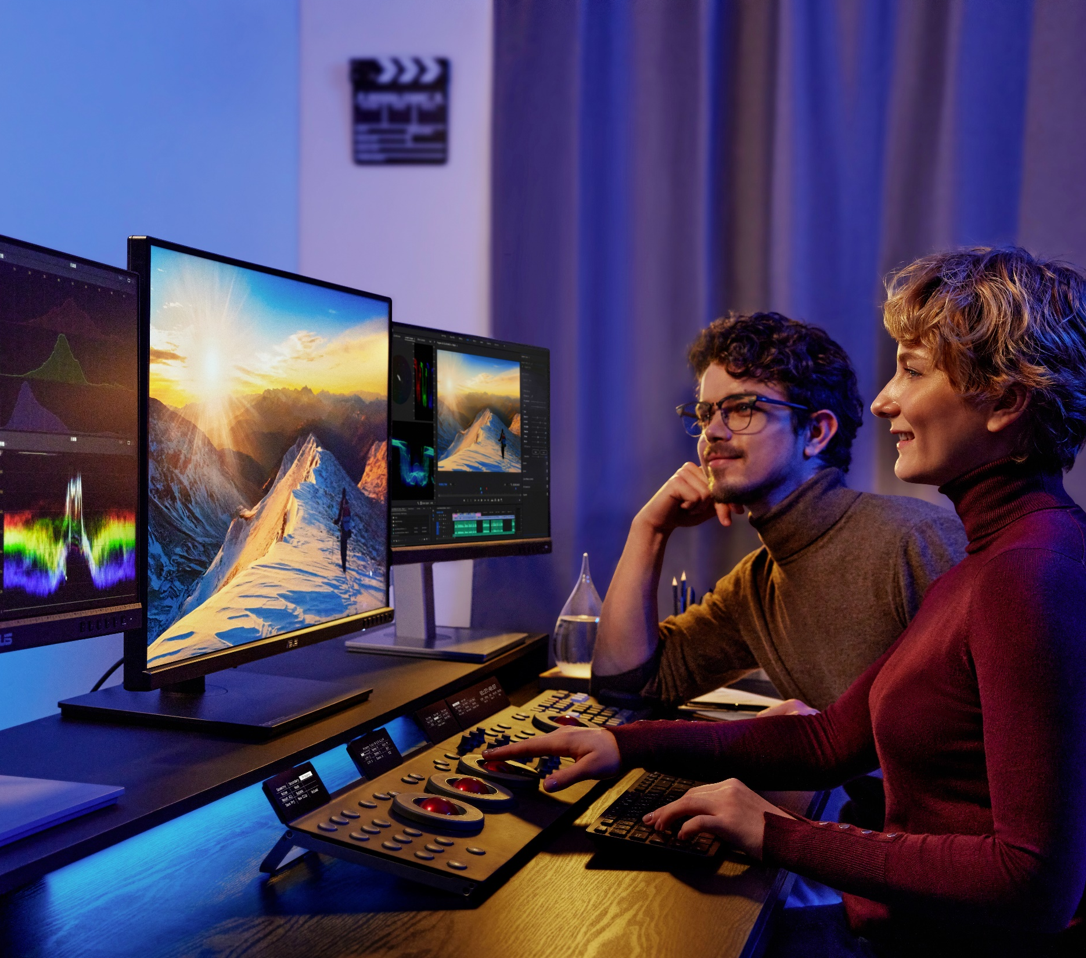
From Imagination to Creation
The ASUS ProArt lineup for creators
brings out the passion of users to
unleash creativity and push the limits
of artistic possibilities.
CONFIDENTIAL AND PROPRIETARY INFORMATION
Notes:
And, we are empowering creators with products like our ProArt lineup.
ASUS enhances the work of all kinds of creators and artists with robust visuals and specialized features that streamline creative workflows.

Slide 13
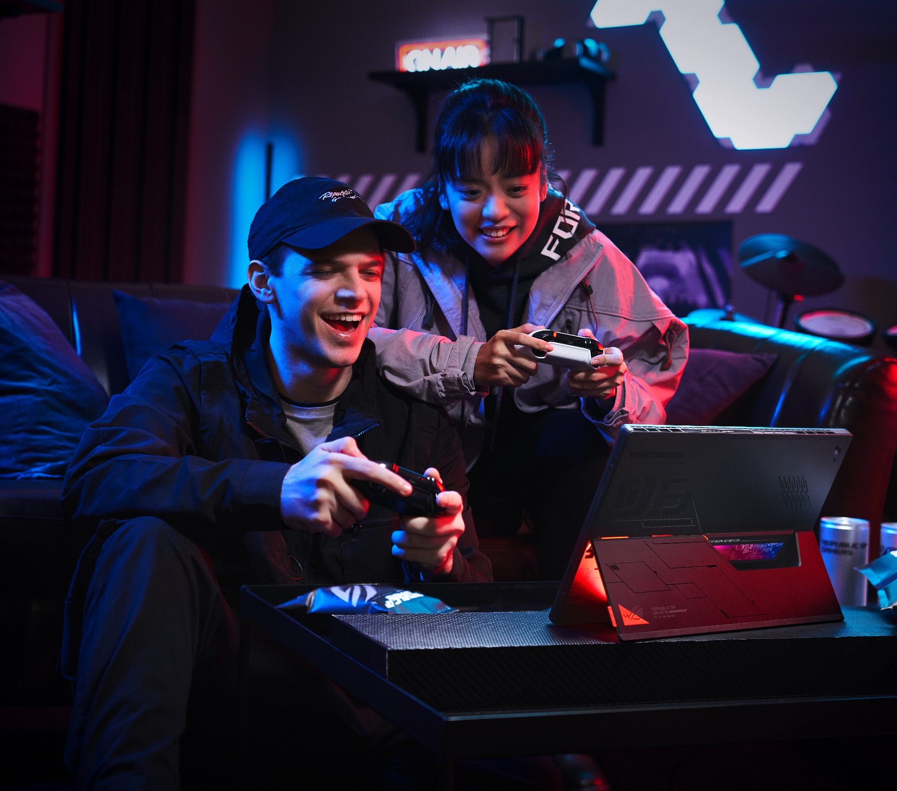
The Power to Win
ASUS is the gaming leader
because we drive future trends
yet leave nobody behind.
CONFIDENTIAL AND PROPRIETARY INFORMATION
Notes:
We are helping gamers take their gaming to the next level with incredible ASUS products and products from our sub-brand, Republic of Gamers (ROG)
From giving DIY PC gamers a winning edge with top-notch components and peripherals, to pushing the envelope to offer mobile and console gamers the very best, we provide a comprehensive ecosystem that fosters a gaming community and gives all types of gamers the path to victory — the world’s best hardware and software.

Slide 14
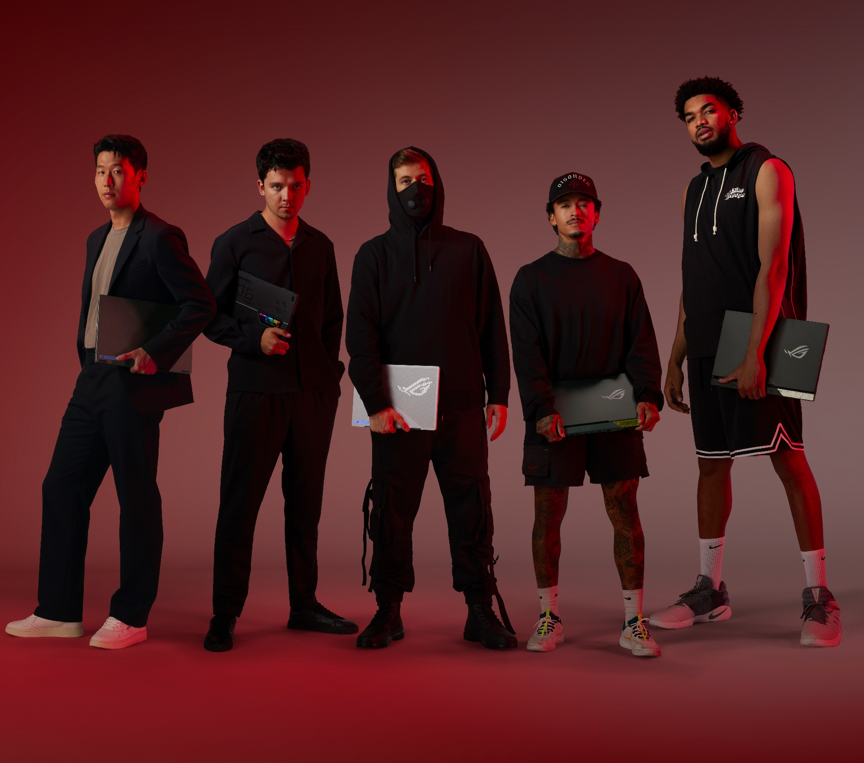
Partnerships and
Collaborations
ASUS embraces innovation through diverse partnerships and collaborations.
CONFIDENTIAL AND PROPRIETARY INFORMATION
Notes:
But gaming is no longer simply about games, competition, winning, and losing.
It’s evolved into a worldwide lifestyle, an evolution that ASUS has embraced and advanced through collaborations like those between ROG and superstar artist, DJ, and music producer Alan Walker;
We have also done a major collaboration with IKEA, combining a deep understanding of the gaming lifestyle with the major furniture brand’s home furnishing knowledge and expertise to deliver synergies that give gamers the gaming spaces they have always imagined.

Slide 15


Smart Retail
ASUS delivers tailor-made retail solutions
to maximize consumer insights & empower businesses.
Applications include:​
Digital Signage​
Self-checkout Kiosks​
Interactive Self-service Kiosk​s
POS Terminals​
Vending Machines​
CONFIDENTIAL AND PROPRIETARY INFORMATION
Notes:
ASUS Smart Retail offers tailor-made solutions that empower businesses by leveraging customer insights and enhancing shopping experiences, delivering value for both retailers and their customers. ​
ASUS IoT smart retail solutions are designed for retailers that need powerful systems built to withstand commercial environments and support for extensive AI capabilities. ​
We provide a comprehensive product range and competitive tailored solutions for any retail environment, helping store owners to make the most of their budget and upgrade the operational efficiency of their business. ​
Applications include digital signage, self-service kiosks, POS terminals, vending machines, and more. ​
Other ASUS Smart Retail solutions include: ​
ASUS IoT Face Recognition Edge AI Dev Kit, a one-stop solution for identifying faces and other key personal markers.​
ASUS IoT ALPR Dev Kit, a comprehensive automatic license-plate recognition (ALPR) solution that includes both the necessary hardware and software to enable systems integrators (SIs) to create edge applications.​
ASUS premium hardware, together with powerful software and a network of talented integrator partners, provides the best, most complete solutions for digital signage needs.

Slide 16
Smart
Manufacturing
ASUS Smart Manufacturing solutions maximize the intelligence and efficiency of factory equipment to create lasting value for manufacturers.
CONFIDENTIAL AND PROPRIETARY INFORMATION
Notes:
ASUS Smart Manufacturing solutions transform factory equipment into highly intelligent business assets that reduce costs, increase safety, improve quality assurance and provide greater overall equipment effectiveness for manufacturers.
This includes both hardware and software solutions.
Hardware solutions include entry-level to high-end industrial motherboards and edge computers capable of withstanding harsh environments.
Software solutions include the ASUS AISVision AI toolkit that helps customers build AI models for automated optical inspection (AOI).
For quality inspection and defect detection, the ASUS AISVision application provides more consistent and faster results than human inspectors and can store data for auditing and tracing purposes. It can be used in the production phase and, with an intuitive user interface, a production engineer or line manager can create an AI model in under a minute without requiring any AI expertise.
This is just one example of the power of the AI toolkit, which reduces development time of AI models by up to 80% and since it can run on an ordinary Intel CPU without any AI accelerator, dramatically improve efficiency, accuracy, investment, and cost-savings.

Slide 17

Smart Healthcare
ASUS drives AI-powered healthcare
across devices, platforms, software
and services for greater efficiency,
better experiences and outcomes.
CONFIDENTIAL AND PROPRIETARY INFORMATION
Notes:
ASUS Smart Healthcare is empowering individuals to take better care of themselves and empowering medical professionals and institutions to provide better, smarter care the world over.​
These solutions address preventative care, digital diagnosis, and telecare services, as well as a cloud platform that protects health information, boosts productivity of health professionals, improves health data insights, and more. ​
For example:​
ASUS VivoWatch helps with health tracking and preventative care.​
EndoAim, an AI-powered software for colonoscopy, enables digital diagnosis and enhances the inspection quality and efficiency of healthcare professionals.​
Our telecare solution gives patients quick access to care and easy health maintenance, allowing healthcare professionals to provide telemedicine services. ​
ASUS xHIS platform, a cloud-based SaaS healthcare information system, helps ease the burden of healthcare providers.

Slide 18

Thank you
For more information
Visit ASUS
www.asus.com
CONFIDENTIAL AND PROPRIETARY INFORMATION

