Slide 1
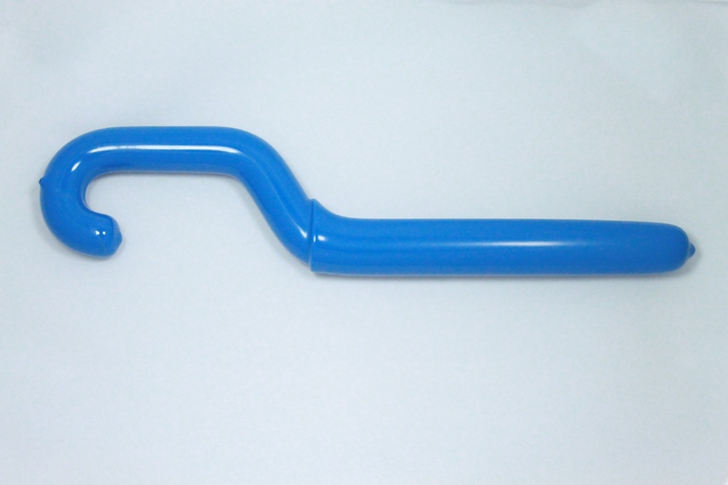
Using a Gas Cylinder Wrench to Remove Stuck-On Caps From Gas Cylinders
ChE Safety Committee Recommendations
If your gas cylinder has the cap STUCK ON and this can’t be removed by hand:
DO NOT USE a regular wrench, hammer, crowbar, etc. to remove the cap that is stuck due to rust, worn threads, etc.)
Do not use WD-40 or other lubricant on the gas cylinder
To SAFELY REMOVE a CYLINDER CAP, use a dedicated Cylinder Wrench , such as the Matterson TW-5 Cylinder Handwheel Wrench. This tool can also be used for opening cylinder valves (see next page for details)
The ChE Safety Committee recommends that labs using gas cylinders also keep a Matterson TW-5 Cylinder Handwheel Wrench, or a similar product in the lab
If using the special tool does not help and you are unable to remove the cap, or to open the valve safely, contact the supplier to replace the cylinder

Slide 2
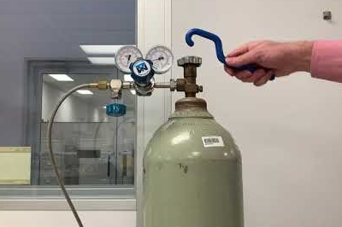
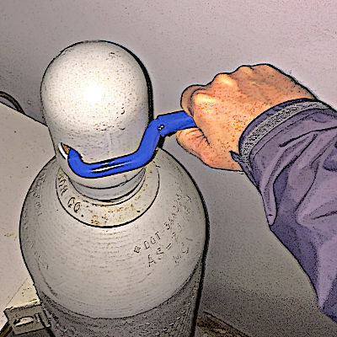
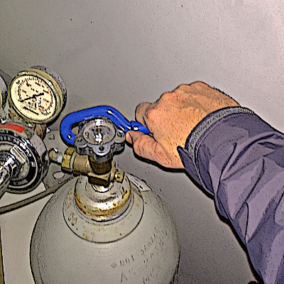
Use of TW-5 Cylinder Handwheel Wrench to Safely Remove Stuck-On Caps From Gas Cylinders and Open Cylinder Valves
Removing a gas cylinder cap with the Matterson TW-5 Cylinder Handwheel Wrench
Video: Use of Matterson TW-5 Cylinder Handwheel Wrench
TW-5 Cylinder Handwheel Wrench
https://store.mathesongas.com/tw-series-cylinder-wrenches/
Opening a a gas cylinder valve using the Matterson TW-5 Cylinder Handwheel Wrench

