Slide 1

Science and Chemical Engineering around the World… Really!
:
Leon L. Robert Jr., PhD
Consultant, Purdue Military Research Institute (PMRI)
Brigadier General, U.S. Army (Ret.)
Professor Emeritus, United States Military Academy

Slide 2
Overview
Professional Background
Soldier-Scientist
Academic Experience & Accomplishments
Pyrotechnics Research
Collaborations with Purdue
Current DoD Grant with Purdue
PMRI Consulting
Oil/Gas and Steel Industries
Summary

Slide 3
Professional Background
PhD in Entomology, Texas A&M University
30+ year U. S. Army career in Public Health
  Brigadier General (retired, Oct 1, 2017)
  Distinguished Service Medal (highest award)
Two combat tours (Afghanistan & Djibouti/Somalia
Six overseas tours (Honduras, Korea, Kenya, Germany, Albania, Kosovo)
Battalion Command, Ft. Lewis, WA
Department Head, Chemistry, Life Science and Chemical Engineering, United States Military Academy, West Point
Check-6 International Inc., 2018 - present

Slide 4
Solider-Scientist
Research Entomologist, WRAIR, 1987-90
Commander, Medical Company, 5th PMU, Korea, 1990-91
Head, Leishmaniasis Research Unit, USAMRU-Kenya, 1992-95
Asst. Professor, Dept of Chemistry, USMA, 1995-98
Head, Entomology Dept, CHPPM-Europe, Germany, 1998-01
Assoc. Professor, Dept of Prev Med & Biom. USUHS, 2001-03
Commander, Sci & Tech Battalion, Ft. Lewis, WA, 2003-05
Assoc. Professor & Dep. Head, Department of Chemistry, Life Science and Chemical Engineering, USMA, 2005-10
Vice Dean, National Military Academy of Afghanistan, Kabul, Afghanistan, 2009-10
Professor & Head, Department of Chemistry, Life Science and Chemical Engineering, USMA, 2011-17

Slide 5
Academic Accomplishments
41 Peer-reviewed publications and 3 book chapters
Sabatini, J.J., J.D. Moretti, D.R. Hall and L. L. Robert. 2013. Recover, recycle, and reuse: Prove-out of pyrotechnic illuminants containing demilitarized magnesium. ChemPlusChem, 78:1358-1362. Wiley VCH publisher featured this paper amongst their "hottest papers" in the area of sustainable chemistry.
U. S. Patent
Sabatini, J.J., L. L. Robert Jr., and J.D. Moretti. Magnesium/Alkyl Polysulfide White Star Illuminants, Patent No.: US 9,193,637 B1, Date of Patent: Nov 24, 2015.
Peer-reviewed Conference Publications:
L.L. Robert, D.R. Hall, J.M. Raab, S.L. Lowell, J.J. Sabatini and J.D. Moretti. 2014. Physical and Chemical Analysis of Demilitarized Magnesium: Teaching the Next Generation of Energetics Professionals. Proc. 40th International Pyrotechnics Society Seminar, 40:392-397.
J.J. Sabatini, J.D. Moretti, D.R. Hall and L.L. Robert. 2014. Recover, Recycle, and Reuse: Prove-Out of Pyrotechnic Illuminants Containing Demilitarized Magnesium. Proc. 40th International Pyrotechnics Society Seminar, 40:398-405.
Vice Dean, National Military Academy of Afghanistan
Safi, N., G.D. Davis, M. Nadir, H. Hamid, L.L. Robert and A.J. Case. 2012. Evaluation of thermotherapy for the treatment of cutaneous leishmaniasis in Kabul, Afghanistan: A Randomized Controlled Trial. Military Medicine 177:345-351.

Slide 6
Grants Awarded
Department of Defense, Deployed Warfighter Protection Program. 2022-2025. $900K DoD Pesticide Usage Web-Based Archival and Retrieval System and iOS Mobile App. (Co-PI). Funded.
Program Executive Office – Ammo (PEO-Ammo). 2015-16. $100,000. Enhanced lethality of the M759 155-mm artillery high explosive unitary round using a potential new combination of fragmentation, fusing, and explosive fill (PI).
PEO-Ammo Grant. 2014. $50,000. Defining the characteristics of pyrotechnics mixing of explosive and pyrotechnic surrogate compounds using acoustic mixing technology (PI).
PEO-Ammo Grant. 2013. $50,000. Developing a chlorine-free variant of the red-light-emitting flare (PI).
United States Army Armament Research, Development and Engineering Center Grant. 2012. $10,000. Physical and chemical analysis of demilitarized magnesium (PI).
U. S. Army Medical Research and Materiel Command Grant. 2010-2013. $150,000. siRNA therapeutic to address heterotopic ossification, a condition of uncontrolled bone spur growth following combat-related amputation (Co-PI; Jeffrey Hollinger, Carnegie Mellon University, Co-PI).

Slide 7
Academic Leadership Accomplishments
Initial ABET accreditation for Chemical Engineering Program
  Next General Review (NGR) – The program had no deficiencies or weaknesses (Accreditation for six years).
Initial American Chemical Society approval of Chemistry major
Increased female leadership positions within the Department from 0/6 to 4/6
Began sabbatical and post-doc programs within the Department
Increased external research funding by 500%
Member, Doctoral Committee, Anthony Chase, Purdue Univ.
Completed $150M renovation of Science Center at West Point to include new Chemical Engineering Research and Teaching Labs

Slide 8
Improving Critical Thinking via Authenticity: The CASPiE Research Experience In A Military Academy Chemistry Course
The Center for Authentic Science Practice in Education (CASPiE) is “a multi-institutional collaborative project that aims at providing course-embedded authentic research experiences for undergraduate students during advanced general chemistry course.
The Chemical Engineering Group worked to determine which scrubbing method (e.g., solid phase material or liquid solvent) was most effective at removing unwanted tars from the gas of a prototype gasifier used for a Army power generation unit.
Tony Chase, Purdue PhD student, lived and conducted research at West Point for a full academic year. Speaker was on his PhD Committee and attended Committee meetings virtually from Djibouti.
Students reported significant increases in their perceptions of learning through the laboratory, authentic scientific laboratory practices and interest in chemistry when compared to previous chemistry courses with traditional laboratory activities.
Significant increase in critical thinking scores, moderated by student perception of the authenticity of the laboratory activities.
A. M. Chase , H. A. Clancy , R. P. Lachance, B. M. Mathison, M. M. Chiu and G. C. Weaver . Chem. Educ. Res. Pract., 2017, 18, 55-63

Slide 9
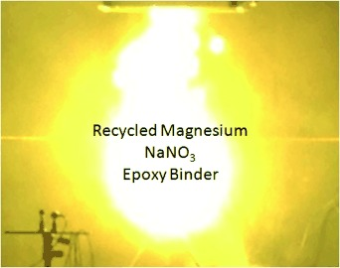
Recover, Recycle, and Reuse Demilitarized Magnesium
Design, build, and operate a process for the recovery of magnesium (Mg) from obsolete or unserviceable illuminating rounds
Requalify and use recovered Mg in new munition.

Slide 10
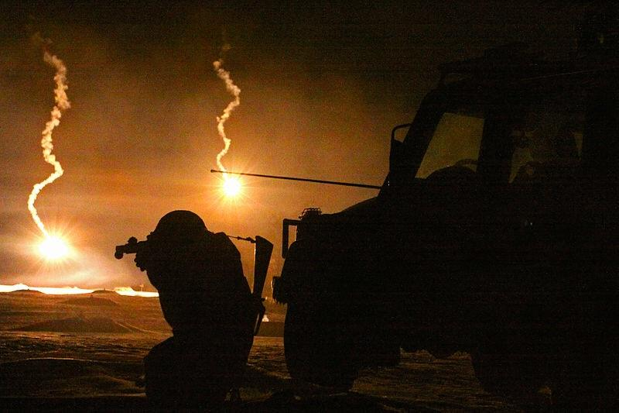
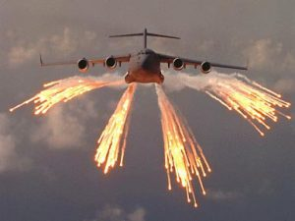
Recover, Recycle, and Reuse (R³) Demilitarized Magnesium
Pyrotechnic compositions of magnesium/sodium nitrate/binder are widely used in military flares.
The demilitarization of excess, obsolete, or unserviceable flares and other energetic waste currently relied on open burning and open detonation (OB/OD) – a practice that produces an ongoing uncontrolled release of Per- and polyfluoroalkyl substances (PFASs) and other toxic chemicals to the environment.
81mm mortar flares
C-17 Globemaster flares

Slide 11
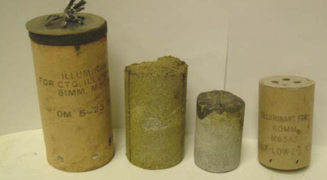
Recover, Recycle, and Reuse (R³) Demilitarized Magnesium
Goals : Design, build, and operate a prototype process for the recovery of magnesium (Mg) from obsolete or unserviceable illuminating rounds
Implement an R³ effort
350,000 pounds of Mg for reuse or sale (110,000 munitions)
240,000 pounds of sodium nitrate (NaNO₃) byproduct to sell instead of dispose
Estimated savings is up to $10 per pound ($3.5 M) of Mg
Avoids incineration and potential environmental impact
Eliminate single point failure (SPF) in Laminac 4116 supply. Also has a 6-month self life before it starts to degrade.
Composition of then current in-service US Army M127Al White Star Illuminant.
________________________________________________
Weight
Component Percentage (%)
________________________________________________
Magnesium 30/50 (fuel) 66%
Sodium Nitrate (oxidizer) 29%
Laminac 4116/LuperSol 5%
Binder System

Slide 12
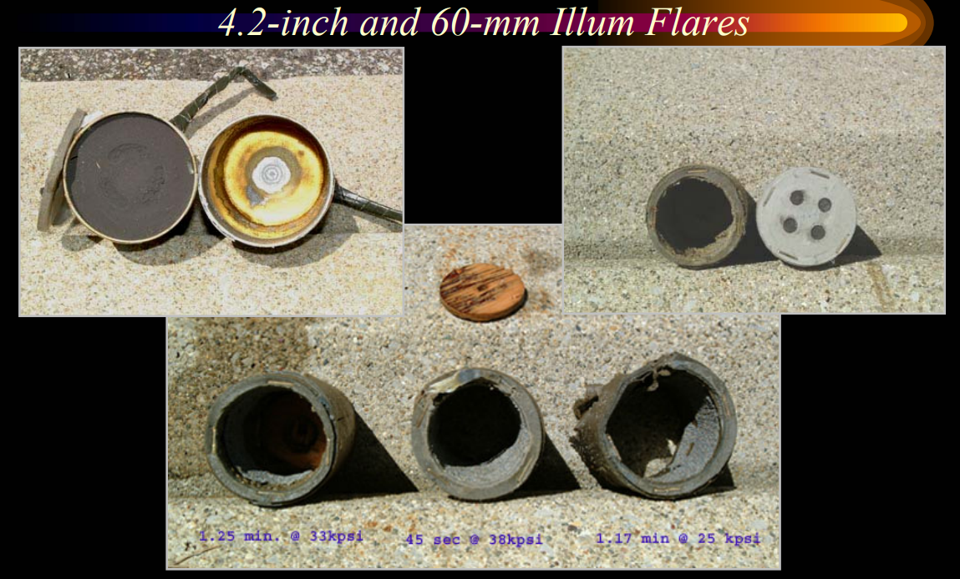
Recover, Recycle, and Reuse (R³) Demilitarized Magnesium
Multi-service interest in recovered Mg fostered Army/Navy partnership in 2000 on Phase lll SBIR project funded under Army Demil R&D Program
Waterjet Washout Testing (instead of anhydrous ammonia) at NSWC-Crane.
Recovered Mg successfully.
Capability to process candles from 14 types of munitions:
60-mm Mortars 155-mm Projectiles 81-mm Mortars 2.75” Rockets 4.2” Mortars Mk 45 Aircraft Flares 105-mm Projectiles LUU 2B/B Aircraft Flares
Safely handle any hydrogen generation as well as all waste streams
Separate & recover sodium nitrate for reuse

Slide 13
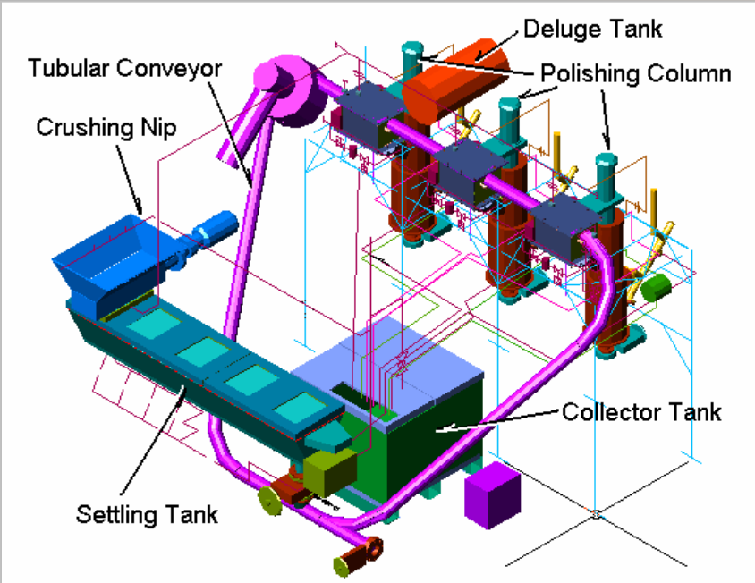
Magnesium Recovery Prototype Plant
El Dorado Engineering, Salt Lake City, UT
The MRPP consisted of all the required equipment to:
  • Remove illuminant from a wide variety of military flares
  • Separate & recover magnesium in a directly usable form
  • Separate & recover sodium nitrate for reuse

Slide 14
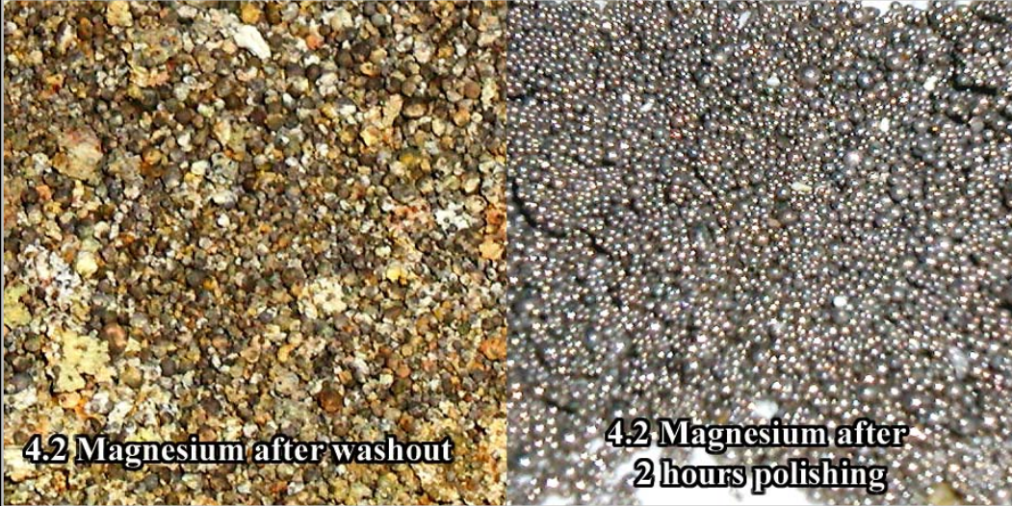
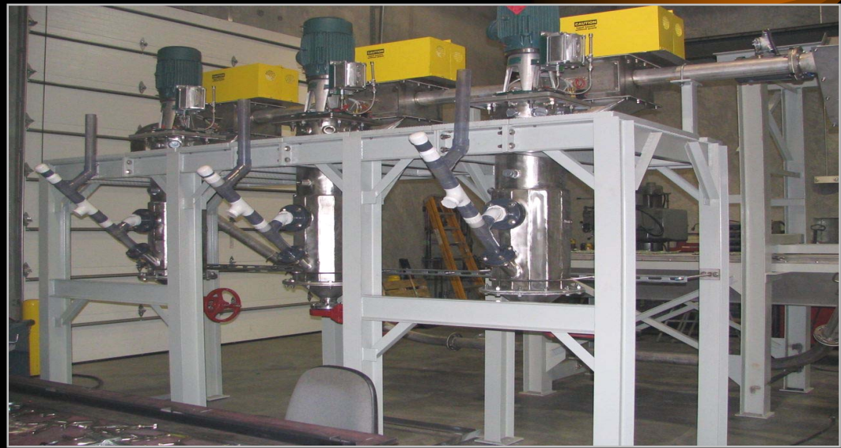
Recover, Recycle, and Reuse (R³) Demilitarized Magnesium
Multi-service interest in recovered Mg fostered Army/Navy partnership in 2000 on Phase lll SBIR project funded under Army Demil R&D Program
Magnesium Recovered in Pilot Plant

Slide 15
Recover, Recycle, and Reuse Demilitarized Magnesium
  Our Research Goals:
  Requalify and use recovered Mg in new munitions.
  Munition must meet Mil Spec.
Invention was a relatively simple mixture; wherein,
the oxidizer is powdered sodium nitrate;
(2) the fuel is recycled magnesium of relatively low purity (<98%) that contains an alkyl polysulfide polymer; and
(3) the binder system is bisphenol-A epoxy polymer (about 80%) and a polyamide cross-linking agent (about 20%).
The subject inventive composition provides up to 1.27 times the luminosity in candela (cd) and up to 1.21 times the luminous efficiency in [(cd · s) g⁻¹] of an equal quantity of the prior white star hand signal pyrotechnic illuminant.
Jesse J. Sabatini, Leon L. Robert, Jr. and Jared D. Moretti. Magnesium/alkyl polysulfide white star illuminants, U.S. Patent 9,193,637, Nov. 2015.

Slide 16
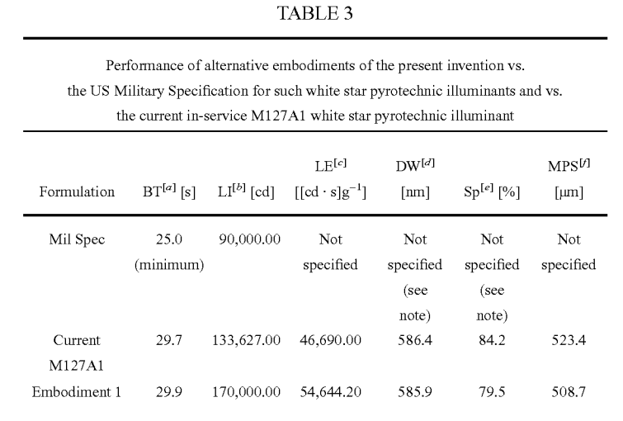
Recover, Recycle, and Reuse Demilitarized Magnesium
[a] BT = burn time;
[b]PLI= luminous intensity;
[c] LE = luminous efficiency;
[d] DW = luminous intensity;
[e] P = spectral purity;
[f] MPS = mean volume particle size of magnesium used.
[g] MPS = mean volume particle size of magnesium used
Note: the current military specification for white star pyrotechnic illuminants does not specify (include) luminous efficiency, dominant wavelength and spectral purity specifications,

Slide 17
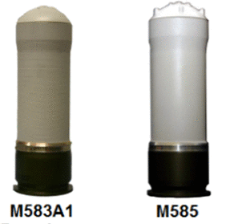
Recover, Recycle, and Reuse Demilitarized Magnesium
A white star pyrotechnic illuminant composition, useful in US military M127A1 parachuted handheld signals (HHS), which illuminant provides surprisingly enhanced luminous intensity and luminous efficiency versus the current M127A1 U.S. military HHS white star pyrotechnic illuminant. The inventive illuminant formulation includes a mixture of powdered sodium nitrate, magnesium, alkyl polysulfide polymer and a binder; wherein the magnesium and alkyl polysulfide is preferably recovered from the demilitarization of obsolete munitions to realize a significant savings.
M583A1 star parachute (L)
and M585 star cluster signals.
Jesse J. Sabatini, Jared D. Moretti, Derrick R. Hall, and Leon L. Robert Jr. 2013. Recover, Recycle, and Reuse: Prove-Out of Pyrotechnic Illuminants Containing Demilitarized Magnesium. ChemPlusChem, 78:1358-1362. 2013.
Wiley VCH publisher featured this paper amongst their "hottest papers" in the area of sustainable chemistry.

Slide 18
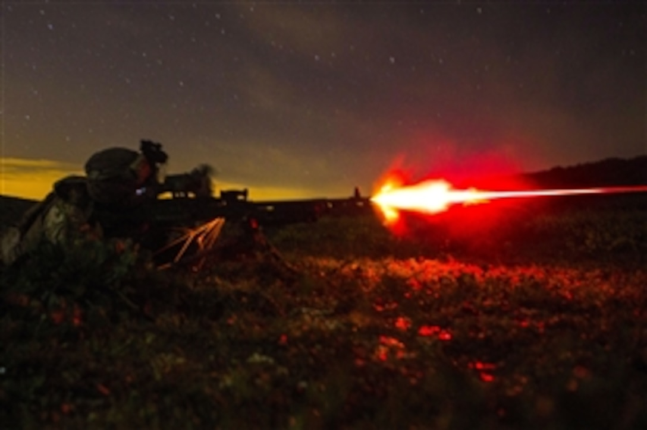
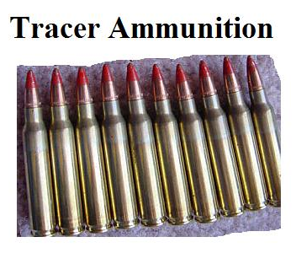
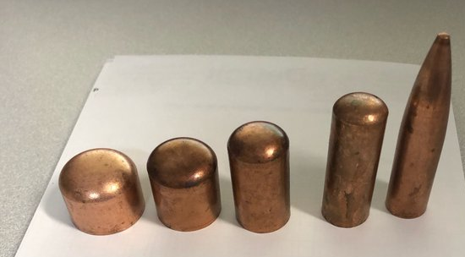
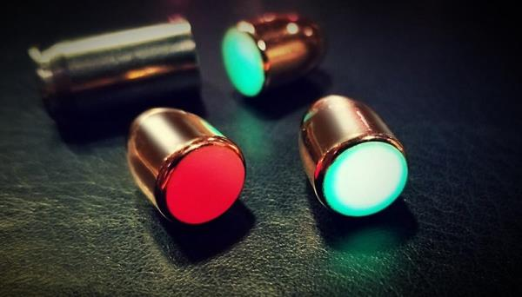
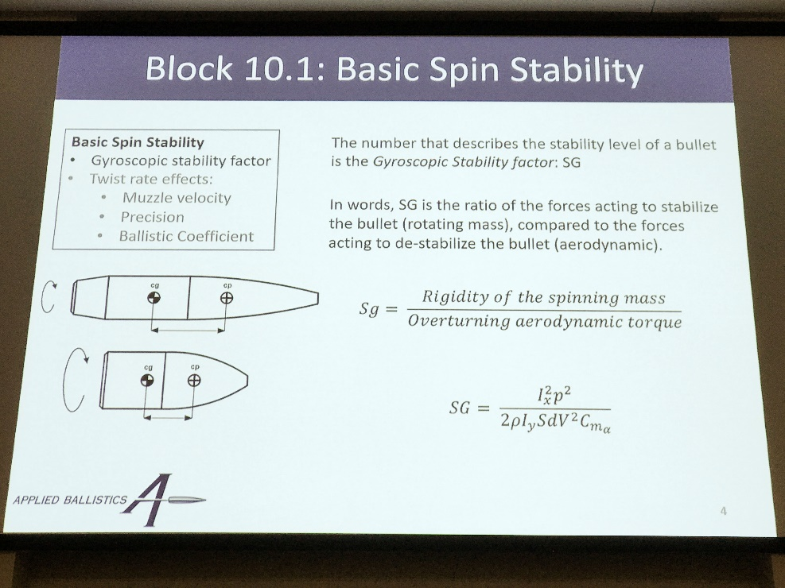
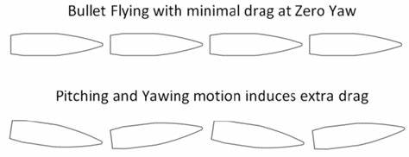
Hidden Tracer Project

Slide 19
Recent Collaborations at Purdue University
Consultant, Chemical Engineering and Purdue Military Research Institute (PMRI), Purdue University, West Lafayette, IN, March 2021 to present.
Purdue University Battery Systems for Extreme Low Temperature Operations. Vilas G. Pol, and Leon Robert, Purdue University; and Thomas Adams, Naval Surface Warfare Center-Crane. Center for Research on Extreme Batteries (CREB) Winter Biannual Meeting, 10 December 2021.
Lithium-ion Batteries with Tri Fluorinated Electrolyte for Low Temperature Space Applications. Ethan Adams, Pol, and Leon Robert, Purdue University; and Thomas Adams, Naval Surface Warfare Center-Crane. 2021 NASA Aerospace Battery Workshop, November 2021.

Slide 20
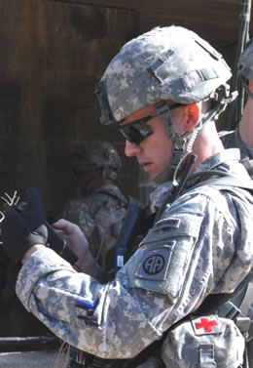
Department of Defense Deployed Warfighter Protection (DWFP) Program Grant
“DoD Pesticide Usage Web-Based Archival and Retrieval System and iOS Mobile App”
Co-PI, 3-year (2022-2025), $900k grant
Collaboration with:
  Department of Entomology, Purdue
  The Center for Environmental and Regulatory Information Systems (CERIS), Purdue
  U. S. Army Public Health Command, Aberdeen, MD
  U. S. Navy Facilities Atlantic Command, Norfolk, VA
  U.S. Air Force Civil Engineer Center, Tyndall A.F.B., FL
  FUNDED

Slide 21
PMRI
Strategic national asset to educate military officers and DoD civilians.
32 officers started program in Fall 2022 (largest group ever)
Use deliberate innovation and coordinated research opportunities to drive defense innovation and maximize military officer education.
  Collaboration with Engineering Education at Purdue
Space Force officer currently working on project to maximize Purdue’s benefit to Space Force.
Recent Presentations:
  A New Model for Joint Advanced Academic Education. L. Robert, J. E. Dietz and J. Pekny Inaugural Strategic Leadership Development Forum, U. S. Army War College Carlisle, PA, 26 January 2022.
  A New Model for Advanced Academic Education. L. Robert, J. E. Dietz and J. Pekny. Learning Professionals' Consortium (LPC-22) HQ AETC/A3BP, JSBA-Randolph, TX

Slide 22
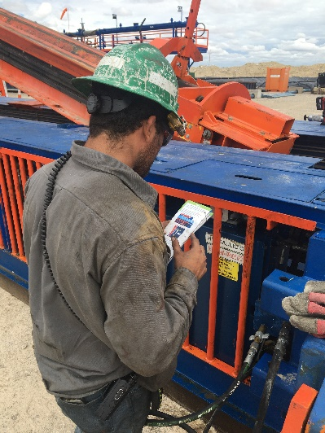
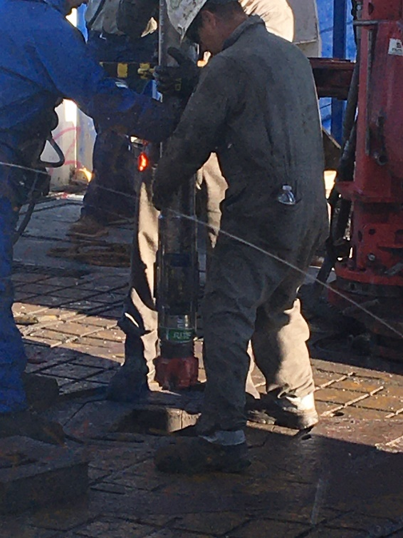
Chemical and Safety Operations in High Reliability Organizations
Chevron Drilling and Completions
  Permian Basin, TX & NM
  January 2018 to present
  Applying the principles of chemistry, biology, physics, and math to solve problems
Performance Excellence
  Improve procedural discipline
  Improve safety, health, and environmental compliance
  Improve efficiency of operations
  Planning and improving equipment layout
  Incorporating safety procedures for working with dangerous chemicals
  Monitoring and optimizing the performance of production processes
Connections
Davidson School of Chemical Engineering
Enhanced Oil Recovery Lab
CISTAR
NEPTUNE Center for Power and Energy Research

Slide 23
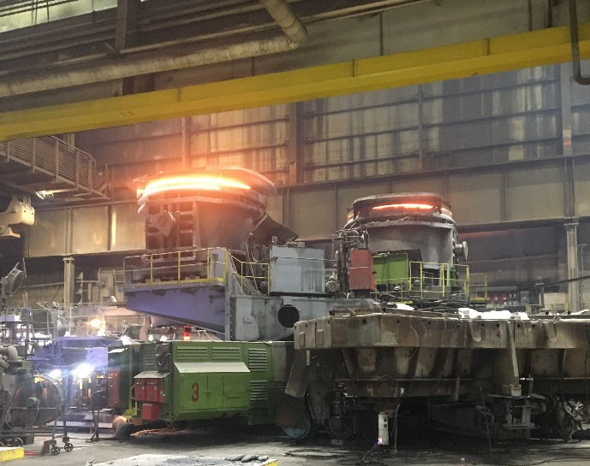
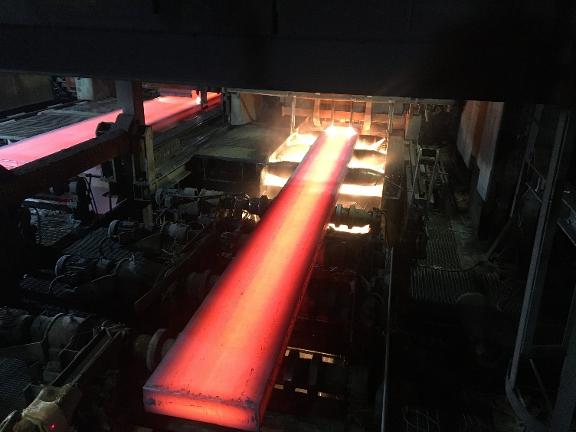
Chemical and Safety Operations in High Reliability Organizations
Cleveland Cliffs Steel Producing Mill
  East Chicago, IN
  January - July 2022
Performance Excellence
  Improve procedural discipline
  Improve safety, health, and environmental compliance
  Improve efficiency of operations
  Planning and improving equipment layout
  Incorporating safety procedures for working with
  molten steel
  Monitoring and optimizing the performance of
  production processes
Connections
School of Materials Engineering
Davidson School of Chemical Engineering

Slide 24
Summary
Professional background of Solider-Scientist
PMRI is entering next phase
Collaborations with Purdue University
Funded research
PMRI
Help to better connect Chemical Engineering faculty with DoD funding streams

Slide 25
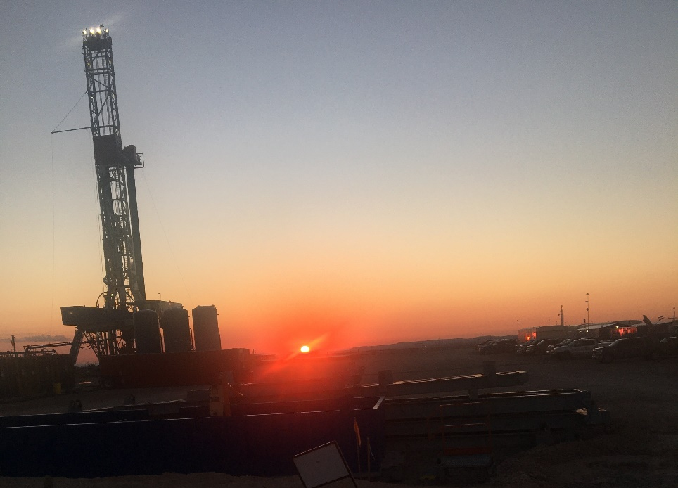
Conclusion
Enjoy working at Purdue and want to contribute
Enjoy being part of Chemical Engineering “Family”
Enjoy helping to educate military officer and civilian students
A strong desire to bring my practical experience to the College of Engineering
Thank you for your time and attention.

