Slide 1

OVERVIEW of Purdue online
Doctor of Engineering PROGRAM
All Faculty Meeting (15min Version)

Slide 2
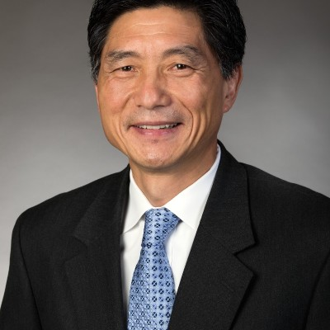
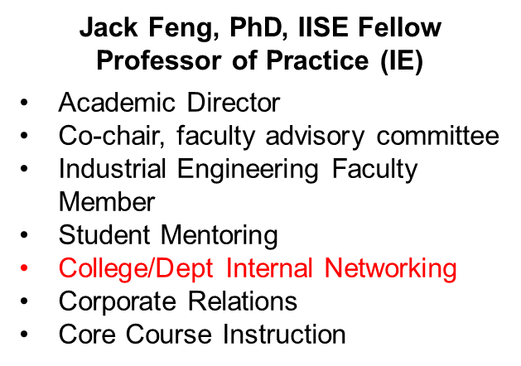
Agenda
The D.Eng Program
Why am I Here Today?
Frequently Asked Questions
Benefits to and Responsibilities of the D.Eng Faculty Advisor or Grad Chair
Q & A

Slide 3
Purdue University Online Doctor of Engineering (D.Eng.)
Vision:
To empower engineering professionals by providing a flexible, interdisciplinary online doctoral program that fosters innovation, technical expertise, and leadership, enabling them to drive significant advancements in their fields and achieve their career aspirations.
Target Learner:
Mid- to senior-level engineer / team lead / manager / director.
Clear professional and academic goals, including a clear vision for their research project and dissertation and interest in specific Purdue faculty.
Unable to pause their career while pursuing a traditional residential PhD.
Program Basics:
60+ credits with a previously earned master's in engineering
Incl. 30 credit research requirement and dissertation
  Purdue Faculty Advisor, Dissertation Committee, and non-Purdue Industry Partner (employer)
Required coursework in technical, professional, and foundational areas
Key Admission Criteria (Refer to page 20 for details):
A master’s degree in engineering.
5+ years’ professional working experience.
3.0 (out of 4.0) GPA
D.Eng website

Slide 4
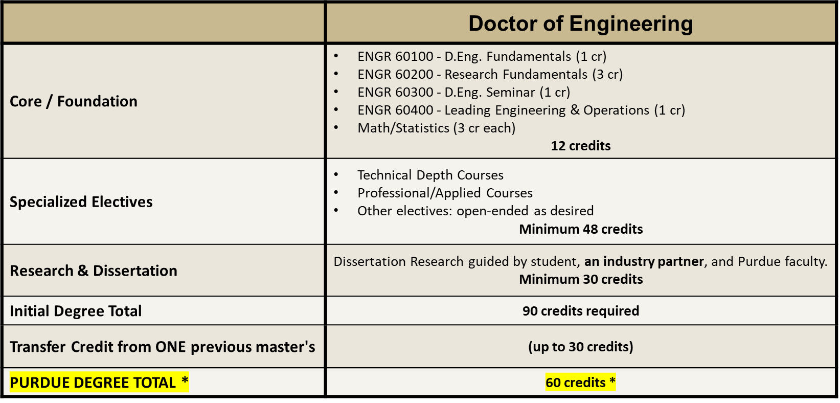
D. Eng Curriculum (Estimate: 4~ 6 years)
46 students enrolled (started in SP 2025)
Top three areas of research interest: (1) AI / ML and data science applications in their area; (2) Robotics & autonomous systems; (3) Industrial / systems engineering, and operations and supply chain management & analytics.

Slide 5
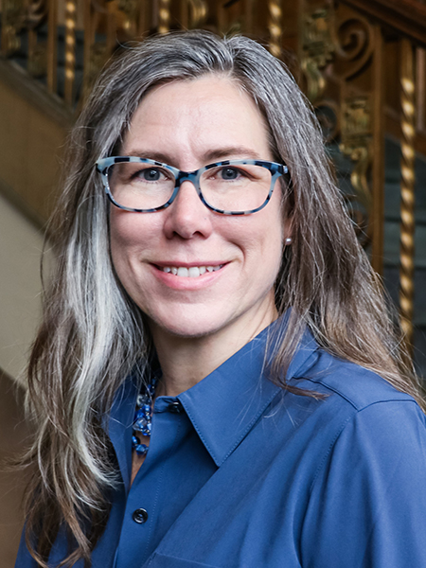
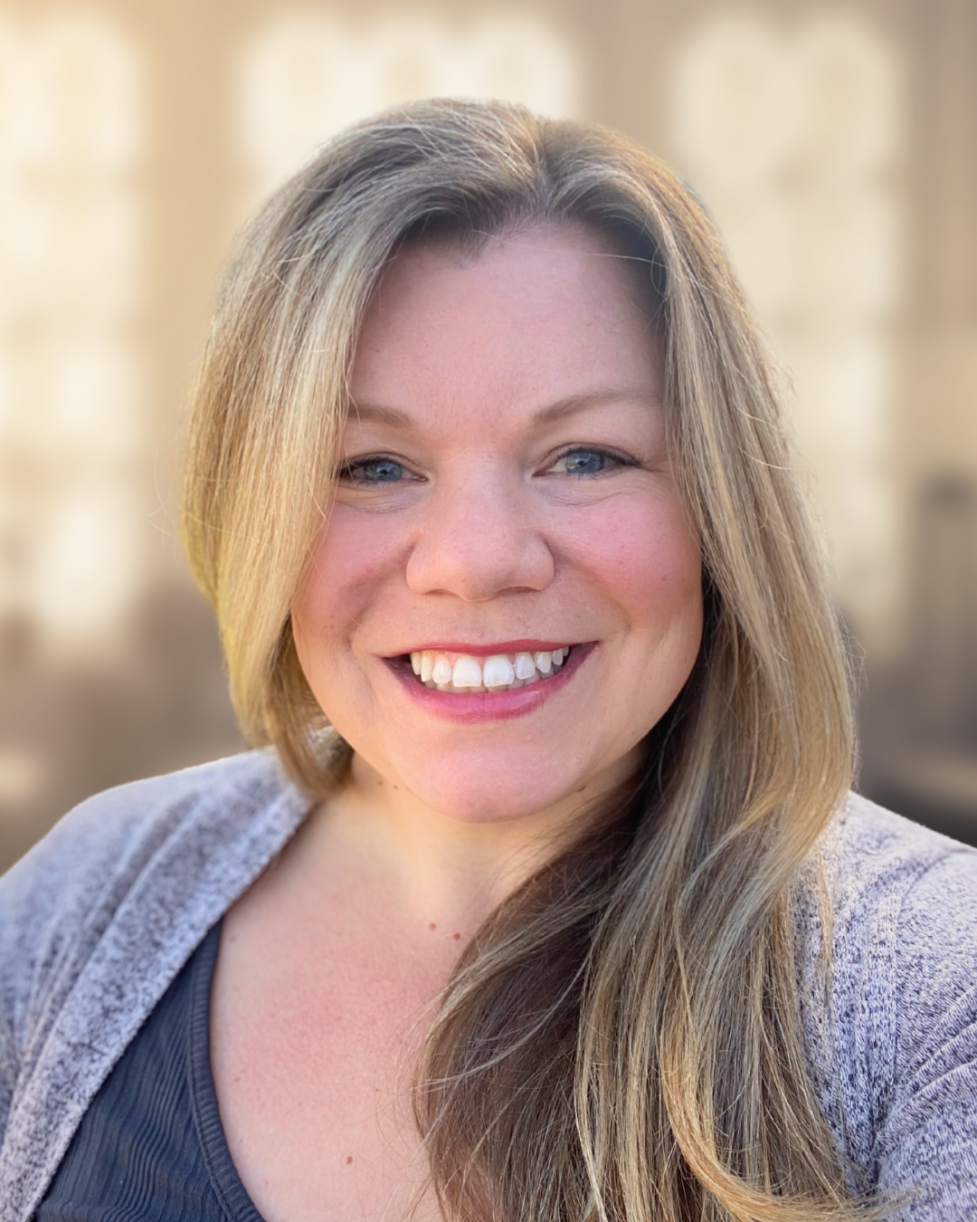
FYI - Doctor of Engineering - Program Team
Dr. Tamara Kinzer-Ursem
Associate Dean of Graduate & Professional Education
Jack Feng, PhD, IISE Fellow
Professor of Practice (IE)
Alisyn Gruener
Program Manager
Academic Director
Co-chair, faculty advisory committee
Industrial Engineering Faculty Member
Student Mentoring
College/Dept Internal Networking
Corporate Relations
Core Course Instruction
D.Eng. Program & Department Head, Interdisciplinary Engineering
Co-chair. faculty advisory committee
College of Engineering oversight of professional, graduate programs
Program operations
Functional program staff support
Department & OGSPS policies, procedures, requirements
Project manage faculty committee(s) and other groups
Process Documentation

Slide 6
FYI - Purdue University - PhD vs. Professional Doctorate (D.Eng)
PhD
Guiding Philosophy: Theory and scholarship
Develops a new theory or theoretical model
Contributes to the academic community
May extend major professor’s research agenda
Academic or industrial research career
Early career
Residential, on-campus, full-time
School/Department-based
Professional Doctorate
Guiding Philosophy: Practice and Application
Develops a practical solution or applied framework to address a real-world problem
Aims for practical application in professional settings
Aligns with industry needs or organizational challenges
Engineering/Technology leadership role in industry or public sector
Mid-career
Non-residential, online, part-time
College-wide: an IDE Degree
Hold value in academic and professional fields.
Culminate in a dissertation demonstrating research independence
Confer the title "Doctor."

Slide 7
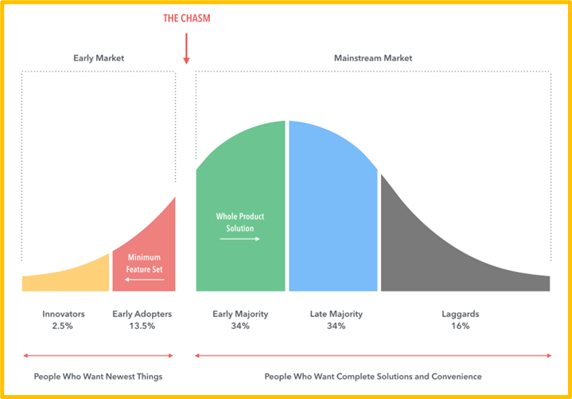
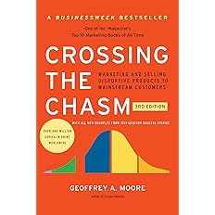
Key Concerns for our D.Eng Program – Cross the Chasm
Infant Mortality
Cross the Chasm
Resource Constraints
Recent high-profile products not Crossed the Chasm: Nikola Motor & Apple car. What about the Tesla Cybertruck? Will Google’s Waymo cross the chasm?
Geoffrey Moore, 2014, Crossing The Chasm: Marketing and Selling Disruptive Products to Mainstream Customers, 3rd Edition. New York, NY: Harper Business.
Notes:
Our D.Eng Program is in the “Early Adopters” stage based on current data. How and when will we cross “the chasm” to reach the “Early Majority” market?

Slide 8
Key Concerns for our D.Eng Program – Lessons from our D.Tech Program
Infant Mortality
Cross the Chasm
Resource Constraints
Bottleneck in the Capacity of Faculty Advisor or Graduate Chair
# of Faculty Members
Students #
Research / Dissertation
D.Eng – 30 hours
D.Tech – 15 hours
Faculty capacity
Total faculty #
R1 / qualified faculty #
2017
2024
2025
Notes:
Based on a simple math, we won’t reach capacity constraint in the aggregate level by reaching an enrollment of 2,000 students, but it does not mean we won’t face constraint in some specific area due to students’ and their employer’s interest focused in 3 areas shown on slide 23. I am dealing with one of them already.
That is why we are proactively reaching out and engaging our broad faculty base.

Slide 9




Faculty Team: Grad Chair and Committee
Committee Member #1
Committee Member #2
Committee Member #3
Faculty Advisor / Grad Chair
COE faculty member w/regular R1 faculty status & extensive expertise
Supervise student’s study, research, and writing
Sign off on plan of study, dissertation forms, etc.
Responsible for guiding through the dissertation process
Support committee selection
Evaluate student's ability to start research, pass prelim, and defend dissertation
COE faculty member
Subject matter expert in research area
Sign off on plan of study and dissertation forms
Evaluate student's ability to start research, pass prelim, and defend dissertation
Purdue faculty member
Subject matter expertise
Sign off on plan of study & dissertation forms
Evaluate student's ability to start research, pass prelim, and defend dissertation
Industry partner with PhD or Purdue faculty member
Subject matter expert from industry
Sign off on dissertation forms
Evaluate student's ability to start research, pass prelim, and defend dissertation
The applicant is required w/ or w/o consent from his / her sponsor to
list some research areas and
have identified and initiated the contact w/ at least a faculty member whose research matches his / her interest areas.
1st semester
2nd semester

Slide 10
Pros and Cons of Advising a D.Eng Student vs. a PhD Student
Pros -
Higher motivations
Cross-functional team support
No Purdue funding needed
Cons -
Lack of in person interactions
Manage the complexity with an industry partner on the Graduate Committee (slide 7)
Potential time zones differences

Slide 11
Value Propositions to Faculty Members
Non-Monetary Benefits
Any comments from a faculty advisor?
Industry Insights: As working professionals, students bring real-world experience and current industry knowledge to their research, providing faculty with up-to-date perspectives on practical challenges and trends.
Collaborative Research: Students’ research projects often focus on practical applications and industry needs, which can lead to collaborative opportunities for faculty to engage in applied research that has immediate relevance and impact.
Diverse Perspectives: The diverse backgrounds and professional experiences of students can enrich the research environment, fostering innovative ideas and interdisciplinary approaches to problem-solving.
Professional Networks: Students’ connections within their industries can open doors for faculty to establish partnerships with companies, access new resources, and explore funding opportunities for research projects.
Enhanced Research Output: The practical focus of students’ research can lead to publications, presentations, and other scholarly outputs that enhance the faculty’s academic profile and contribute to the broader engineering community. In addition, faculty can gain satisfaction and professional growth from mentoring students, helping to shape the next generation of engineering leaders and contributing to their own legacy in the field.

Slide 12
Value Propositions to Faculty Members
Monetary Benefits
Agree to serve as major professor and student files an official plan of study - $1,000
Student successfully passes the Preliminary Exam - $1,000
Student successfully defends Dissertation - $1,000
Serve as major professor/instructor for ENGR research courses - $100 per student per credit hour; research credits required: 30 minimum ($3,000 minimum)
Total: Minimum $6,000 for completed dissertation

Slide 13
Faculty Chair Responsibilities:
Serve as an academic mentor and advisor to the student for their doctoral program
Help guide, as needed, to identify relevant coursework for the student's intended area of study and approve the student’s official plan of study
Support the student as they finalize their research topic and proposal and ensure the proposal will meet Purdue and field-specific dissertation standards
Advise the student on the selection of other dissertation committee members and approve proposed committee members, one of whom will likely be external to Purdue (the student’s industry partner)
With the committee, assess the student’s capability to undertake the research and defend the dissertation
Be aware of and follow all Purdue University procedures and ensure that the student stays on track. Reinforce deadlines and discourage postponements.

Slide 14
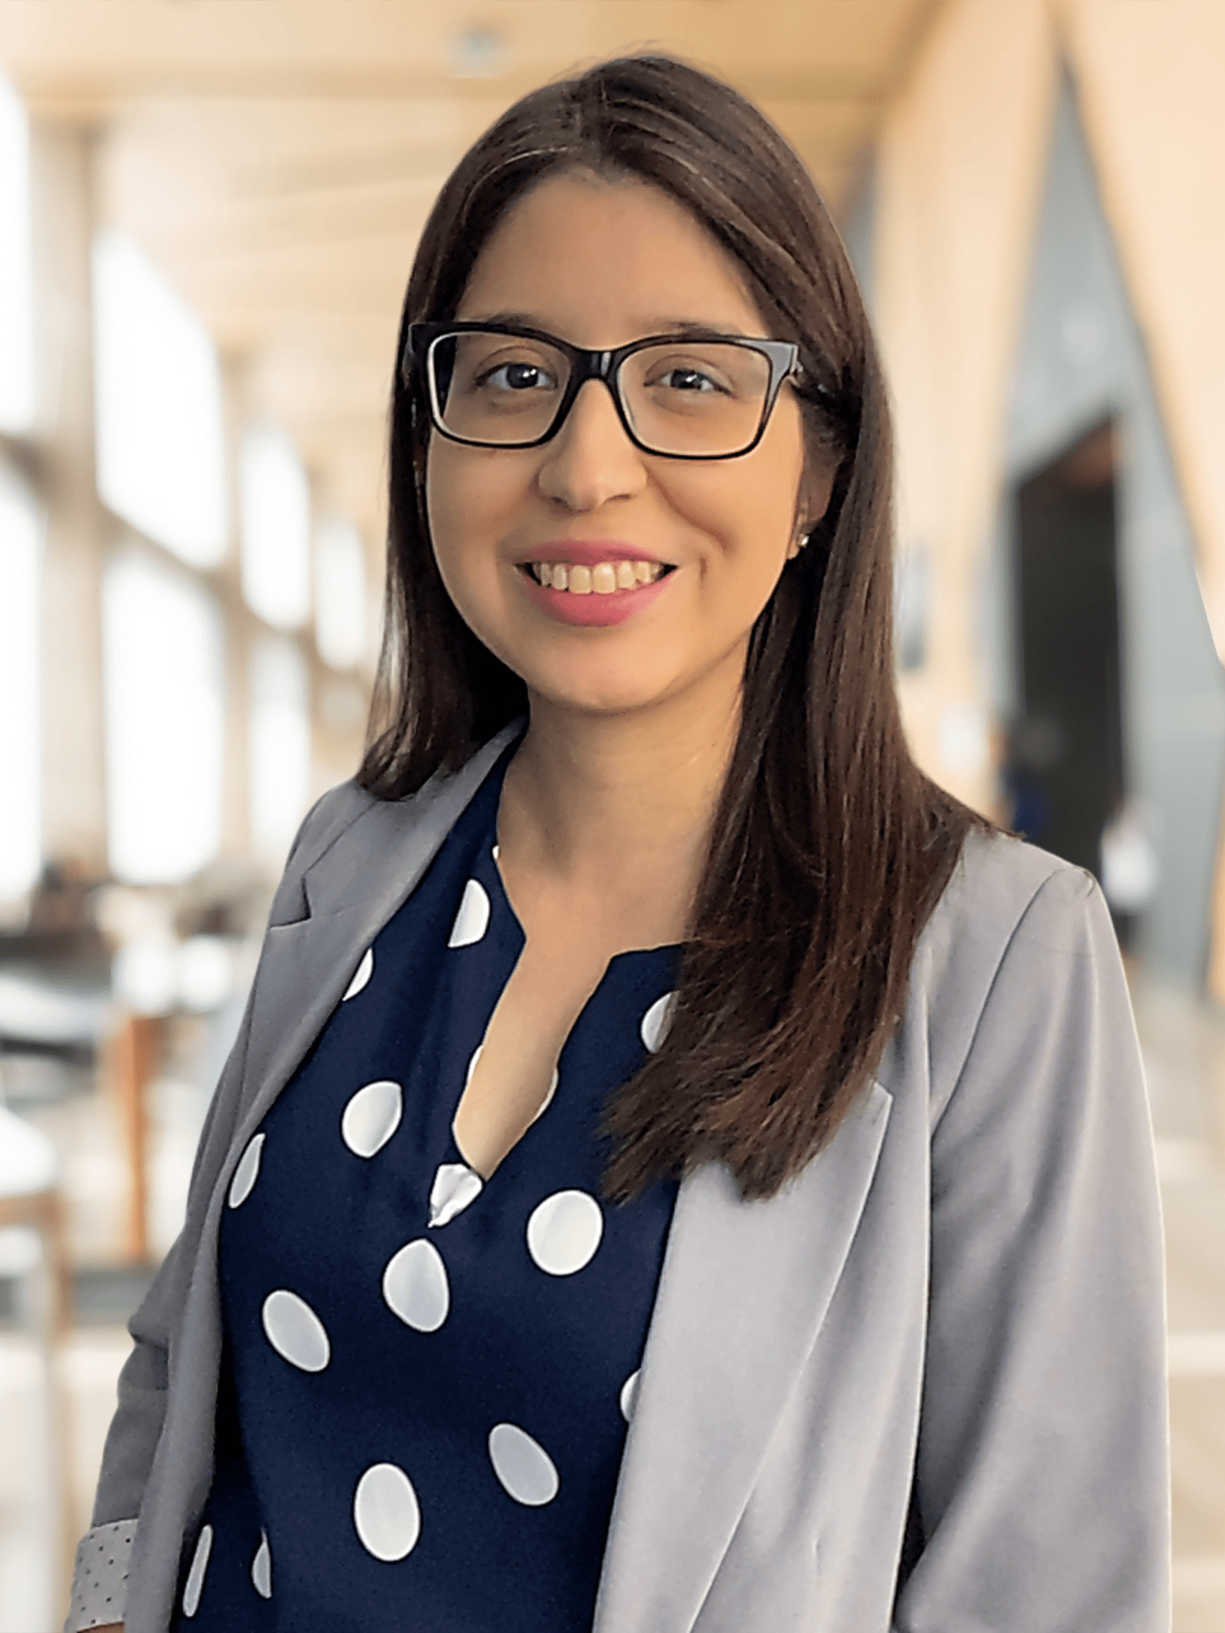
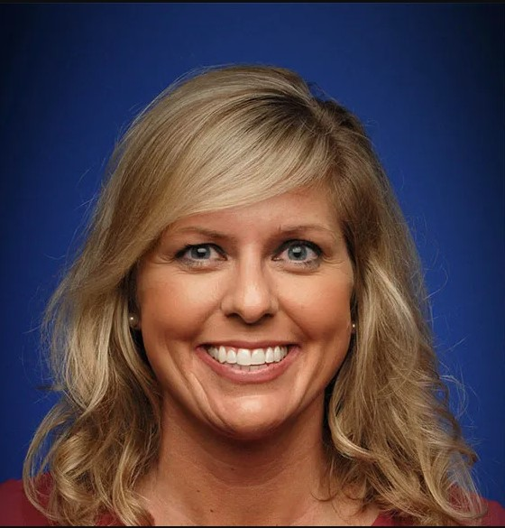
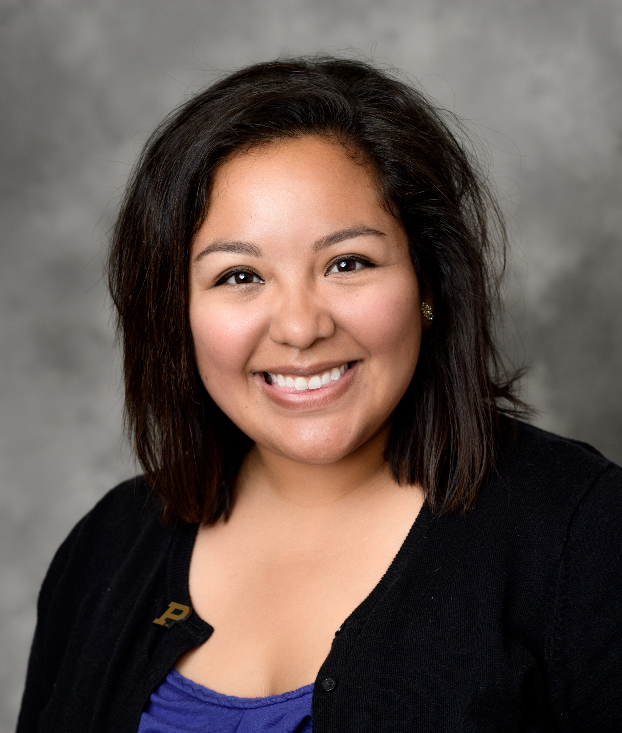
Doctor of Engineering - Student Success Team
(Currently on Family Leave) Lezlie Ontiveros
Success Coach
Last Names A-L
Stacia Rosen
Success Coach
Currently: All Students
Last Names M-Z
Brittany Cruz
Academic Advisor
Academic questions & concerns
Course planning and selection
Plan of study worksheet and official EPOS
General program questions and help
Resource and support referrals
Guidance for navigating online course environment
Support for areas of academic / professional challenges
Networking and connection

Slide 15
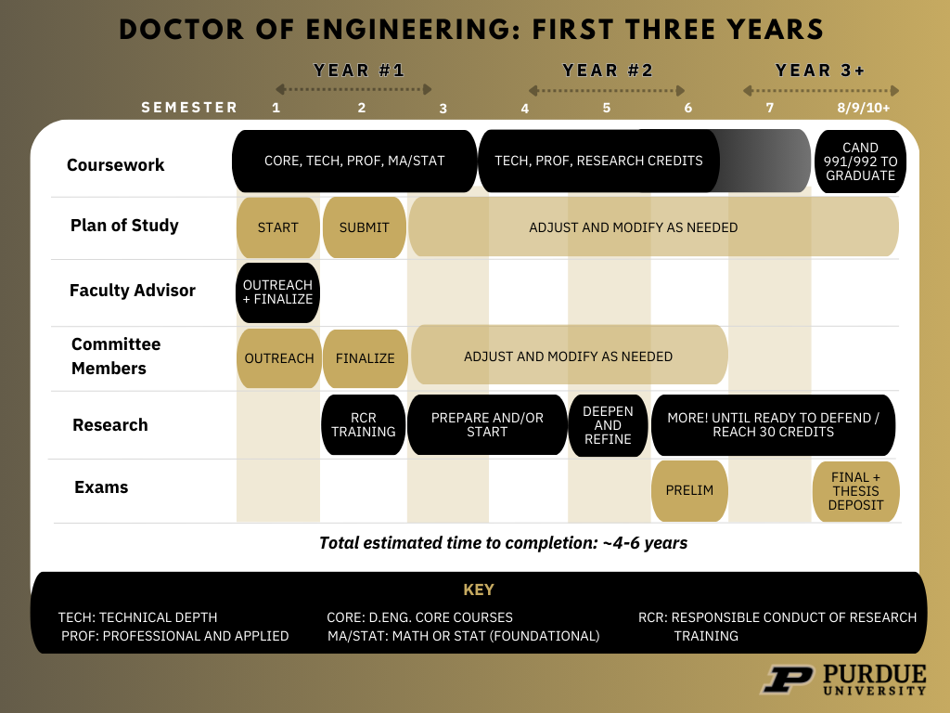
FYI --

Slide 16
Q & A

Slide 17
Appendix

Slide 18
FYI - Dissertation Milestones
Milestone | Timeline | Details
1: Plan of Study submitted | Submit no later than end of 2nd semester | Use ENGR 60100 & Academic Advisor for support w/initial plan Submit transfer credit evaluation proposal ASAP Official plan finalized with faculty advisor Filed with OGSPS + Signed off on by Chair & Committee
2: Start Research | 3rd-4th Semester | No research permitted in the first semester Complete RCR training and research fundamentals course (ENGR 60200) prior to starting or concurrently with Work with Chair and Industry Partner on plan
3: Preliminary Exam and Research Proposal | Varies – no later than 1 year prior to graduation | Overseen and evaluated by Committee Taken after at least 9 credits of research and no more than 21 credits completed AND Must be taken minimum one year prior to final defense
4: Final Exam / Defense | Varies | In the final semester
5: Dissertation Deposit | Final step | $125 deposit fee Must be kept on file with Purdue

Slide 19
Value Propositions to Sponsoring Organizations
~ 5X or Higher Return On Tuition Investment
  A typical part-time Lean Six Sigma Black Belt (BB) graduate: $100K ~ $150K EBITDA / year
  A typical part-time Master Black Belt (MBB) graduate: $150K ~ $250K EBITDA / year
  A D.Eng Dissertation takes 1.5 ~ 2 years AND its training is higher than that of a BB or an MBB: $250K+ / year or $375K ~ $500K in 1.5 to 2 years.
  Total tuition investment: ~$80K or ~$20K / year (assuming 4-year duration)
New resource supporting succession planning & talent retention
Future leaders immersed w/ trending issues, more structured problem-solving skills and more critical / innovative thinking skills
Broadened professional network w/ Purdue alumni (incl. their classmates) and faculty members

Slide 20

Detailed Admissions Requirements
DOCTOR OF ENGINEERING
Academic Statement of Purpose and Personal History Statement
English Proficiency for Non-Native Speakers (follows OGSPS guidelines)
Official transcripts from all institutions attended
3 Recommendations
Resume / CV
Master's Degree + at least one degree in Engineering
Min 3.0 GPA
5 years relevant industry experience required.
Plan for industry partner and research topic.
Notes:
Ryan

Slide 21
FYI - Current Student Profile: Industries and Titles
General Motors, Engineering Group Manager
Lacy Diversified Industries, VP of Strategy & Operations
Food and Drug Administration (FDA), Assistant Director Bone-Soft Tissue Interface
Cummins, Inc., Assistant SVL and Power Cylinder Team Lead
The Boeing Company, Associate Technical Fellow, Enterprise Support
Alcon Research, Program Head: Intraocular Devices R&D
Northrup Grumman, Principal Reliability Engineer
Google, Software Engineer
Nevada National Security Sites, Certified Packaging Engineer
SRAM Rockshox Mechatronics, Senior Design Engineering
IQVIA, Senior Machine Learning Engineer
Alcon Research, Program Head Intraocular Devices R&D
Key clusters:
Defense / Aerospace (9 students)
Manufacturing (6 students)
Professional, Scientific & Technical Services (3 students)
Transportation & Warehousing (2 students)
Research (2 students)
Media / Software / Telecom (2 students)
50% of students hold senior or leadership roles
Top employers: Boeing, Collins, Northrop Grumman

Slide 22
FYI - Applicant Profile
Future graduates are expected to take on significant leadership responsibility, technical oversight, and influence over strategic decision-making in engineering or technology-driven organizations.
Academic Background | Master’s degree required. At least one degree in engineering required.
Professional Experience | Minimum 5 years of relevant industry experience required.
Desired Career Outcome Examples | Executive Leadership: CTO, Chief Product Officer, Chief Engineer/Scientist, Chief Operations Officer, Director of Engineering Gov’t Engineering Consultant Innovation Director Consulting Engineer: Senior or Principal Professor of Engineering
Top Areas of Interest for Research and Coursework | Prevalence of AI/ML and Computer Science Majority of applicants weave AI, ML, data analytics, or advanced computing into their primary research interests. Many also mention IoT, robotics, or quantum. Robotics and Automation as a Major Sub-Theme Robotics, autonomy, and mechatronics appear frequently, often paired with industrial or manufacturing applications. Industrial & Systems Engineering and Operations / Supply Chain Analytics Several applicants focus on smart manufacturing, digital transformation, or supply chain optimization, typically leveraging AI, IoT, or real-time analytics. Smaller Clusters in Energy/Nuclear, Biomedical, and Defense Multidisciplinary Overlaps

Slide 23
FYI - Value Propositions to Learners
Flexibility. The 100% online format allows working professionals to balance their studies with their job and personal commitments.
Customization. Students can tailor their coursework and research projects to align with their specific career goals and professional interests.
Advanced Technical Skills. The program provides in-depth knowledge in various engineering domains.
Industry Relevance. The focus on practical application and industry-related research projects bridges the gap between academic theory and real-world practice.
Networking & Peer Learning Opportunities. Students can connect with peers, faculty, and industry professionals.

Slide 24
Current Student Profile: Professional Experience
For accepted applicants from the spring 2025 semester, most report between 4 and 28 years of experience. Average is 13 years of experience.
For denied applicants, the range is roughly 3 to 30 years, with an average around 19 years.
Despite some exceptions, on average, denied applicants have more total years of experience than accepted applicants. That said, there are outliers on both ends (e.g., a 27-year-old with 3 years’ experience was denied, but a 36-year-old with only 4 years’ experience was accepted).
Notes:
Alysa and then Alisyn
DENG:
Engineering Manager
Project Manager
Lead Engineer
Systems Engineer
DTech:
IT Manager / Director of IT
Data Scientist / Data Analyst
Project / Product / Program Manager
Cybersecurity Analyst / Cybersecurity Manager
Systems Architect / Solutions Architect
Software Developer / Engineer

