Slide 1

BS + MS Combined Program, lyles School of Civil and construction engineering
Burke Graduate Program
Dulcy Abraham
Jenny Ricksy
Stacy Lane
Undergrad Advising
Julie Jesiek
Melody Carducci
Laura Lathrop
Brandon Fulk
Rabita Rajkarnikar

Slide 2
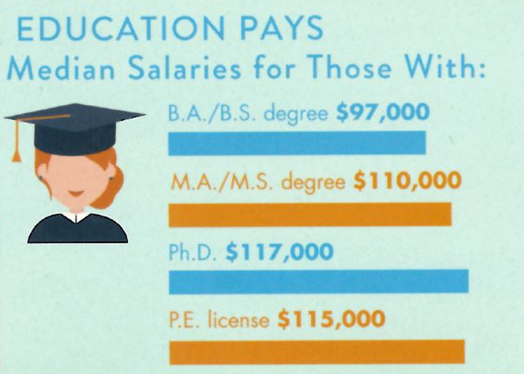
Why Consider Graduate School – Part 1
Broaden knowledge base and add to the body of knowledge and practice
Improved earning potential
Enhanced career options

Slide 3
Pursuing a Master’s Degree in Civil and Construction Engineering
Provides deeper knowledge in Civil Engineering
Provides opportunities to be hired as an expert in a company
Better starting salary
Typically involved in more proposals/interviews at an earlier stage in career.
Earns one year credit toward Professional Engineer (P.E.) licensure experience

Slide 4
Combined BS + MSCE Program
The Combined BS/MSCE Program is an integrated degree program in which qualified students can receive a BS and an MS in Civil Engineering in as little as five years.
The program provides a seamless transition from the BS to MS programs for Purdue students where graduate courses taken as undergraduate electives are counted toward both the BS and MS degrees, thereby reducing the overall time required for the MS degree.
This program is only available to students in the BSCE and BSCNE programs at the West Lafayette campus.

Slide 5
Combined Program Eligibility Requirements
Minimum of 3.3cumulative GPA
Complete application in semester 5
  Application Form
  Official Purdue transcript
  Two Letters of Recommendation (you must request these and follow-up with the faculty members)
Applications due November 28, 2025

Slide 6
Graduate School Application Fee Waiver
The College of Engineering is holding a virtual Graduate Showcase September 28-29, 2025
  Meet Purdue Engineering Graduate Programs Faculty and Students
  Learn about both graduate research and summer undergraduate research programs at Purdue. Free, online, and interactive.
  Attend event to receive an application fee waiver
  Free, online, and interactive.
  Registration Link: https://purdue.ca1.qualtrics.com/jfe/form/SV_0c6TMV4LmAZ9ol8
  Learn more here: https://engineering.purdue.edu/Engr/Academics/Graduate/graduate-showcase

Slide 7
Coursework Requirements
Complete all bachelors degree requirements where up to two graduate level courses (500 or 600) are taken to be used for both degrees
  An additional two courses can be taken, which are not used for the BS and would then be considered undergraduate excess credit
Only graduate level courses taken while in dual degree status can be dual counted
Must earn a grade of B or better in the dual counted courses
Maintain at least a 3.3 cumulative GPA

Slide 8
Master’s Degree
Choose a concentration area when applying
Can complete a non-thesis MSCE in as little as two semesters or can be thesis option (usually 3 semesters)
30 credits in total for the MSCE degree
      A total of 12 credits earned while an undergrad are eligible to transfer to the MSCE
        Max of six credits dual counted
        Other credits can be “Available for graduate credit”
        All must be approved by your MSCE faculty committee
  Thesis option would require at least 9 hours of research (CE 698) and a total of 21 hours of coursework
  Can take one 300 or 400 level course as part of the master’s program (while in graduate student status)

Slide 9
Courses Approved for Dual Credit
Any graduate level (500 or 600) CCE (CE or CEM) course taken while in Combined Status, that earns a B or better, is eligible to be double counted. Final approval comes from your MSCE advisory committee.
If you are planning to apply for the Combined Program, be sure to tell your undergrad advisor so that you can begin planning.

Slide 10
Transition from undergrad to graduate studies
Undergraduate
Structured learning
Mainly only responsible for yourself
Learning across broad areas of CE
Coursework load of 12-15 credits per semester
Typically complete in 8 semesters
Graduate
Independent learning
Collaborative learning and research
Begin to specialize in one area of CE
9-12 credit load per semester
Program time is often varied based on research activities

Slide 11
Degree Requirements – Master’s
Non-thesis | Thesis
30 credit hours (courses) | 21 credit hours (courses) 9 credit hours research
 | Thesis and oral defense
Committee: Major professor / advisor + 2 faculty members
Plan of study should be submitted in first semester.

Slide 12
Program Flexibility
As a combined program student, you have all the same options as any other MSCE student:
  Thesis Option
  Non-Thesis Option
    Professional Masters concentration
    MS/MBA combined program
    Continuation to the PhD
You can be funded as an RA or TA.

Slide 13
Burke Graduate Program, Lyles School of Civil and Construction Engineering
1st Named Graduate Program at Purdue (2017)
  Christopher B. and Susan S. Burke Graduate Program in Civil Engineering
Purdue Civil Engineering currently has 449 graduate students (Fall 2025)
134 → pursuing online MSCE degree
116→ pursuing residential MSCE degrees
187 → pursuing PhD degrees
12 → Non-Degree
149 are women students
226 are international students (from 40 different countries)

Slide 14
General Information on the Graduate Program
All students can participate in Job Fairs (CE job fair, Industrial Roundtable). We encourage master’s students to submit their resume for the resume book.
Domestic students are also encouraged to apply for NSF (as a first-year graduate student)
You are allowed to take any course at Purdue – therefore you can take courses of interest while you are here (languages, PE, etc).
Many opportunities for scholarships/awards within CCE, CoE and graduate school (Research, Teaching and Service)
Professional Development – CIE, CCO for resume review, mock-interviews, job search, Entrepreneurial/Management/Leadership courses
Please review the CCE website (spot-lights, CEGSAC handbook, general information) https://engineering.purdue.edu/CCE/Academics/Graduate/Current

