Slide 1

ACE Campus food pantry
Notes:
DATA SET ASIDE TO SHARE:
HOC surveyed 34 campuses
Done by CUFBA, NSCAHH, SGRC, SPIRG
48 percent food insecure in the last 30 days
22 with VERY LOW (research more to explain well)
57 black students
56 first gen
64 housing, 15 homeless
43 meal plans (point run out, days closed)
61 on services like SNAP, TANF
55 couldn't buy a textbook as a result, 53 missing class as a result, 35 dropping class as direct consequences of being food insecure

Slide 2

Outcomes for Today
Understand where the ACE food pantry fits into Well-Being at Purdue
Learn how the pantry works
Gain information to inform your students about how to volunteer or access the pantry
Receive tangible resources for students that align with Well-Being
Notes:
Reference chart, expiration date standards are on the diagram
Hailey’s last slide
Our weekly grocery rescue donors are Target, Dollar general, and Panera
Monthly food drive through st. tom’s
Entomology department has also been donating collard greens to us

Slide 3
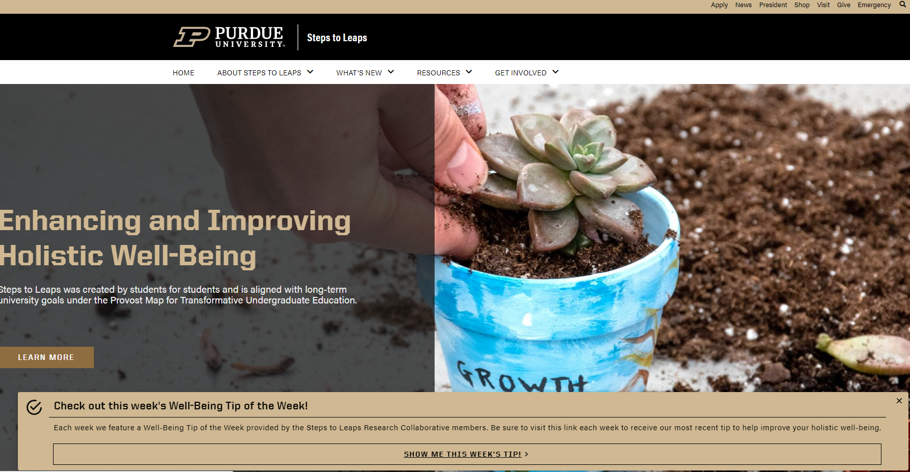
What is Steps to Leaps?
Notes:
Reference chart, expiration date standards are on the diagram
Hailey’s last slide
Our weekly grocery rescue donors are Target, Dollar general, and Panera
Monthly food drive through st. tom’s
Entomology department has also been donating collard greens to us

Slide 4





Program Pillars
Well-Being — Staying healthy in body, brain, and spirit is a life-long journey. Learn strategies to improve your own well-being with steps to security, health and prosperity.
Leadership — Boilermakers have a strong tradition of leadership in their careers and communities. Learn how to tap into your own strengths as you become the next generation of leaders with steps to initiative, guidance and direction.
Impact — Every Boilermaker strives to leave their footprint, and world-changing examples can be found throughout Purdue’s rich history. Learn the importance of creating an impact through your everyday actions with steps to modify, touch and influence.
Networks — A strong network serves as a resource throughout your life. The tightest networks are created by connections with individuals and require active participation. Learn how to build your network with steps to making connections and bonds.
Grit/Persistence — Life is full of ups and downs. Learn strategies to tap into your inner fortitude to overcome challenges and become your best Boilermaker with steps to resolve and character.
Notes:
Reference chart, expiration date standards are on the diagram
Hailey’s last slide
Our weekly grocery rescue donors are Target, Dollar general, and Panera
Monthly food drive through st. tom’s
Entomology department has also been donating collard greens to us

Slide 5
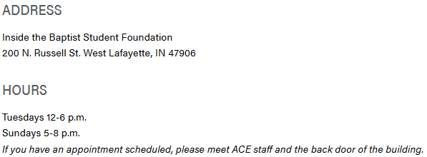
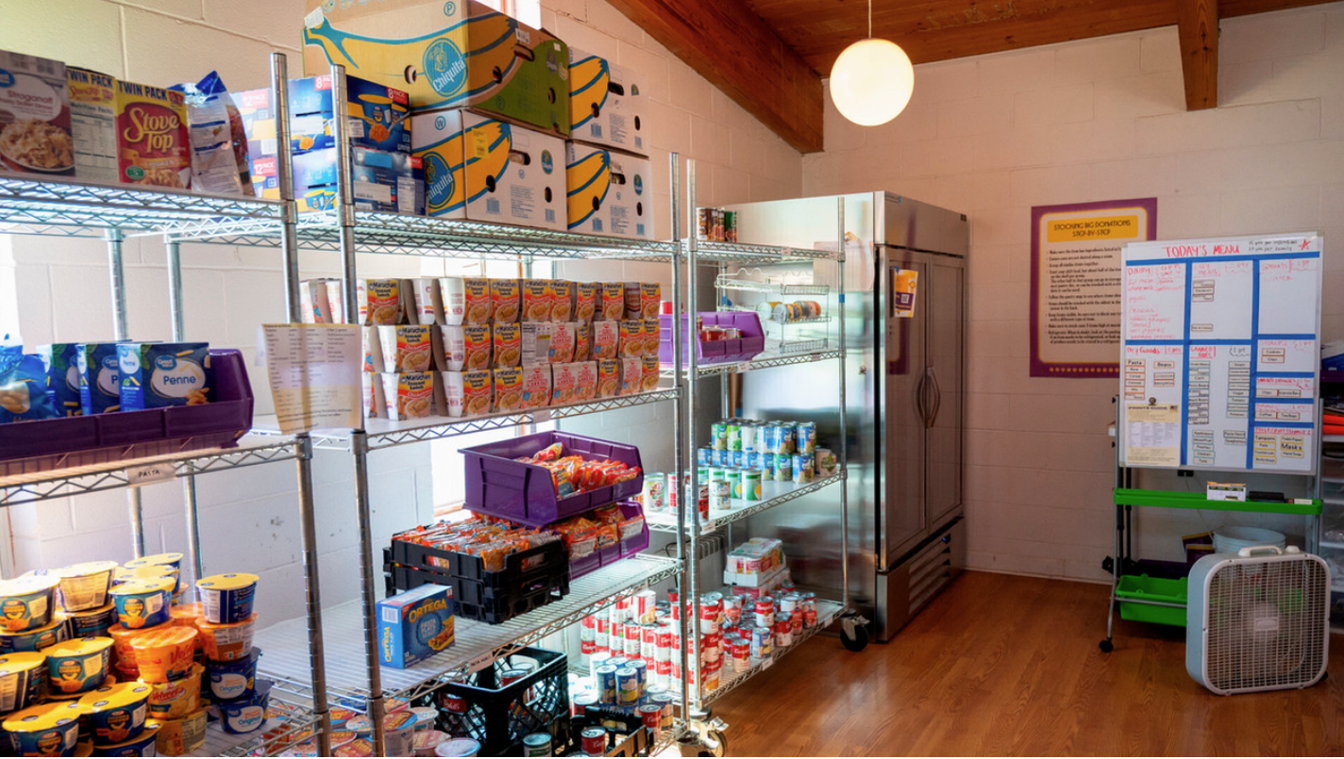
What is the ace food pantry?
The ACE Campus Food Pantry makes food more readily available to members of the Purdue community who may be experiencing food insecurity on a consistent or inconsistent basis. All you need is your Purdue ID!
While we focus efforts on serving the immediate needs of our clients in the Purdue community, we also focus on the eradication of the root causes of hunger (food access, food use, food availability) so that we may live in a world where ACE no longer needs to exist.
Notes:
Reference chart, expiration date standards are on the diagram
Hailey’s last slide
Our weekly grocery rescue donors are Target, Dollar general, and Panera
Monthly food drive through st. tom’s
Entomology department has also been donating collard greens to us

Slide 6
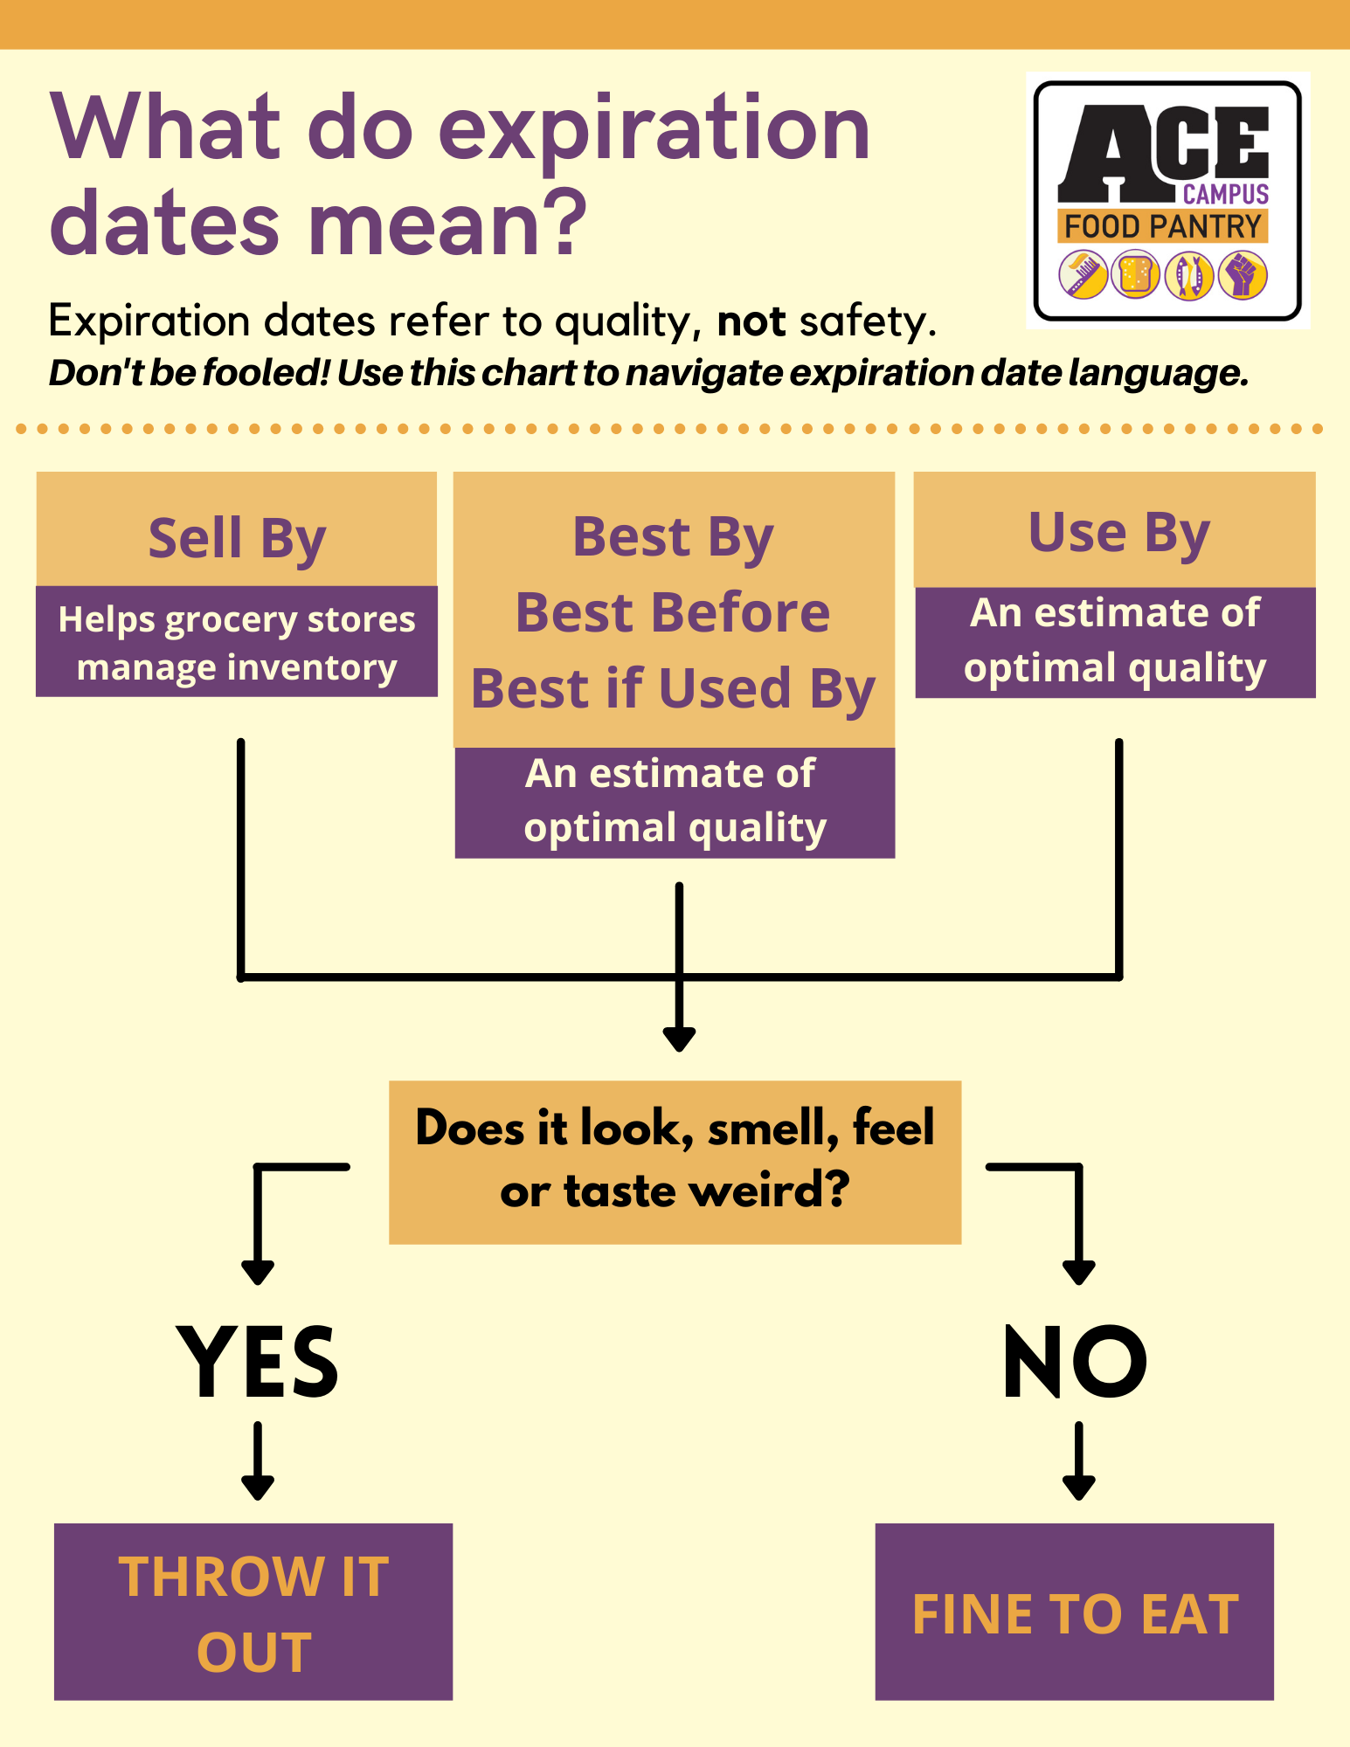
What Are OUr Food Sources?
Food Finders Food Bank
Grocery Rescue
St. Toms Monthly Pickups
Purdue Student Farm
Community Donations
Partnerships & Donations
  Monetary
  In-kind
  Pick-ups: Target, Dollar General, Panera and more!
Notes:
Reference chart, expiration date standards are on the diagram
Hailey’s last slide
Our weekly grocery rescue donors are Target, Dollar general, and Panera
Monthly food drive through st. tom’s
Entomology department has also been donating collard greens to us

Slide 7
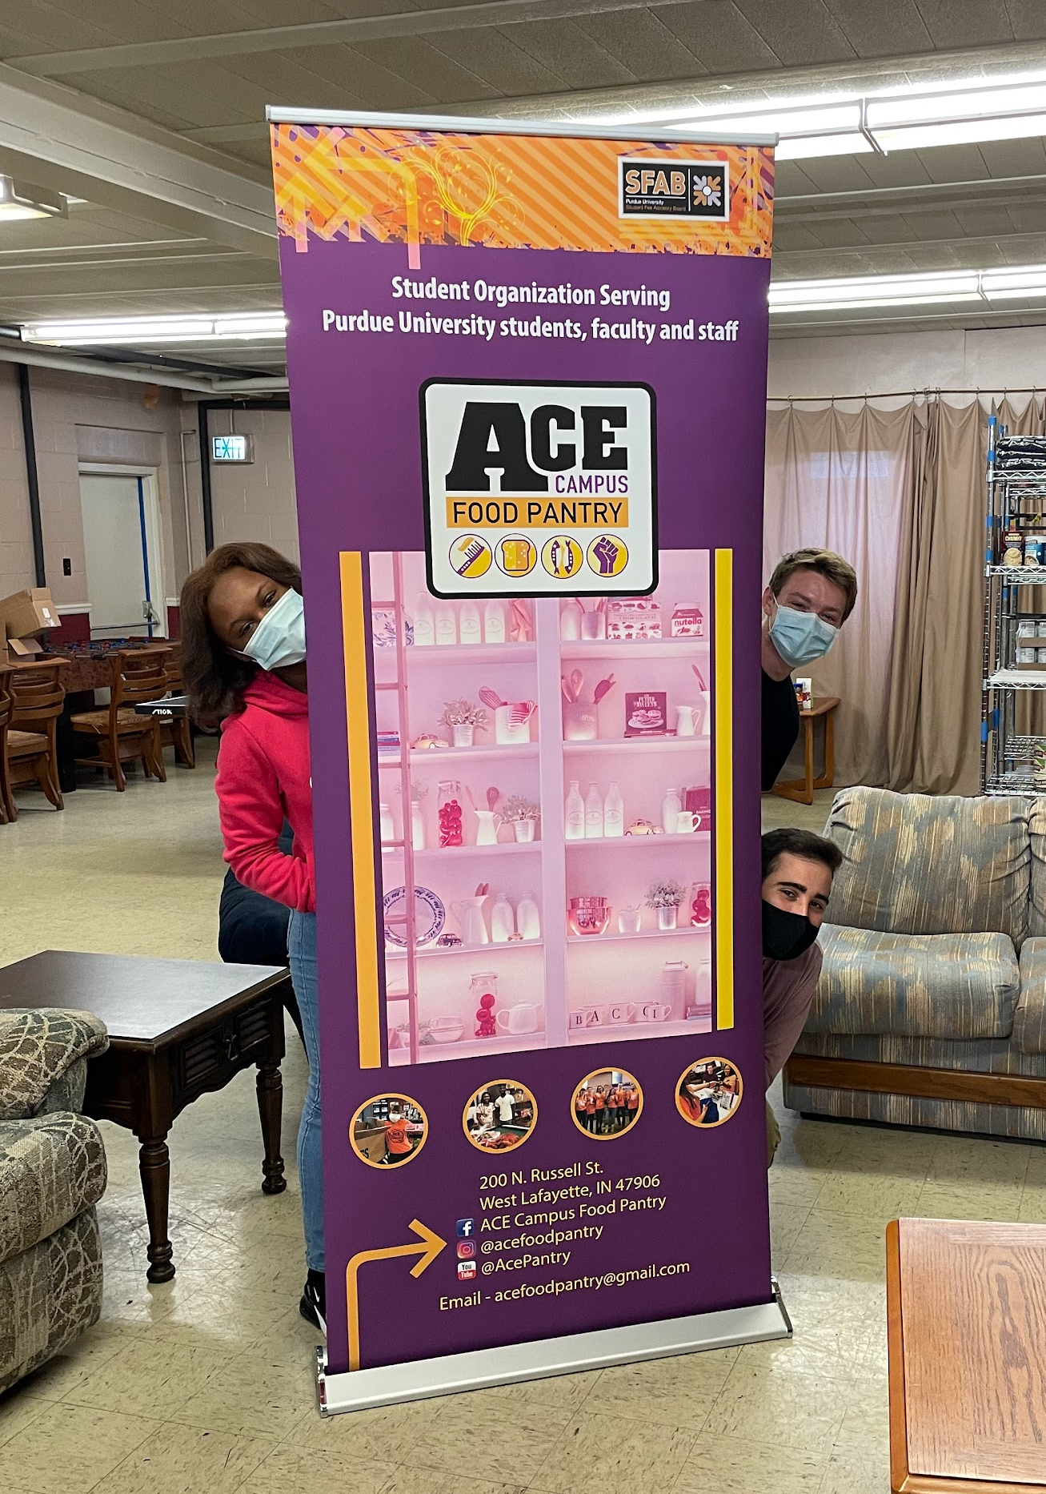
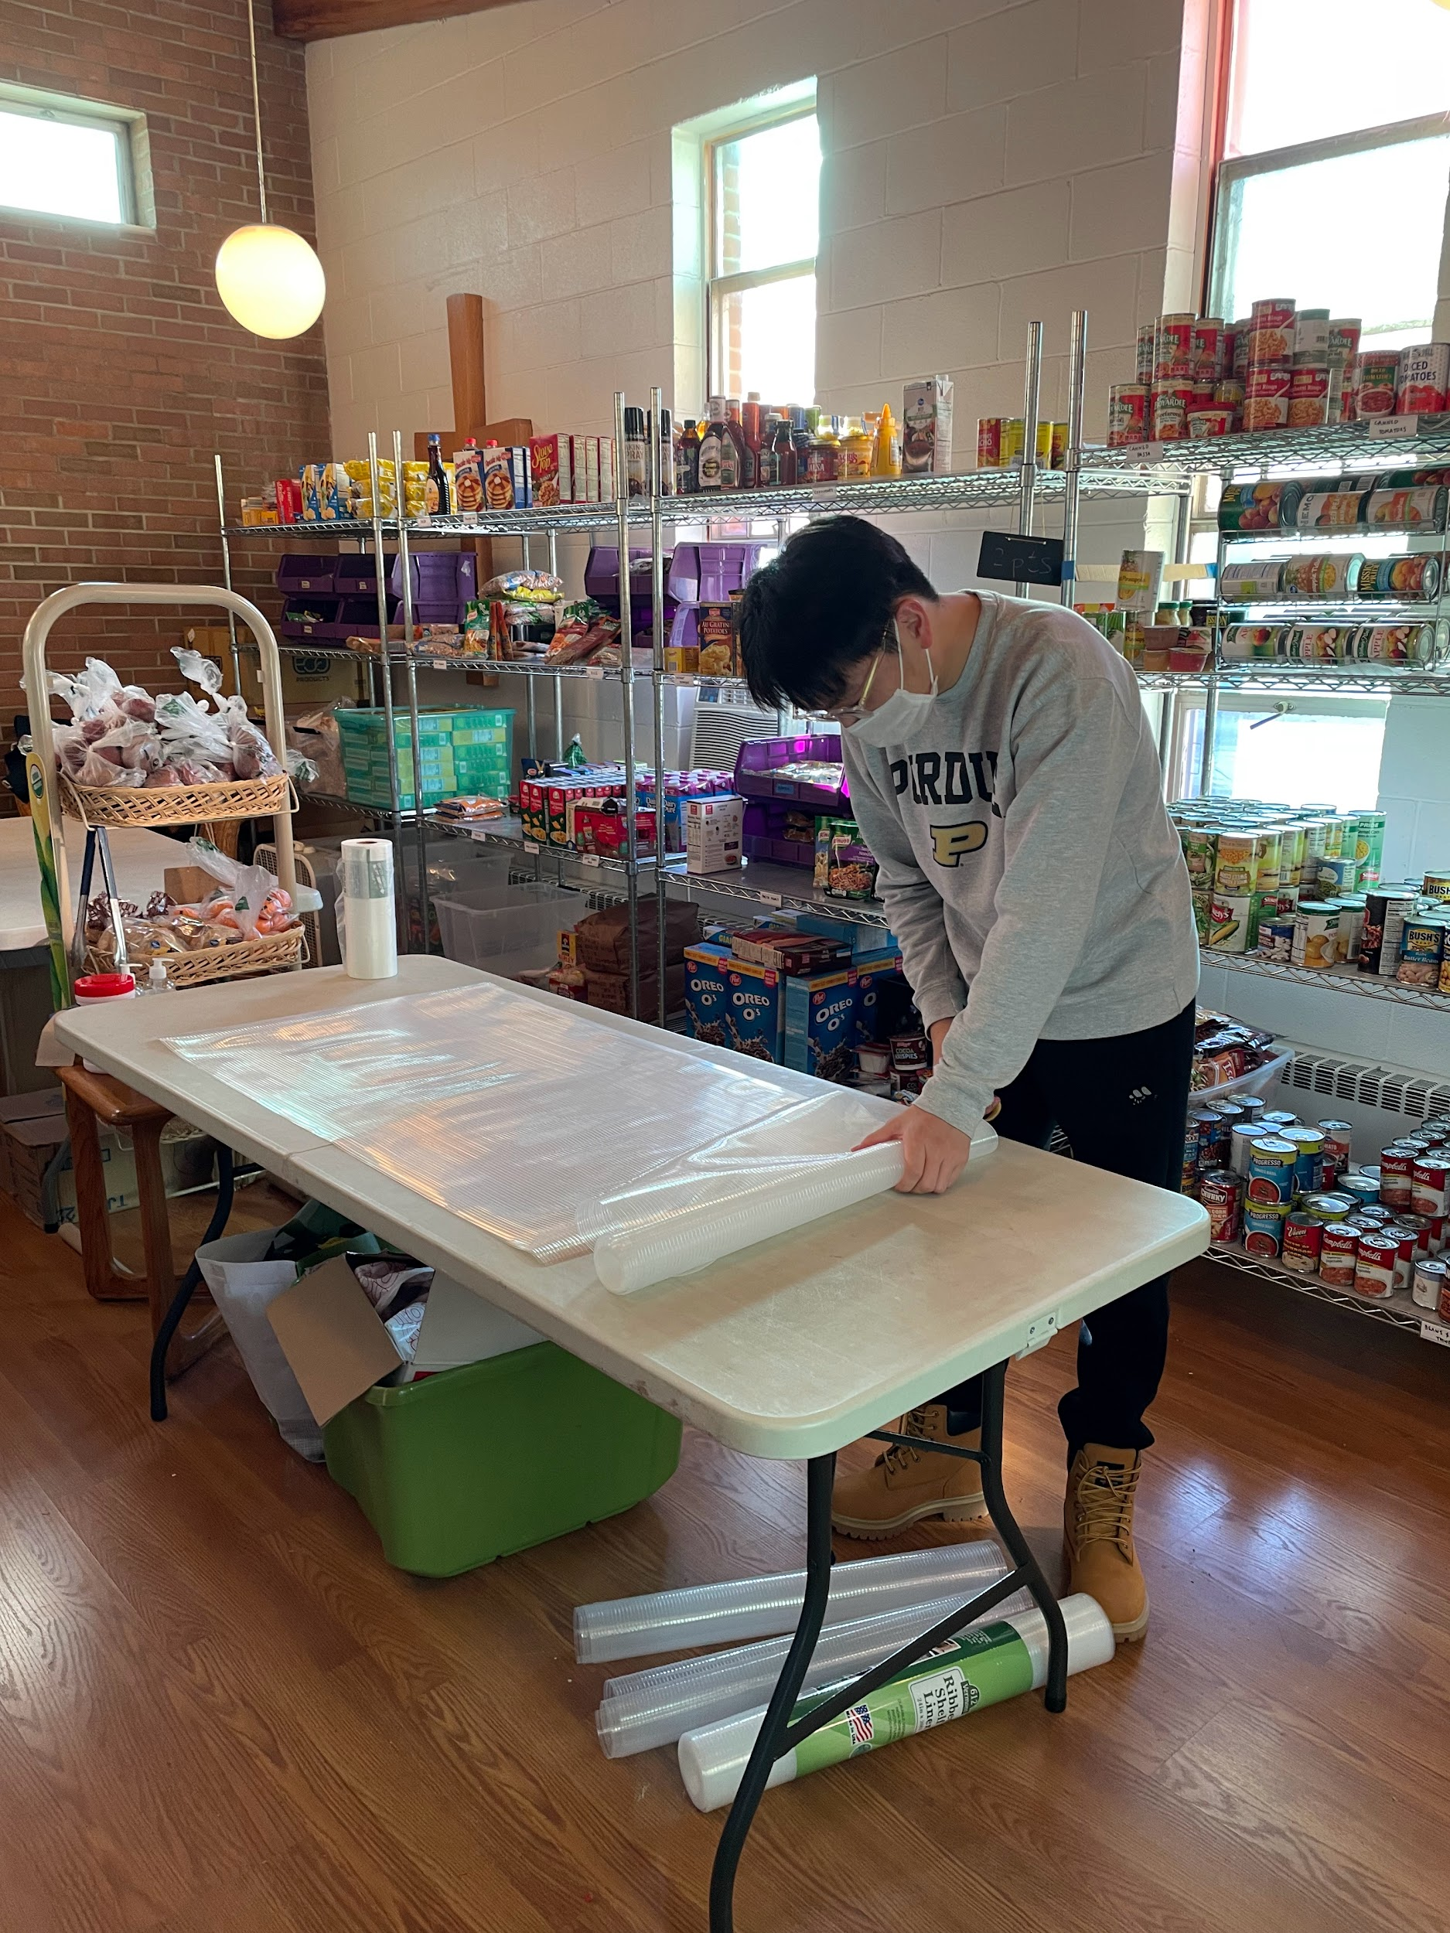
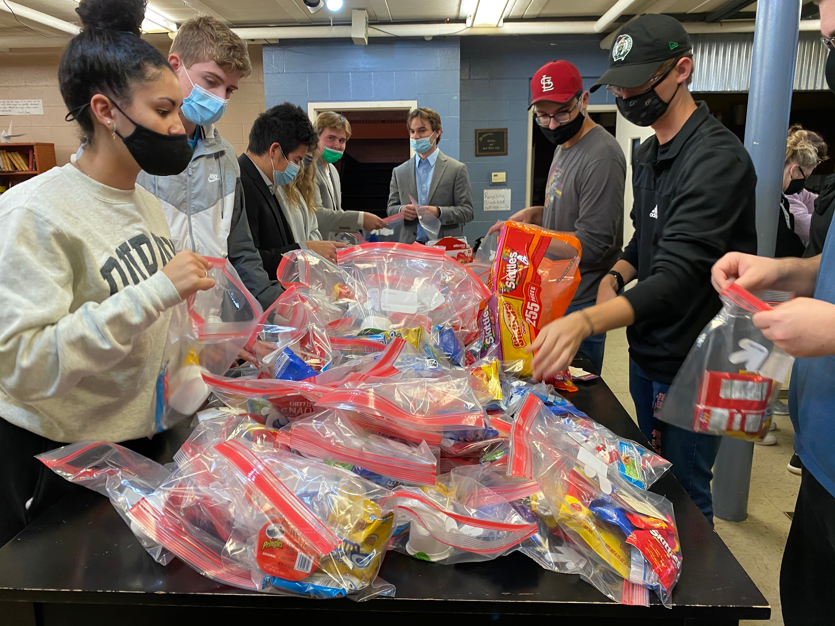
What is Our Volunteer Structure?
Student directors (serve 5hrs/week)
Shift leads (serve 3hrs/week)
~40 volunteers a week
~200 community members and students per semester engaged through volunteering
Notes:
Student Director
Volunteer Coordinators
Directors of Inventory
Director of pop-ups
Director of Outreach
Director of Donations

Slide 8
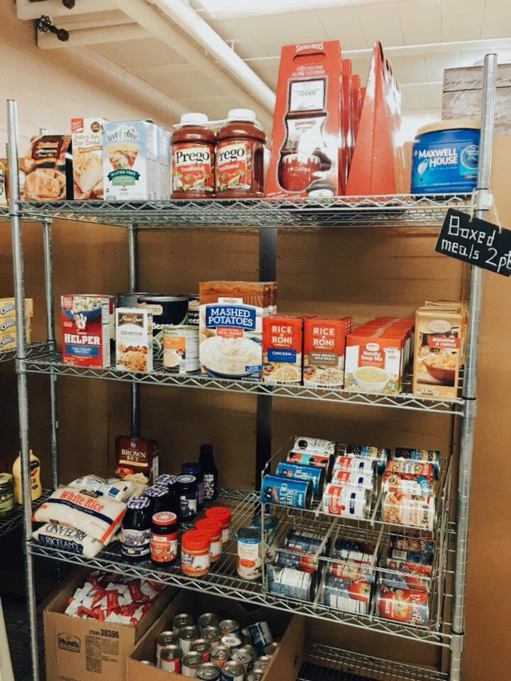
WHAT is a Day in the Pantry?
Central Location (The Found)
(Tu: 12-6pm Su: 5-8pm)
Just a Purdue ID Required -- no other info collected
Point system: 15 for individuals, 20 for families
ACE provides bags (but we always need more)
Pop-Ups
HORIZONS, Vet School, CoRec
LGBTQ+ Center, BCC, LCC, & AAARCC
Notes:
POINTS: bread and produce are 0 points, cans are 1 point, we go largely based upon serving size from there
*The LGBTQ+ center just moved over winter break. New address is Hicks Library, Room G988
504 W State St, West Lafayette, IN 47907.
Pop ups serve as more of a marketing tool…not going to have as wide a variety as the actual pantry so if you are looking for a variety of choices go to the central location
Audrey’s first slide

Slide 9
What is Our Philosophy?
We are a choice-based pantry not a health-based pantry
  Our food items are not priced by how “healthy” an item is
  There is no diet talk at ACE
  We believe that our clients have the agency to choose what food items they’d like to take
We are a community
  It’s okay if you feel like you’re not “working”!
  Take the down time to talk to other volunteers and clients
  Building community is important to us and that means talking to the people around you!
  We host socials and invite the volunteers to come!
Notes:
What’s considered healthy for one person isn’t necessarily healthy for another
There are some food pantries that use a color-coded teer system (green, yellow, red) for health

Slide 10

Cultural Appropriateness
Availability
Access
Use
Consistency
Example: Donor Education, offering culturally appropriate foods to clients
Example: Pop-up pantries for convenience, hours over breaks, hot meals
Example: Cooking Demonstrations, Trained Volunteers, Recipe Cards
Example: Open at above average rate among peer institutions
Example: All food is at no cost
Notes:
Foundations of ace – these are our 5 pillars
Availability: Open throughout the week
Access: Purdue community is able to access at no cost, just need to show purdue ID
Use: things available to clients like cooking demos, recipe cards, and volunteer training
Cultural Appropriateness: try our best to stock our pantries w/ food from different cultures. We will be partnering with cultural centers this year.
Consistency: we don’t close unless necessary

Slide 11
What Do students do during a Shift?
Monday Morning shift (9:30 - 11:30 AM)
  Pick-ups from Target and Dollar General
Monday Evening Shift (8:30 - 9:30 PM)
  Picking Up Panera Bread and taking it to the Pantry
Tuesday or Sunday shifts
  Check in: Checking clients in outside of pantry, recording their PUID’s
  Check out: Counting up points of items, sending clients to bagging station
  Assistants: Helping clients find items in pantry, answering any questions
  Swing: Getting meat from freezer downstairs, helping clients bag items outside
Thursday Shift
  Restock and Sorting Donations

Slide 12
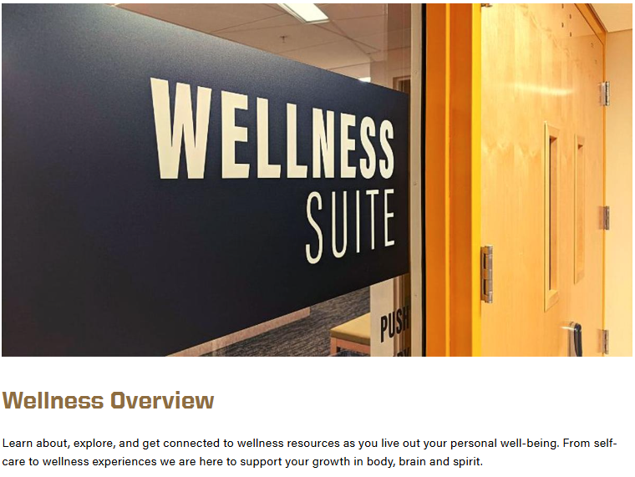
Additional Well-Being Resources (Get your Phones Ready)
Demonstration Kitchen
Boiler Financial Track
Modules
TAO – CAPS Resources
ODOS Resource List

Slide 13
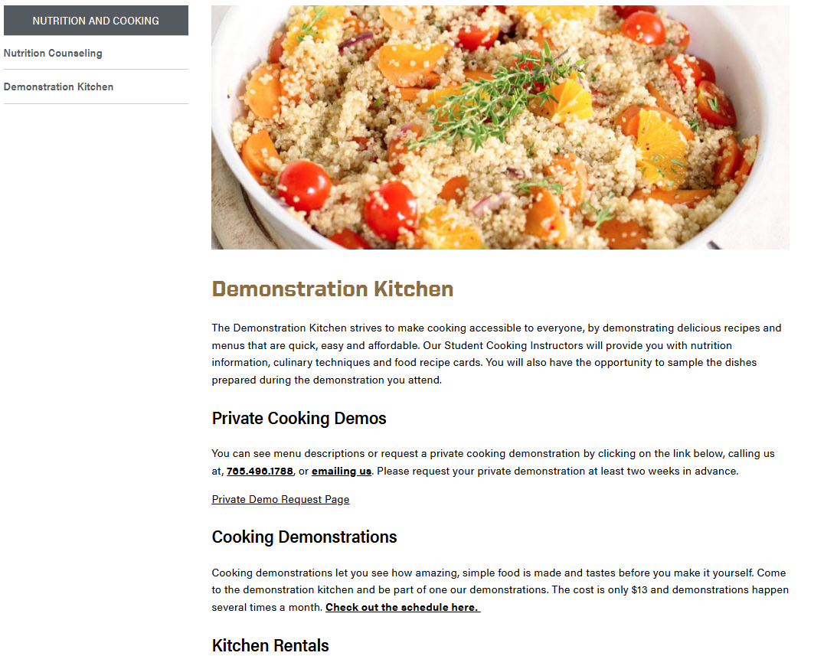

Additional Well-Being Resources (Get your Phones Ready)
Demonstration Kitchen
Boiler Financial Track
Modules
TAO – CAPS Resources
ODOS Resource List

Slide 14
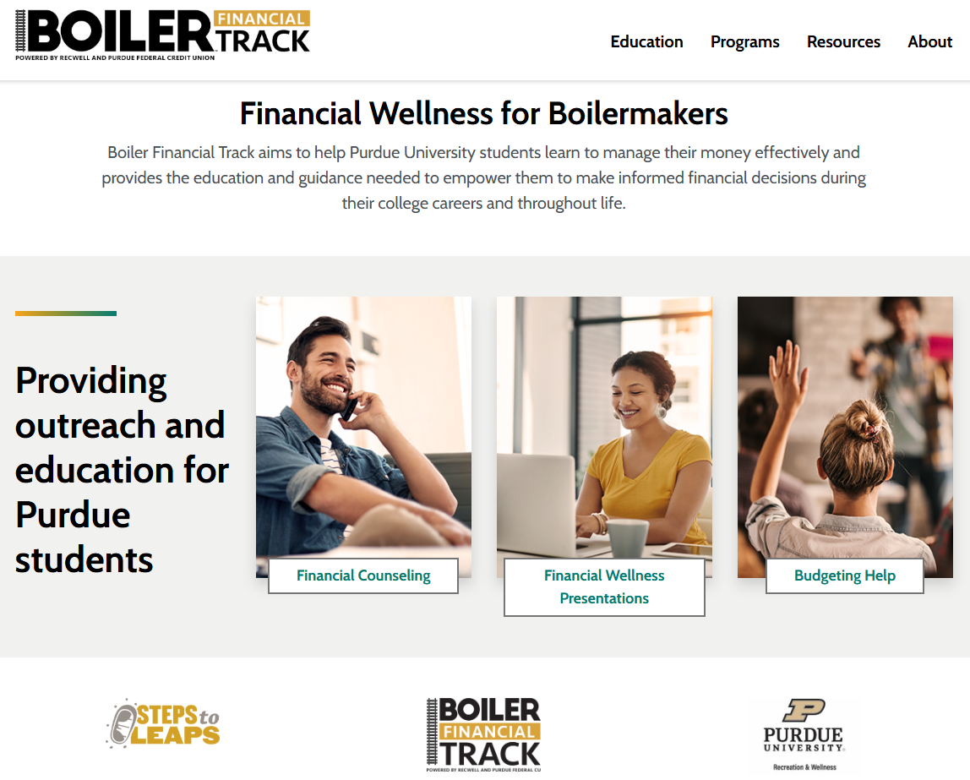

Additional Well-Being Resources (Get your Phones Ready)
Demonstration Kitchen
Boiler Financial Track
Modules
TAO – CAPS Resources
ODOS Resource List

Slide 15
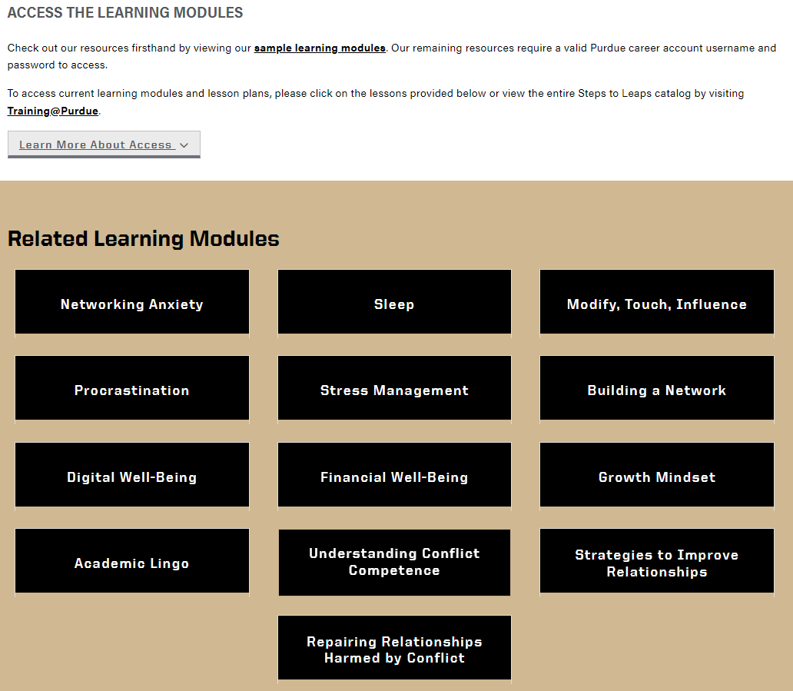

Additional Well-Being Resources (Get your Phones Ready)
Demonstration Kitchen
Boiler Financial Track
Modules
TAO – CAPS Resources
ODOS Resource List

Slide 16
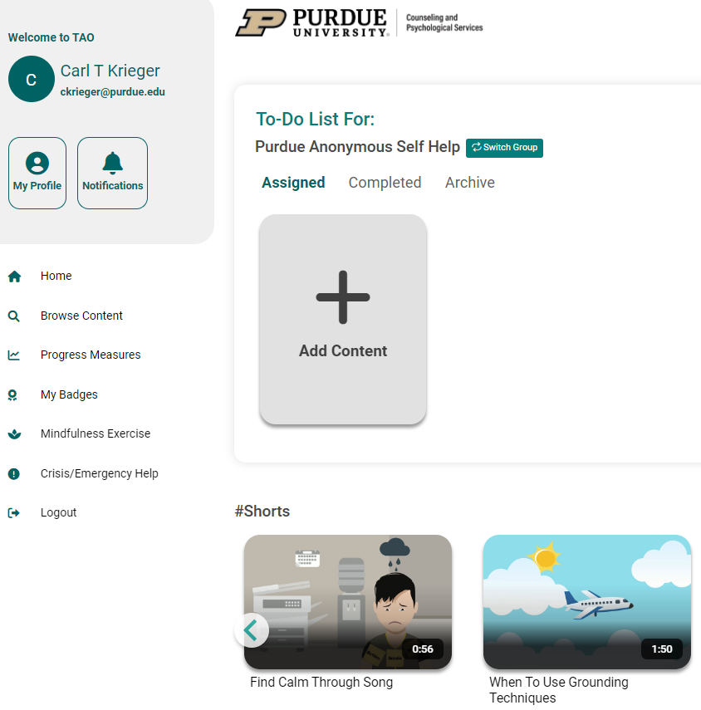

Additional Well-Being Resources (Get your Phones Ready)
Demonstration Kitchen
Boiler Financial Track
Modules
TAO – CAPS Resources
ODOS Resource List

Slide 17
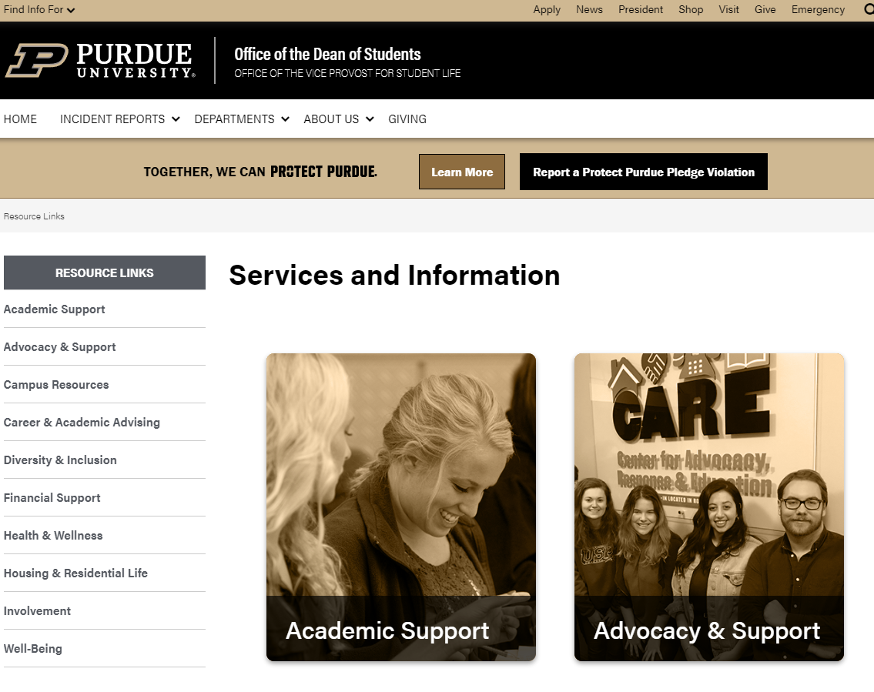

Additional Well-Being Resources (Get your Phones Ready)
Demonstration Kitchen
Boiler Financial Track
Modules
TAO – CAPS Resources
ODOS Resource List

Slide 18
Thank you! Questions?
Executive Student Director
Hailey Kane: ekane97@purdue.edu
Graduate Advisor
Megan Mihalkanin: mmihalka@purdue.edu
Contact ACE: (765) 357-3788
LinkTree: https://linktr.ee/acepantry
Email: acefood@purdue.edu
Notes:
Many of you indicated that you’re not yet FERPA certified, please shoot me an email and I can send you the information to get that taken care of
If you have any questions, feel free to unmute yourselves or drop your question in the chat. Otherwise, you are free to go.

