Slide 1

May/August 2025
Candidate workshop
January 30, 2025
Dulcy Abraham
Professor and CCE Burke Graduate Chair
Jenny Ricksy
Burke Graduate Program Manager
Stacy Lane
Burke Graduate Program Senior Assistant

Slide 2
Agenda
Introduction
Scheduling
Masters Students – non-thesis
Area Secretaries
  Professional Courtesy
Thesis/Dissertation Students

Slide 3
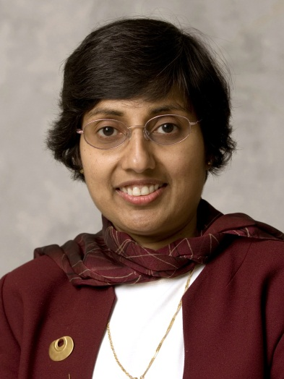
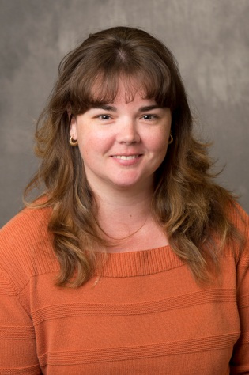
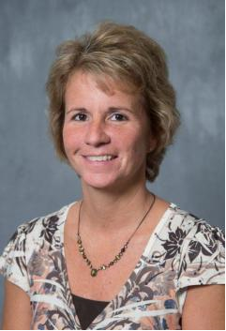
CCE Burke Graduate Program Office
Dulcy Abraham
Grad Program Chair
Jenny Ricksy
Grad Program Admin
Stacy Lane
Grad Program Assistant

Slide 4
Important Dates – May 2025
Failing to Plan implies Planning to Fail
February 5th is the last day to declare candidacy
April 16th Exam Completed
  Forms submitted online by advisor by 5:00 pm or candidate will be removed as candidate.
April 29th Final Date for Thesis Deposit
  You will not be permitted to upload your document to the Graduate School for deposit until the Form 9 has been fully approved by Civil.
Candidate deadlines can be found at:
  https://engineering.purdue.edu/CCE/Academics/Graduate/Current/Candidates/May2025

Slide 5
Important Dates – August 2025
Failing to Plan implies Planning to Fail
May 16th Plan of study must be fully approved by CCE
June 11th is the last day to declare candidacy
July 21st Exam Completed
  Forms submitted online by advisor by 5:00 pm or candidate will be removed as candidate.
July 29th Final Date for Thesis Deposit
  You will not be permitted to upload your document to the Graduate School for deposit until the Form 9 has been fully approved by Civil.
Candidate deadlines can be found at:
  https://engineering.purdue.edu/CCE/Academics/Graduate/Current/Candidates/Aug2025

Slide 6
Candidate Deadlines/Information
Available at the Current Students page:
https://engineering.purdue.edu/CCE/Academics/Graduate/Current/Graduating_Students
There are checklists available to help you navigate the process.
If you determine that you will not graduate, please let the CCE Grad Office know as soon as possible so you can be removed from the candidate list.

Slide 7
Deadline Fees
The graduate school has implemented fees for late candidate deadlines:
A $200 late fee will be charged to a student who submits their Plan of Study (POS) after the deadline in the semester they wish to be a candidate. For students wishing to graduate in May 2025, that date was January 12th
A formal request must still be made of the graduate school to accept the POS after the deadline. If they do not approve, no fee will be charged.
Changes to POS do not affect the deadline.

Slide 8
Deadline Fees
A $200 late fee will be charged to a student who requests candidacy after the appropriate deadline for the semester. For students wishing to graduate in May 2025, that date is February 5th.
A formal request must still be made of the graduate school to add the student to the candidate roster. If they do not approve, no fee will be charged.

Slide 9
Deadline Fees
A $200 late fee will be charged to a student who has been on the candidate roster for the same degree for more than two consecutive semesters. For example, graduate students who were on the candidate roster for the same degree in Summer and Fall 2024 and register as a candidate for May 2025, will be charged this fee.
Any candidate registration during a semester (even one day) begins this count.

Slide 10
Commencement Task List
On February 14, the registrar will put a “Commencement” task list on your myPurdue account.
This is where you will provide information needed for commencement and order a cap and gown.
  March 21, 2025-- Last day to indicate participation in the ceremony.
  April 21, 2025-- Last day to order cap and gown rentals at the discounted price.
  April 28, 2025-- Last day to order cap and gown rentals through the Commencement task list. All rental orders after this date will need to be placed through the University Bookstore.
  May 14, 2025-- Last day to provide diploma mailing address.
  May 15, 2025– PhD students will graduate (time TBD)
  May 16, 2025-- 9:30 am MSCE students graduate
  May 21, 2025– Degree Award notification will appear on official transcript
  May 31, 2025-- Deadline to ship back gown rental

Slide 11
Posting of Degree
  Although the University will try to post degrees by May 21, 2025, the Graduate School has 30 days, after commencement to complete the candidate audits. Unsubmitted grades, late approvals of final exam paperwork, and plan of study updates can cause delays in posting the degree.
  Diplomas will be mailed to your “diploma address” listed on myPurdue.

Slide 12
Responsible Conduct of Research (RCR)
Completion of the online Response Conduct of Research (RCR) module is a requirement of all Graduate Students for Graduation. Must complete it before scheduling the exit interview with Professor Abraham (MSCE thesis students and PhD students) or Jenny Ricksy (non-thesis MSCE students)
Getting to the right CITI course: www.citiprogram.org
https://engineering.purdue.edu/CCE/Academics/Graduate/Current
Side note: Purdue-relevant information is available at
http://www.purdue.edu/gradschool/research/rcr/index.cfm
Most students completed this requirement in their first semester as part of CE 691 – Grad Student Orientation

Slide 13
Additional Information
Review your approved plan of study. If there are changes that need to be made (committee members, coursework updates, concentrations, etc) please initiate a change to your Plan as soon as possible.
Your Purdue email account will stay active for about 6 months.
It is possible to walk in a future commencement ceremony as a returnee: https://www.purdue.edu/commencement/students/returneeParticipation.html.

Slide 14
Additional Information
Thesis option student must be registered for at least one credit hour of research in their graduation semester – even if you already have the minimum required research hours.
Residential international students must be registered for at least one in-person course each semester; this includes the graduation semester.
  Can register for one online/distance course as long as you are also registered for an in-person course. Research is considered in-person.

Slide 15
Final Exam
Every student, whether they are non-thesis or thesis option, must have a Report of Final Examining Committee on file with the graduate school in order to graduate.
This is confirmation that your committee agrees that you have completed all degree requirements to their satisfaction.

Slide 16
Final Exam
For thesis option students, this is done at their final defense.
For non-thesis students, the style of the final exam is up to the committee. It may be an oral or written exam, a meeting with the student or a committee meeting in the absence of the student. Non-thesis students should speak to their committee as soon as possible to determine the manner of their final exam.

Slide 17
Continuing for PhD
If you are continuing for a PhD you do not have to hold an exit interview.
  Non-thesis MS students should still turn in the non-thesis MS rubric
  Thesis students will still have to process a Form 9.

Slide 18
Masters Degree Exam Report for Non-Thesis Option
Student should contact advisor to ask about examining procedure. Policies vary by area.
If an exam event will be held, contact the CCE Grad Office at least two weeks before the exam date.
Grad Office will prepare the electronic paperwork.
Exam committee will electronically sign form.

Slide 19
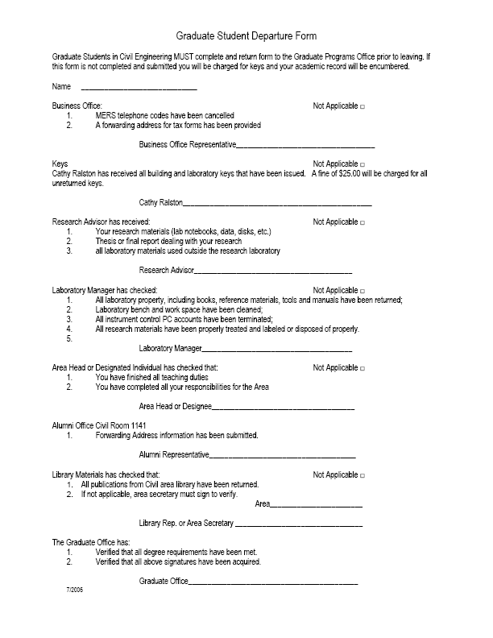
MSCE non-thesis exit interview
Two required forms:

Slide 20
MSCE non-thesis exit interview
Contact Jenny Ricksy (jricksy@purdue.edu) to arrange an exit interview, to be held April 14 – May 2, 2025
You must take completed Departure Form and MS non-thesis rubric with you to the exit interview for final signature. Links to these documents are available on the CCE Current Grad Student webpage.
Exit interview is an informal 15-minute meeting – where you have a chance to voice any concerns/suggestions about the program.

Slide 21
Intermission
Questions?
Non-thesis students excused
Please be sure that you have signed-in

Slide 22
Agenda
Masters Students with thesis
Doctoral Students

Slide 23
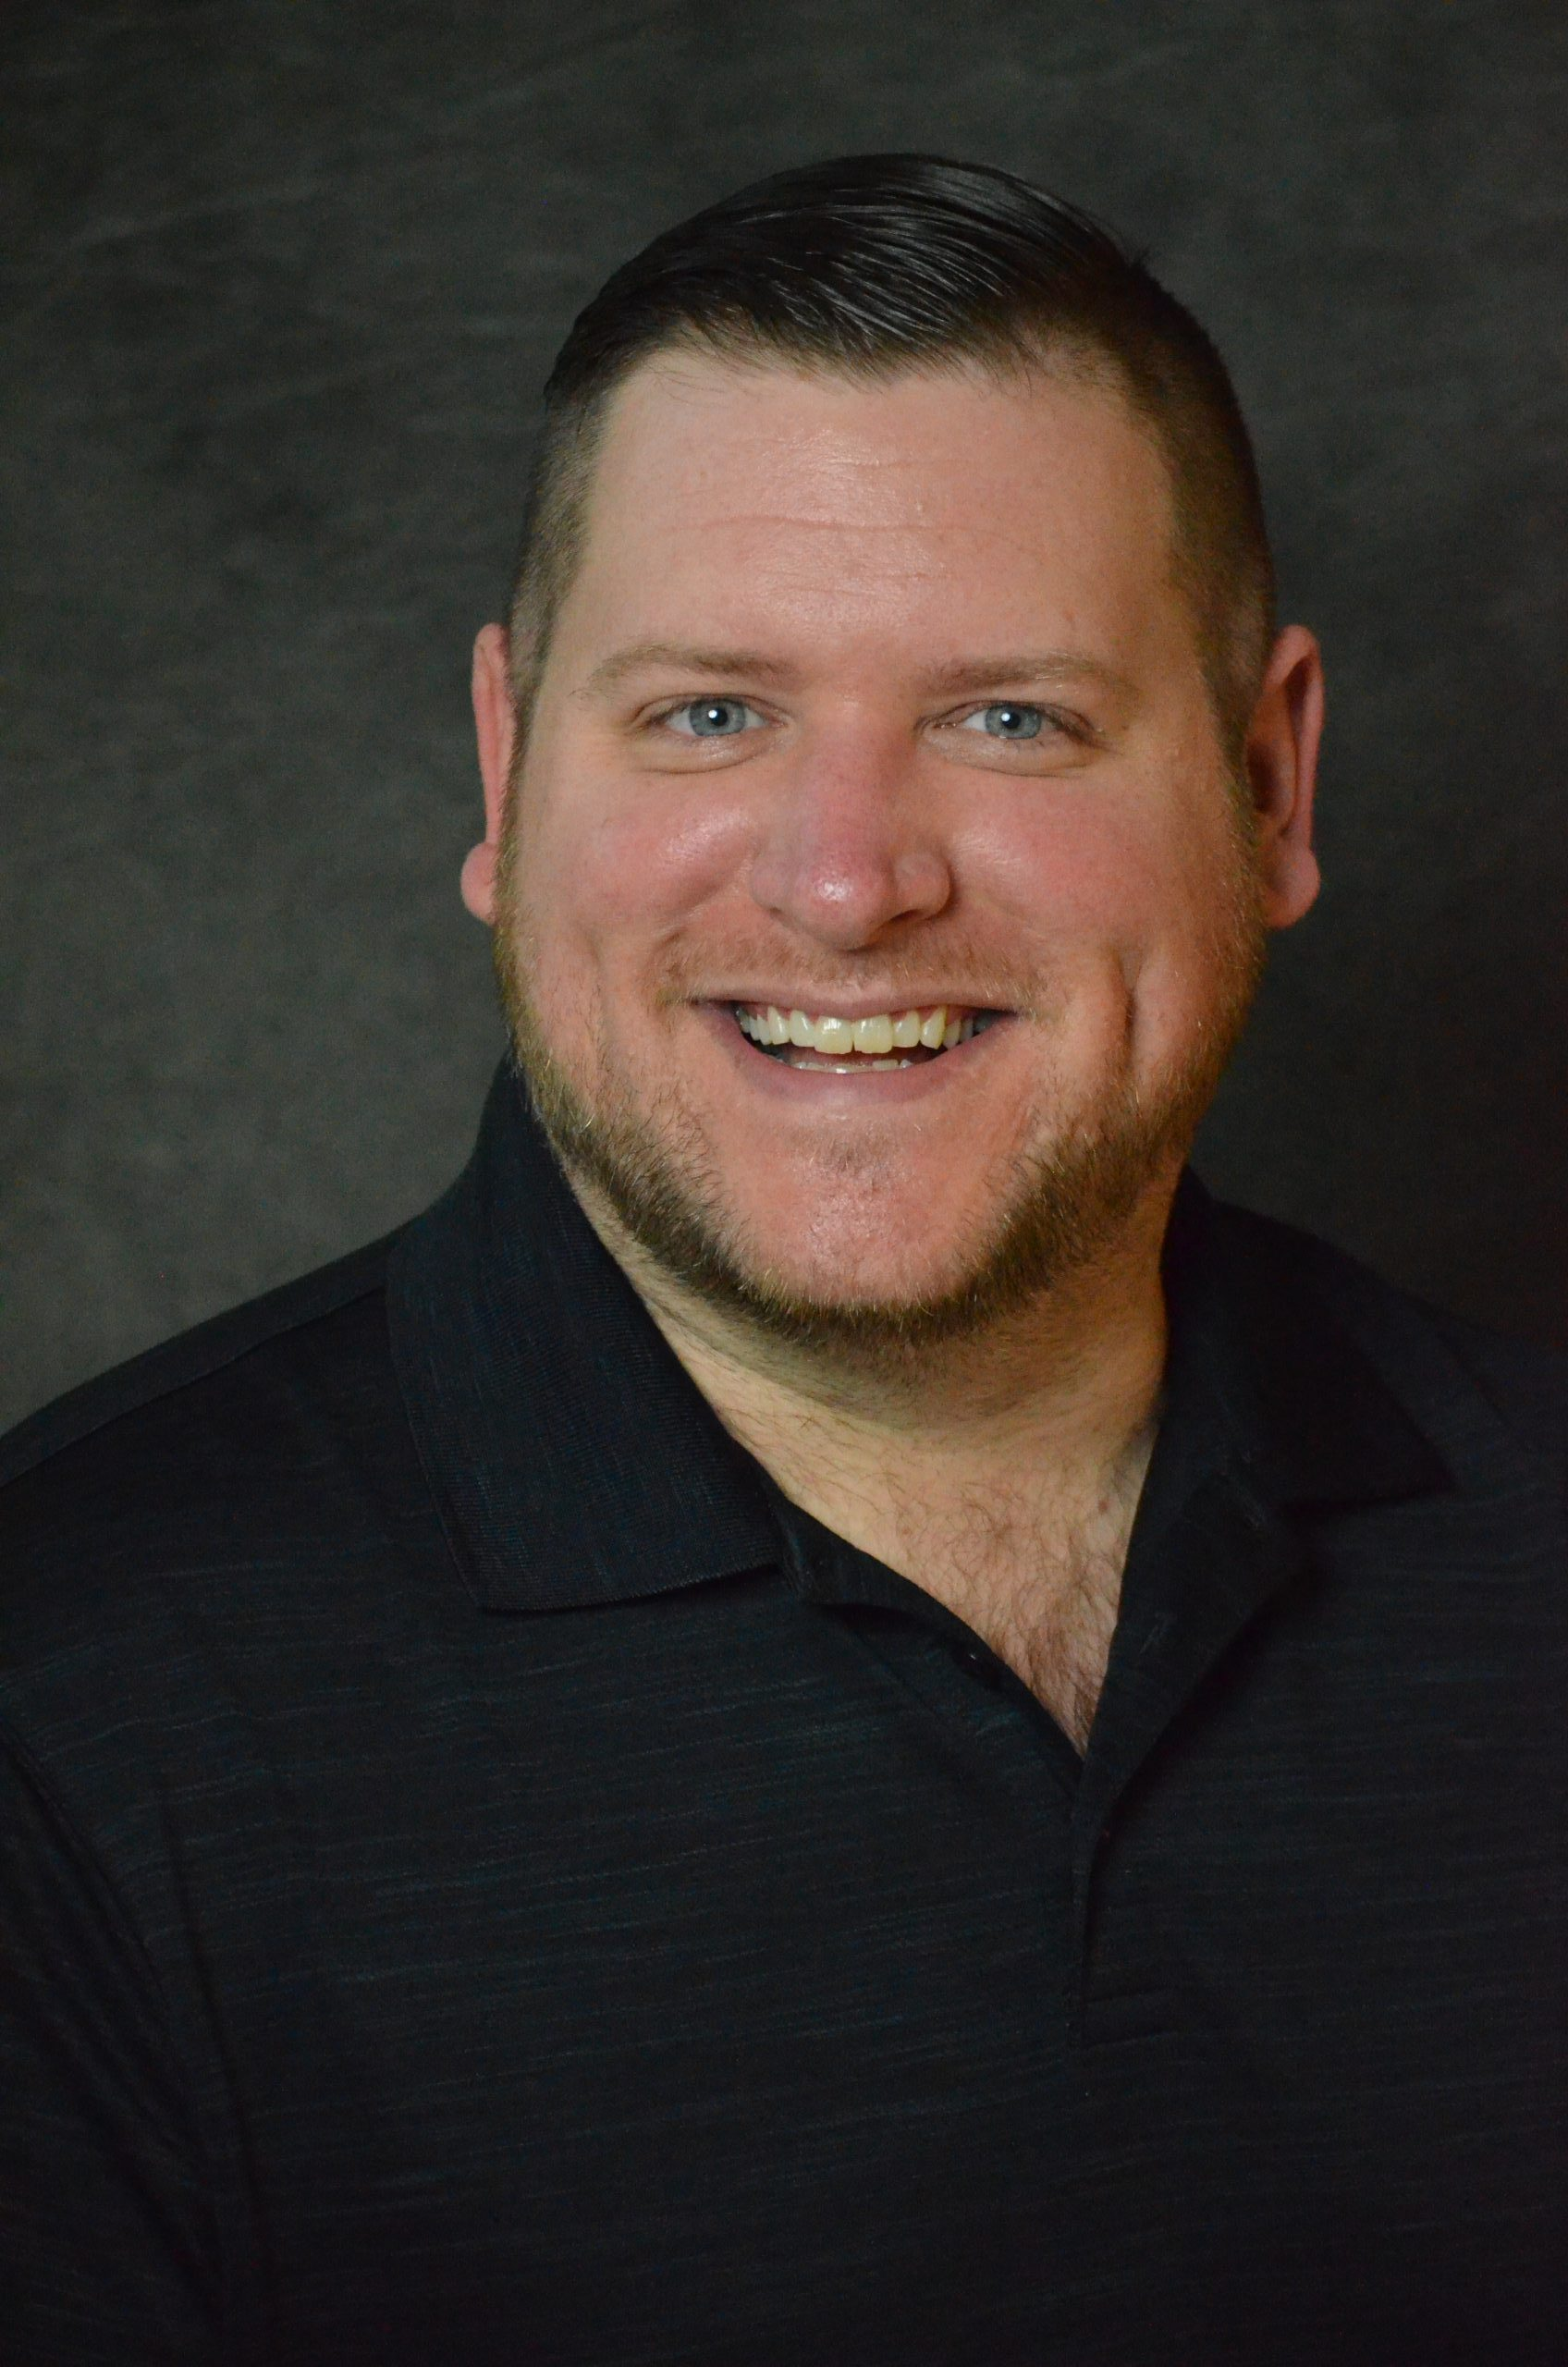
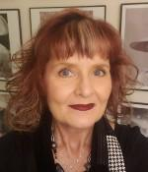
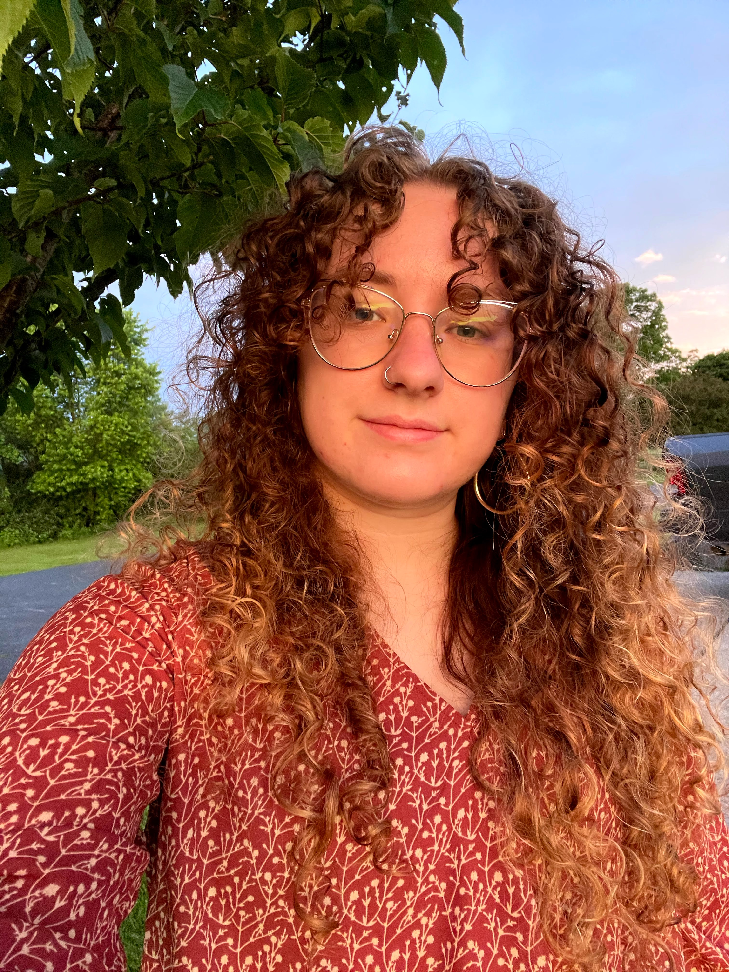
Staff Introductions – Area Contacts
  Cole Stonebraker
  Construction
Emma Montes
  Geotechnical
  Architectural
  Transportation
  Materials
  Bobbie Vance
    Hydraulics and Hydrology
    Environmental
  Lucy Dillman
    Structures
    Geomatics

Slide 24
Graduate School Thesis and Dissertation Office
https://www.purdue.edu/academics/ogsps/research/thesis/index.html
Contact: thesishelp@purdue.edu
Format Options: https://www.purdue.edu/academics/ogsps/research/thesis/templates.html
MS Word Template
LaTex : If you are using, or think you may use, LaTeX, please sign up for the PurdueThesis mailing list so you can stay up to date on communications related to LaTeX. See the first paragraph of https://engineering.purdue.edu/~mark/PurdueThesis for the web address of the mailing list.
**The Burke Civil Engineering Graduate Program requires that you must use one of these formats**
If you do not, your document will not be approved for deposit with the graduate school

Slide 25
Graduate School Thesis and Dissertation Office
Thesis Format Requirements
Students should follow the Graduate School format guidelines – various links are available at: https://www.purdue.edu/gradschool/research/thesis/templates.html
Formatting Guidelines and Deposit Procedures Presentation: bit.ly/thesiswl
Access workshop series here: https://tinyurl.com/PUthesisworkshop
You can request an individual consultation: https://www.purdue.edu/gradschool/research/thesis/appointment.html
The Thesis Deposit office suggests that you submit your document to their office (thesishelp@purdue.edu) for a format consultation by April 16th.

Slide 26
Steps to graduate
Submit Plan of study
Get on the Candidate List
Submit form 8
Submit pdf of abstract to CCE Grad Office
Complete Grad School Surveys
Hold Defense
Submit form 9
Get format check approval
Hold exit interview with Dr. Abraham
Upload document to Grad School deposit site
Pay deposit fee
*For PhD students: Hold Prelim at least one year before the semester you plan to graduate

Slide 27
Sample Timeline for thesis option students

Slide 28
Electronic Process for Exam Forms
There are two main elements for thesis option graduation:
  Defense : student initiates a Request for Appointment of Examining Committee (form 8). This then prompts the generation of a Report of Final Examination form, which your committee will sign to record the approval of your defense (the student does not see this form)
  Deposit: student initiates a Thesis Acceptance Form (form 9).

Slide 29
Electronic Process for Exam Forms
All forms (Form 8, Exam forms, Form 9) are processed electronically in a process similar to the plan of study.
Students must use the online system to submit a Form 8 – requesting their exam date. Confer with Major Professor and ensure that the thesis (document) is in good shape so that the requested date is realistic for conducting the exam. Requests should be submitted at least 3 weeks prior to the requested exam date.
You must be registered in order for exam forms to be processed.

Slide 30
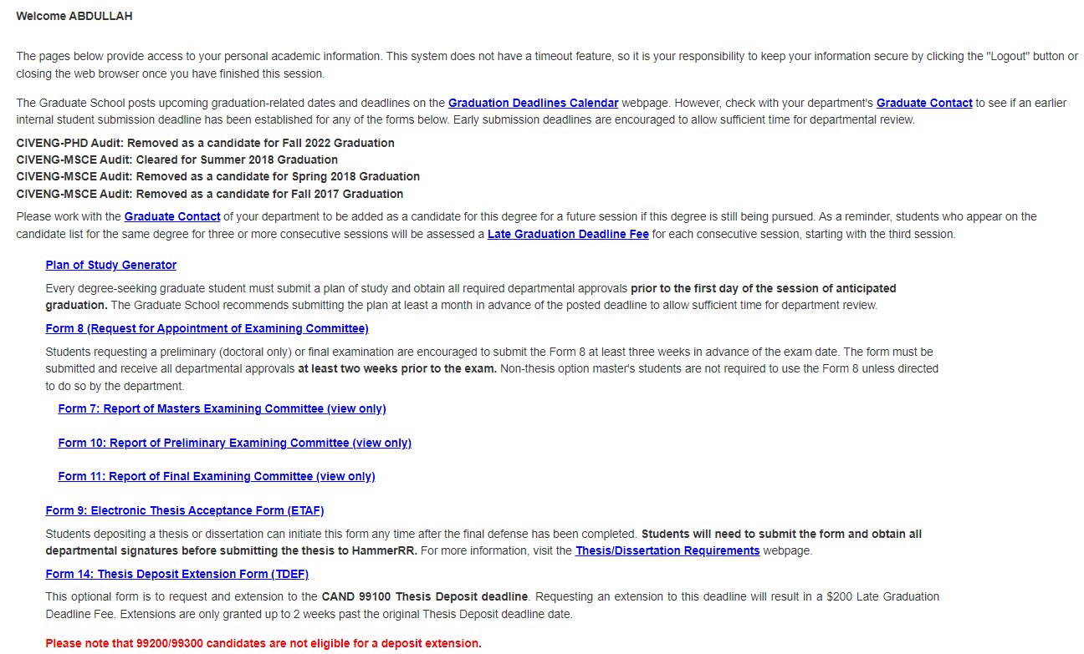
Electronic Process for Exam Forms
Click on the “Form 8: Request for Appointment of Examining Committee” link to initiate the form and then indicate the exam to be taken.

Slide 31
Electronic Process for Exam Forms
Click on the “Update Exam Committee” – confirm that the correct people are listed on your committee.
Enter the exam date and time. You can use online/virtual/webex, etc. for location if it will not be in-person.
In the “Thesis Title” section, enter the thesis title if requesting a final examination (this does not have to match the final title).
Once completed, submit the form for approval.
Notes:
The form may be left in “Saved” status for editing but must be submitted in order to be processed.
This request must be received by the Graduate School at least 3 weeks prior to the requested exam date.
You will receive an automated email when the Form 8 has been fully approved.

Slide 32
General Requirements
You should submit the final draft of your thesis to your advisor/committee for review BEFORE submitting the Form 8.
When you submit your Form 8 you can also submit a pdf version of your thesis abstract to the CCE Grad Office – jricksy@purdue.edu – and meeting invitation information so your defense date can be announced.

Slide 33
Form 8 – Additional Information
You should work with your committee to find a date that works. The CCE grad office does not assign dates or rooms.
We strongly recommend contacting your thesis format advisor at the time you submit your Form 8 to let them know you will be depositing so that a timeline for format review can be worked out.

Slide 34
Final Defense vs Thesis Acceptance
The process of holding your final exam and having the final exam form submitted to the graduate school is separate from having your thesis accepted and approved by the committee members.
Do not assume that because your committee approves your final exam, that they will approve your thesis.
Be sure to leave adequate time between your final exam and the deadline for thesis deposit to make any corrections to your thesis document that may be required by your committee.

Slide 35
Thesis Format Check
A format check must be done on all thesis/ dissertations.
Two options:
  The area secretary is designated as the format check advisor.
  Graduate School thesis deposit office
The Form 9 will not be signed by the CCE Grad Chair without the format check advisor approval and the approval of the committee members (including chair/co-chair of committee)
The final deadline to submit your document for final CCE format check is at least three business days BEFORE your exit interview with the CCE Grad Chair, but no later than April 23, 2025.

Slide 36
Deposit Information
Please be sure to be consistent with listing your committee member’s participation. If they are listed as Co-Chair on your POS, then you should continue to list them as Co-Chair in other documents.
Be consistent with your own name across all publications. This will ensure that future searches will find you.

Slide 37
Exam/Thesis Acceptance Form Approval - Special Circumstances
If you have a special certified faculty member on your committee– that member will need to send an email to the CCE Grad Office (jricksy@purdue.edu) indicating their approval of your defense and giving permission for the CCE Grad Office to electronically approve on their behalf.

Slide 38
Additional Information
Schedule exit interview with Dr. Abraham (CCE Grad Chair) as soon as possible since her schedule fills quickly during this time. Most of the time slots later in the semester gets filled very fast. The exit interviews can be held virtually or in-person.
Reminder: She will not be able to approve Form 9 until all your committee has approved and she has received email approval from the format check advisor.

Slide 39
Additional Information about the Deposit Process
We strongly recommend that you plan to deposit early. Although the Thesis/Dissertation office will do their best to process deposits by the April 29th, 5:00 pm deadline, if you wait until the last minute, your deposit may not get in by the deadline.
If you do not have the Form 9 completed, Hammer Deposit Approved and Survey(s) complete by April 29th at 5:00 pm, you will have to request a Deposit Extension Deadline (Form 14) in order to graduate in May. There will also be a $200 fee.
The Thesis Deposit office suggests that you submit your document to their office (thesishelp@purdue.edu) for a format consultation by April 16th.
This review is just to help make sure that the thesis or dissertation is in the correct format prior to the defense and for future publication. Content changes can still be made to this document up until the final thesis submission deadline for fall, which is April 29th

Slide 40
Thesis Acceptance – Form 9
Student should initiate Form 9 once a final title has been decided (usually at your defense).
The link to Form 9 is in the same place as the plan of study generator and the link to Form 8.
The committee members will be prompted by the system to approve the form.
If you have a special certified faculty member on your committee– that member will need to send an email to the CEE Grad Office (jricksy@purdue.edu) indicating their approval of your thesis/dissertation and giving permission for the CCE Grad Office to electronically approve on their behalf.
Also includes confirmation that your document has been reviewed by iThenticate Plagiarism Software. This must be done by your advisor.

Slide 41
Copyright
Be sure to obtain permission if you want to reuse somebody’s copyrighted material en-mass.
You will also need to get permission to use your own materials if they have been published.
Copyright permission(s) must be uploaded with your document to HammerRR
For more information visit http://www.lib.purdue.edu/uco/

Slide 42
Exit Interview
Email Dr. Abraham at dulcy@purdue.edu to arrange an exit interview to be held before April 28, 2025
At least 48 hours before exit interview, please email a copy of the dissertation/thesis to Dr. Abraham (dulcy@ecn.purdue.edu). This does not have to be a final/approved version.
*Note, Dr. Abraham will not be able to approve Form 9 until all committee members have approved and she has obtained approval from the format advisor.

Slide 43
Deposit with Graduate School
Complete Electronic Thesis Acceptance Form (Form 9)
  The upload link will not be available to you until all the signatures have been obtained on the form 9.
Submit Electronic Thesis/Dissertation to HammerRR
  The Graduate School requires that you submit your electronic deposit no later than 5:00 pm on April 29, 2025.
Graduate School exit survey must be complete
Pay Deposit fee
  MSCE is $90
  PhD is $125

Slide 44
Deadline Extension
The Graduate School will allow a request to extend the graduation deadline by up to two weeks.
The request must be made BEFORE the regular deadline – so before April 16 for a defense extension or before April 29 for a deposit extension.
The request form (Form 14) can be found in the Grad School database – the same place you do your plan of study and exam forms.
There is a $200 fee to extend the deadlines

Slide 45
Quality
Your thesis/dissertation will be publicly accessible
Spelling, grammar, figure quality, references, cross referencing take time to work out. Use OWL as a resource
Your committee’s first read should be a very high-quality document… not a mid-point draft
Be considerate of your advisor’s time on drafts. Make sure each revision he/she re-reads reflects more then a few hours of inserting edits
We recommend you first meet with your format advisor at the time you submit Form 8

Slide 46
Thank You
Any questions?

