Slide 1

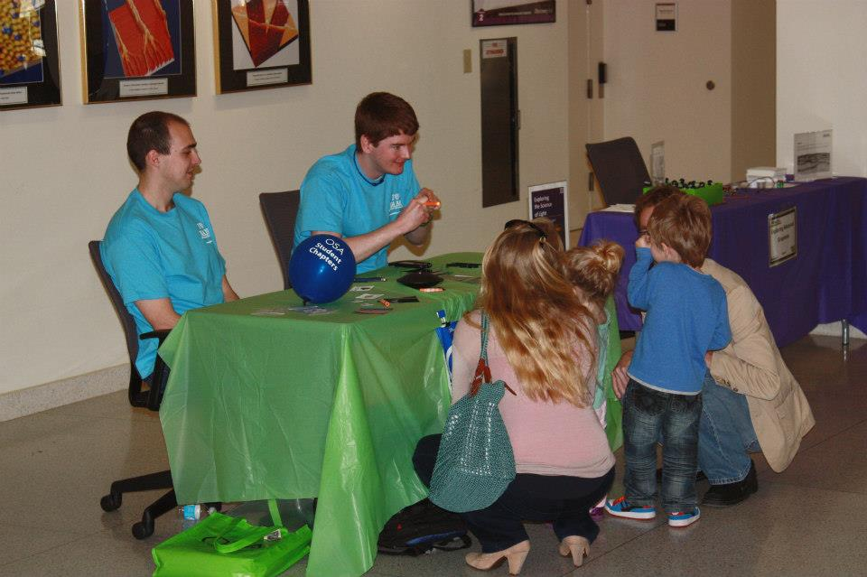
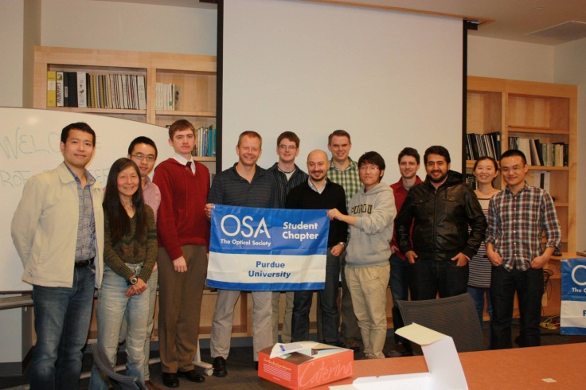

OSA (Optical Society of America) Purdue Student Chapter 2014 FALL CALLOUT
Would you like to learn about the OSA Purdue Student Chapter ?
Here you will hear the latest scientific progress in optics, and many exciting events and professional activities are waiting for you throughout the year.
Fun & Learn Lecture
Three surprising optical phenomena in nature,
and what we can do with them ?
Speaker: Prof. Peter Bermel, School of Electrical and Computer Engineering
Abstract: A broad range of optical phenomena in nature have created long-standing mysteries. For example, what gives animals like butterflies their rich colors? How can many animals see in places that appear to be completely dark? And how can sightings of some unusual natural phenomena like mirages be explained? The process of solving these mysteries has interacted synergistically with the modern fields of photonics, plasmonics, and metamaterials. A few exciting applications of this work, including photovoltaics, will also be briefly discussed.
September 10th, 5:30pm, Birck Nanotechnology
Center, Room 1001
Food and beverages will be provided.
Contact us: osa.purdue@gmail.com
Find us on Facebook and http://osa.braveline.com/purdue/

