Slide 1
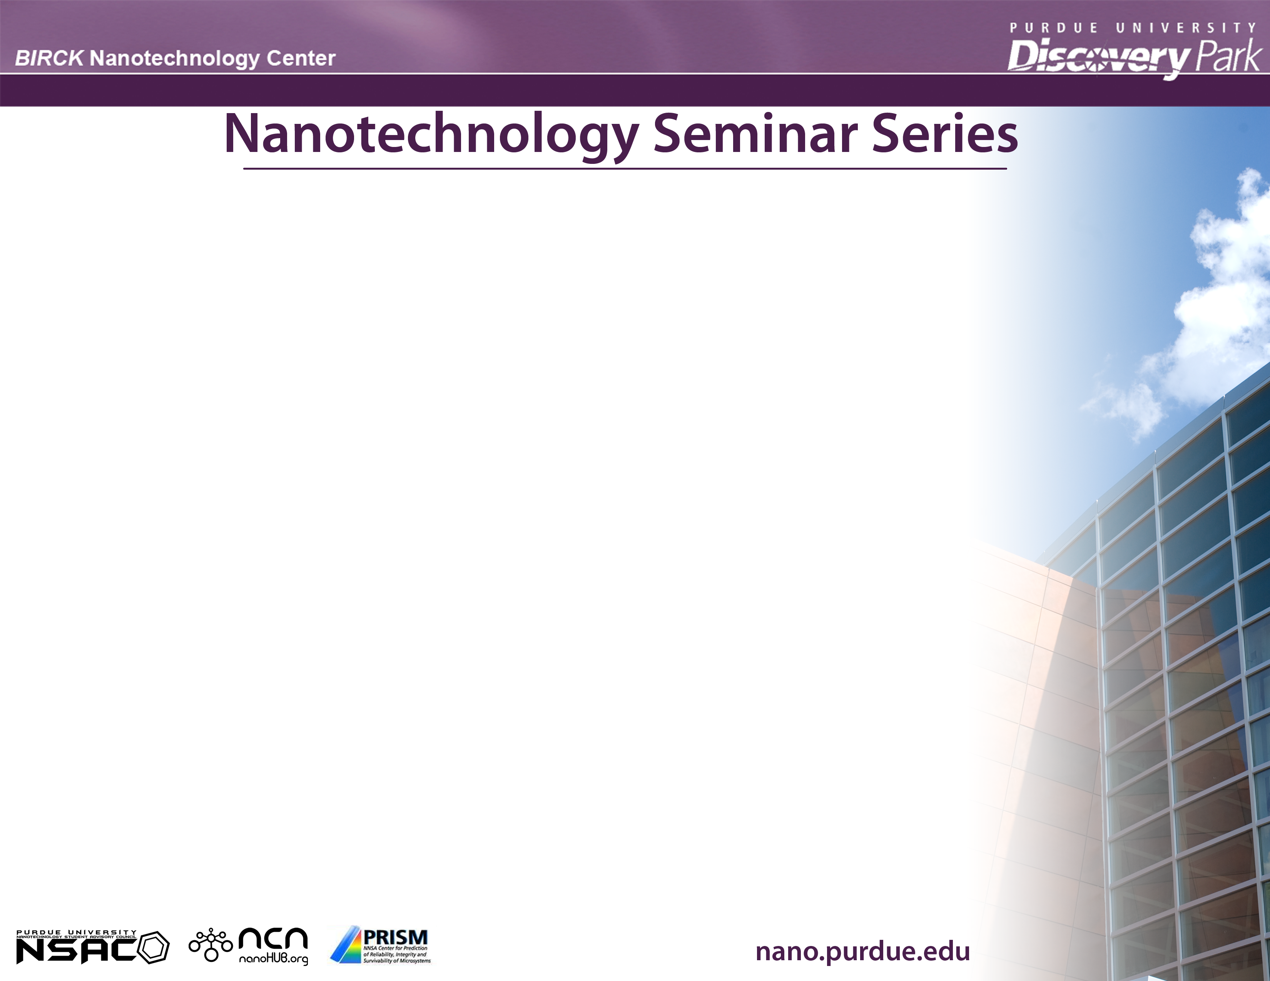


“Correlation Between Structural and Mechanical Properties
of Nano-multilayer TiCN/TiNbCN Coatings”
October 5, 2010, BNC 1001, 1:30 PM
Professor Pedro Prieto, Director of CENM
Center of Excellence for Novel Materials, Universidad del Valle Cali, Colombia
Improvement in the mechanical properties of hard coatings such monolayer (TiN, CrN, AlCN, WC-Co, TiCN) [1], has been achieved using compositional gradient WC/C layer, or multilayered type [transition metal/transition carbide]_{n}, [transition metal/transition nitride]_{n}, [TiCN/ZrCN]_{n}, among others. Multilayered coatings exhibit better mechanical and chemical properties, such as hardness, adhesion, wear resistance, than those in monolayer [2, 3]. We have improved mechanical properties in a multilayered system such as [BCN/c-BN]n, n varying between 1 to 16 [4]. Improvement in the mechanical properties is of crucial importance from industrial applications point of view, especially in processes where high mechanical performance is required. In this work, we have grown superlattices based on the ternary and quaternary coatings of the type [TiCN/TiNbCN]n, maintaining constant the total thickness of the coating. The main goal is to study the crystalline and interfacial structure via electron microscopy in cross section view and correlated them with structural, morphological and mechanical properties. [TiCN/TiNbCN]_{n} coatings were grown onto Si (100) and steel substrates by reactive r.f. magnetron sputtering technique using two alternating targets (TiC and Nb) [5-6]. The bilayer period (Λ) was varied from the micrometric (1.5 µm) to the nanometric range (15 nm), for a total thickness of 3 µm. Coatings was structurally characterized by x-ray diffraction (XRD), transmission electron microscopy and (TEM) and Atomic Force Microscopy (AFM). Fig.1 displays a cross section TEM micrograph showing the diffraction contrast of the multilayer and its corresponding diffraction pattern; in Fig 2 we can observed a TiNC/TiNbCN interface via the high resolution TEM micrograph. Fig. 3 shows an AFM image of a surface of a multilayer showing the nano-indentation traces. Fig. 4 shows the improvement of the hardness with the increase of the bilayers number. Detailed analysis of high resolution images and their diffraction pattern on multilayer with the lowest bilayer thickness indicates an epitaxial relation between TiNC and TiNbCN layers inside each columnar crystallite, it is given by Ti-N-C(111)||Ti-Nb-CN (111) showing cube-on cube assembly. Hardness measurements were performed by using nano-indentation. The tribological properties were determinate via dynamic contact test using a Microtest MT 4001-98 tribometer and Scratch Test Microtest MTR2 system; from them, the friction coefficient and critical load for the different samples were measured. An enhancement of both hardness and elastic modulus was observed when the bilayer period (Λ) in the coatings was reduced. Sample with the smallest bilayer period (Λ = 15 nm, n = 200 bilayers) showed the lowest friction coefficient (~0.1) and the highest critical load (80 N), corresponding to 2.2 and 1.6 times better than those values for the coating with n = 1, respectively. The enhancement effects in the [TiCN/TiNbCN]n multilayer coatings can be attributed to the Hall Petch effect in multilayered coatings, in which the interfaces act as a barrier against the movement of the dislocations and the bilayers of materials having different mechanical properties generate an inhomogeneous. This work was supported by the Center of Excellence for Novel Materials (CENM) under Colciencias/CENM contract # RC-043-2005.
Professor Pedro Prieto is the Director of the Excellence Center for Novel Materials in Colombia ( http://calima.univalle.edu.co/cenm/Eng/about-us.htm ), as well as the Director of the Thin Films Group in the Department of Physics at the Universidad del Valle, Cali, Colombia. He holds a Physicist degree, in 1974 and a Magister Scientiae degree in Physics from Universidad Nacional de Colombia in 1978, working on Silicon Oxide Thin films. He received the “Doktor der Naturwissenschaften” Dr.rer.nat from Rheinische Westfaliche Hochschule RWTH-Aachen Germany in 1982 for the doctoral thesis: ¨Neutronenkleinwinkelstreuung an Guinier - Preston - Zonen in Aluminium - Kupfer - Legierungen¨ (Small Angle Neutron Scattering on Guinier-Preston Zones in AlCu Alloys). He joined the Universidad del Valle Cali, Colombia, in 1974 and became Full Professor in the Physics Department in 1986. Presently, he leads the Thin Films Research Group, which he established in 1978. Most of Prieto’s career has been devoted to R & D of materials science and electronic devices, particularly amorphous semiconductors, solar cells, High Temperature Superconductor materials, HTC Electronic Devices and Hard Coating Materials. The Thin Film laboratory began with the study of amorphous metallic alloys and through a COLCIECIAS research project (1983-1987) with Hydrogenated Amorphous-Si thin films. Since 1989, he has been working on the development of high-temperature superconductor devices based on superconducting thin films, in Magnetic materials in PZT - ferroelectric thin films and in Hard Coating Materials. Prof. Prieto has authored or co-authored over 100 scientific publications. He is an Alexander von Humboldt Fellow (1988), Guggenheim Fellow (1998) and American Physical Society Fellow (2000) “For forefront research in the Josephson Junction effect in high temperature superconductors and outstanding contribution to the development of physics in Latin America.”
Adobe Connect: Talk 2 - https://gomeet.itap.purdue.edu/prieto2/ Host: Professor Arvind Raman

