Slide 1
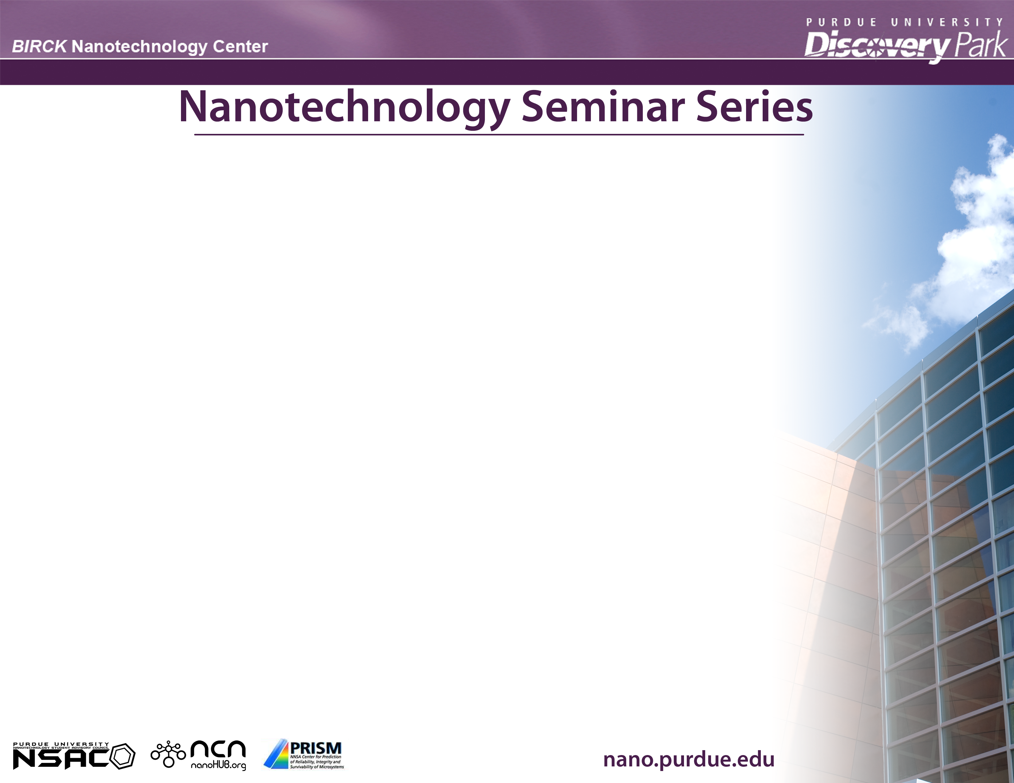
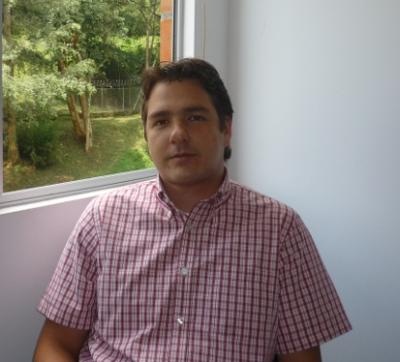

“Advanced nanocomposite polymers for electrical/functional applications”
4/14/2011
BRK, ROOM 2001, 10:30 AM
FRANKLIN JARAMILLO ISAZA, Eng., Ph.D.
Center for Research Innovation and Development of Materials –
University of Antioquia, Colombia.
Nanocomposite based on conducting polymers/nanoparticles are useful materials in a wide number of technological applications. Incorporation of nano-metallic oxides into polymers offers important changes in the electronic, optical, thermal, mechanical properties. In the present study films and bulk polypyrrole and polyaniline were obtained in the presence of iron oxide nanoparticles. Also it is showed how synthetic iron oxide nanoparticles can be doped to tune the electronic energy levels. The effect of the nanoparticles on the structure of the polymer matrix is determined using Raman and Mossbauer spectroscopy and electrochemical techniques. The results show that the magnetite incorporation decreases polymeric film resistance and Raman experiments have evidenced that the incorporation of nanoparticles into polymeric matrix not only stabilizes its polaronic form, but also preserves the polymer from further oxidation.
Education:
2002 – 2005 PhD in Chemistry, semiconducting polymers. The University of Manchester, Manchester, UK. Scholarship from The Colombian Institute for the Development of Science and Technology -COLCIENCIAS-.
1996 – 2002 BSc in Chemical Engineering. The University of Antioquia, Colombia. Young researcher COLCIENCIAS scholarship.Young graduated researcher COLCIENCIAS scholarship.
Work Experience:
2006 - present Leader of the polymers and composite materials research area on the Center for Research Innovation and Development of Materials CIDEMAT - Professor, Materials Engineering Department, University of Antioquia, Colombia. Courses in advanced polymers, nanocomposite materials and transport phenomena.
2004 – 2005 Laboratory teaching assistant of the polymers spectroscopy course, School of Chemistry, The University of Manchester, UK.
2001 Associated researcher at the Corrosion and Protection Group, University of Antioquia, Colombia. Analysis of atmospheric contaminants by chromatographic techniques. Host: JP Allain, allain@purdue.edu, 496-9718
Bio:
Host: Name, Email, Phone

