Slide 1

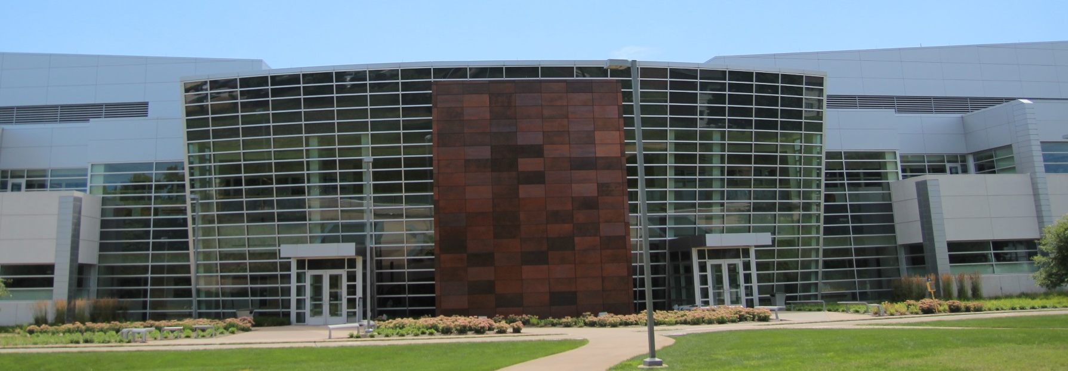
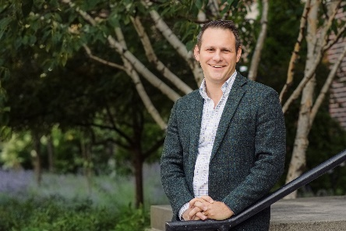

Birck Nanotechnology Center
Faculty Seminar Series
Dr. Brett Savoie
Charles Davidson Assistant Professor of Chemical Engineering
(by courtesy) at Purdue University
Thursday, November 18th, 2021
12:00pm – 1:00pm, Zoom
https://purdue-edu.zoom.us/j/98695180597
How Things Fall Apart: Learning from Degradation Chemistry
Abstract: Advances in both experimental and computational methods have dramatically accelerated the prediction, optimization, and validation of organic chemical and materials properties. Despite this progress, chemical stability, which is central to analyzing the life-performance and feasibility of novel organic materials, remains beyond our current capability to predict. This capability gap has resulted in many computational design efforts yielding libraries of conceptually interesting organic molecules and materials that nevertheless often fail to connect with real applications. Moreover, chemical stability prediction faces the challenge that degradation chemistry is poorly represented in reaction databases, and as such cannot use domain heuristics that have been successful in other reaction prediction contexts. In this talk, I’ll discuss how recent developments in automated reaction prediction, by our group and others, have created an opportunity to bring chemical stability into the realm of routine predictability. In particular, we have recently been able to reduce the cost of predicting reactions involving generic organic molecules over 100-fold while also improving the accuracy of transition states and increasing the scope of kinetically relevant pathways. I’ll demonstrate how we’ve used our methodology to (re)discover common organic synthetic reactions without using any prior domain knowledge and also predict a thermal degradation network for a benchmark system that is the most comprehensive report to date. On the horizon, the throughput enabled by these and similar efforts will generate valuable data sources for nascent machine learning efforts in this space, which will ultimately allow us to routinely predict how things fall apart.
Bio: Brett Savoie graduated with degrees in chemistry and physics from Texas A&M University in 2008 and obtained his Ph.D. in theoretical chemistry from Northwestern University in 2014. From 2014-2017 Brett was a postdoc with Thomas Miller at Caltech where he developed new simulation methods for polymer electrolytes. Since 2017, Brett has been an assistant professor of Chemical Engineering at Purdue University, where his research group develops and implements both physics-based and machine learning methods to characterize and discover new materials. Brett is the recipient of the ACS PRF, NSF CAREER, Dreyfus Machine Learning in the Chemical Sciences, and ONR YIP awards. His group’s research has been highlighted in Science and Nature, and they contributed to the development of a polymer named as one of the “Molecules of the Year” by C&E News in 2018. Brett teaches graduate engineering mathematics, undergraduate engineering statistics, and he has developed a new course on machine learning in chemical engineering.

