Slide 1

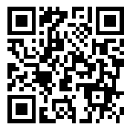
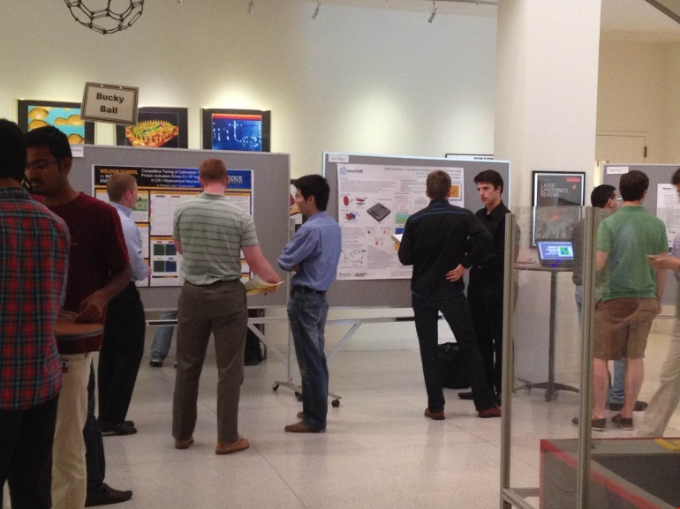
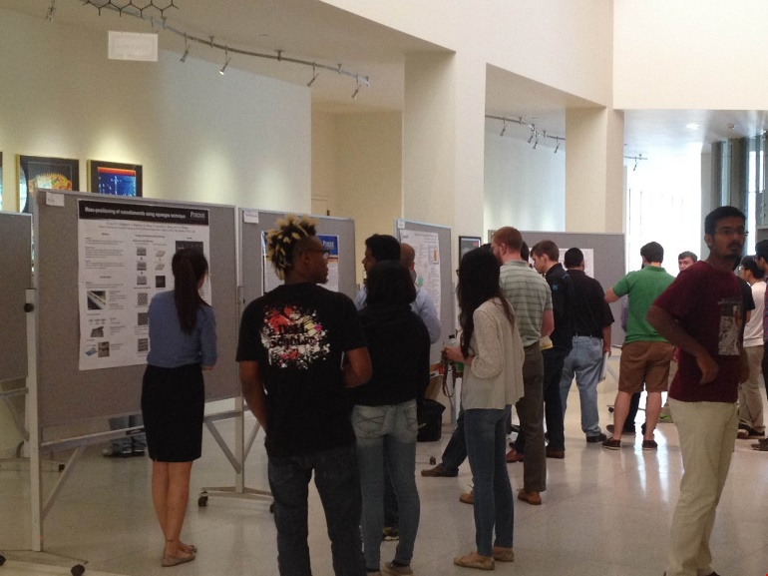
NSAC Undergraduate Research Symposium 2017
The Nanotechnology Students Advisory Council (NSAC) invites undergraduates to present a research poster in the UG Symposium this summer at the Birck Nanotechnology Center.
Location: Birck Atrium, 1205 W State St
Date: Friday, August 4th, 2017
Time: 2:00 - 4:00 PM
Prizes will be awarded to the top three posters!
REGISTER AT: https://goo.gl/forms/vKZQ1U2Itg8dZyic2

