Slide 1
Monsanto’s
Emerging Leaders in Science Program

Slide 2
Monsanto’s Technology Organization
Participants in the Emerging Leaders in Science program will be an integral part of Monsanto’s Technology Organization, which is a multi-crop organization compromised of four broad areas; Biotechnology, Breeding, Chemistry and Regulatory.
These areas collaborate to create products in our R&D pipeline, which has a proven track record of creating products that are proprietary, first to market and profitable.

Slide 3
Emerging Leader in Science Program (ELS)
Monsanto’s ELS rotational program is a comprehensive, cross functional experience by a world leader in agricultural biotechnology. You’ll work with and be mentored by some of Monsanto’s most talented scientific leaders- emerge prepared to lead the way to agricultural innovation
The program consists of three, one year rotational assignments within your selected strategic scientific focus area. Following a successful completion of the three year program, you’ll be placed in a key role within Monsanto’s Technology Organization

Slide 4
Who are we looking for?
We are looking for top scientific talent who are PhD or Post-Doctoral graduates educated in one of the following or closely related discipline
Advanced Engineering/ Bioengineering
Biochemistry
Bioinformatics & Computational Biology
Chemistry
Crop Science/ Seed Biology
Entomology
Environmental Sciences
Genetics
Plant Biology (Physiology or Molecular)
Plant Breeding
Plant Pathology
Statistical Genetics
Toxicology
Weed Sciences

Slide 5
How do I apply for the ELS program?
Follow the one of the links below or visit our careers webpage and use the key words “Emerging Leaders in Science”
http://www.monsanto.com/careers/Pages/emerging-leaders-in-science.aspx
http://jobs.monsanto.com/st-louis/research-and-development/jobid1902462-emerging-leaders-in-science-program-jobs

Slide 6
Who is Monsanto?

Slide 7
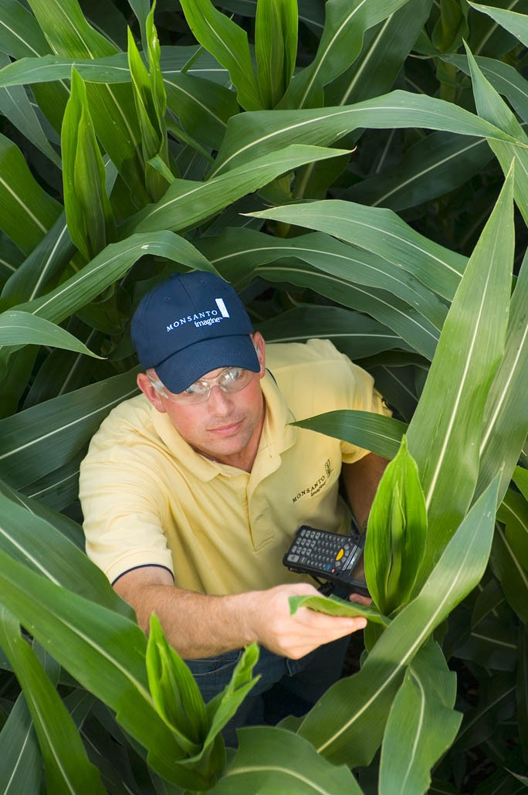
Monsanto is 100% focused on agriculture
Monsanto Company is a leading global provider of technology-based tools and
agricultural products that improve farm productivity and food quality.
Our Mission
We work to deliver agricultural products and solutions to:
• Meet the world’s growing food needs
• Conserve natural resources
• Protect the environment
“We succeed when farmers succeed.”
Hugh Grant, Monsanto CEO

Slide 8
Monsanto Company at a Glance
A LEADER IN THE FIELD OF AGRICULTURAL TECHNOLOGY
MONSANTO’S VITAL STATISTICS
A leader in seeds, crop protection and biotechnology
Headquartered in St. Louis
Employs more than 20,000 people worldwide
More than 500 locations worldwide in 4 primary regions — Europe/Africa, Asia Pacific, Latin America and North America
Business Segments
Seeds and Genomics
Agricultural Productivity
Sales by Seeds and Traits
Soybean
Corn
Cotton
Vegetable
& Fruit
All other
Crops
Sales by Geography
NA
LA
E-A
A-P
Dedicated to Bringing the Next Generation of Ag Products to the Market
Notes:
Updated January 4, 2011 from FY10 10-K report, October 2010
We produce leading seed brands in large-acre crops like corn, cotton, and oilseeds (soybeans and canola), as well as small-acre crops like vegetables.
We also produce leading in-the-seed trait technologies for farmers that are aimed at protecting their yield, supporting their on-farm efficiency and reducing their on-farm costs.
We're constantly looking at ways to maximize the potential of seed – both its yield potential and the technology used to protect it – so farmers can get more out of each seed.
Monsanto is headquartered in St. Louis, Missouri, and has locations in multiple locations around the world.
The locations are variously administrative and sales offices, manufacturing plants, seed production facilities and research centers – all part of the corporate focus on agriculture and supporting farmers.
By having locations close to our customers, we are better able to experience the needs of those customers, to understand the pressures confronting them and to develop innovations tailored to their needs.

Slide 9
Monsanto’s Locations at a Glance
More than 1,000 employees
More than 100 locations world-wide participating in plant breeding research for corn, oilseeds and cotton
Over 50 locations world-wide devoted to vegetable research in field and protected-culture
More than 180 locations world-wide supporting biotechnology research for corn, oilseeds and cotton
100 - 500 employees
Less than 100 employees

Slide 10
Why Monsanto?
Monsanto is an Industry Leader
Personal Growth and Development
Our People
Winning Culture
Diversity
Compensation and Benefits

Slide 11
Monsanto as a Great Place to Work
2008-2009
2006-2007
2004-2005
Fortune Magazine - 100 Best Companies to work for in 2005
Science Magazine – Top Employers (2004)
Science Magazine – Top Employers (2005)
The Scientist – Best Places to Work (2005)
Fortune Magazine - 100 Best Companies to work for in 2004
The Scientist – Best Places to Work (2006)
St. Louis Business Journal - Best Place to Work in St. Louis (2006)
Science Magazine –Top Employers (2007)
Fortune Magazine - Ranked #59 of 100 Best Companies to Work for in 2010
2010
Science Magazine –Top Employers (2008)
ABA Stevie Award Winner – Most Innovative Company with more than 2,500 employees (2008)
The Scientist – Ranked #2 of Best Place to Work in Industry (2009)
Forbes Magazine – Company of the Year (2009)
Harvard Business Review – Hugh Grant ranked #10 of 100 Best Performing CEO’s in the World (2010)

Slide 12
How to find other career opportunities at Monsanto?
Visit our careers page and create a profile www.Monsanto.com/careers
Search for jobs at Monsanto at our SEO Site www.jobs.monsanto.com

