Slide 1
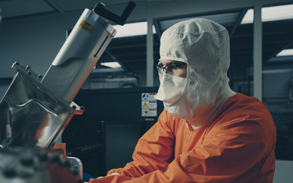
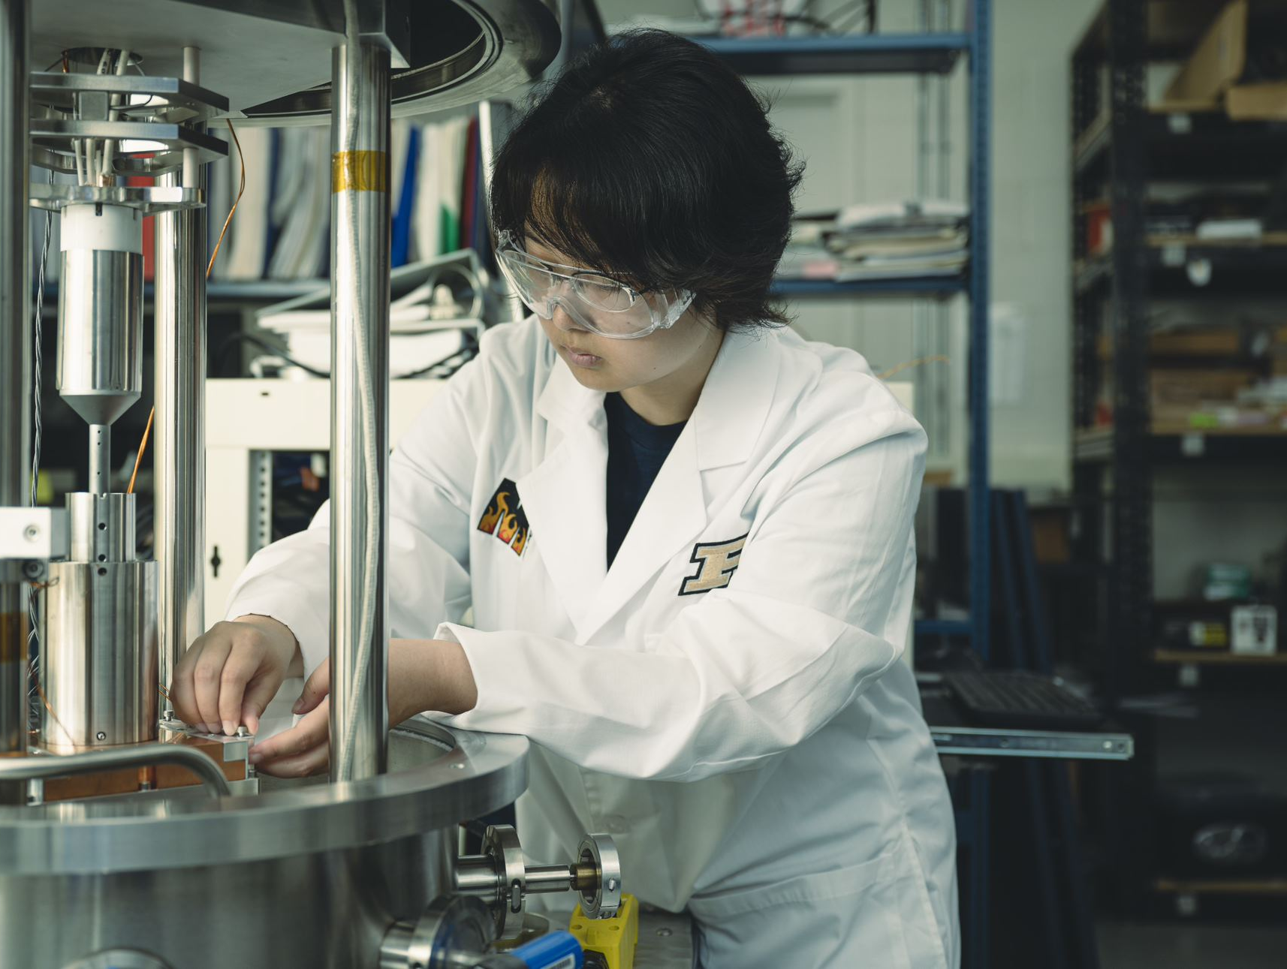
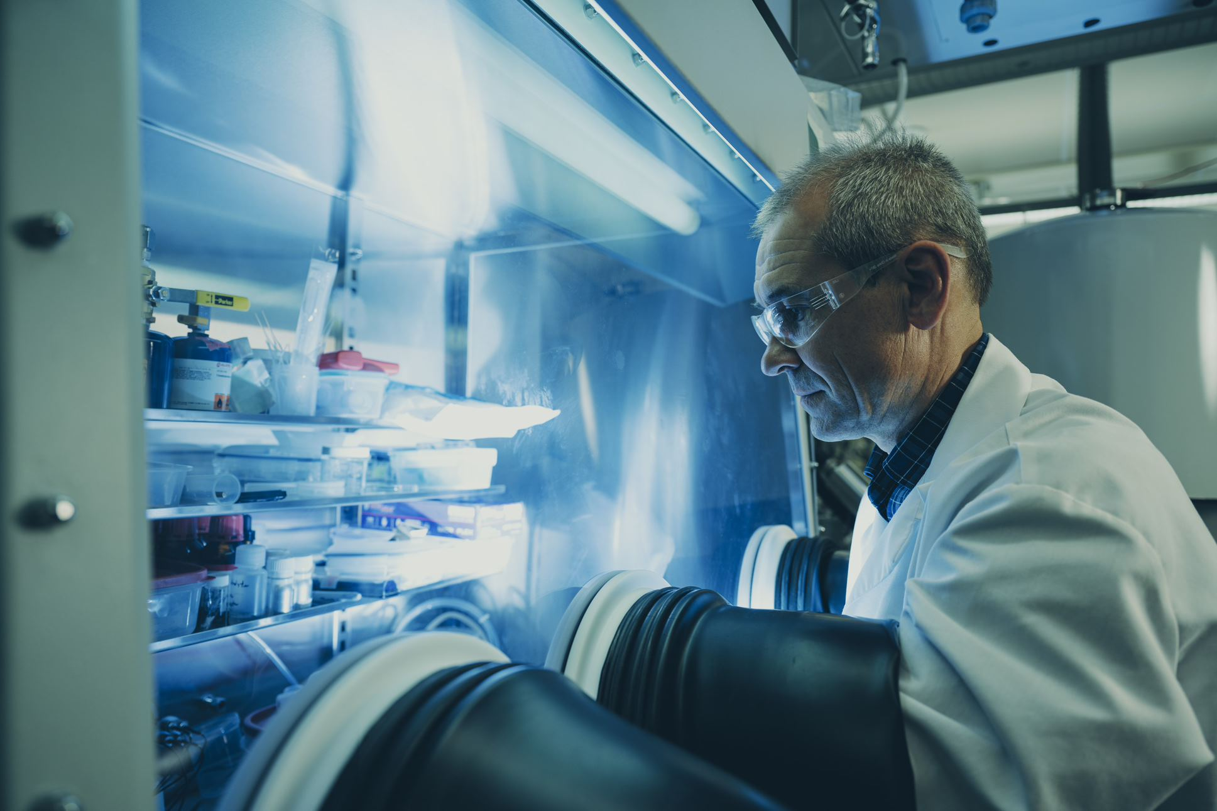
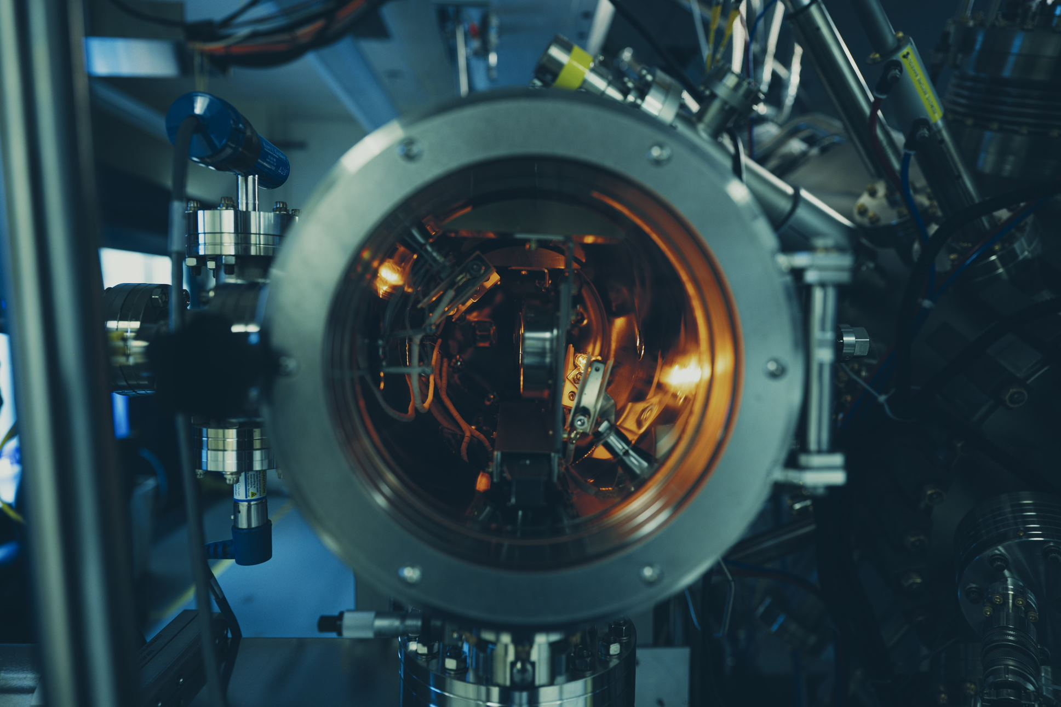
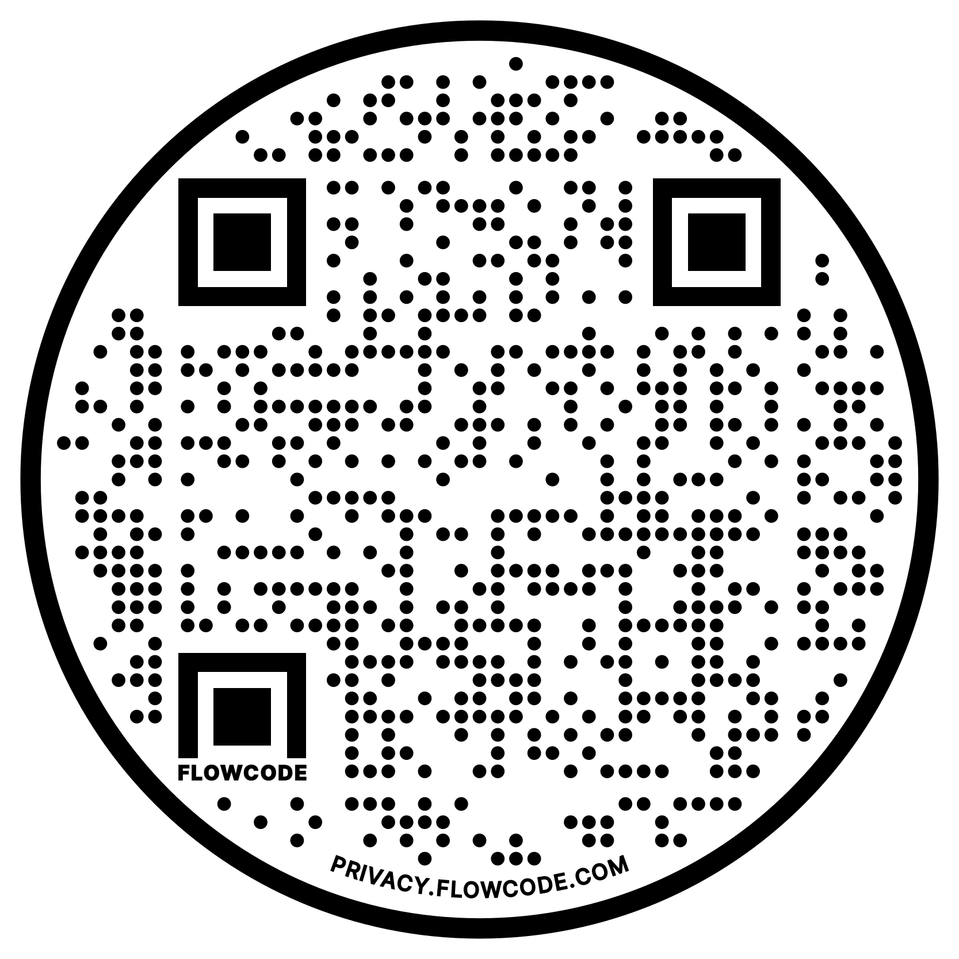
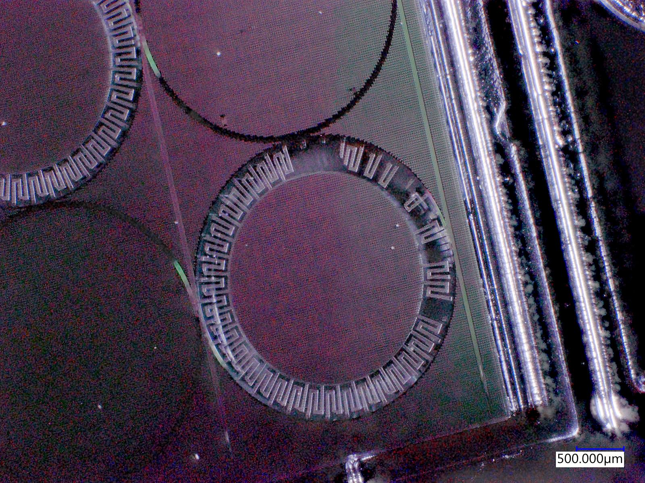
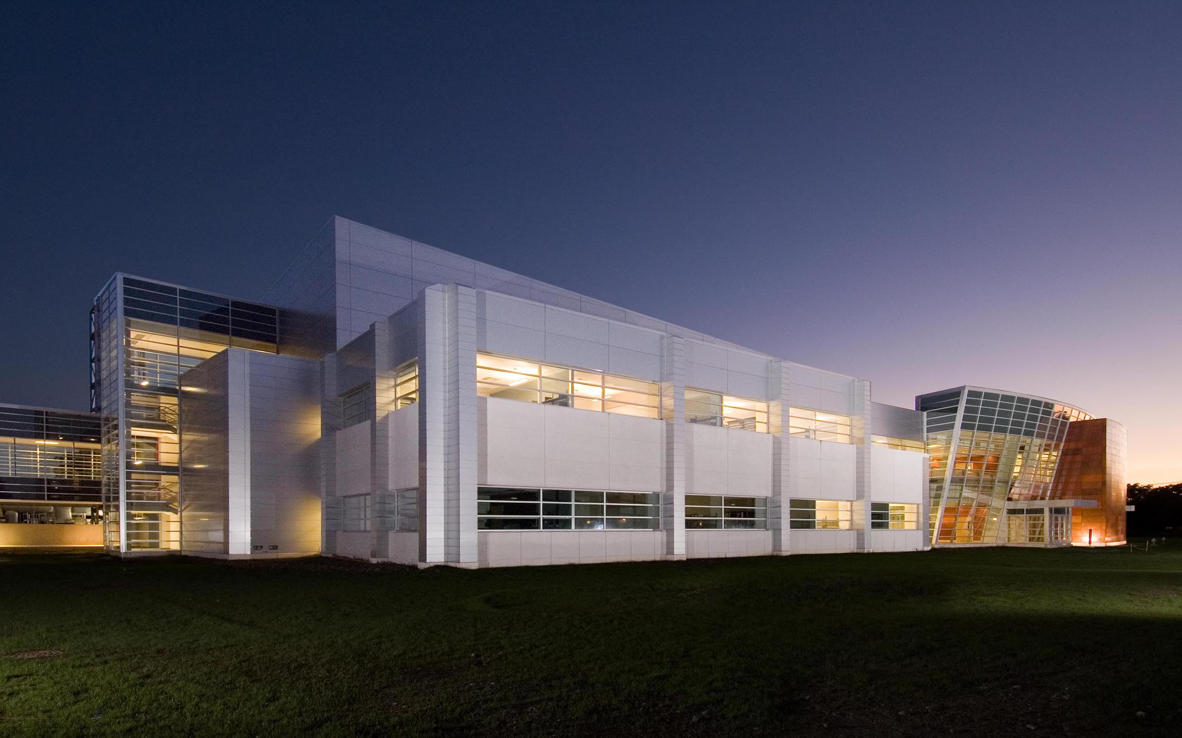


NanoV
CALL FOR
PAPERS
NanoVisions
Birck
Nano technology
Center
April 26, 2023
NanoV is a conference that will bring together researchers with a focus on nano-materials, devices and characterization to showcase their work and to stimulate collaborations
09:00AM – 11:30AM
Research talks at BRK1001
11:30AM – 1:00PM
Lunch with professors & BNC research and engineering staff at Birck Atrium
1:00PM – 2:00PM
Distinguished lecture at BRK1001
2:00PM – 4:00PM
Research poster open house
at Birck Atrium
No registration fee
Free lunch for ALL attendees
Coffee and snacks at breaktime
Cash awards for best presentations/posters
Photo by: Purdue University/ Neil Dilley
all Photos by: Purdue University/Charles Jischke unless otherwise noted
Photo by: Steve Hall @ Hedrich Blessing

