Slide 1

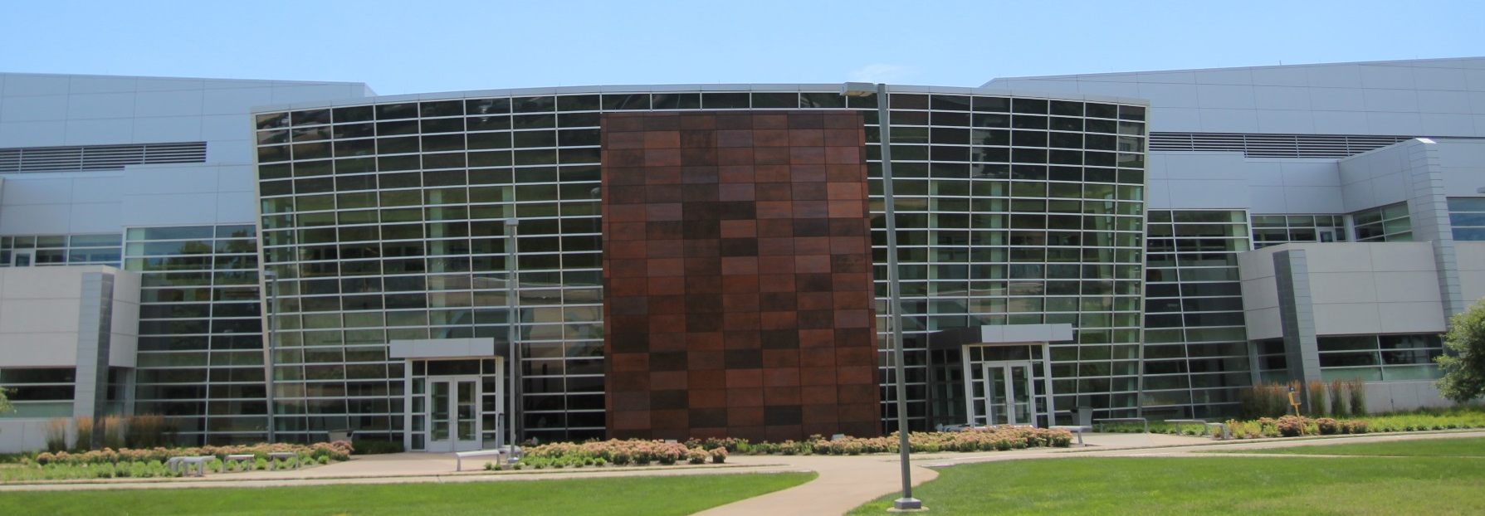
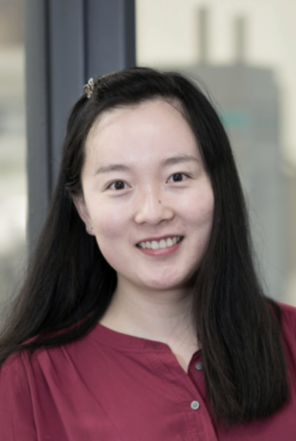

Birck Nanotechnology Center
Faculty Seminar Series
Tian Li
Assistant Professor of Mechanical Engineering
(by courtesy) at Purdue University
Thursday November 4th, 2021
12:00pm – 1:00pm, Zoom
https://purdue-edu.zoom.us/j/98695180597

