Slide 1
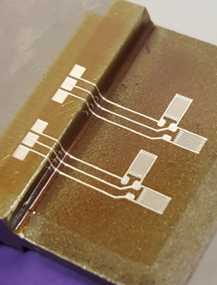
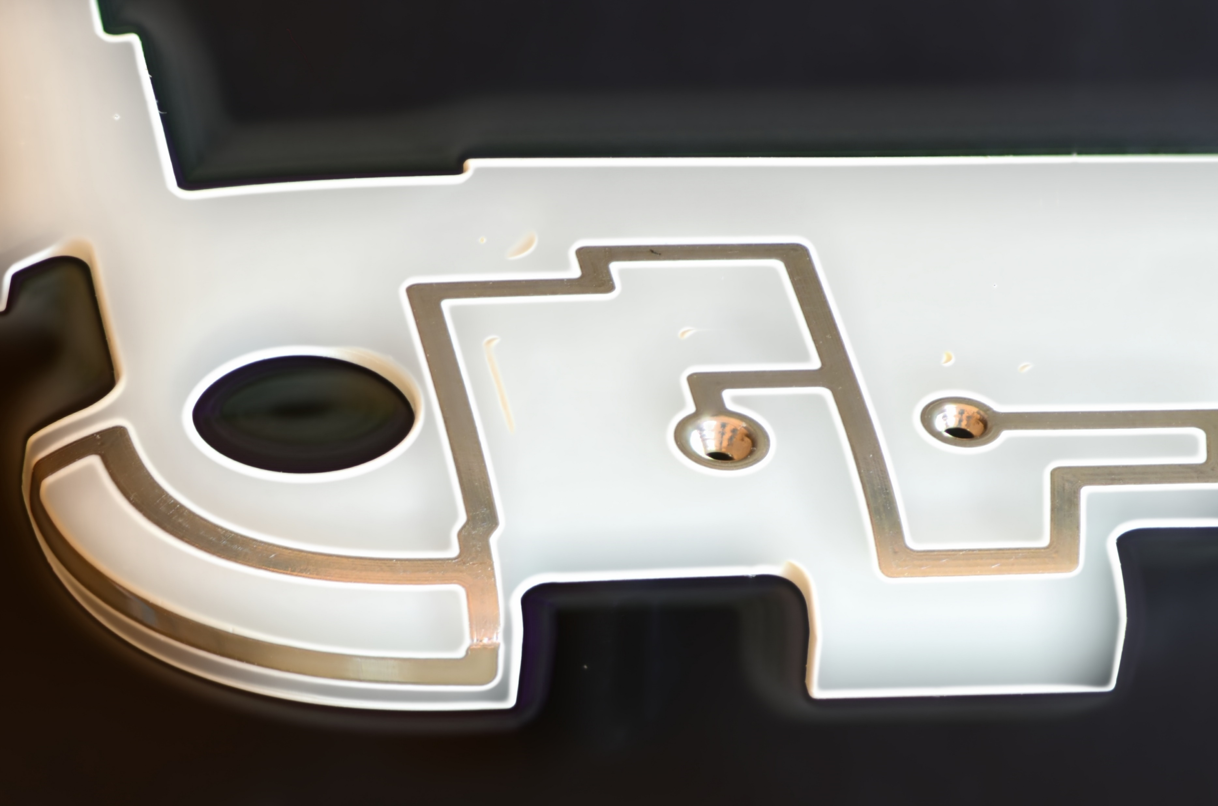
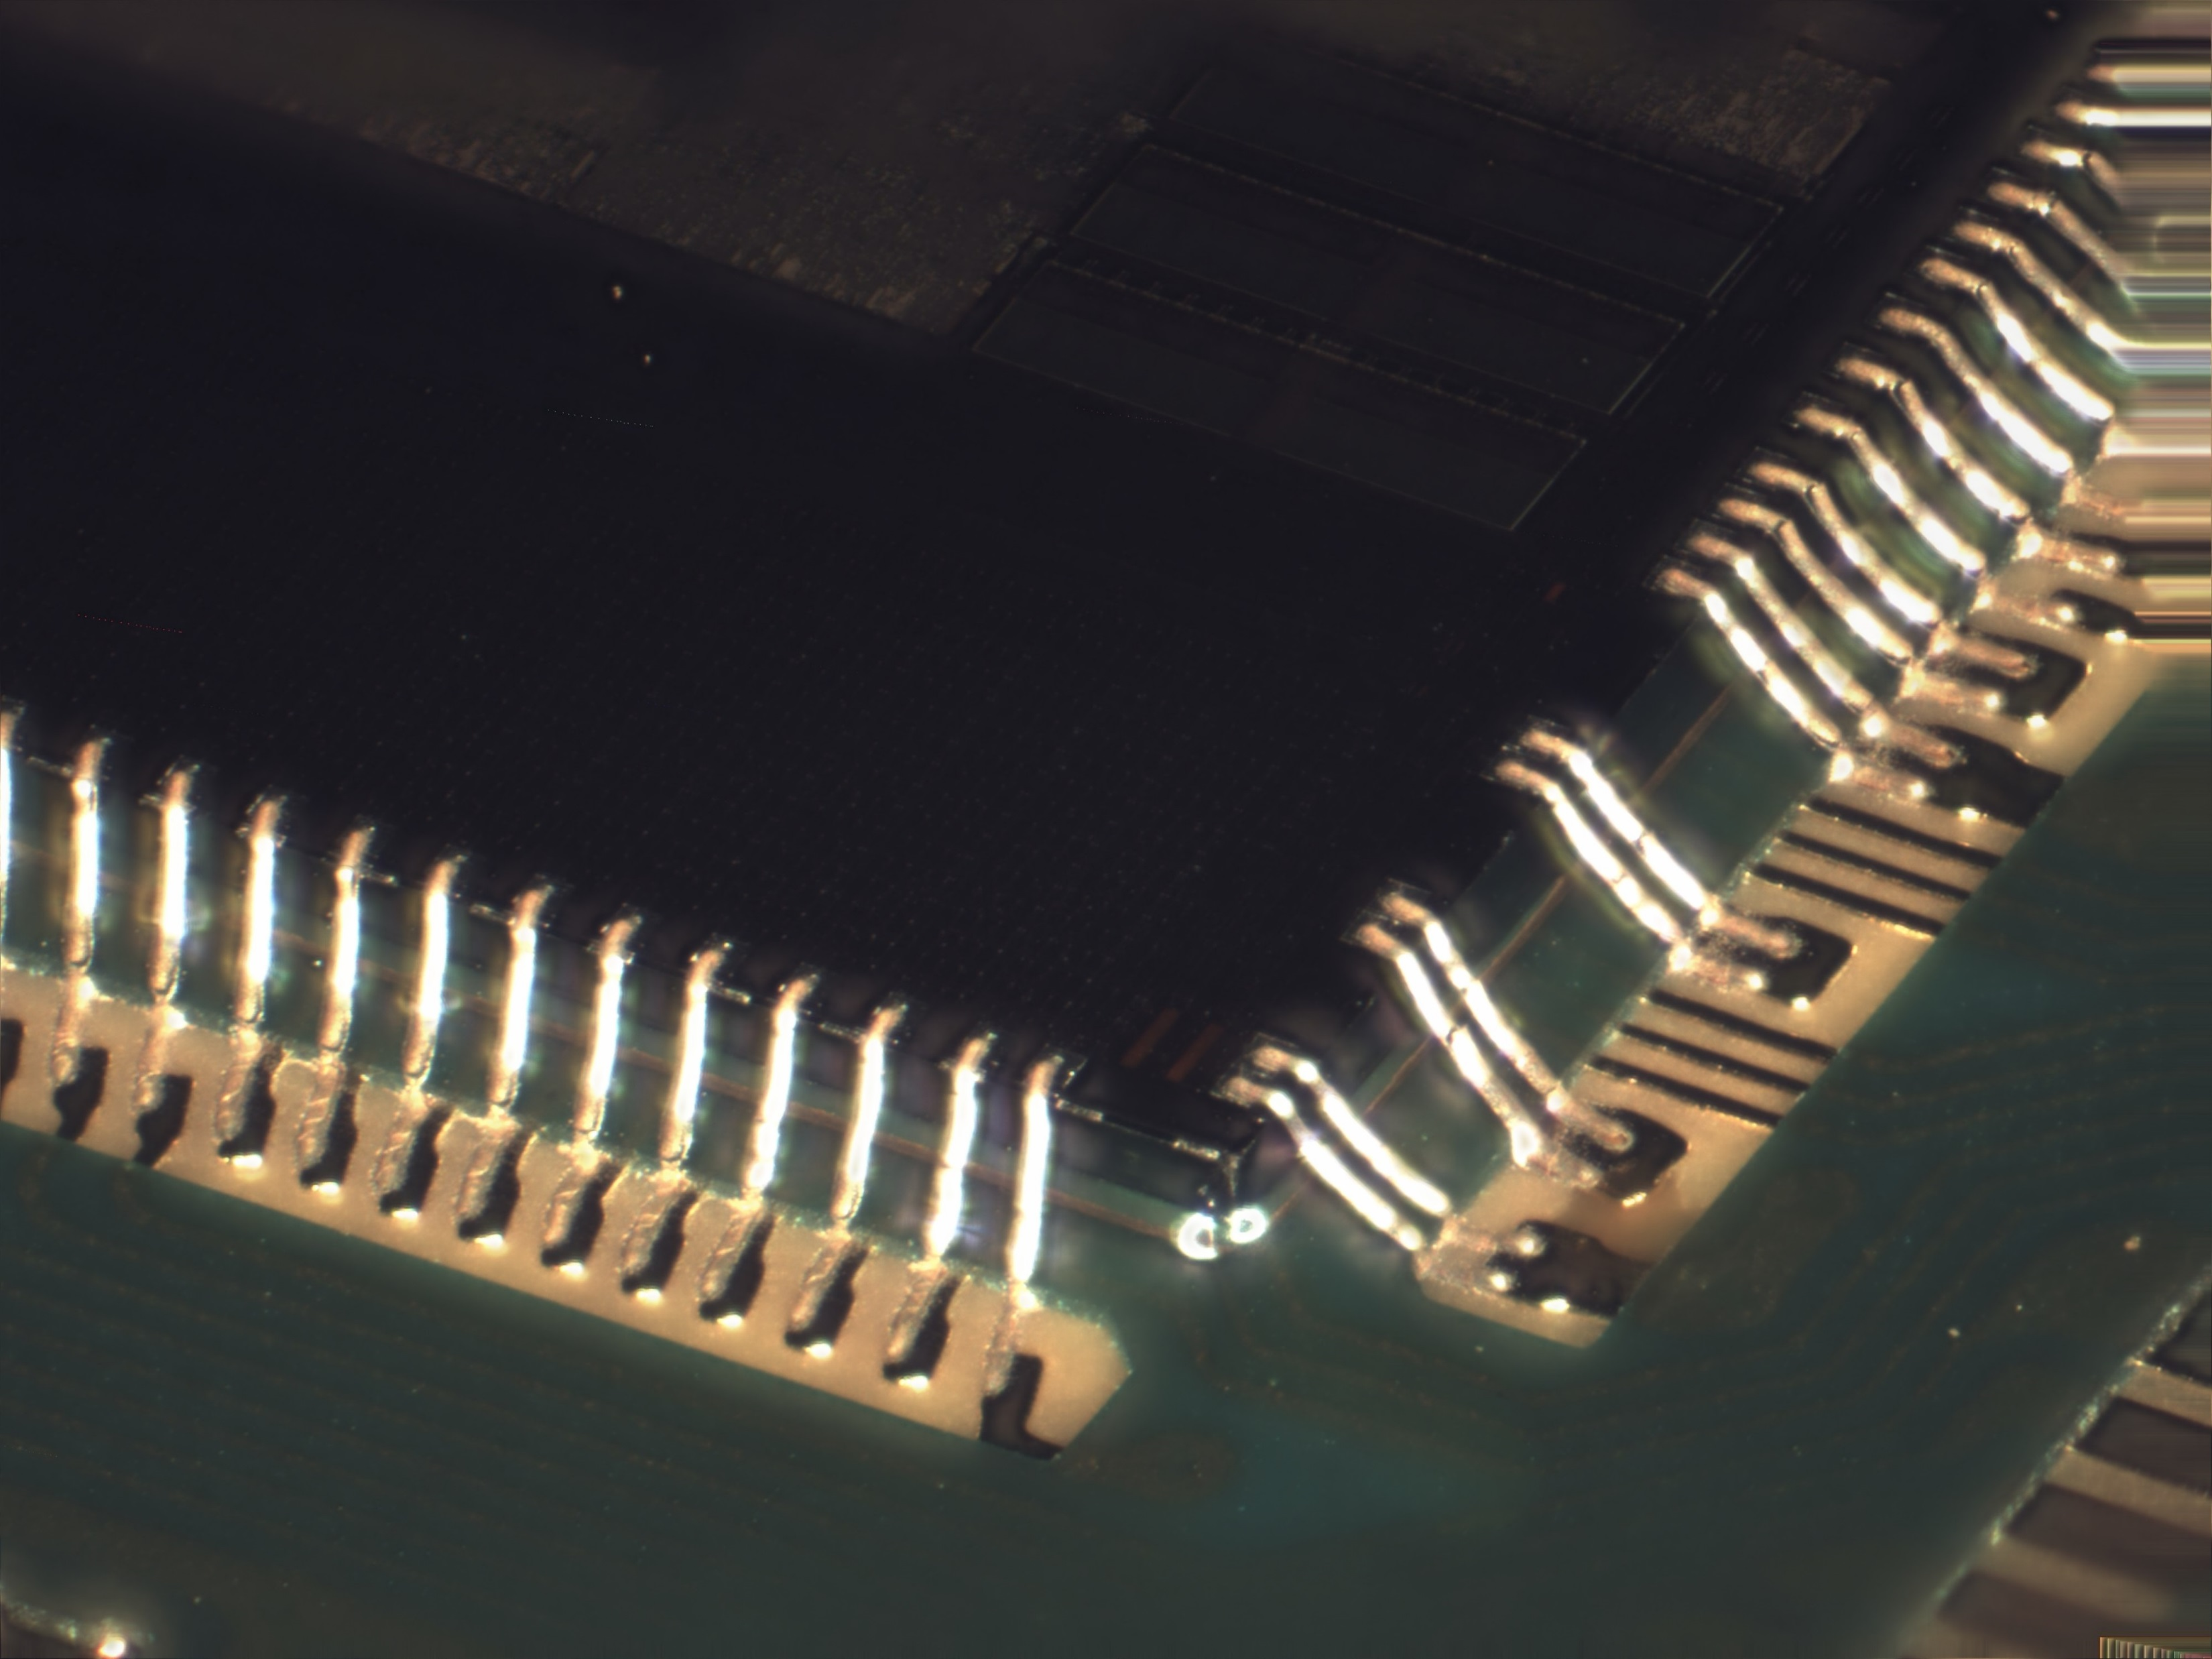
Presentation:
Printed Electronics:
Using Aerosol Jet Technology to Print Conductive Features onto 3D Objects
Tuesday, February 25
1 pm, BRK 1001

