Slide 1
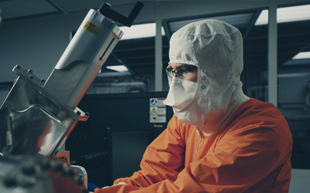
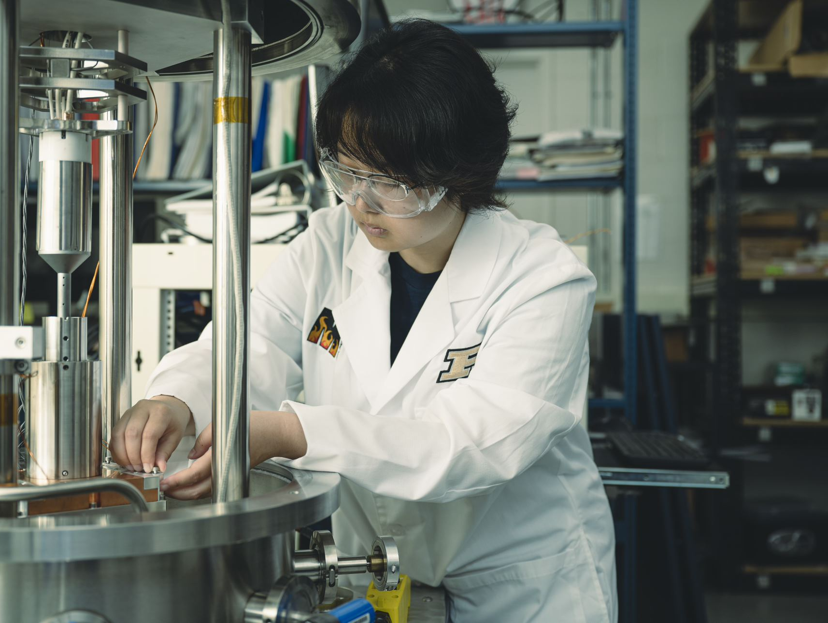
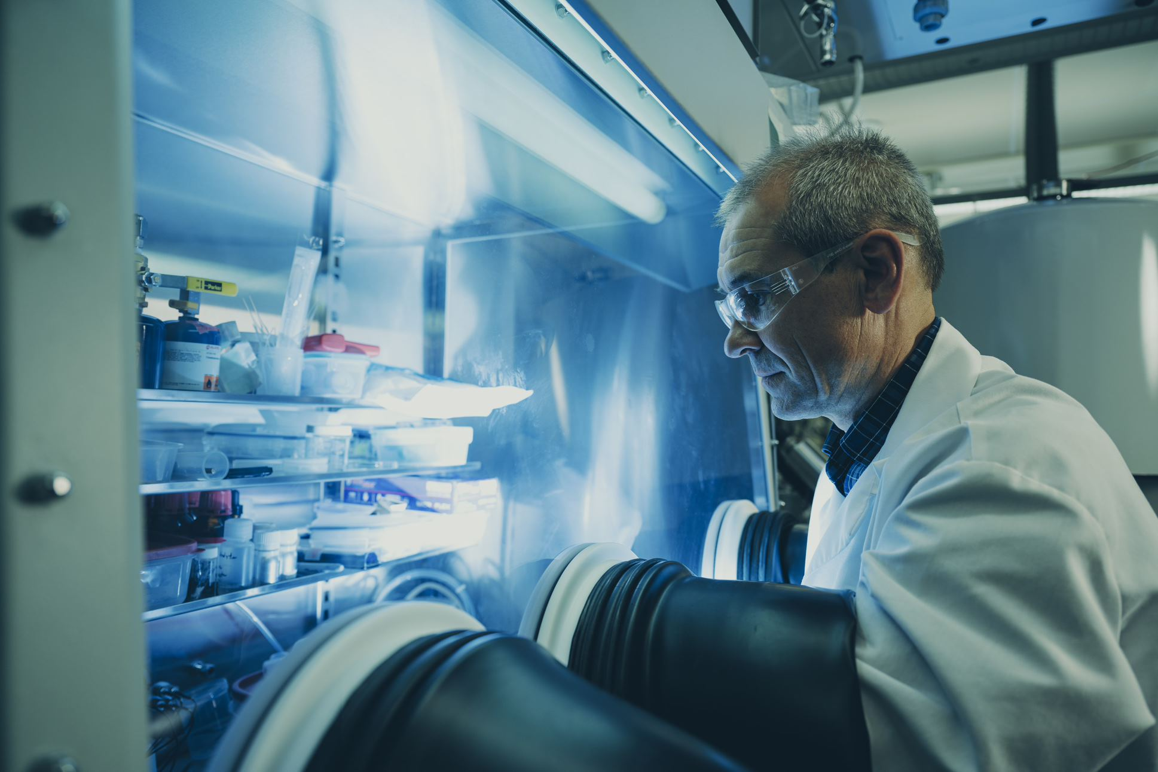
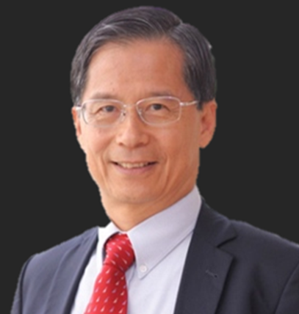
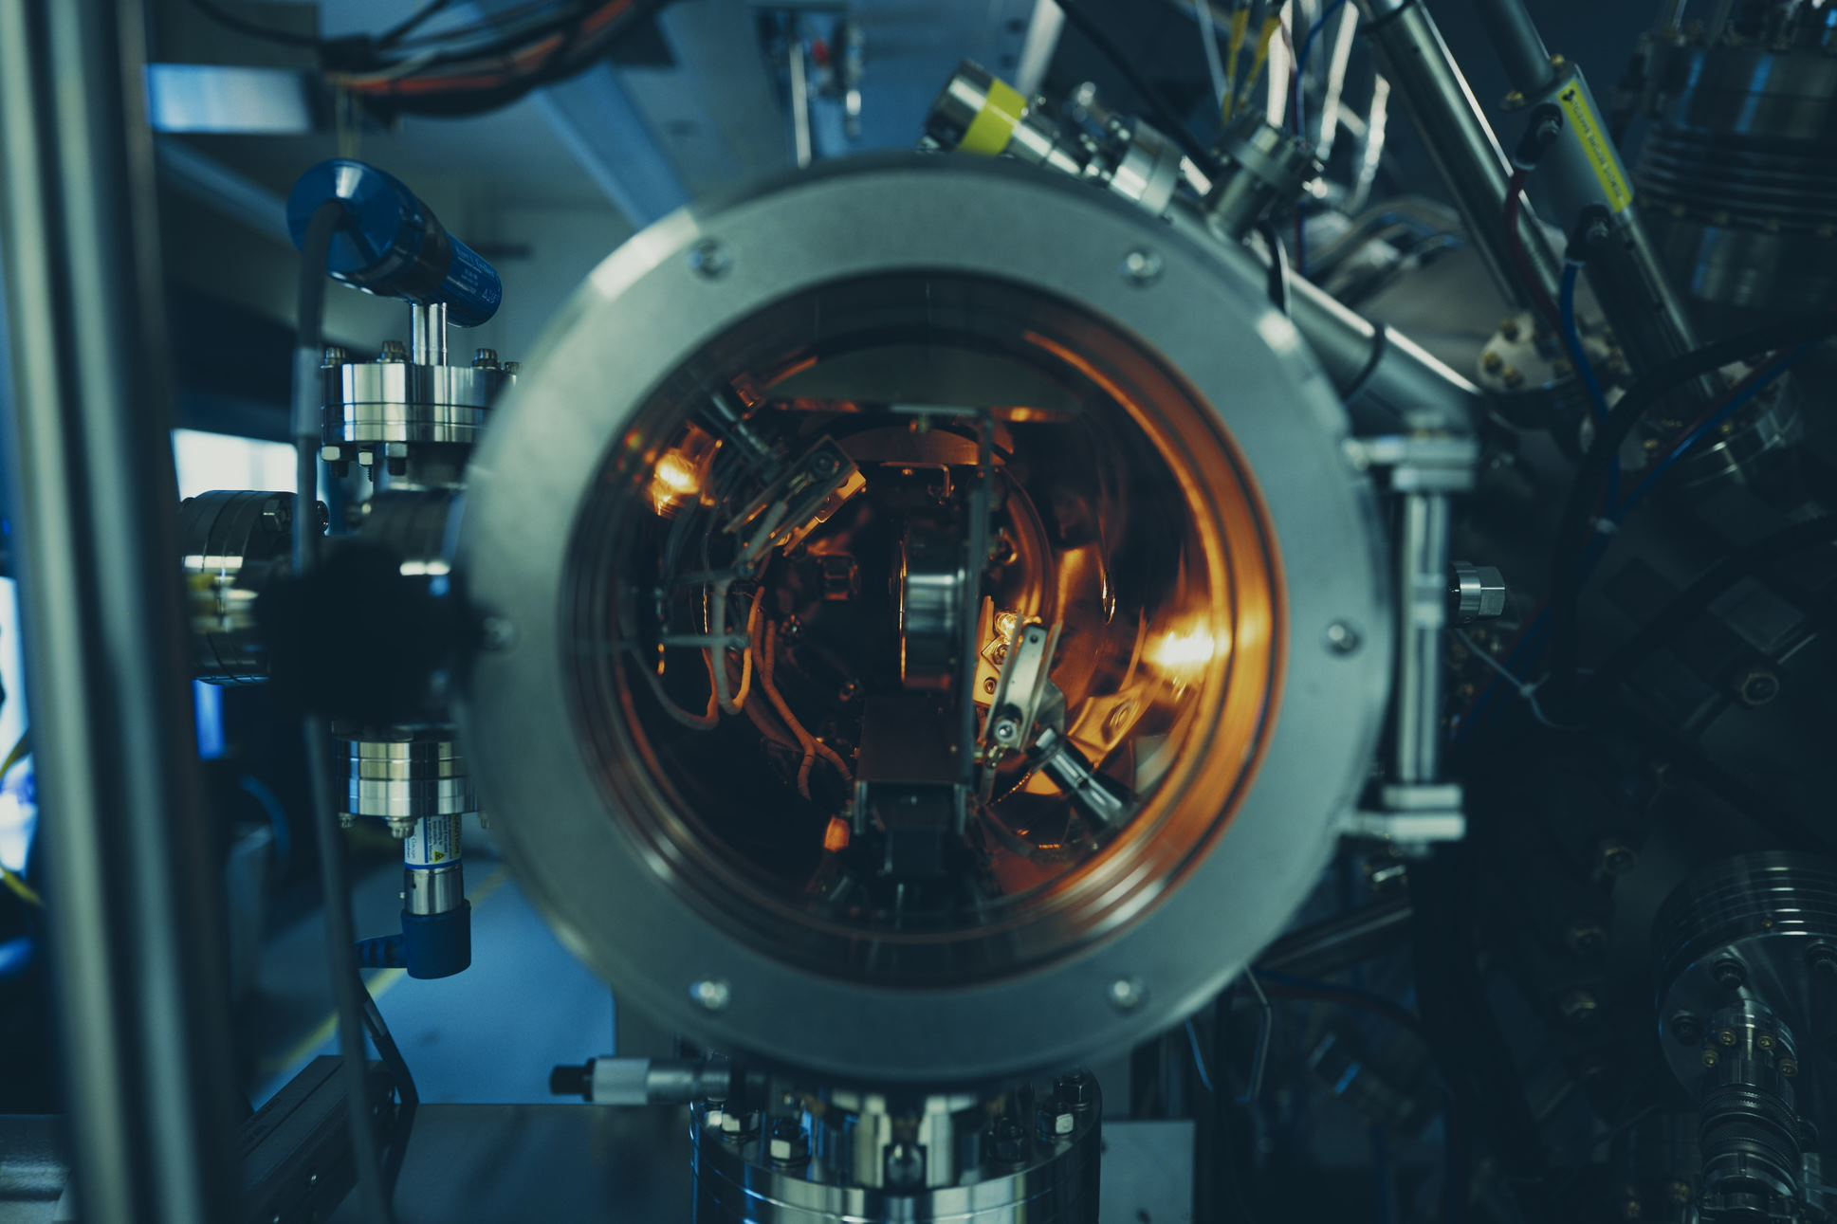
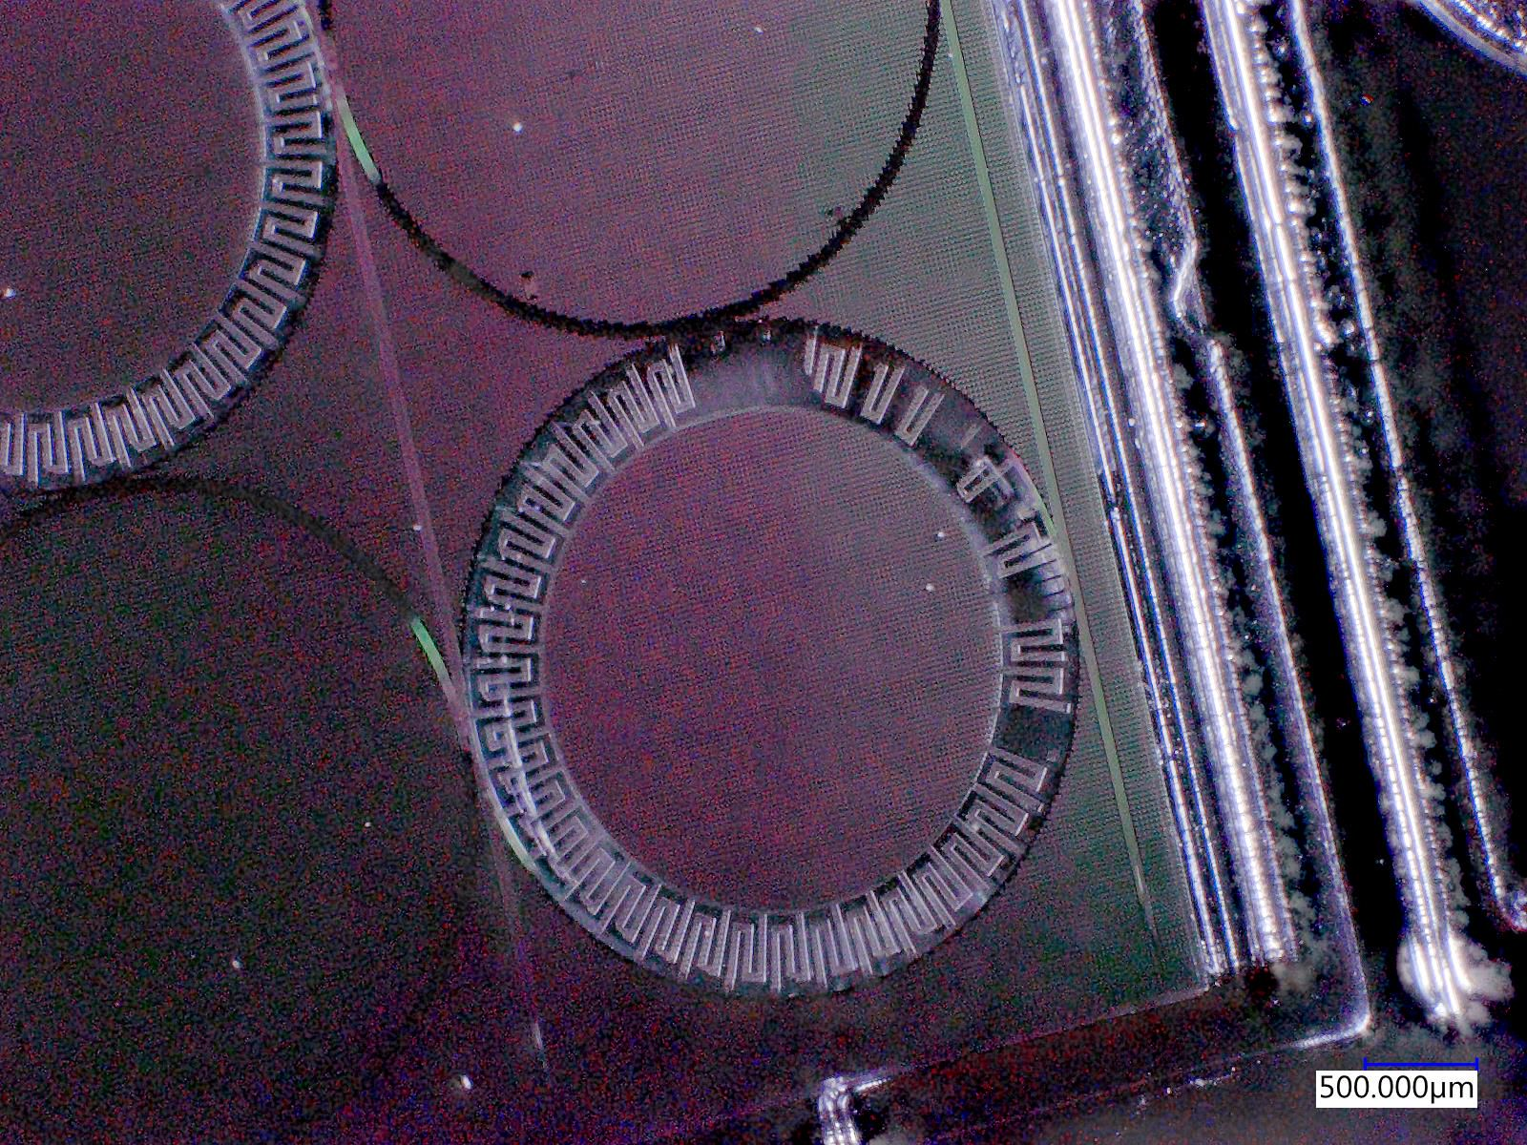
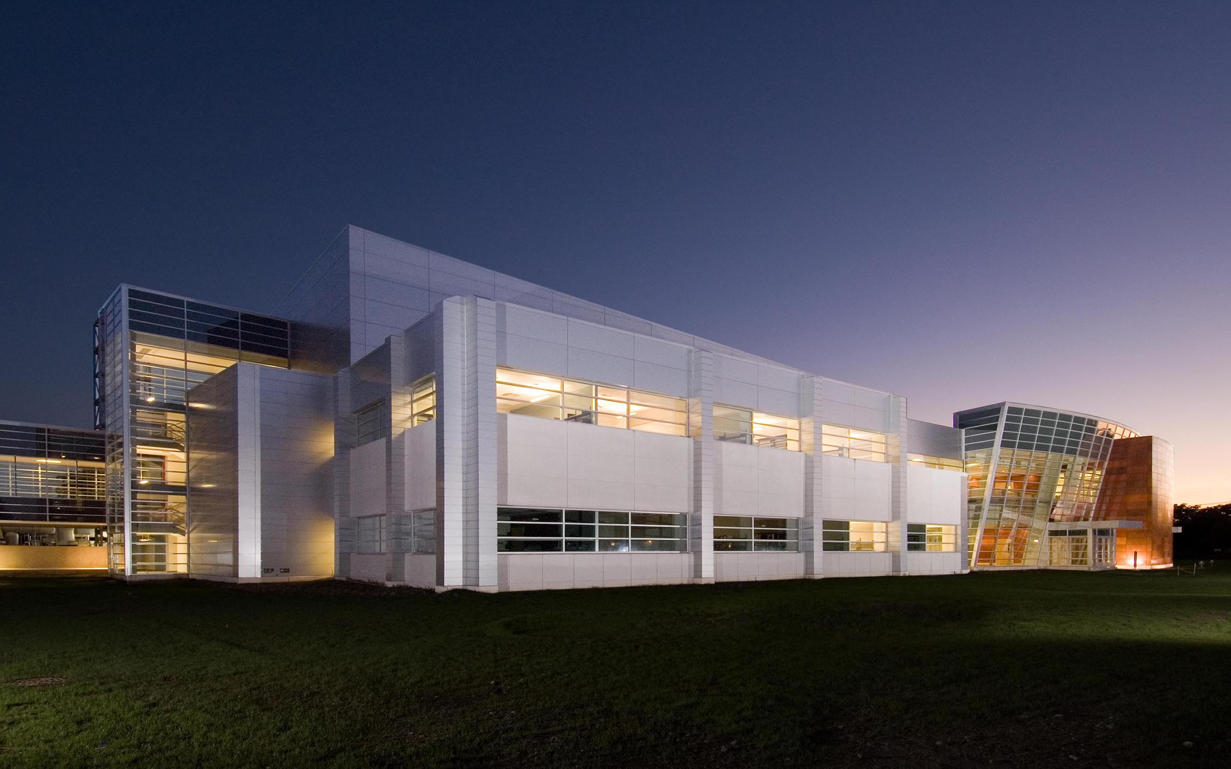


Birck
Nano technology
Center
NanoV
NanoVisions
April 26, 2023
NanoV is a conference that will bring together researchers with a focus on nano-materials, devices and characterization to showcase their work and to stimulate collaborations
09:00AM – 11:30AM
Research talks at BRK1001
11:30AM – 1:00PM
Lunch break (All participants invited)
at Birck Atrium
1:00PM – 2:00PM
Distinguished lecture at BRK1001
Dr. Jack Sun, NYCU
“Semiconductor innovation
- A foundry experience and perspective”
2:00PM – 4:00PM
Research poster presentations open house
at Birck Atrium
Photo by: Purdue University/ Neil Dilley
all Photos by: Purdue University/Charles Jischke unless otherwise noted
Photo by: Steve Hall @ Hedrich Blessing

Slide 2
Birck
Nano technology
Center
NanoV
NanoVisions
April 26, 2023
Research talks schedule
09:00AM – 09:15AM Chang Niu
Topological quantum transport in Chiral 2D Tellurium
09:15AM – 09:30AM Shuchen Zhang
Angle-dependent exciton transport in twisted two-dimensional halide perovskites moiré superlattice
09:30AM – 09:45AM Ozan Erturk
AlN/Diamond composite FBAR for Coherent Acoustic Control of NV Centers
09:45AM – 10:00AM John Daniel
Utilizing stochastic MTJs for probabilistic spin logic
10:00AM – 10:15AM Breaktime
10:15AM – 10:30AM Rajni K. Sah
IMOSFET- Designing Highly-scaled Vertical Silicon Carbide Power MOSFETs
10:30AM – 10:45AM Sina Nejati
Smart traceable capsule for targeted sampling through gastrointestinal tract
10:45AM – 11:00AM Marco Fratus
S.O.S. fast response for microneedle-based patches: How can a physics-based model save us?
11:00AM – 11:15AM Michael Tan Bezick
Denoising Diffusion for Material Topology Sampling
11:15AM – 11:30AM Christopher Gilpin
Transmission electron microscopy talk
Photo by: Purdue University/ Neil Dilley
all Photos by: Purdue University/Charles Jischke unless otherwise noted
all Photos by: Purdue University/Charles Jischke unless otherwise noted
Photo by: Steve Hall @ Hedrich Blessing

