Slide 1
Air Traffic Control Engineering Division
Air Traffic Control Engineering Division – What We Do
Provide global Air Traffic Control, Aviation Command and Control (AC2) and Meteorology systems engineering, Air Traffic Control operations, Electronics Maintenance, and Meteorological forecasting and observation services.
Air Traffic Control Engineering Division
Philip Braswell
Polar Programs IPT
Shore ATC IPT
ATC Special Programs
IPT
METOC IPT

Slide 2
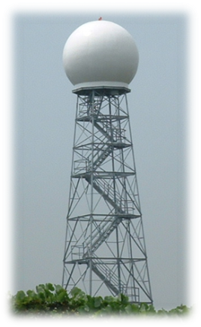
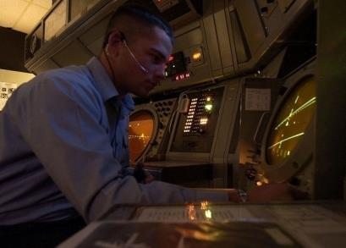
Air Traffic Control Engineering Division Overview
Primary Customers
What We Provide
ATC/METOC Design, Engineering, and Integration
Aviation Command and Control Services
ATC Logistics and Configuration Management
NAVAIRSYSCOM PMA-213 & Program Executive Officer, Tactical Aircraft Programs (PEO T)
Marine Corps Training and Education Command (TECOM)
U.S. Air Forces Central Command (AFCENT)
SPAWAR Fleet Readiness Directorate (FRD)
National Science Foundation (NSF)
Federal Aviation Administration (FAA)
NAVAIR 1992 MOA established SPAWAR Systems Center Atlantic as an ATC Center of Excellence to support shore-based ATC & Landing systems/programs worldwide

Slide 3
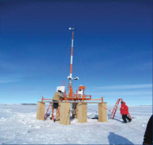


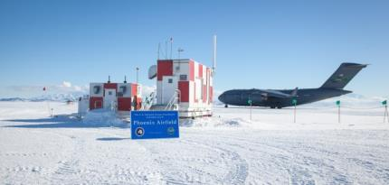
Polar Programs IPT
Overview
Support the National Science Foundation’s (NSF’s) mission in Antarctica by providing aviation engineering and operational functional support services in support of Arctic and Antarctic research programs. The team’s work enables scientists funded by NSF to conduct ground-breaking research.
SSC Atlantic Role
Air traffic control/management
Terminal Instrument Procedures (TERPs) design for the Antarctica region
Engineering and life cycle support for Polar Programs aviation and operational meteorology systems, ground-based navigation systems, precision approach systems, and communications systems
Systems engineering and life cycle support for all information systems necessary for the collection, storage, dissemination, and display of aviation C2 data
Antarctic and Arctic research programs cybersecurity
Projects
Meteorology: Local observing and forecasting for McMurdo Station and remote forecasting for all areas south of 60º
  Air Traffic Control: Enroute, Approach, and Tower operations for Antarctic airfields; TERPs development for Antarctica region; and Air traffic control and operational forecast services from SSC Atlantic Remote Operations Facility (ROF) in Charleston
  ATC Systems Maintenance: ATC systems and landing aids and frequency management

Slide 4
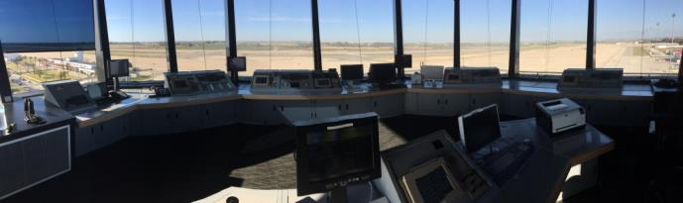
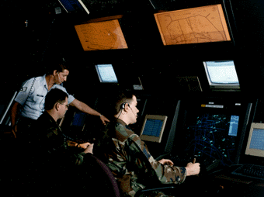
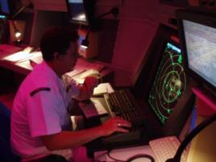
Shore Air Traffic Control IPT
Overview
Provide shore-based Aviation C2, C4I systems-level in-service engineering, systems engineering, development, acquisition, integration, installation, integrated logistics support, and configuration management at Navy and Marine Corps facilities worldwide.
SSC Atlantic Role
Requirements analysis, development, and design
Systems and Sustainment engineering
Software development
Acquisition engineering
Integration, Testing, and Installation
Logistics engineering
ATC Facility Equipment Installations & Relocations
Major equipment refurbishments and overhaul
ATC Facility MILCON Support
ATC Tower siting
Terminal Approach Procedures (TERPs)
Parts and repair support
Training
Projects
National Airspace System Modernization the Navy’s lead field activity
Next Generation Air Transportation System (NextGen)
Standard Terminal Automation Replacement System Enhanced Local Integrated Tower Equipment (STARS ELITE) advanced digital ATC radar processing and display system upgrades
AN/GPN-30 Digital Airport Surveillance Radar (DASR) enhancements
AN/FYC-22B/C Visual Information Display System installation/support
CM-300 (V2) ATC radio upgrade & AN/GRC-260/261 Transceiver upgrade
Wind Farm Mitigation
Remote Virtual Tower Early Operational Assessment (Air Force)
Spectrum Efficient National Surveillance Radar (SENSR)

Slide 5
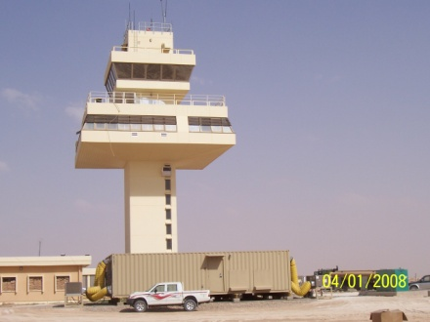
Air Traffic Control Special Programs IPT
Overview
    Provide rapid planning, programming, budgeting, development, and deployment/delivery of Transportable Aviation C2 systems as well as Sustainment services and support for U.S. Air Forces Central Command (AFCENT) in assigned AORs and “Air Defense of Arabian Gulf” (ADAG) missions.
SSC Atlantic Role
Project management
Acquisition engineering
Integration, Testing, and Installation
Systems engineering
Aviation Command and Control systems
Integrated logistics support
Technical support
Planning, programming, budgeting
Acquisition support
System deployment
Projects
Battlespace Command and Control Center (BC3) Test Bed Lead Technical Agent
Battlespace Command and Control Center - Theatre (BC3-T)
BC3-T Mobile Training Suite (MTS)
AFCENT Ground-to-Air Transmitter/Receiver (GATR) and Joint Radio Relay (JR2)
Large Mobile Air Traffic Control Tower for FAA
Aviation Range Development and Processes for Marine Corps Training and Education Command (TECOM)
NAVAIR-METCAL Calibration Standards Asset Management System (CSAMS)
NAVAIR Support Equipment Maintenance System (SEMS)
Notes:
NAVAIR-METCAL Calibration Standards Asset Management System (CSAMS) / Team Work Plan Automation Module (TWPAM) applications. Includes technical customer support and software maintenance on an as required basis. Support also includes: Technical Reviews, System Analysis, and Design.
NAVAIR SEMS: is the sole automated source of in-use Naval Aviation Support Equipment (SE) asset information used by SE managers when determining equipment allowances and excess/deficit status. SEMS provides SE asset management personnel with timely, accurate, and readily available SE allowance and inventory data as well as depot-level rework TRACKING

Slide 6
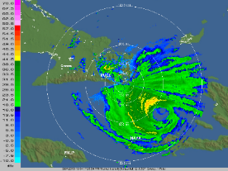
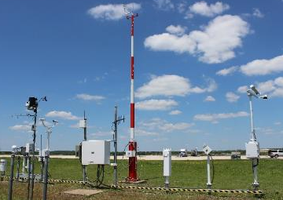
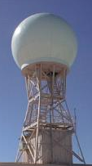
Meteorological and Oceanography (METOC) IPT
Overview
Provide aviation safety meteorological in-service engineering, systems engineering, development, acquisition, integration, installation, integrated logistics support, and configuration management for Naval Air Stations and remote operating locations worldwide supporting the NAVMETOCCOM Resource Protection mission.
AN/FPS-131A
Supplemental Weather Radar (SWR)
Automated Surface Observing System (ASOS)
SSC Atlantic Role
In-service engineering
Systems engineering
Acquisition engineering
Integration
Installation
Software development and support
Equipment upgrades and technical refresh
Technical assistance
Projects
ASOS Service Life Extension Program (SLEP) maintenance
ASOS Acquisition Control Unit & Data Collection Package replacement project
ASOS relocations and installations
SWR SLEP maintenance
SWR Radar Control Unit (RCU) upgrade
East coast Fleet tech rep for AN/UMK-4 (V) Naval Integrated Tactical Environmental System (NITES)-Fielded, NITES-IV Roll-on/Roll-off, and NITES-Next

