Slide 1
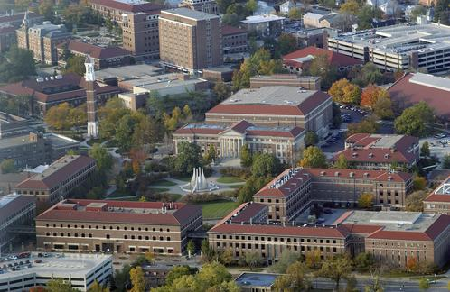
Conflict Resolution
April 18, 2018
Sharon Williams
494-7398
ssw@purdue.edu
Alvin Lee
494-7418
aleejr@purdue.edu

Slide 2
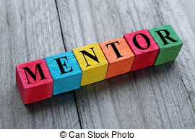
objectives
Provide a platform for discussing mentor relationships and their complexity.
Review a model for dealing with conflict.
Discuss issues – conversations that may be uncomfortable and or challenging in mentor relationships.

Slide 3
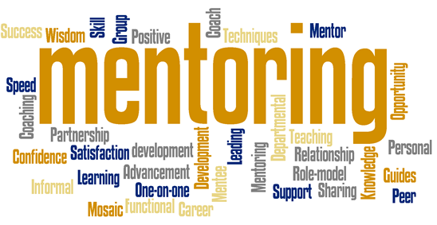
Guidelines for today
Safe place to ask questions – here to help your success.
Please share details as appropriate – respect confidentiality.
Serious learning and sharing – can be enjoyable!

Slide 4
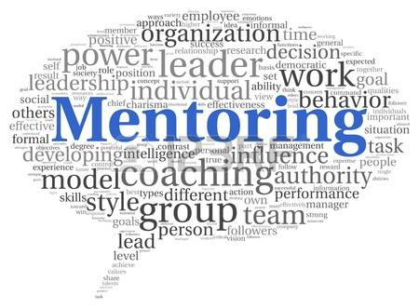
In small groups
Please discuss:
  What are some characteristics of good – productive mentor/mentee relationships?

Slide 5
small groups debrief
  What are some characteristics of good – productive mentor/mentee relationships?

Slide 6

In small groups
Please discuss:
  What are some barriers, unintended characteristics that get in the way of good – productive mentor/mentee relationships?

Slide 7
small groups Debrief
  What are some barriers, unintended characteristics that get in the way of good – productive mentor/mentee relationships?

Slide 8
Mentoring roles
In General:
Mentor Qualities | Mentee Responsibilities
Compassion and genuineness | Develop trust
Honesty/Trust | Responsible for own learning
Approachability, availability, and the ability to listen | Open about needs and provide feedback to mentor
Objectivity and fairness | Recognize mentor’s limitations and appreciate their support
Confidentiality | Be flexible, keep an open mind and have fun

Slide 9
Back into your small groups
Please discuss:
Does the mentor/mentee have to be the same gender?
Same race?
Share the same socio – economic background

Slide 10
small groups Debrief
Does the mentor/mentee have to be the same gender?
Same race?
Share the same socio – economic background?

Slide 11
Questions – thoughts so far . . .

Slide 12

Conflict & Difficult Conversations
“A disagreement through which the parties involved
perceive a threat to their needs, interests, or concerns”

Slide 13
Communication Barrier
http://www.youtube.com/watch?v=_ZpDnXYIFjo

Slide 14
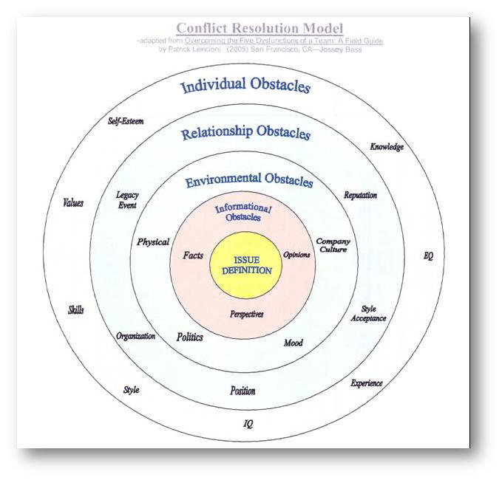

Slide 15
What is Your conflict Style
  http://www.ipcontherun.ca/wp-content/uploads/2014/06/Conflict-Management-Styles-Assessment.pdf

Slide 16
ANSWER SHEET: Record your responses across the page and ADD EACH Column!
1. | 2. | 3. | 4. | 5.
6. | 7. | 8. | 9. | 10.
11. | 12. | 13. | 14. | 15.
16. | 17. | 18. | 19. | 20.
21. | 22. | 23. | 24. | 25.
26. | 27. | 28. | 29. | 30.
31. | 32. | 33. | 34. | 35.
Turtle Withdrawing You win, I bend Avoidance | Shark Aggressive I win, you lose Competition | Teddy Bear Accommodating I lose, you win Smoothing | Fox Compromising You bend, I bend Deal maker | Owl Collaborating I win, you win Problem solver

Slide 17
Difficult Conversations
Prepare!
  What do you plan to accomplish?
  What assumptions are you making about this person’s intensions?
  Are you more emotional than the situation warrants?
  How are your needs, wants, desires or fears toward the conversation influencing your perception of it?
  How have you contributed to this situation?

Slide 18
Communication Barriers
Language
Distorted perceptions
Culture
Power struggles
Assumptions
Social Media, EMAIL/Facebook/Instagram

Slide 19
Questions – thoughts . . .

Slide 20
Summary
A successful mentor relationship depends on having mutual expectations.
Be prepared to deal with conflict if it happens.
Stay focused - return to your purpose at difficult moments.
Don’t take emotional attacks personally.
Don’t assume he/she can see your point of view.

Slide 21
Resources
Perfect Phrases for Dealing with Difficult People, Susan F. Benjamin
Crucial Conversations, Tools for Talking When Stakes are High, Kerry Patterson, Joseph Grenny
How Impact Leaders Communicate, Powerful Conversations, Phil Harkins
Perfect Phrases for Dealing with Difficult People, Susan F. Benjamin
Crucial Conversations, Tools for Talking When Stakes are High, Kerry Patterson, Joseph Grenny
How Conversations Go Wrong and What You Can Do to Right Them, Holly Weeks
Getting to Yes, Harvard Negation Project, William Ury, Roger Fisher

Slide 22
Resources
Other mentoring websites at Purdue:
http://www.purdue.edu/cie/teachingacademy/FacultyMentoring.html
https://www.purdue.edu/horizons/2016/12/07/student-faculty-mentor-recognition-reception/
https://engineering.purdue.edu/Engr/Research/SURF/Faculty/mentoring_tips.html
https://www.purdue.edu/undergrad-research/faculty/mentor/successful-mentoring.php
https://ag.purdue.edu/biochem/department/Pages/Mentoring.aspx

Slide 23


