Slide 1
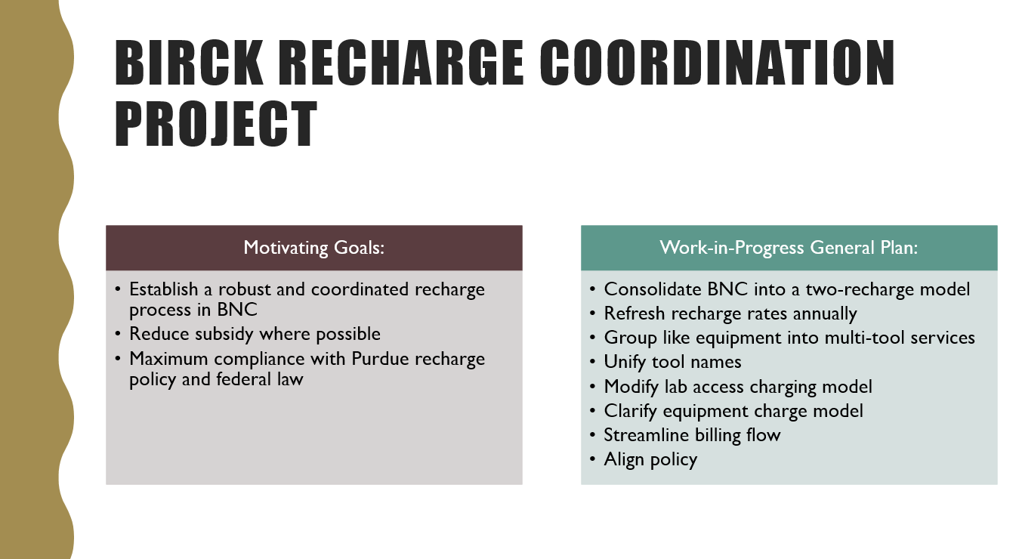
New Rates Process
Streamlining Recharge Rate Updates
Complete rate review for all BNC to be ready by 7/1/2020
Combining like services
Developing a process to make this easier and more robust

Slide 2
New Rates Process
New to FY21: Streamlining Recharge Rate Updates
Currently, updating BNC recharge rates is unwieldy
  Large number of recharges (13) and services (153)
For FY21, consolidate recharge operations
  2 recharges, ~40 services (grouping like equipment into each service)
Will allow annual refresh of rates, which is critical to:
  stay cost competitive with other institutions
  respond to changes in usage/cost, while also maintaining year-to-year rate consistency between similar tools
  keep subsidy as low as possible
In general, faculty will see a cost increase of 10% compared to FY20
  Essentially an inflation increase from last rate review (2013)
  Any faculty can set up to meet and discuss about PI specific impacts vs. FY19 or FY20

Slide 3
New Rates Process
Simplified Lab Access Charging Model
Combining center-wide costs into a “base” daily swipe fee for entry into any/all BNC labs on a particular day
  Birck Laboratory Access: House gasses, Support equipment, and BNC-wide staff time
On top of this, charging daily lab consumable surcharge for each lab type:
  General Labs (one rate that combines previous dry/acid/solvent labs)
  Bio Labs
    3D Cell Culture (applies on top of Bio Labs surcharge)
  Cleanroom
A user entering multiple lab types on a given day only pays the “base” Daily Lab Access Fee once, and pays all associated lab type surcharges used in that day
  Entry into BNC labs will cost: Birck Lab Access Fee + Lab Specific Consumables Surcharge(s)
  Examples: lab use in one day
    Entry into BRK 1100A: Birck Lab Access Fee + General Labs Surcharge
    Entry into Cleanroom: Birck Lab Access Fee + Cleanroom Surcharge
    Entry into BRK 1100A, Cleanroom, BRK 2081, and back into BRK 1100A
      Birck Lab Access Fee + General Labs Surcharge + Cleanroom Surcharge + Bio Labs Surcharge
Advantages:
  Promotes use of multiple lab types, multidisciplinary research
  Simplifies lab access cost structure; Fair distribution of common costs

Slide 4
New Rates Process
Simplified Lab Access Charging Model
FY21 $ costs, excluding F&A
Daily Fee Type | INT | ENP/ISB | EFP
Birck Lab Access Fee | 10 | 20 | 23
Surcharge: GenLabs | 2 | 2 | 2
Surcharge: BioLabs | 6 | 9 | 10
Surcharge: 3D3C | 18 | 21 | 24
Surcharge: Cleanroom | 27 | 33 | 37
INT = Internal;
ENP = External Non-Profit;
ISB = Indiana Small
Business;
EFP = External For-Profit
Comparing combined daily FY21 and FY20 $ costs, including F&A
Lab Type | FY21 INT | FY20 INT | FY21 ENP/ISB | FY20 ENP/ISB | FY21 EFP | FY20 EFP
GenLabs | 12 | 4/13/19 | 34.10 | 22/69/100 | 38.75 | 25/79/114
BioLabs | 16 | 31 | 44.95 | 48 | 51.15 | 55
3D3C | 34 | 22 | 77.50 | 52 | 88.35 | 58
Cleanroom | 37 | 43 | 82.15 | 67.17 | 93 | 75.84
Note: FY21 3D3C access will include Birck Lab Access Fee, BioLabs Surcharge, and 3D3C Surcharge. Users of both BioLabs and 3D3C will actually see a daily cost decrease under the new model.

Slide 5
New Rates Process
Comparison to current rates and subsidy changes
Compared to current rates:
  General Labs: More expensive than “dry”, cheaper than “solvent” or “acid”
    Combination of current Dry/Solvent/Acid into one General Labs rate has little overall effect, except on faculty who are exclusively heavy users of dry labs
  BioLabs and Cleanroom: Slightly cheaper for internals
  Generally cheaper for faculty who utilize many different lab types
Subsidy in FY21:
  Birck Lab Access Fee: 50% Subsidy
  General Operations Subsidy: 18% subsidy on
    Lab Access Surcharges
    Birck staff supported shared use services
  15 days per month swipe cap for all lab access fees/surcharges
  Scifres Cap: $12,000 hard cap for equipment services on Scifres recharge
    per user, per account (WBSE/IO), per fiscal year
    “Uncapped” for any user after total of $12,000 in subsidy across
    all accounts per fiscal year

