Slide 1

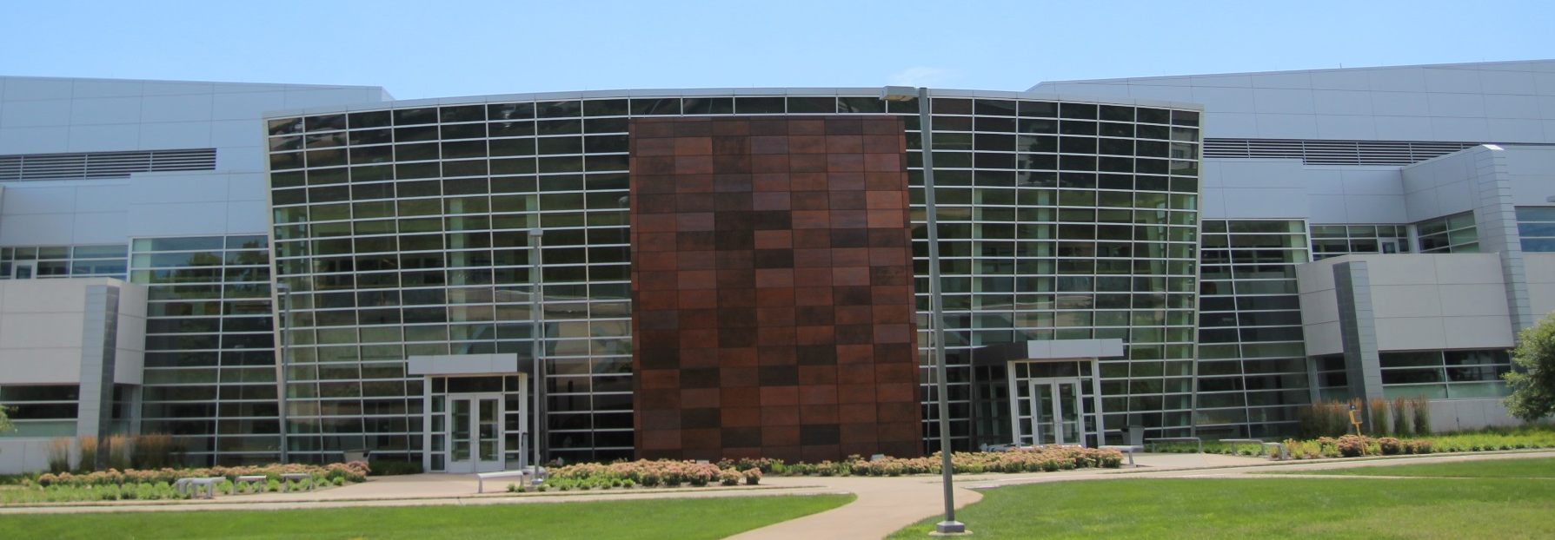
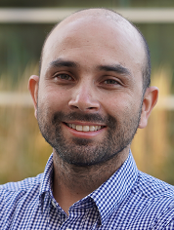

Birck Nanotechnology Center
Faculty Seminar Series
Dr. Andres F. Arrieta
Assistant Professor of Mechanical Engineering and Aeronautics and Astronautics Engineering
(by courtesy) at Purdue University
Thursday, October 28th, 2021
12:00pm – 1:00pm, Zoom
https://purdue-edu.zoom.us/j/98695180597
Hierarchically Multistable Metastructures for Mechanosensing and Mechanologic
Abstract: Shape adaptation in materials and structures enables multifunctionality by leveraging the ability to adopt different geometrical configurations. The idea of rendering engineering systems adaptable and multifunctional has driven the development of diverse research fields, such as soft robotics, adaptive structures, and programmable metamaterials. These multifunctionality and adaptability stem from the intimate relationship between property, form, and function in which any variation in one induces in changes in the other. An interesting avenue for exploiting this relationship leverages geometrical multistability, the property of a system exhibiting several stable states that depend solely on the architecture independently from the material constitution. Geometrically multistable systems show shape and stiffness programmability by switching between their available stable states. Recently, we have unveiled a new class of multistable structures exhibiting hierarchical multistability, in which the number of available stable states increases exponentially with the number of unit cells.
This seminar will present examples in which hierarchical multistability in metamaterials and metastructures enables programmable properties, including 1) bioinspired mechanosensing and 2) information processing as a material property exploiting multistability..
BioDr. Andres F. Arrieta is an Assistant Professor of Mechanical Engineering and Aeronautics and Astronautics Engineering (by courtesy) at Purdue University, where he leads the Programmable Structures Lab. Previously, he worked as a Group Leader at ETH Zurich’s CMAS Lab and as a Research Associate at the Dynamics and Oscillations Group at TU Darmstadt. He received his Ph.D. in Mechanical Engineering from the University of Bristol in 2010 and his BEng from the Los Andes University, Bogota, Colombia, in 2006. Prof. Arrieta’s work focuses on investigating instabilities and nonlinearity in structural mechanics. Current efforts are focused on the modeling and designing of programmable structures, soft robotics, nonlinear metamaterials, and morphing structures. The Programmable Structures Lab’s work has been highlighted by several media outlets, including National Geographic and Nature’s News and Views.
Dr. Arrieta has received several awards, including the NSF CAREER Award (2020); the ASME Gary Anderson Award (2018) for outstanding contributions to the field of Adaptive Structures; and the ETH Postdoctoral Fellowship (2012).

