Slide 1

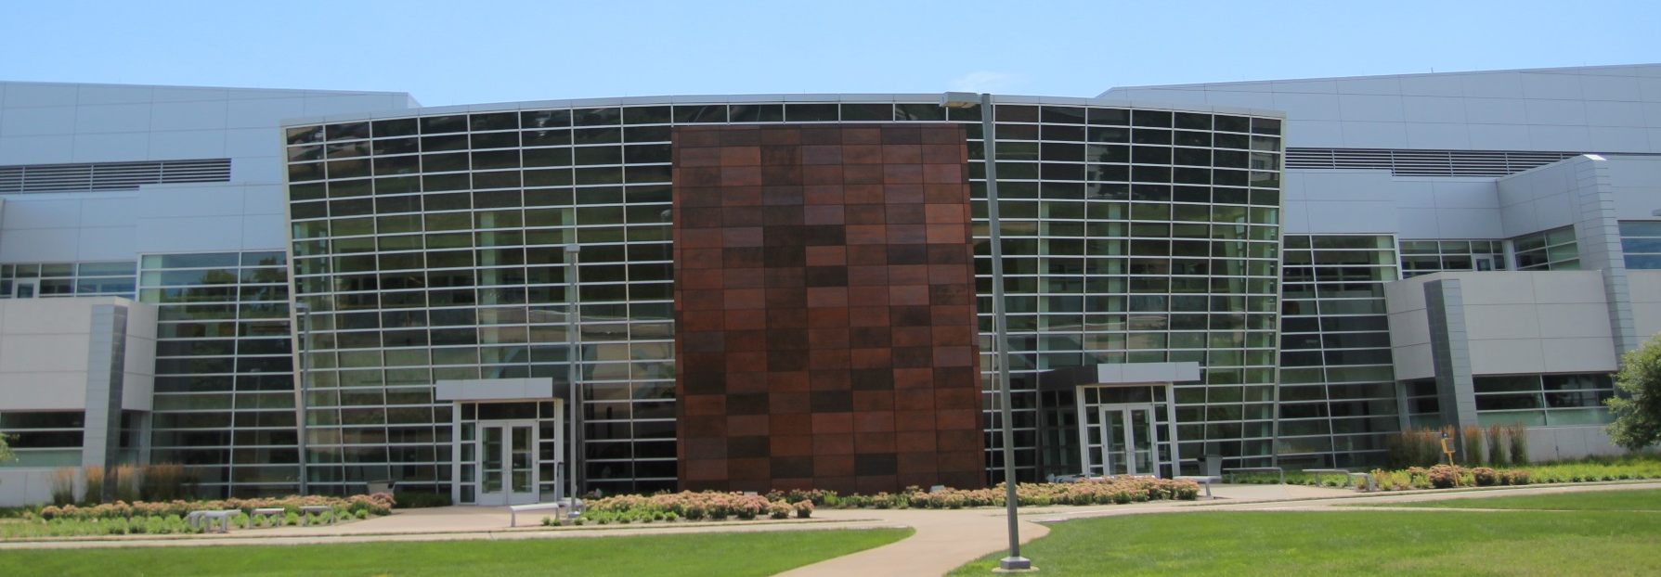
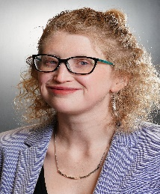

Birck Nanotechnology Center
Faculty Seminar Series
Dr. Caitlin Proctor
Assistant Professor of Agricultural and Biological Engineering & Environmental and Ecological Engineering
(by courtesy) at Purdue University
Thursday, November 11th, 2021
12:00pm – 1:00pm, Zoom
https://purdue-edu.zoom.us/j/98695180597
Biofilms in Everyday Life
Abstract: While engineers have mastered the removal of many harmful bacteria from drinking water, some opportunistic pathogens still present a lasting microbial threat to drinking water safety that has proven difficult to manage. Bacteria naturally grow in biofilms along pipe walls and certain pathogens like Legionella pneumophila or nontuberculous mycobacteria (NTM) are particularly well-suited for growth in this ecosystem. When aerosols containing these opportunistic pathogens are inhaled, they can cause respiratory disease, especially in immunocompromised populations. In order to control exposure to these organisms, it is necessary to understand the complete ecology of biofilms and interactions between biofilm and water phase. My work aims to understand and manipulate these biofilms.
Bio: Dr. Proctor is an assistant professor in Agricultural and Biological Engineering & Environmental and Ecological Engineering at Purdue University in Indiana, USA. She received her undergrad and masters from Virginia Tech and her PhD from ETH Zurich, with PhD research completed at Eawag, the Swiss Federal Institute of Aquatic Science and Technology. She also completed a postdoc at Purdue before joining the faculty. Her work explores the drinking water microbiome and behavior of opportunistic pathogens in building plumbing.

